Slide 1
DMA

Slide 2
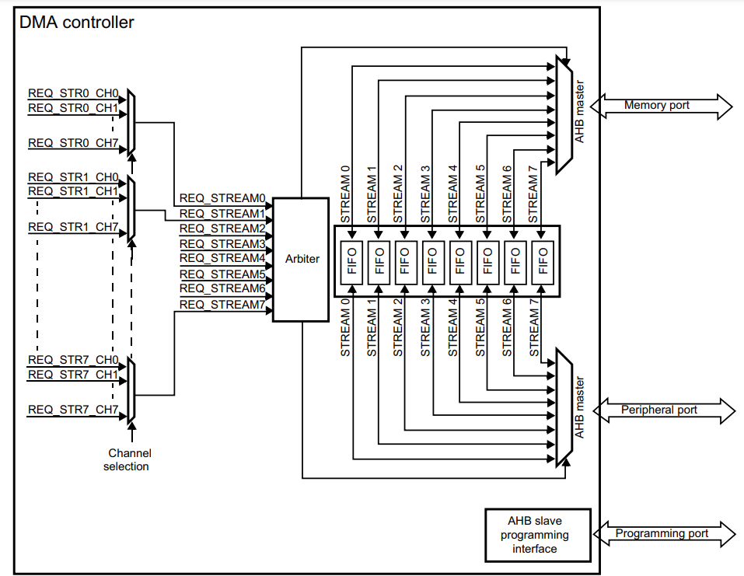

Slide 3
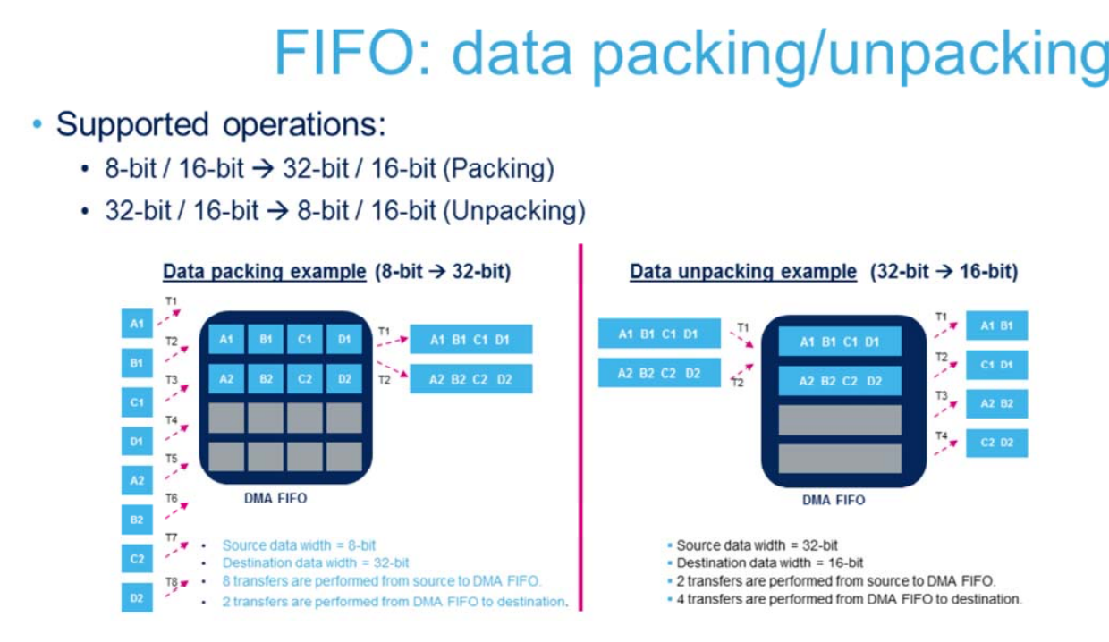

Slide 4


