Slide 1
EduLoyalty Reward Point System
</
/>
Presenting = (“ Parisha Desai ”,
“ Prasad Mahabare ”,
“ Shruthi Mandaokar ”,
“ Suparshwa Patil ”)

Slide 2

</Project Overview
What:
Encourage Participation
Improves Student Engagement
Who:
Students
Consumers
Why:
Front End and Back End Integration
ETL

Slide 3
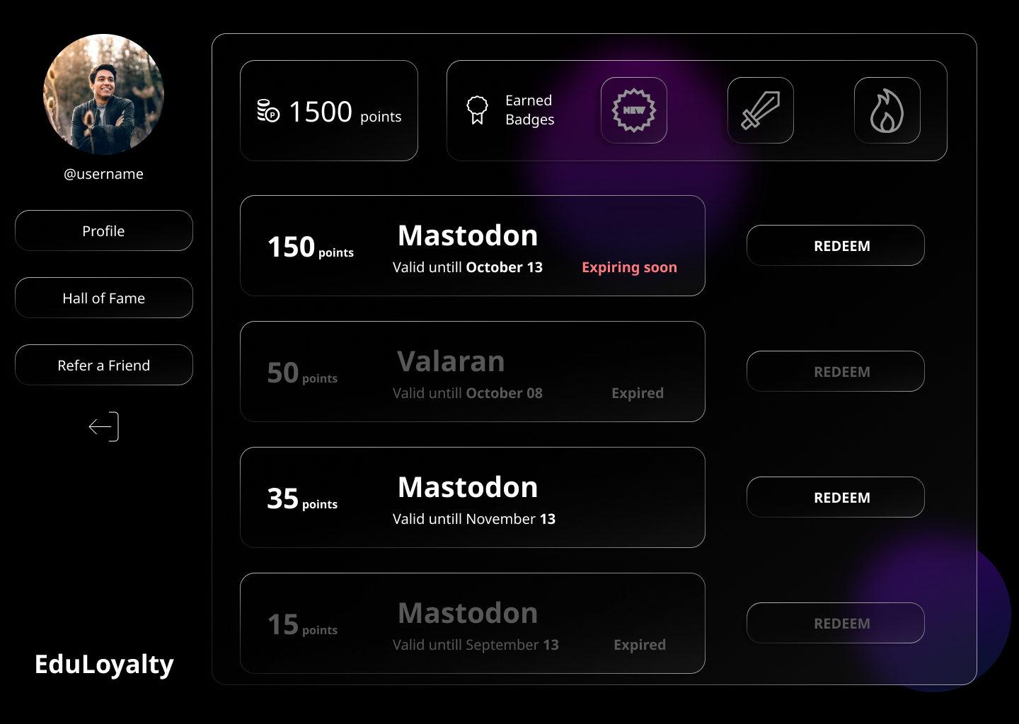
</Requirements
Functional
Sign Up
Dashboard
Points
Coupons
Hall of Fame
Refer a friend
Non-Functional
Security
Interpretability
Responsive
Maintainability
User logs

Slide 4
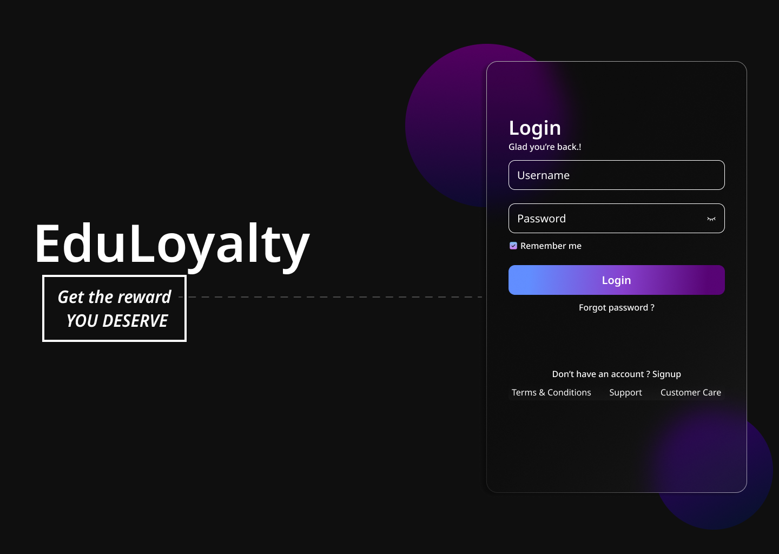

</Preferred
Nice to have
Extension
Purdue Domain

Slide 5

</Tech Stack
User Interface
Middleware
Back End
DB
Web
Services

Slide 6
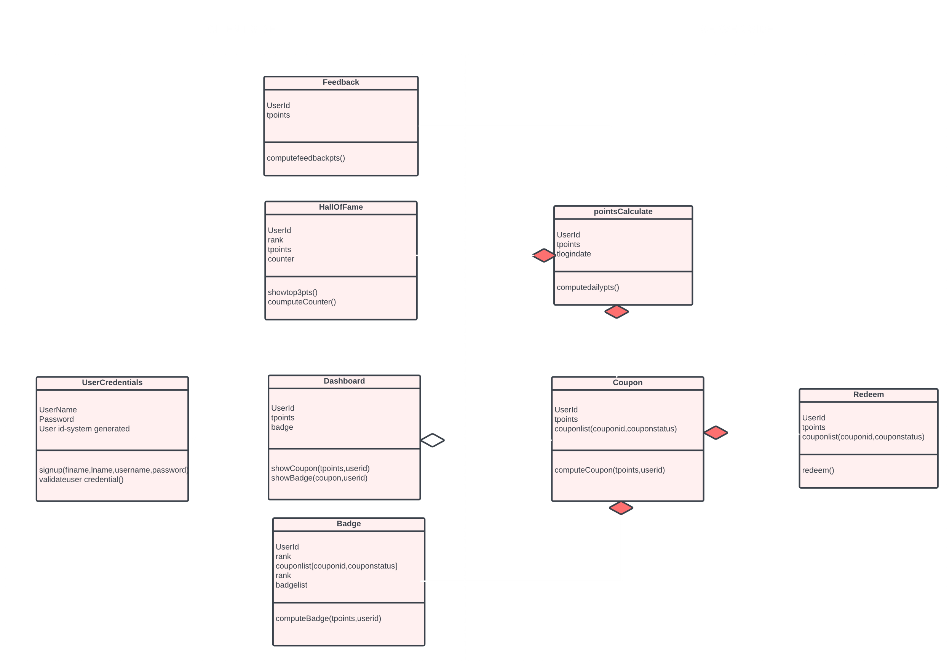
</Class Diagram

Slide 7

</Thank You

