Slide 1

COMPUTER GRAPHICS PROJECT
DAY-NIGHT TRANSITION OF SCENARY
PREPARED BY:
PARTHA PRITAM PAUL(14-1-5-059)
UDIT NARAYAN BORA(14-1-5-062)
RAJ KAMAL DAS(14-1-5-068)
RITURAJ DAS(14-1-5-061)

Slide 2
INTRODUCTION
AIM: DAY/NIGHT TRANSITION OF A SCENERY.
(Using basic drawing algorithms)
SUMMARY:
A small scenery is shown with only the borders.
The scenery is then transformed into two modes:
Night mode and Day mode.
Some special transitions are shown.

Slide 3
LIBRARIES USED
<stdio.h> library
<GL/glut.h> library
<stdlib.h> library
<math.h> library

Slide 4
USER-DEFINED FUNCTIONS
border()
tree1()
tree2()
tree3()
color()//daymode
nightmode()
sun1()
moon1()
circle1()
modifynight()
movesun()

Slide 5
ALGORITHMS USED
The scenery is composed of components that are constructed by geometrical shapes.
Line Drawing functions are used for generating the rectilinear shapes like mountain, tree and house.
Circle generating function is used for drawing the moon, sun, clouds and stars.

Slide 6
DESCRIPTION
The borders of the scenery is shown at first.
The scenery can be changed into two modes:
Day mode and night mode.
Day Mode: In Day mode the sun appears on the left top which can be controlled to move to the right of the screen. Also the colour of the sky is blue and other components lighter.
Night Mode: In Night mode the moon appears on the right top which can be controlled to change its shape. The sky appears black with stars. Other components are darker.

Slide 7
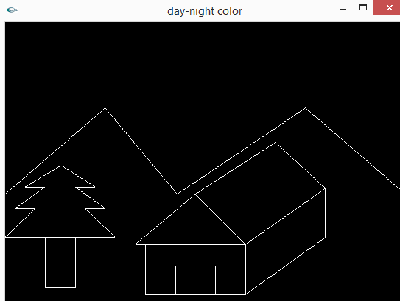
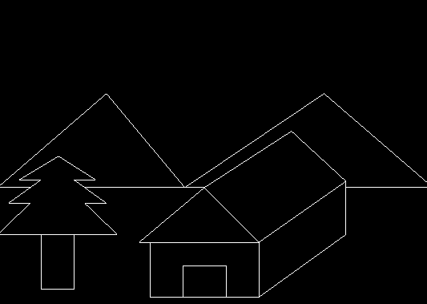
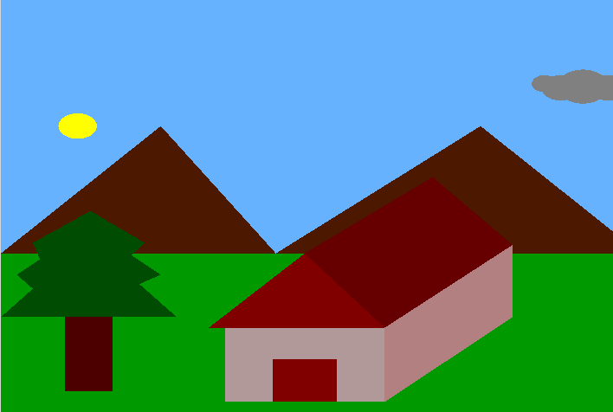
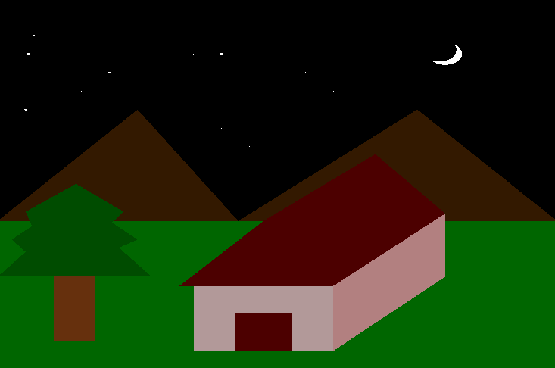
11
2
33
1.Outline Mode
2.Day Mode
3.Night Mode

Slide 8
OUTLINE MODE
The outline mode shows the borders of different components of the scenery with the background being black.
In this mode we use some user-defined functions such as:
void border(void) which implements line drawing and polygon drawing functions to draw the outlines which are basically lines or polygons.
void tree1(void) which is a function which draws the outline of the tree and is implemented in the border function.

Slide 9
Outline Functions
glBegin(GL_LINE_STRIP);
glVertex2f(0,400);
glVertex2f(250,700);
glVertex2f(430,400);
glEnd();
glBegin(GL_LINE_STRIP);
glVertex2f(0,400); //mountain
glVertex2f(250,700);
glVertex2f(430,400);

Slide 10
DAY MODE
The border mode is changed to the day mode by pressing “D” on the keyboard or by right clicking on the mouse and selecting “day colour change”. This operation is achieved by creating two functions ,void menu(int) and void keys(char) which takes input from the mouse and keyboard respectively.
All the black components are filled with colour. For this we use predefined openGL functions to fill colour inside the components. These are implemented inside the user defined function void color(void).
New components, the sun and clouds appear. They are drawn through the functions void sun1() and void circle1().

Slide 11
NIGHT MODE
The border mode is changed to the Night mode by pressing “N” on the keyboard or by right clicking on the mouse and selecting “night colour change”. This operation is achieved by creating two functions ,void menu(int) and void keys(char) which takes input from the mouse and keyboard respectively.
All the black components except the sky are filled with colour but darker than the day mode. Similar to the day mode we use a separate function void nightmode() for this operation.
New components, the moon and stars appear which are implemented by basic circle drawing function void circle1(GLfloat,GLfloat,GLfloat).

Slide 12
SPECIAL EFFECT 1
A special effect can be shown by pressing “s” to shift the position of the sun in steps by using the function void keys(char).
The basic idea behind this effect is that for every press of the key “S” a function void movesun() is run which alters the coordinates of the sun on the screen and the sun appears to move.

Slide 13
1.movesun()
void movesun()
{
if(p<500.0)
{
p=p+20;
q=q+10;
circle1(p,q,30.0);
glFlush();
glutSwapBuffers();
}
else if(p<900)
{
p=p+20;
q=q-0.2;
circle1(p,q,30.0);
glFlush();
glutSwapBuffers();
}
else if(p>800.0||q>900)
{
p=120.0;
q=700.0;
circle1(p,q,30.0);
glFlush();
glutSwapBuffers();
}
}

Slide 14
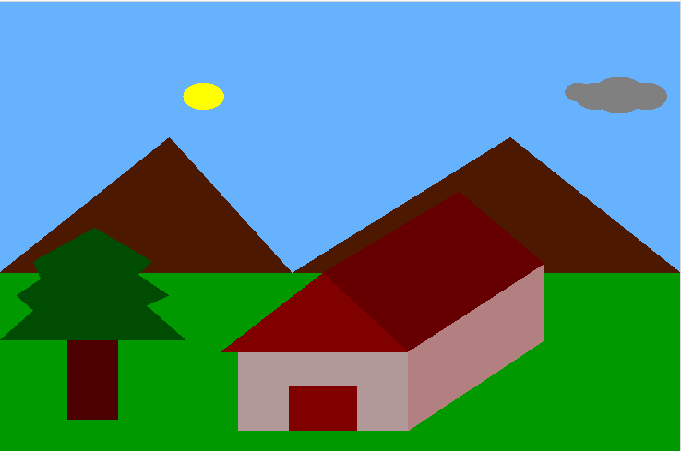
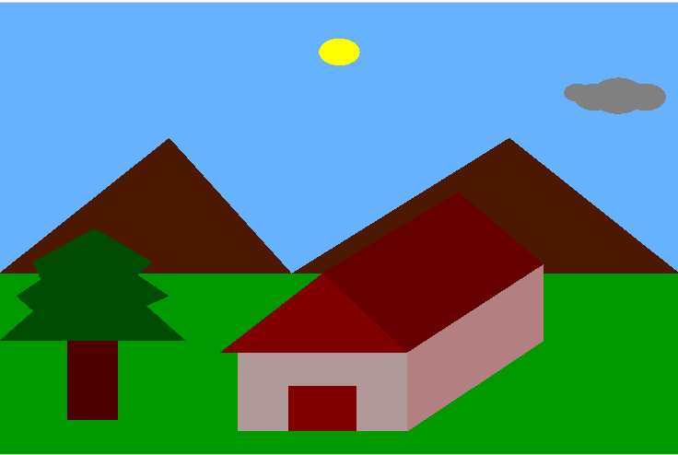
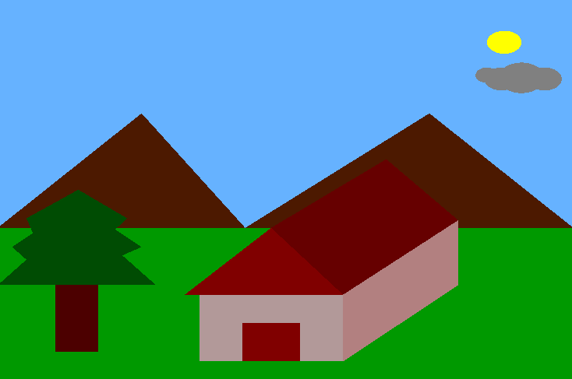
1
2
3
4

Slide 15
SPECIAL EFFECT 2
A special effect can be shown by pressing “m” to change the shape of the moon in steps.
The basic idea behind this is that we take two circles : one black and the other ,white. Then the black circle is made to change its coordinates through the function void modifynight() such that it overlaps the white circle at different portions to give the effect that the moon is changing its shape.

Slide 16
2.modifynight()
GLfloat a=800.0,b=850.0,d=800.0,e=850.0;
GLint m=0,n=0,f=30.0;
void modifynight()
{
glColor3f(1.0,1.0,1.0);
circle1(a,b,30.0);
glColor3f(0.0,0.0,0.0);
circle1(d,e,f);
e=e+10.0;
d=d-10.0;
if(d<700||e>900)
{
f=f+15.0;
d=820.0;
e=900.0;
if(f>85.0)
{
f=30.0;
d=800.0;
e=850.0;
}
}
glFlush();
glutSwapBuffers();
}

Slide 17
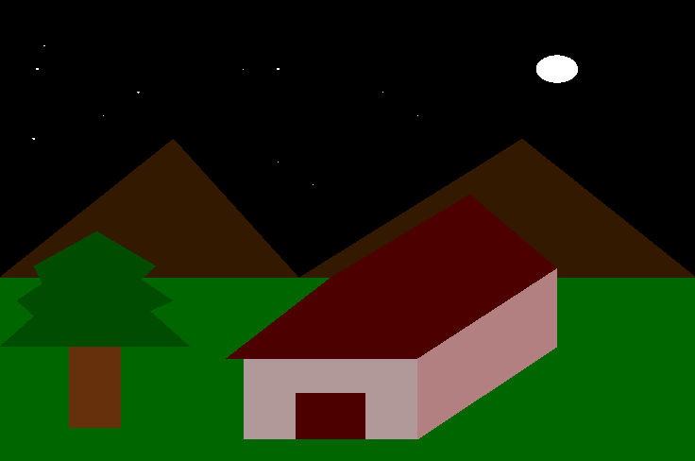
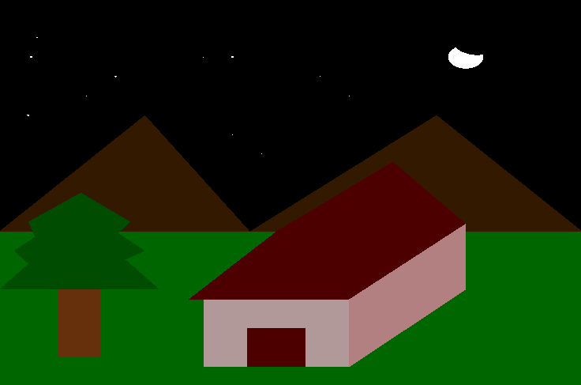
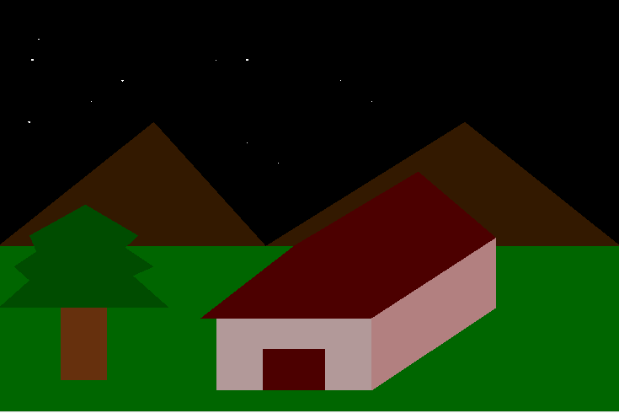
1
2
33
4

Slide 18
CONCLUSION
From the project “Day-Night Transition of scenery” we get to know the implementation of simple operations like: line drawing, circle drawing etc.
The program is the best example of using co-ordinate geometry in drawing the border of mountains, house, tree etc.

