Slide 1


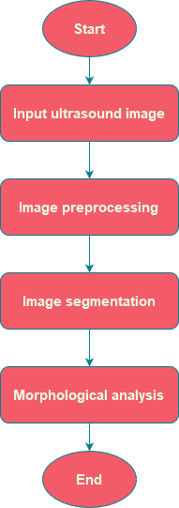
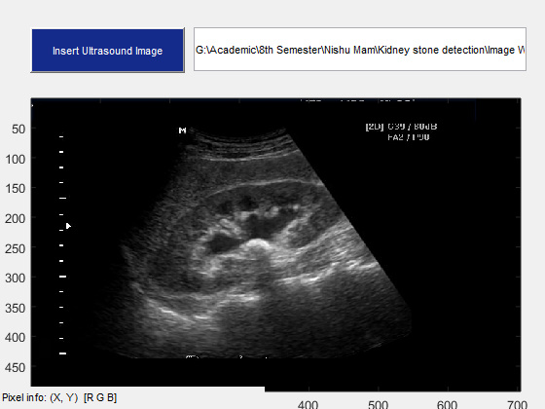
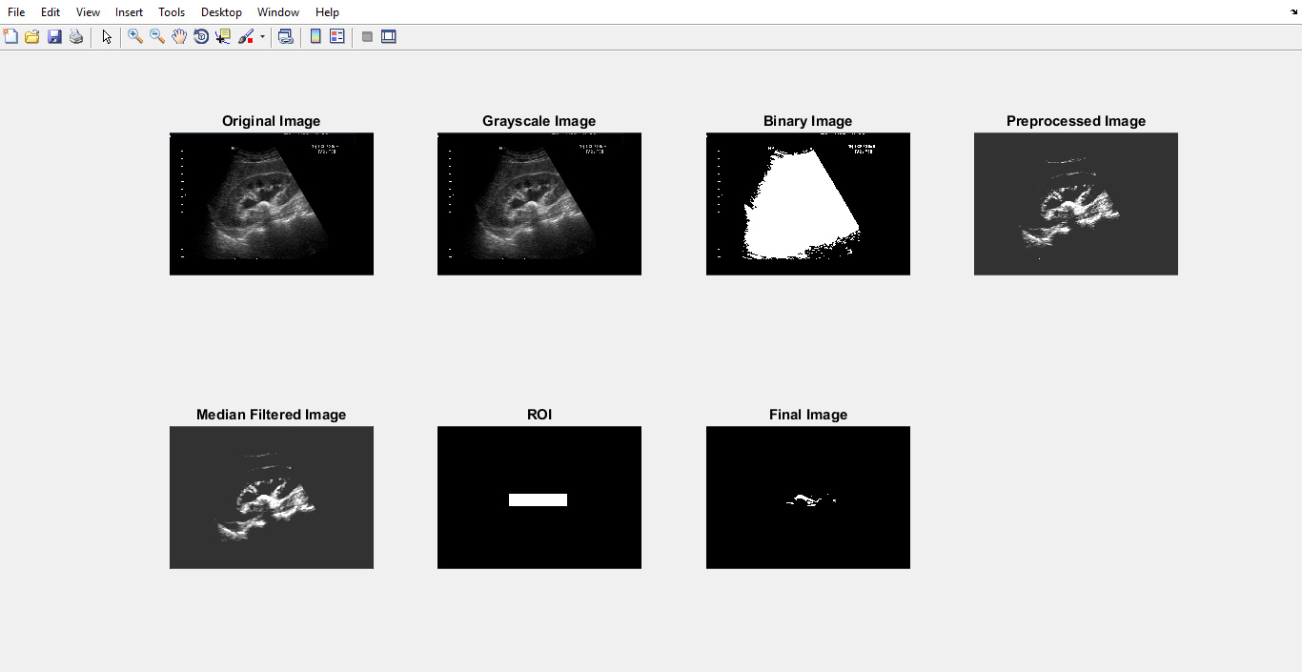
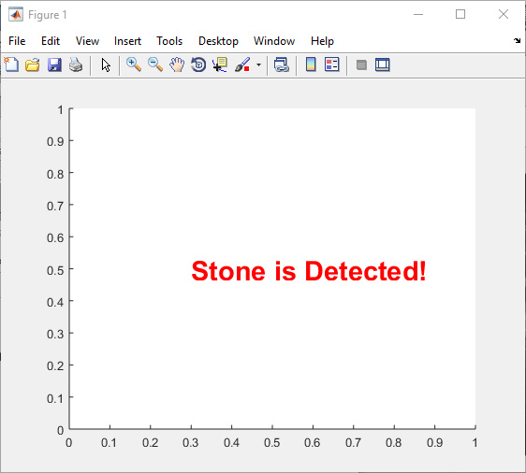
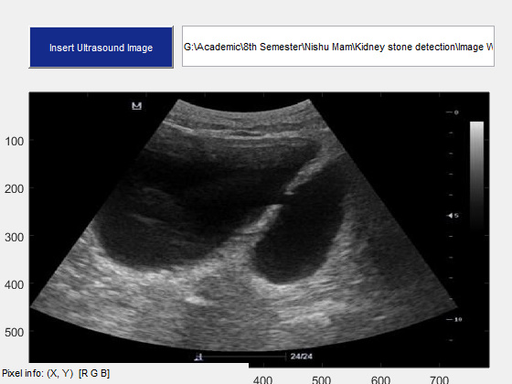
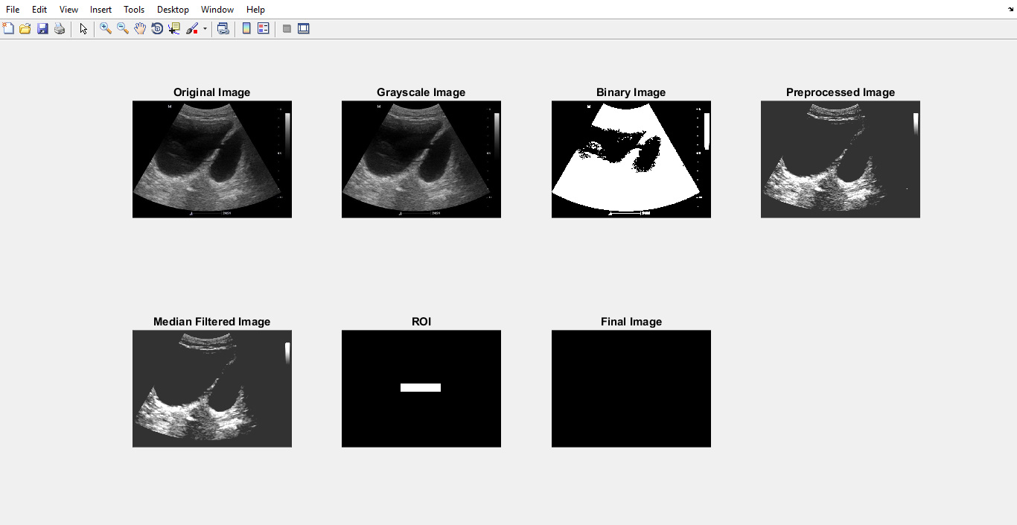
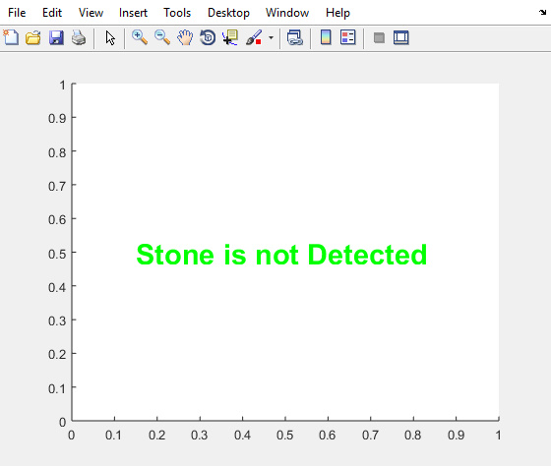
Automated Kidney Stone Detection
Asma Ul Mowa, ID:11808012, Session:2017-2018
Mahabub Rahman, ID:11808043, Session: 2017-2018
Supervised By- Mahmuda Khatun, Assistant Professor, CSE, CoU
Introduction
Objectives
Kidney stones are solid mineral and salt deposits that form within the kidneys. They can cause severe pain and lead to various complications if left untreated.
This project offer a promising approach to enhance the detection of kidney stones in ultrasound image.
To detect stone into the kidney.
Asist medical practitioner in diagnosing and treating kidney stone patients.
Generate a very high enhanced image of stone without any speckle noise.
Algorithm
Research Gaps
Kidney Stone Detection:
Thresholding
Hole filling
Object removal
ROI selection
Renal calculi, another name for kidney stones, are crystal-based solid masses. For surgical procedures, it's essential to locate the urinary calculus precisely and accurately. It is necessary to employ automated algorithms in order to detect kidney stones in ultrasound pictures because it is difficult to do so manually due to the speckle noise present in the images. Some mathematical and analytical methods are used to diagnose kidney abnormalities is ultrasound image. This Automated Kidney Stone Detection System project is developed an image processing technique to identify kidney stones automatically without human interruption.
Proposed Methodology
Results
Binary Image: A threshold of 20 is applied to the grayscale image.
ROI: ROI id is defined as a quadrilateral shape using four sets of coordinates.
Detection: If the number of labeled project is greater or equal to 1, it means at least one stone is detected. If the number is 0, it means no stone is detected.
Conclusion
Limitations
This project presents a comprehensive study on the detection of kidney stones using image processing techniques in MATLAB. This developed project demonstrates promising results in accurately identifying kidney stones from ultrasound images. The integration of image preprocessing, feature extraction, and classification algorithms provides a reliable framework for kidney stone detection.
Works only on ultrasound image.
Image from complex and noisy background can be challenging.
The fixed threshold may not be optimal for all images or conditions.

