Slide 1
AI-Based Plant Disease Detection System
Using Convolutional Neural Networks (CNNs)

Slide 2

Introduction
Plant diseases affect agricultural productivity, causing food shortages and financial losses. Traditional detection relies on expert inspection, which is slow and error-prone. This project introduces an AI-based solution using CNNs to detect plant diseases from leaf images.

Slide 3
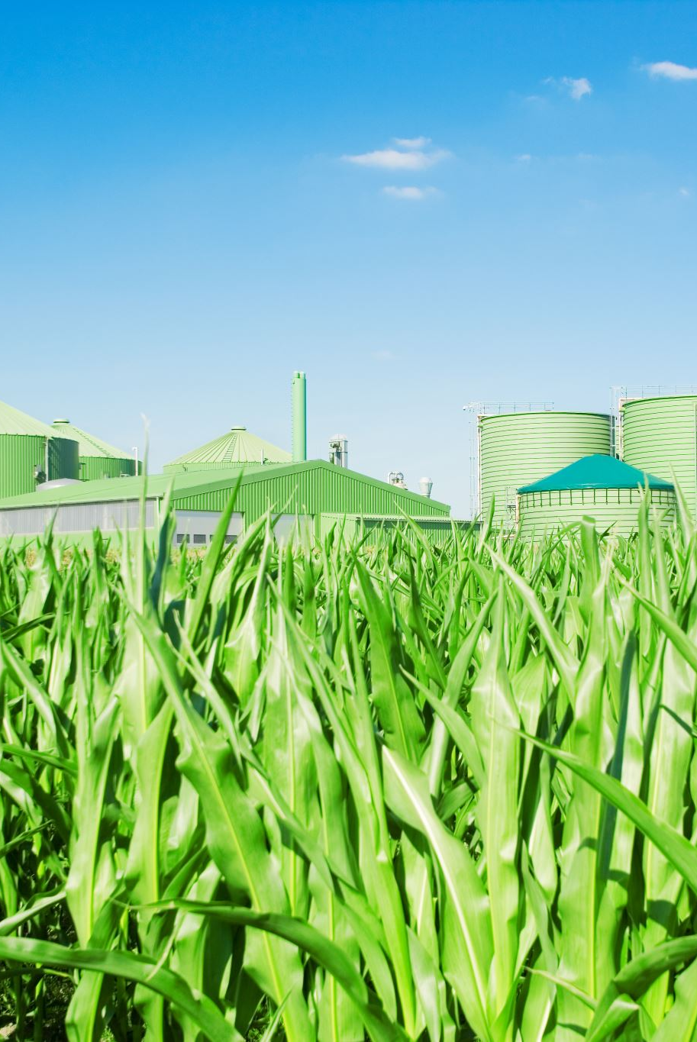
Objectives
To develop an automated system for plant disease identification
• To reduce dependency on human experts
• To provide early detection and prevent large-scale crop damage
• To make disease detection accessible and cost-effective for farmers

Slide 4
Problem Statement
Plant diseases cause major losses in agriculture
• Traditional inspection is slow and dependent on experts
• Experts are not always available in rural areas
• Manual inspection is error-prone and costly
• Delays in detection cause extensive damage

Slide 5
Project Solution
The system uses a CNN to analyze leaf images and identify plant diseases. Users upload an image, and the system quickly returns the predicted disease class. No expert intervention is required.

Slide 6
Benefits
Fast detection (seconds vs. days)
• Cost-effective (no expert needed)
• Accessible via smartphones and computers
• High accuracy with AI
• Early disease prevention
• Scalable to global usage

Slide 7
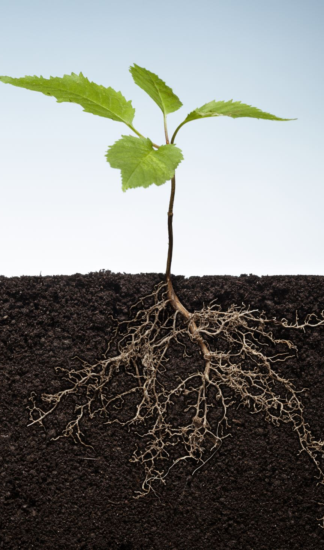
Dataset Description
Source: Kaggle - 'New Plant Diseases Dataset' by vaporous
• 87,000 images across 38 classes
• Includes healthy and diseased leaves
• Structured in folders per class
• Format: JPEG

Slide 8
Reason for Dataset Selection
Large size supports deep learning
• Rich diversity of plant species and diseases
• Publicly available and widely used
• Supports reproducibility and benchmarking

Slide 9
Methodology: Algorithm Used
A Convolutional Neural Network (CNN) is used for image classification. CNNs are effective for extracting visual features and identifying disease patterns automatically.

Slide 10
CNN Architecture Overview
Multiple Convolutional Layers with ReLU activation
• Pooling Layers for dimensionality reduction
• Dropout Layers to prevent overfitting
• Final Dense Layer with SoftMax for classification

Slide 11
Why CNN?
Automatically learns features from images
• Ideal for large image datasets
• Regularization techniques reduce overfitting
• Proven success in various detection tasks

Slide 12
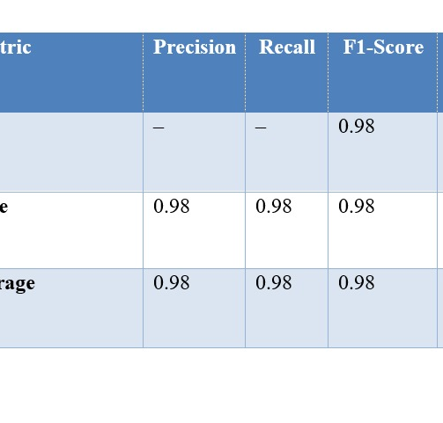
Model Evaluation Metrics
Precision: 0.98
• Recall: 0.98
• F1-Score: 0.98
• Total Samples Tested: 1401
• High reliability across classes

Slide 13
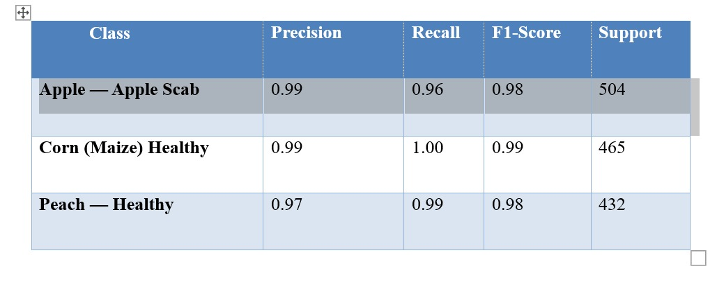
Class-wise Performance
Apple Scab: Precision 0.99, Recall 0.96
• Corn Healthy: Precision 0.99, Recall 1.00
• Peach Healthy: Precision 0.97, Recall 0.99

Slide 14
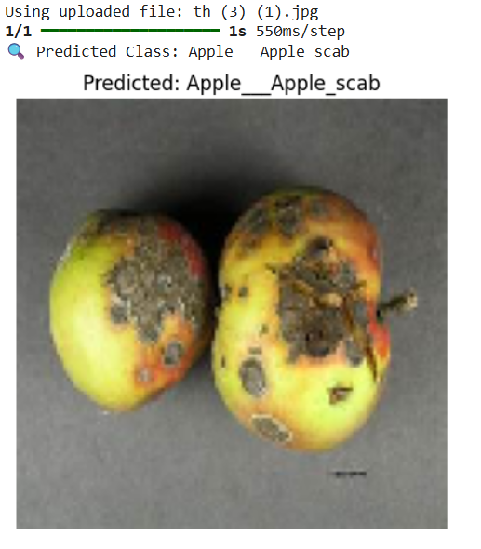
Training Graphs Summary
Training Accuracy: Increased to 98%
• Training Loss: Decreased smoothly
• Indicates effective and stable learning

Slide 15
Visual Testing
Model tested on unseen leaf images and successfully identified diseases. Demonstrates generalization and real-world applicability.

Slide 16
Simulation Results
Software: Python, TensorFlow, Keras
• Optimized using Adam optimizer
• Learning Rate: 0.001, Epochs: 20, Batch Size: 32
• Input Image Size: 224x224

Slide 17
Conclusion
CNN-based plant disease detection system provides accurate, fast, and accessible diagnosis. It reduces dependency on experts, prevents large-scale damage, and fits well in smart farming frameworks.

Slide 18
Future Scope
Expand dataset to include more plant types
• Add environmental data for better prediction
• Integrate with IoT and real-time monitoring
• Multilingual support for wider accessibility

