Slide 1

Autonomous Decentralised Search
and Coverage with UAS Swarms
Can six UAVs sweep an unknown area with no controller,
no map, and no messages between them?
Mahadev Reddy Devireddy Venkata · 2823511 · MSc Robotics
Supervisor: Dr Davood Asadi · University of Bristol & UWE
Notes:
Six drones searching an area nobody has mapped. Nothing telling them where to go, and no radio between them. I wanted to know whether a swarm that learns can cover as much ground as the methods people already use.

Slide 2
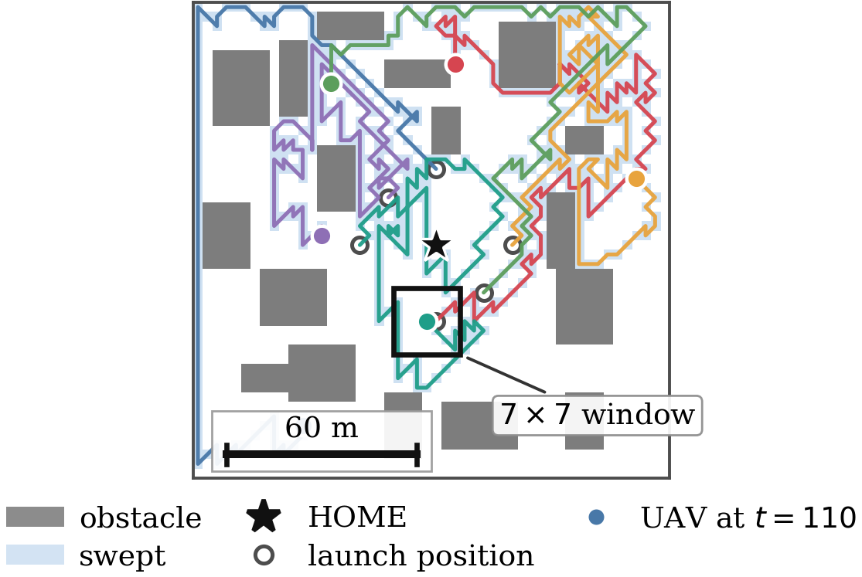
The task
A 150 m × 150 m block after an earthquake.
Six UAVs, 700 steps, one launch point.
Each agent sees 7×7 cells
21 m of a 150 m block
No agent sends a message
One real seeded layout, the deployed policy 110 steps in
Coordination must emerge
Notes:
A hundred and fifty metre block, six drones, seven hundred steps. This is a real run, about a hundred steps in. Each drone only sees that small box — twenty-one metres out of a hundred and fifty. And they can't talk to each other.

Slide 3
What I built and tested
0 learn
0 learn
1 learns
6 learn
Boids
APF
PPO hybrid
MARL
flocking rules
potential fields
1 learned + 5 scripted
one shared network
no learning
fully decentralised learning
1,600
50
4
2
runs
matched seeds
obstacle densities
disjoint seed sets
Every controller sees the identical layout on every seed, so the comparison is paired: Wilcoxon signed-rank, Holm-Bonferroni correction, effect sizes, bootstrap intervals.
Notes:
I tested four controllers, from none of them learning to all six learning. Two classical ones, then a hybrid where only one drone learns, then mine, where all six share one network. Sixteen hundred runs. Every controller got the exact same layout on every seed, so I could compare them run against run.

Slide 4
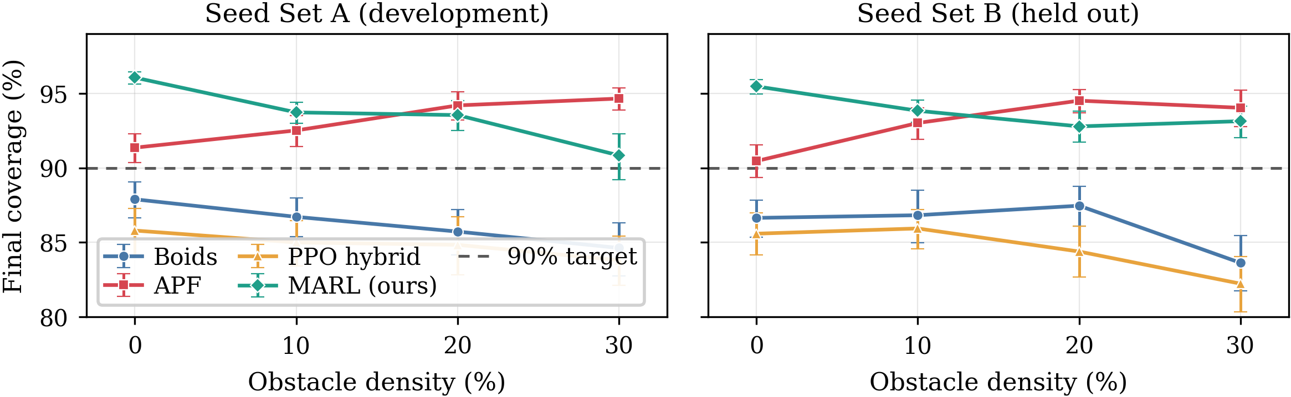
The result: a crossover
Learning wins in the open
Level in the middle
APF holds the hardest case
+4.7 and +5.0 points at 0% obstacles
10% and 20%: nothing survives correction
−3.8 points, on one seed set only
Notes:
This is the main result, and the two lines cross. Mine clears the ninety percent target at every obstacle density, on both sets of layouts. So does potential fields. In open ground mine wins by about five points. Once obstacles appear I can't separate them statistically, and at the hardest density potential fields is slightly ahead. So it matches the classical controller. It doesn't beat it everywhere.

Slide 5
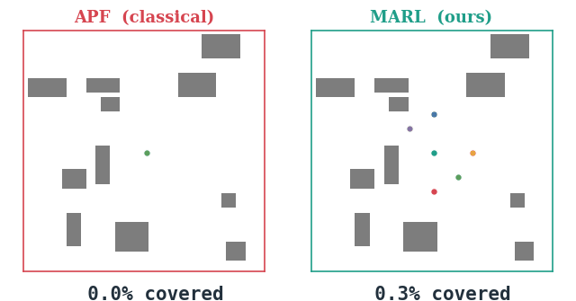
What that looks like
Same layout, same seed, both controllers, 700 steps
APF
follows the corridors
between buildings
MARL
pushes outward and
splits the area up,
with no messages
A typical run: of the 50 seeds at this density, the one whose result sits closest to the reported mean for both controllers.
Notes:
Here they are on the same layout, from the same starting point. Watch the classical swarm funnel along the gaps between buildings. Mine pushes outward and splits the area up — and none of those six is telling the others where it's going.

Slide 6
The finding that mattered most
30.6
Same network. Same budget, seed, observations, dynamics.
Only the reward scheme moved.
Reward each agent for the cells it is first to visit → 93.6%
Give every agent the shared team total → 63.0%, and not one of fifty runs reaches the target
percentage points lost
by changing one thing: the reward
That gap is larger than the distance between any two controllers in the whole study. Credit assignment is not a refinement on the architecture — it decides whether the controller works at all.
Notes:
The thing I found most useful wasn't in that comparison at all. I kept the network, the budget, the seed and everything the drones see the same, and changed one thing: what they're rewarded for. Reward each drone for the ground it covers first, and it works. Reward them on the team total, and coverage drops thirty point six points — not one run in fifty reaches the target. That's a bigger drop than the gap between any two controllers I tested.

Slide 7
What I found against myself
1
A result I retracted
THE RETRACTED FIGURE
An earlier draft reported 95.0% for the memory-free policy. That checkpoint could not be reproduced; the one that survived scores 90.0%, reversing the conclusion.
95.0%
2
A budget that was too short
could not be reproduced
Four training seeds spread 7.8 points. Trained twice as long the spread halves and every seed passes APF, so the budget set that result, not the method.
90.0%
what it actually scores
3
A metric that misleads
Reported in Section VI of the paper, not left for a reader to find.
APF appears to improve as clutter rises. In absolute cells it covers 640 fewer; the free area simply shrinks faster.
None of this was required. All three are in the submitted report.
Notes:
I also checked my own experiments, and some of it went against me. An earlier draft reported a number I couldn't reproduce. The model that survived scores ninety, not ninety-five, which reverses what I'd concluded. Four training seeds showed I'd stopped training too early. And potential fields only looks like it improves as obstacles increase — counting actual cells, it covers six hundred and forty fewer.

Slide 8
What it comes to
A decentralised learned policy matches a tuned classical controller
and beats it where the terrain offers least structure
The reward scheme mattered more than the architecture
30.6 points, from one controlled change
Percentage coverage misleads when free area varies
a caution for the wider literature
1,600 runs · paired tests · effect sizes · code, data and checkpoints submitted
Notes:
So: a swarm that learns, with no messages between the drones, matches a well-tuned classical controller and beats it in open ground. What I rewarded them for mattered more than the network. And measuring coverage as a percentage misleads whenever the open ground changes. Thank you.

