Slide 1
SPP PAYMENT MUSIC SCHOOL
Rohmah dewi (13.61.0013)

Slide 2
Description
As payment for the student information system then stores the data of parents and students who have paid spp as an archive by printing a daily report.

Slide 3
Features
- Login Admin
- Manage Master Data
Dashboard
Siswa
Orang tua
Pembayaran
- Reporting
Daily Report

Slide 4
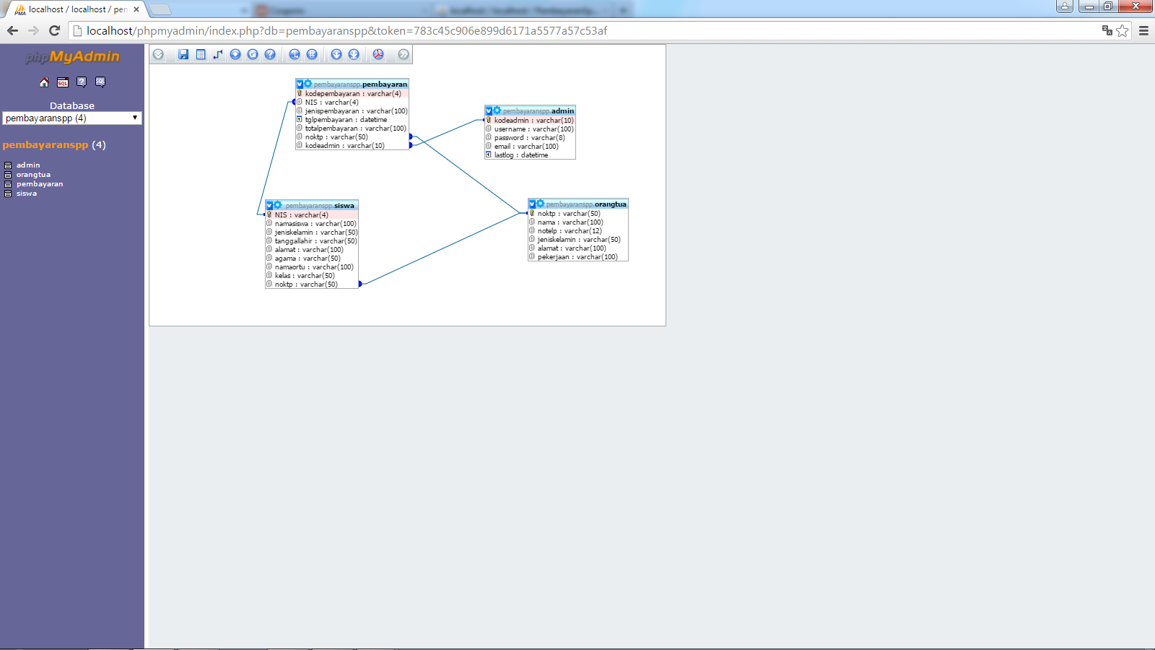
ERD
There are 4 tables for this application
Admin
Siswa
Orang Tua
Pembayaran

Slide 5
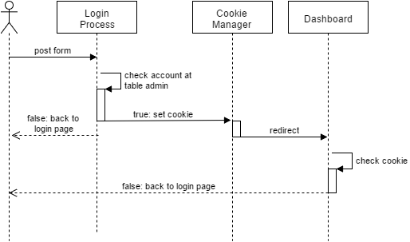
Login Process
Controllers file :
index.php as login page, contains form and auth process. Declaring cookie also write at this file after user submit login form
Dashboard.php as dashboard admin page

Slide 6
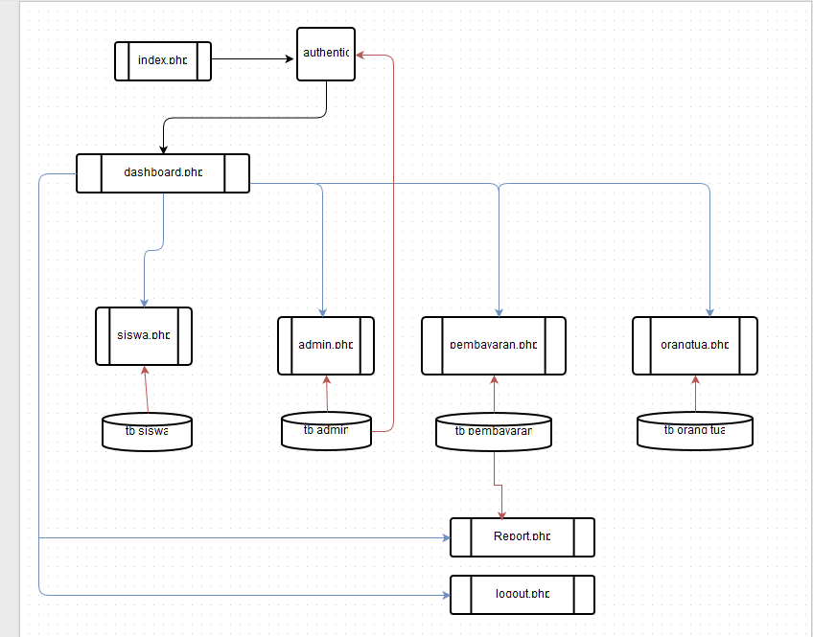
PHP File Diagram
index.php -> auth -> set cookie -> dashboard
Dashboard link to: siswa, admin, payment, parents, Report and logout
Siswa uses tb.siswa
Admin uses tb.admin
Payment and report use tb.payment
Orang Tua use tb.Orang tua
Logout -> clear cookie

