Slide 1
Jellyfish Search Optimization
Meta Heuristic I

Slide 2
Swarm Intelligence (SI)
Simulation of the collective intelligent behavior of insect or animal groups such as flocks of birds, colonies of ants, schools of fish, swarms of bees.
Have high flexibility and high efficiency
Self-organization strategies and independent work of each individual for solving the problems are two important characteristics of the SI methods.

Slide 3
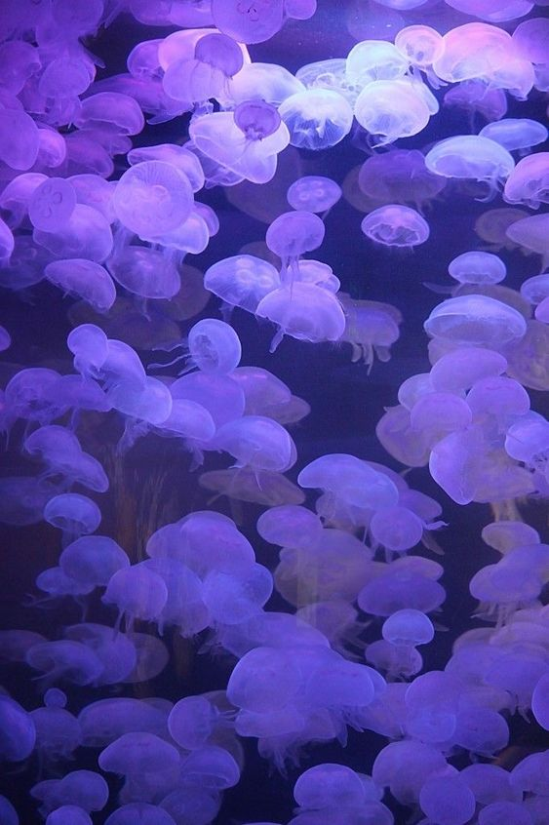
Jellyfish Search (JS) optimizer
Inspired by search behavior and movement of jellyfish in the ocean.
They move in the ocean in search of food.
Jellyfish are weak swimmer and mostly depend on ocean current.
In Swarm, Two type of motion can be observed.
Active Motion
Passive Motion
A “time control mechanism” use to switch between types of movement.

Slide 4

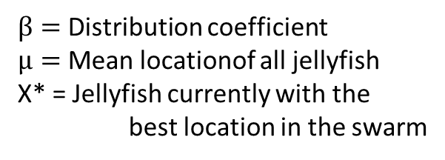
Jellyfish Search (JS) optimizer
Movement with Ocean current
The direction of the ocean current ($\vec{trend}$ ) is determined by averaging all the vectors from each jellyfish in the ocean to jellyfish that is currently in the best location,
………1
$β=$ Distribution coefficient
$µ=$ Mean locationof all jellyfish
X* = Jellyfish currently with the best location in the swarm
………2
….3
[N.B: After sensitivity analysis in numerical experiments $β$=3 was found]

Slide 5

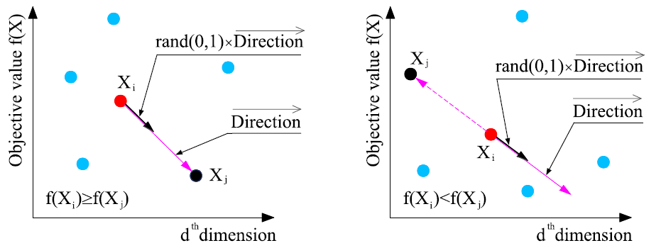


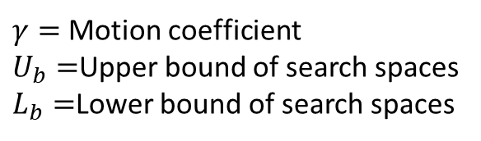
Jellyfish Search (JS) optimizer
Movement in Swarm
Passive motion (Type-A): Around their own locations
$γ=$ Motion coefficient
$U_{b}=$Upper bound of search spaces
$L_{b}=$Lower bound of search spaces
………4
Active motion (Type-B):
………5
………6
………7

Slide 6
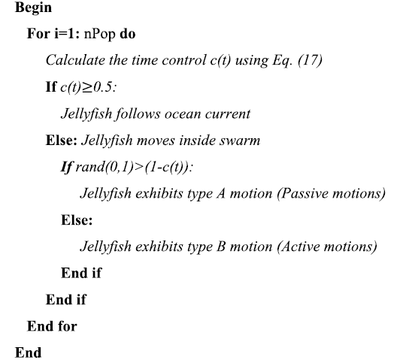
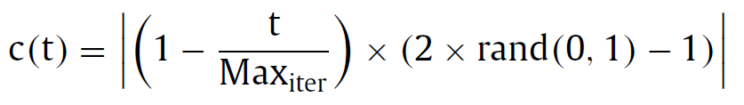
Jellyfish Search (JS) optimizer
Time control mechanism
To regulate the movement between following the ocean current and moving inside the jellyfish swarm.
It includes a time control function c(t) and a constant Co.
8
………8

Slide 7
Jellyfish Search (JS) optimizer

Slide 8
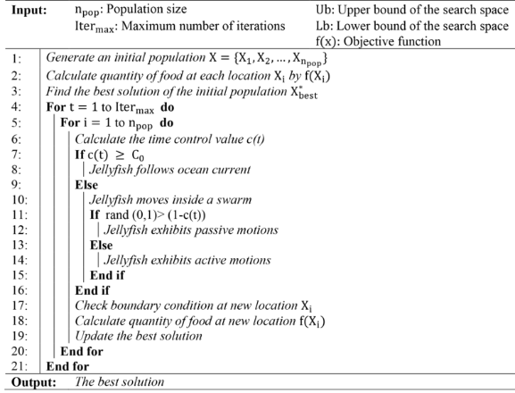
Jellyfish Search (JS) optimizer

Slide 9
Jellyfish Search (JS) optimizer
Schematic representation of artificial JS optimizer
Exploration
Exploitation
Movement toward the ocean current
Switch
Movements within a jellyfish swarm
Time control mechanism

