Slide 1
Hiring Process Analytics
Sangam Mahajan

Slide 2
AGENDA
Introduction
Approach
Tech Stack Used
Exploratory data analysis
Insights and Results

Slide 3
INTRODUCTION
Hiring Process Analytics is metrics of different parameter usually recorded in a dataset during the process of hiring. Hiring process is the fundamental and the most important function of a company.

Slide 4
APProach
Trends such as- number of rejections, number of interviews, types of jobs, vacancies etc. are important for a company to analyze before hiring freshers or any other individual. With knowledge in statistics and different formulas in excel I drew necessary conclusions about the company.

Slide 5
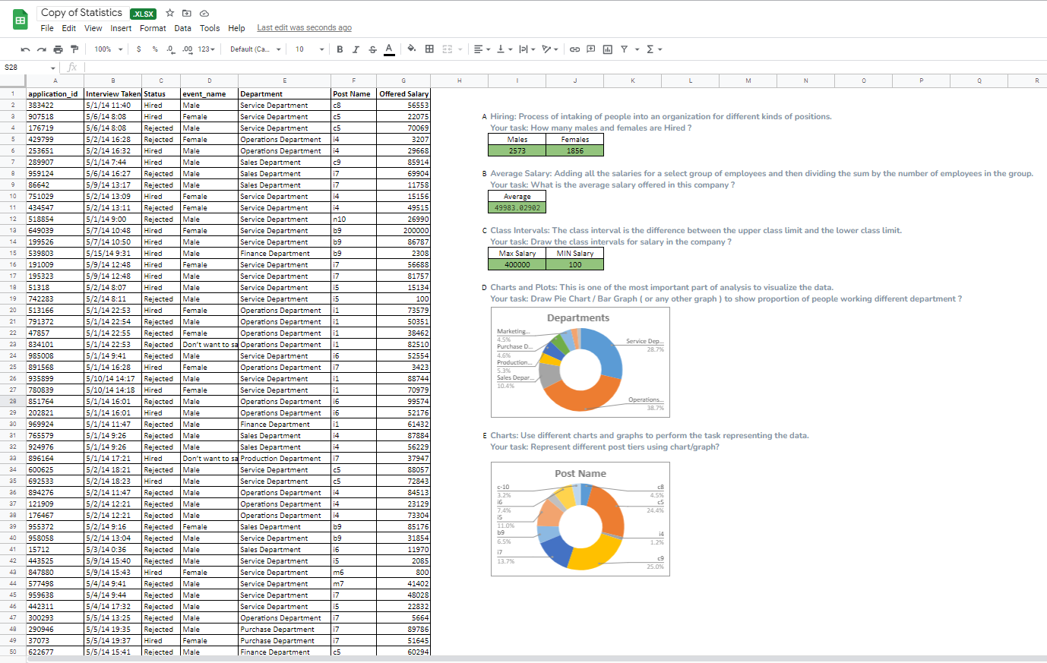
Tech-Stack Used - Spreadsheets

Slide 6
Exploratory data analysis
Missing Data
For Salary Column I filled average in blank columns
For Post Name and Gender I used the most repeated text using formula (after using filter and excluding blanks)-
=INDEX(X2:X7169,MODE(MATCH(X2:X7169,X2:X7169,0)))

Slide 7
Insights & Results

Slide 8
Insights & Results
Hiring: Process of intaking of people into an organization for different kinds of positions.
Formulae used:
=COUNTIFS(D2:D7169, D2,C2:C7169, C2)
=COUNTIFS(D2:D7169, D3,C2:C7169, C2)
Males | Females
2573 | 1856

Slide 9
Insights & Results
Average Salary: Adding all the salaries for a select group of employees and then dividing the sum by the number of employees in the group.
Formulae used:
=AVERAGE(G2:G7169)
Average
49983.02902

Slide 10
Insights & Results
Class Intervals: The class interval is the difference between the upper class limit and the lower class limit.
Formulae used:
=MAX(G2:G7169)
=MIN(G2:G7169)
Max Salary | MIN Salary
400000 | 100

Slide 11
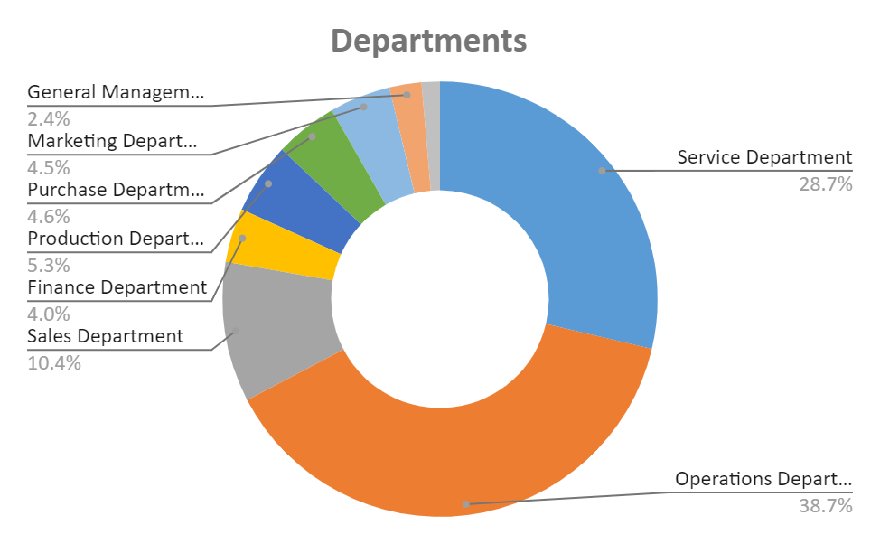
Charts and Plots: Draw chart to show proportion of people working different department ?

Slide 12
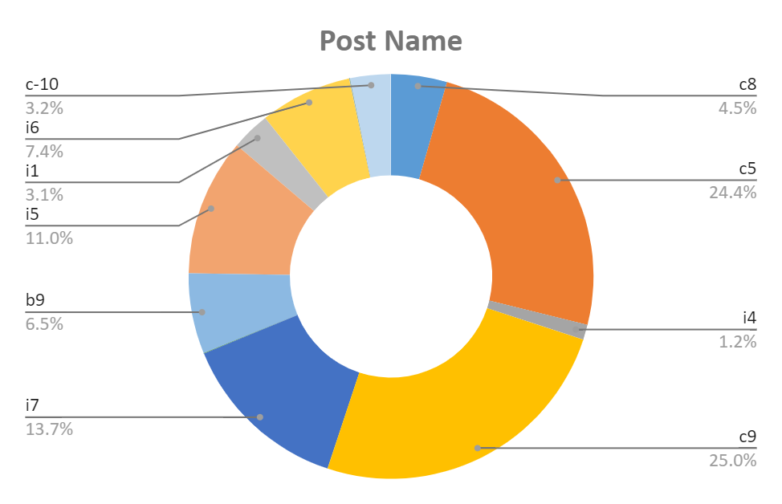
Charts and Plots: Represent different post tiers using chart/graph?

Slide 13
THANK YOU

