Slide 1
My Cookery Master
Submitted in the partial fulfillment for the award of the degree of
BACHELOR OF ENGINEERING
IN
COMPUTER SCIENCE & ENGINEERING
WITH SPECIALIZATION
IN
MOBILE COMPUTING
Submitted by:
Eish Jindal(19BCS4251) Anand Svarup Bhatia(19BCS4257)
Utkarsh Chauhan (19BCS4270) Shubham Mahajan (19BCS4275)
Under the Supervision of:
Mr. Chandra Bhan Singh
Co Supervision of:
Mr. Rahul Rathore
Department of AIT-CSE
DISCOVER . LEARN . EMPOWER

Slide 2
Outline
Introduction
Problem Formulation
Objectives of the work
Methodology Used
Results and Outputs
Conclusion
Future Scope
References

Slide 3
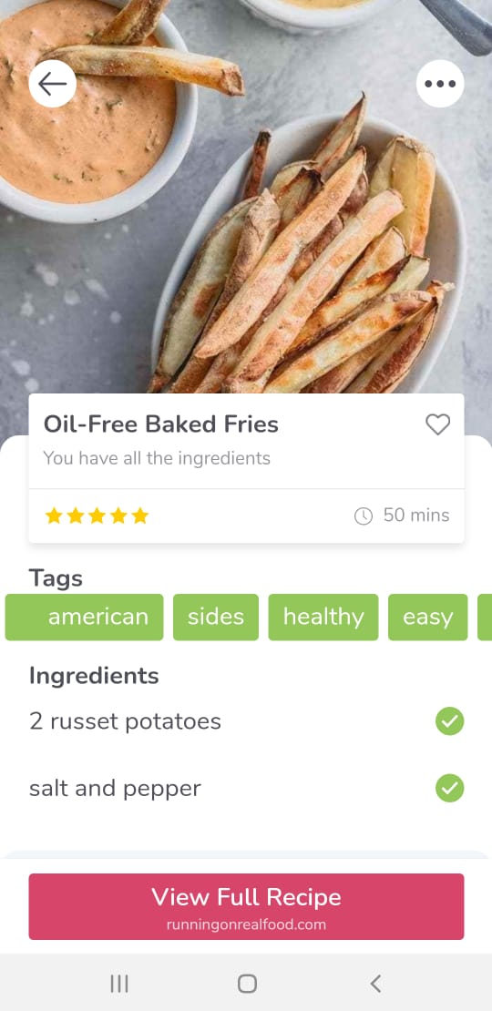
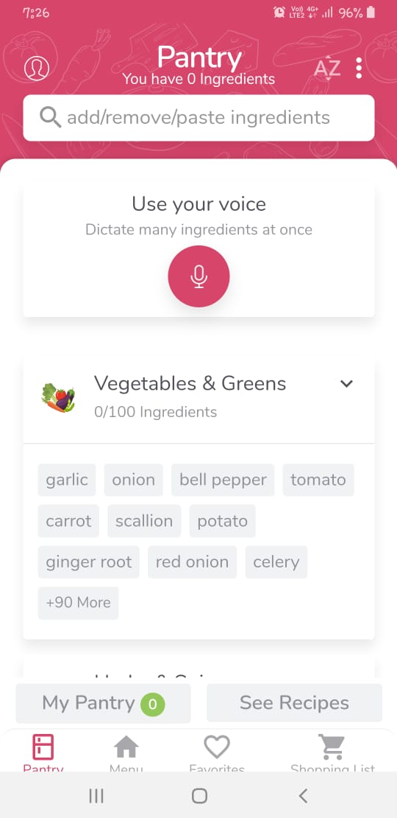
Introduction
PROBLEM DEFINATION:
This app focuses on the problems of the new generation that is cooking and eating healthy food. Most of working-class people are going the easy and unhealthy way that is fast food, because, they don’t know how to make good home cooked food.

Slide 4
PROBLEM OVERVIEW:
This app is cross platform app which helps people to learn cooking.
This app contains written as well as video tutorials of recipes.
This app provides chatting interface for clearing doubts and getting additional guidance.
This app is ads free and clutter free which makes it easy to use.

Slide 5
Problem Formulation
During software development, the main problem with existing app is:
No existing system gives interactive learning on cooking.
Most app available are just cook books or video Library that too un maintained.
Current apps have adware.
There is no app which has collaborative chat feature.
No app contains video + text recipes.
The Problems were tackled by:
App made will be totally free.
No subscription fees or Ad-ware in the app.
Unlimited Members can be added to the chat room.
No limit on Number of queries per user.
Easy to use clutter free UI.

Slide 6
Objectives
The main aim of My Cookery Master is to give people who are not very aware how to cook properly a guidance to tackle their everyday problem.
Since the pandemic people prefer to stay in home and eat something tasty and nutritious.
Current system was tested.
Flaws of current system were detected.
Wishlist of requested features was made.
New app with ironed flaws and new features was created and tested.

Slide 7
Methodology Used
Client-Server Architecture Pattern is used for designing the App.
New features will be implemented to enhance user experience.
Various parameters will be identified to evaluate the proposed system.
Comparison of new implemented approach with existing approaches will be done.
Feedback will be taken from research.
New ideas will be implemented to eliminate cons.
New features will be implemented to enhance user experience.
It focuses on providing users with basic idea of cooking ingredients.
Following tools are used for creating the App:
Flutter toolkit
Base language dart

Slide 8
Cloud database: Firebase
VS Code
Android Studio
Few Flutter widgets

Slide 9
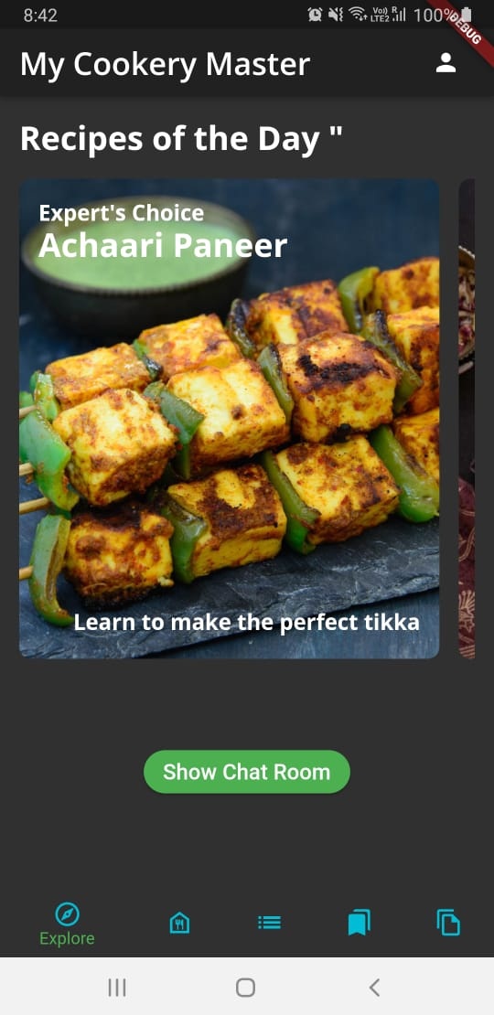
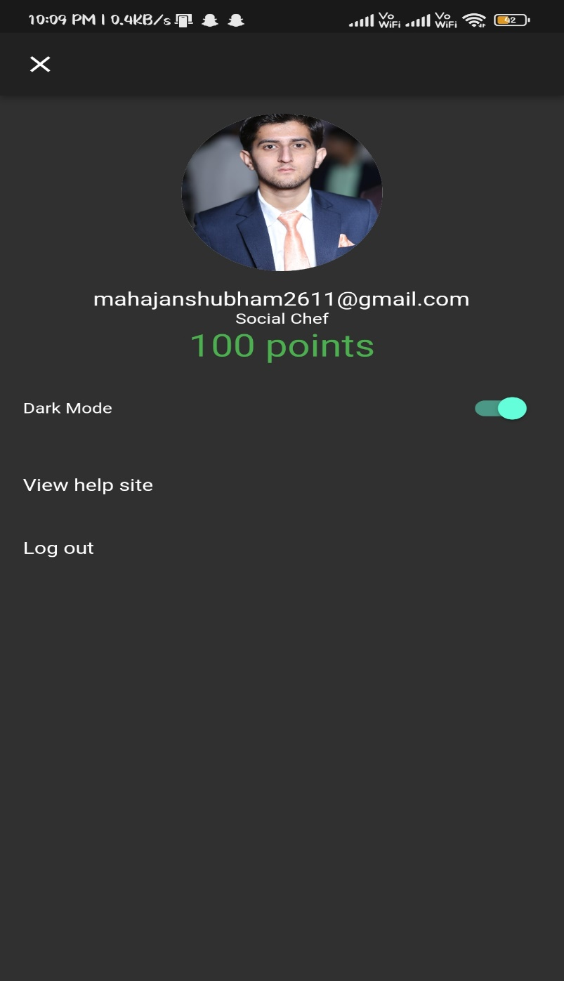
Results and Outputs

Slide 10
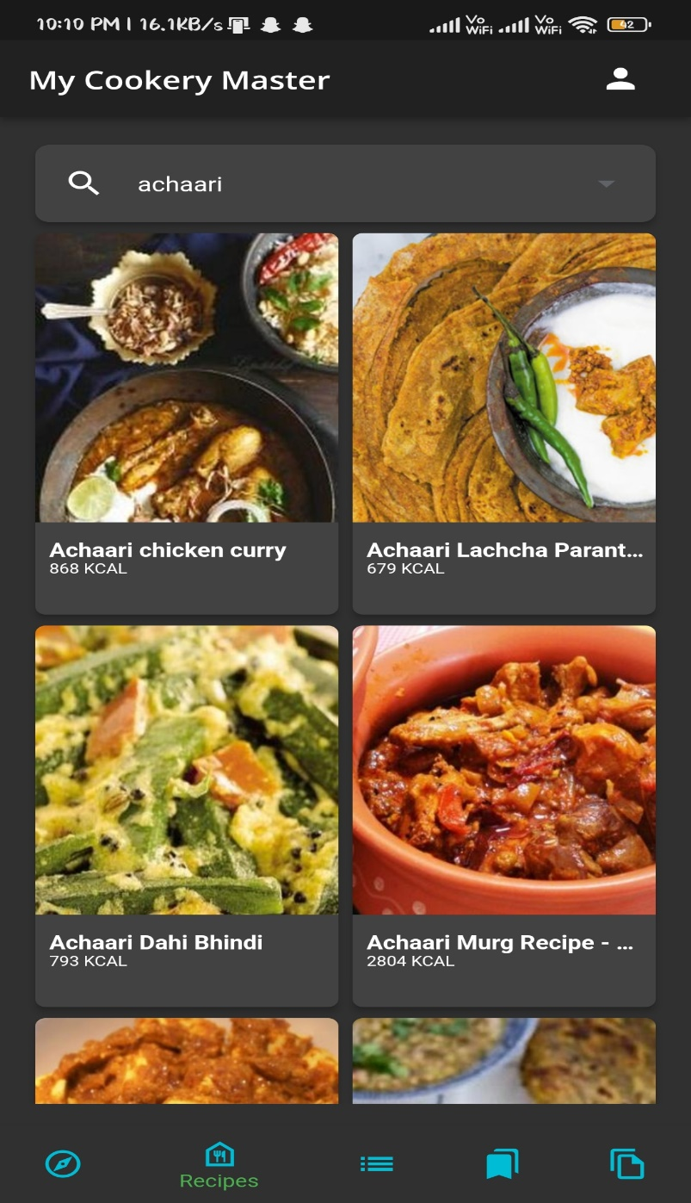
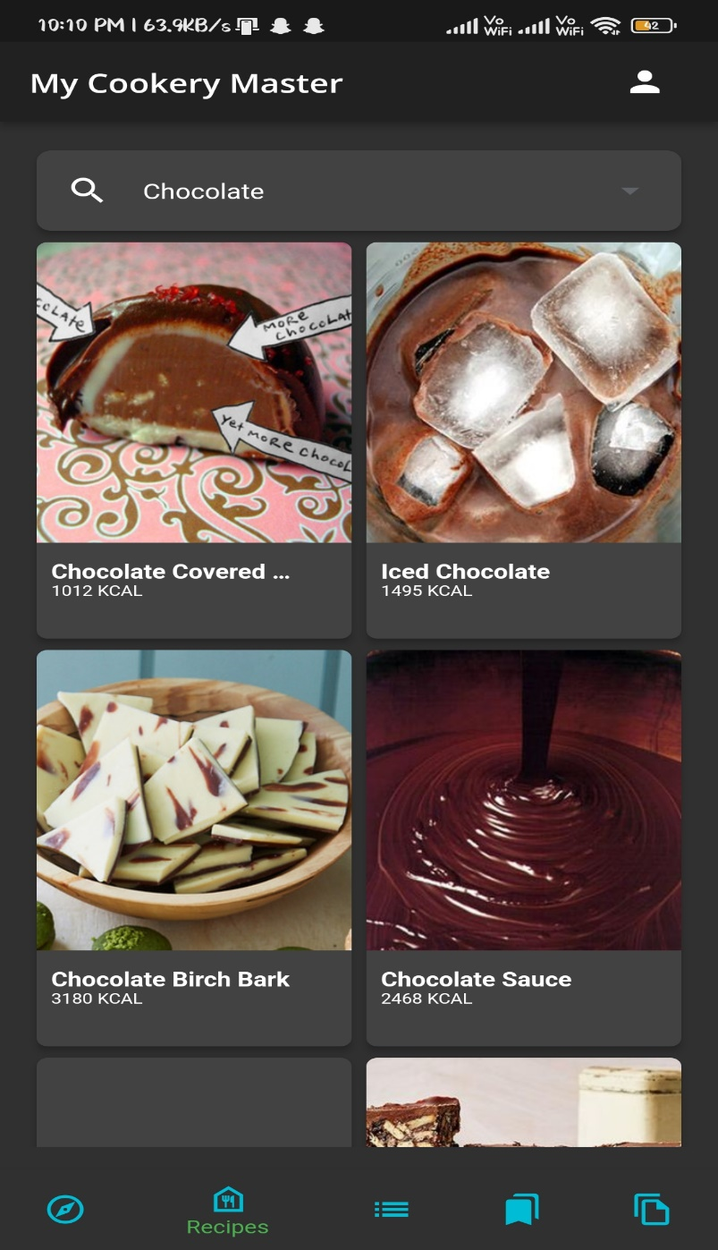

Slide 11
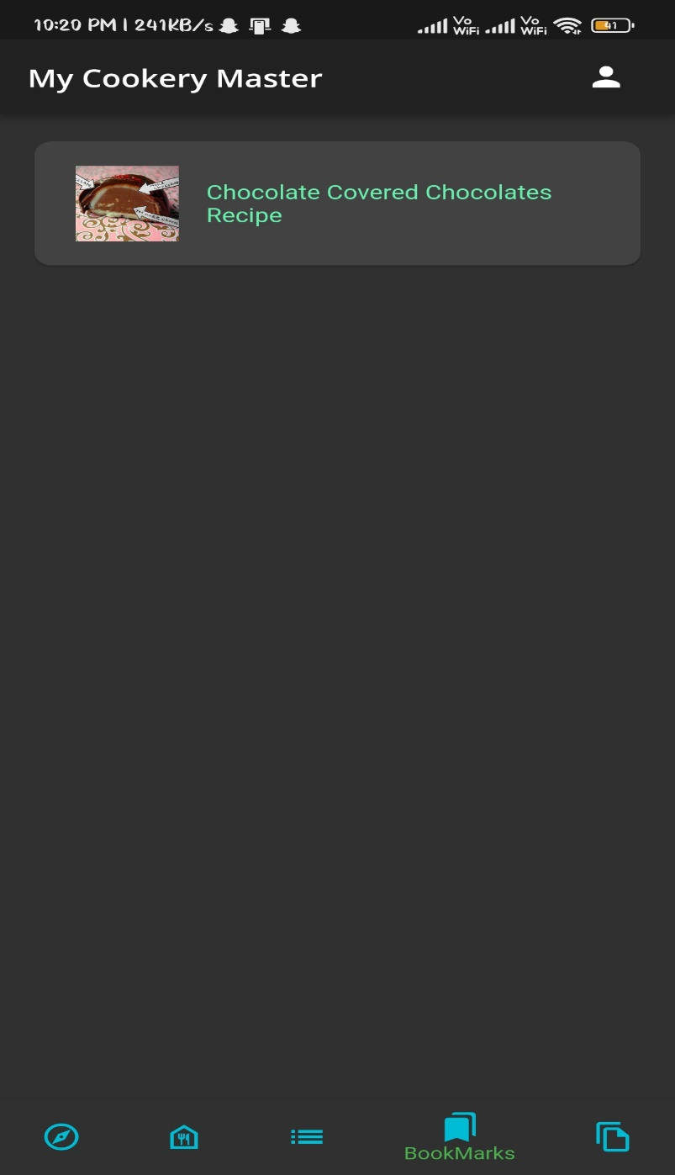
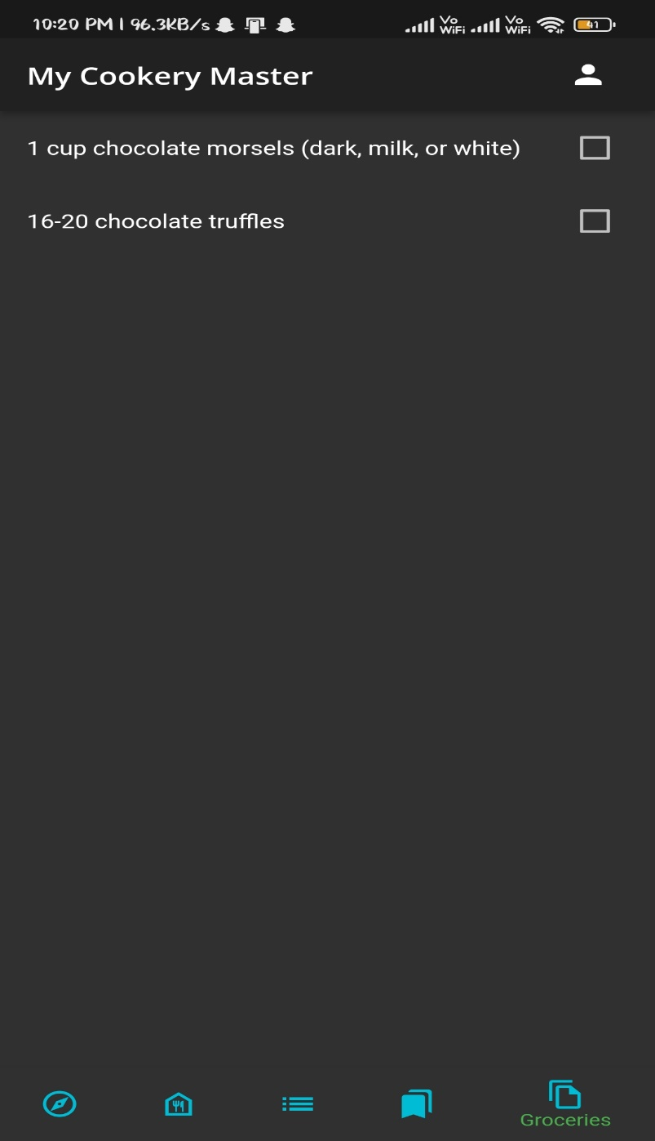

Slide 12
Conclusion
As one can observe that the app is very much ready for daily usage incorporates and families. The app focuses on providing users with the basic idea of cooking ingredients. While also providing various users to communicate with each other and discuss about recipes. It also provides a list to maintain grocery items for the user. The app frontend is implemented using various widgets of flutter and for the backend it uses Firestore & Firebase.

Slide 13
Future Scope
Maps Integration to allow user to see which shop is nearby.
Audio call/ video call between people who are sharing a dish.
Export the dish final image as PNG/JPEG file.
Setting a teacher mode so that a professional chef can guide us properly how to cook.
Colum for Invention of different kinds of recipes.

Slide 14
References
https://flutter.dev/
https://dart.dev/
https://firebase.google.com/
https://www.cookinglight.com/cooking-101/12-cooking-skills-every-young-adultshould-learn
https://retrohousewifegoesgreen.com/basic-cooking-skills/
https://www.reportlinker.com/insight/americans-cooking-habits.html
Asynchronous Programming google: https://dart.dev/codelabs/async-await
State Management google: https://docs.flutter.dev/development/data-and-backend/statemgmt/intro
Networking google: https://docs.flutter.dev/development/data-and-backend/networking
J son and Serialization: https://docs.flutter.dev/development/data-and-backend/json
Firebase google: https://docs.flutter.dev/development/data-and-backend/firebase

Slide 15
Interactivity: https://docs.flutter.dev/development/ui/interactive
Assets and Images google Flutter: https://docs.flutter.dev/development/ui/assets-and-images
Flutter Focus System flutter: https://docs.flutter.dev/development/ui/advanced/focus
Using Actions and Shortcuts flutter: https://docs.flutter.dev/development/ui/advanced/actions_and_shortcuts
Adding a splash screen to your mobile app flutter: https://docs.flutter.dev/development/ui/advanced/splash-screen
Google fonts pub: https://pub.dev/packages/google_fonts/changelog
Flutter: Login App using REST API and SQF Lite_ Kashif Minhaj: https://medium.com/@kashifmin/flutter-login-app-using-rest-api-and-sqflite-b4815aed2149
Create Your First Flutter App and Learn Flutter Framework Mahmud Ahsan: https://thinkdiff.net/getting-started-with-flutter-create-your-first-flutter-app-f6dea473f57d
Firebase use cases google: https://firebase.google.com/use-cases
Firebase Auth google: https://firebase.google.com/docs/auth/flutter/start
Structuring database firebase: https://firebase.google.com/docs/database/flutter/structure-data
Read and Write Data firebase: https://firebase.google.com/docs/database/flutter/read-andwrite
https://firebase.google.com/docs/database/flutter/lists-of-data
Enabling offline capabilities: https://firebase.google.com/docs/database/flutter/offlinecapabilities

