Slide 1
Open AI: Explore Capabilities/Pitfalls

Slide 2
Content To be discussed
Use cases in AI technology
Chat GPT
GPT 3 Versus GPT 4
Dall-E
Stable diffusion
Open AI API
Foundational Model

Slide 3
ChatGPT
ChatGPT is a conversational artificial intelligence (AI) model developed by OpenAI.
It's part of the GPT (Generative Pre-trained Transformer) series of models, which are known for their remarkable natural language understanding and generation capabilities.
ChatGPT is specifically fine-tuned for generating human-like text in a conversational context, making it well-suited for tasks involving chatbots, virtual assistants, customer support, and more

Slide 4
Advantages of ChatGPT
Scalability.
Cost-effectiveness.
24/7 availability

Slide 5
Challenges and Limitations
Generating inaccurate or biased content.
Lack of context in long conversations.
Ethical concerns

Slide 6
Here are some key characteristics and features of ChatGPT:
Conversational AI: ChatGPT is designed to engage in text-based conversations with users. It can understand user inputs and provide contextually relevant responses.
Natural Language Understanding: It has a strong ability to comprehend the nuances of human language, making it effective at processing and generating text in a conversational manner.
Contextual Responses: ChatGPT takes into account the context of a conversation, which means it can respond appropriately to user queries and statements based on the history of the conversation.

Slide 7
It's important to note that while ChatGPT is a powerful tool for generating human-like text and facilitating conversations, it has limitations. These limitations include the potential for generating incorrect or biased information, sensitivity to input phrasing, and a lack of true understanding of context beyond the immediate conversation. OpenAI has taken steps to address these issues, but users should exercise caution and use ChatGPT responsibly.

Slide 8
Use Cases for Leveraging OpenAI Technology

Slide 9
Overview of OpenAI Technologies
Highlight some of OpenAI's flagship technologies:
GPT (Generative Pre-trained Transformer) models.
Reinforcement Learning techniques.
Robotics and automation research.
Language models, like ChatGPT.

Slide 10
Natural Language Processing (NLP) Applications
Explain how OpenAI's NLP models like GPT-3 and GPT-4 can be leveraged.
Use cases:-
Content generation (articles, marketing copy).
Virtual assistants and chatbots.
Translation services.
Sentiment analysis.
Text summarization.

Slide 11
Business and Customer Service
Highlight the impact of OpenAI tech in business and customer service.
Use cases:-
Automated customer support.
Data analysis and insights.
Market research.

Slide 12
Real-world examples of how OpenAI technology can be leveraged across different domains:
Content Generation:
Automated Journalism: OpenAI's GPT models have been used to generate news articles, sports reports, and financial updates automatically.
Content Marketing: Businesses use AI-generated content for blogs, social media posts, and product descriptions.
Customer Support:
Chatbots: Companies employ AI chatbots powered by OpenAI technology to provide 24/7 customer support, answer FAQs, and handle routine inquiries.
Email Responses: AI can draft email responses and suggest solutions for customer issues, improving response times.

Slide 13
Healthcare:
Medical Image Analysis: OpenAI's computer vision technology can assist in the diagnosis of medical conditions by analyzing X-rays, MRIs, and CT scans.
Drug Discovery: AI models can help identify potential drug candidates by simulating molecular interactions.
Education:
Personalized Learning: AI-powered tutoring systems can adapt to individual student needs, providing custom exercises and explanations.
Content Creation: Educators can use AI to generate learning materials and quizzes.

Slide 14
Finance:
Algorithmic Trading: AI models can analyze market data in real-time to make trading decisions.
Risk Assessment: OpenAI's technology can be used to assess credit risk by analyzing financial data.
Creative Industries:
Art Generation: Artists and designers use AI to create digital art and illustrations.
Music Composition: AI algorithms can generate music tracks and assist composers in creating new pieces.

Slide 15
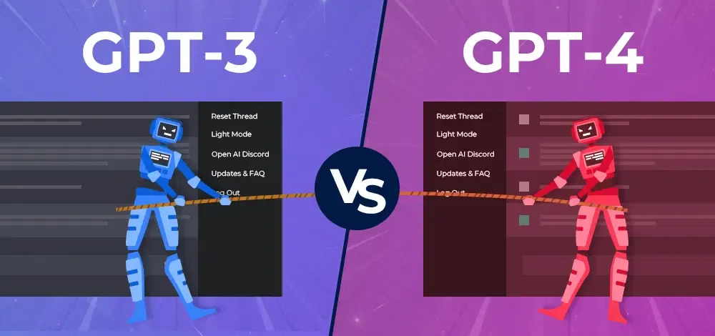
GPT-3 vs GPT-4: A Comparative Analysis
Capabilities
Performance
Linguistic Finesse
Modality
Complex Problem-Solving

Slide 16
Features | GPT-3 | GPT-4
Parameters | 175 billion | More than GPT-3
Capabilities | Language translation, summarization, question answering | Writing essays and articles, creating art and music
Performance | Generates human-like text, struggles with sarcasm and idiomatic expressions | Expected to significantly improve upon GPT-3’s performance
Potential Applications | Chatbots, virtual assistants, content generation, research | Creative writing, art, improvement of existing applications

Slide 17
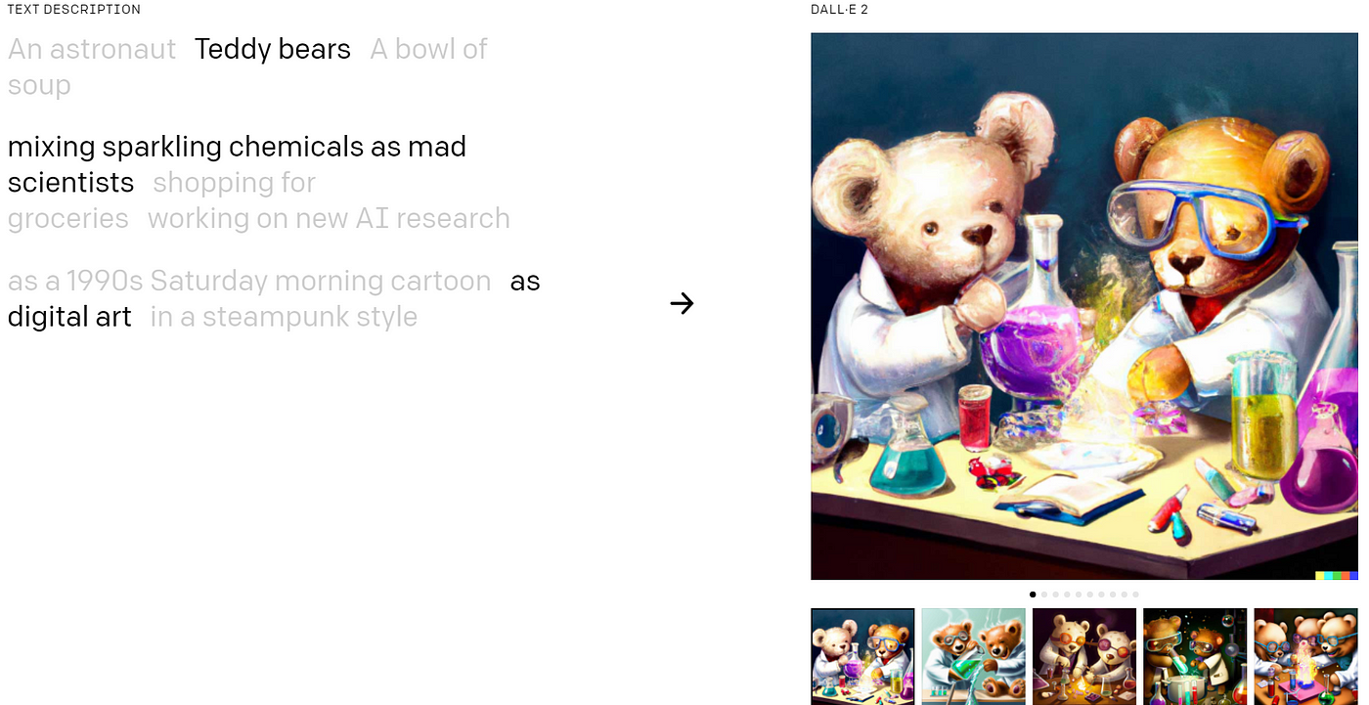
Dalle-E
DALL-E 2 is an AI image generation platform that allows users to create images from scratch using text prompts.
It runs on an artificial intelligence program called GPT-3, which takes natural language and converts it to images.
The platform also allows users to upload their own images and edit them using text prompts to create completely new works of art.

Slide 18
Advantages and Disadvantages
Pros
Easy to use
A lot of creative flexibility
No third-party platform needed
Cons
Simplistic images
Not a high degree of accuracy
Can only create square images

Slide 19
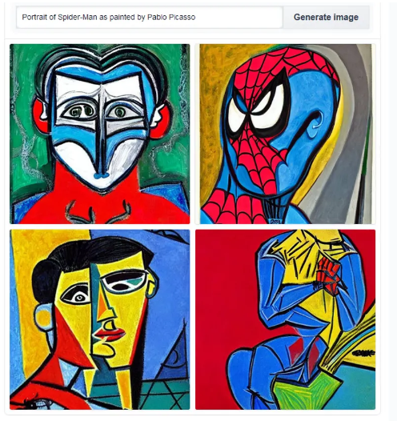
Stable Diffusion
Stable Diffusion is a deep learning, text-to-image model that was released in 2022
It is based on diffusion techniques and is primarily used to generate detailed images conditioned on text descriptions.
It can also be applied to other tasks such as inpainting, outpainting, and generating image-to-image translations guided by a text prompt1.

Slide 20
The model generates images by iteratively denoising random noise until a configured number of steps have been reached, guided by the CLIP text encoder pretrained on concepts along with the attention mechanism, resulting in the desired image depicting a representation of the trained concept

Slide 21
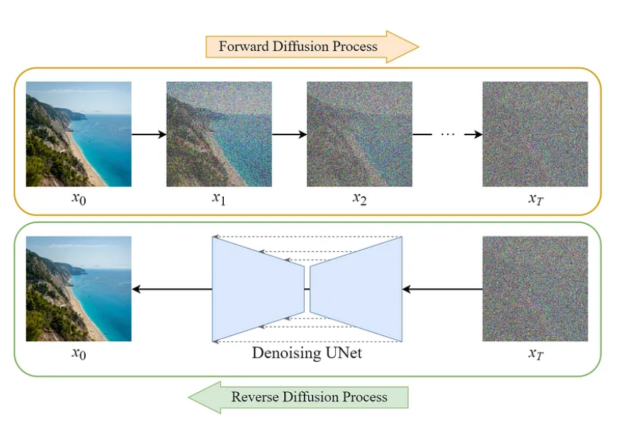
How Stable Diffusion works
Text interpretation
Diffusion model
Continuous learning
Image generation
Editing existing images

Slide 22
Exploring OpenAI API and Its Capabilities

Slide 23
Introduction to OpenAI API
OpenAI API is a cloud interface hosted on Microsoft Azure.​
It gives users access to new pre-trained AI models developed by OpenAI, such as DALL-E, Codex, and GPT-3.​
OpenAI API is ideally designed to ensure users can add state-of-the-art AI capabilities to virtually any task available in the English language. ​

Slide 24
Key Capabilities of OpenAI API
Natural Language Understanding:
Sentiment analysis, Named Entity Recognition (NER), Text classification.
Text Generation:
Content creation, writing assistance, code generation.
Language Translation:
Multilingual applications, cross-language communication.
Chatbots and Conversational Agents:
Customer support, virtual assistants, interactive storytelling.

Slide 25
Models Developed Under OpenAI API
Models | Description
GPT-4 | Models which can enhance on GPT-3.5 and identify as well as generate code or natural language
GPT-3.5 | Models which are improved version of GPT-3, capable of identifying and generating code/natural language
DALL-E(Beta) | Model used to generate and edit images from natural user prompts
GPT-3 | Models which can understand and generate natural language

Slide 26


