Slide 1
Winter Winning Camp
DATABASE MANAGEMENT SYSTEM
Department Of Career Planning & Development
09 Dec 2024 – 24 Dec 2024

Slide 2
Contents
Introduction to DQL, DDL, DML, DCL and TCL …………………………….3-7
Joins in SQL ………………………………………………………………………………....9
Sub-Queries in SQL ………………………………………………………………….…10
Set Operations in SQL …………………………………………………………....11-12
Stored Procedures in SQL ……………………………………………………………26
Functions in SQL …………………………………………………………………………27
Triggers and its types in SQL ……………………………………………………….28
Miscellaneous Problem Statements ……………………………………….37-40
Note: Problem statements & tasks are included after each topic.

Slide 3
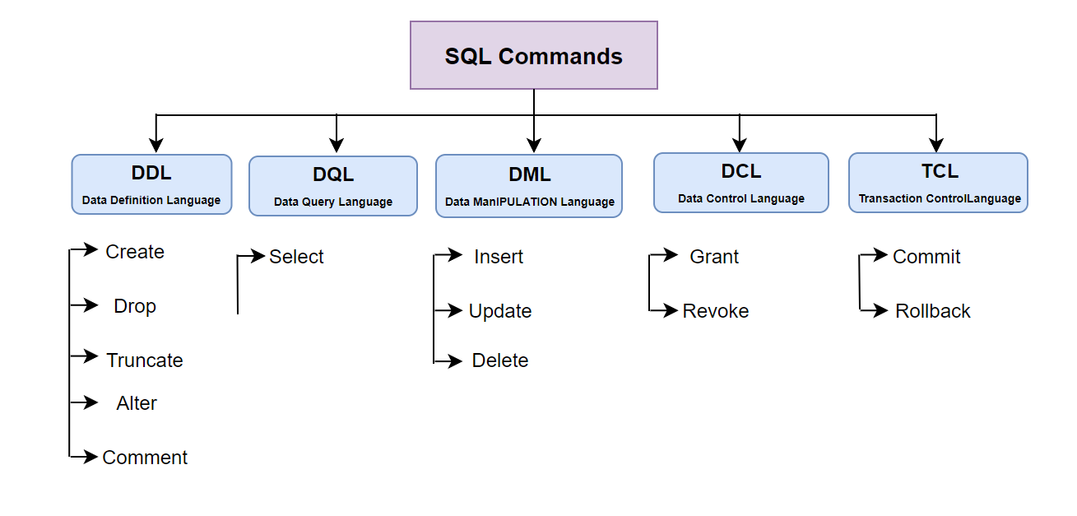
SQL – Structured Query Language
SQL is a language just like C++ and Java. It is actually used for accessing and manipulating the databases.
We have different data definition commands in SQL for accessing and modifying the databases. This includes: DDL, DQL, DML, DCL and TCL.

Slide 4
Introduction to SQL
SQL (Structured Query Language) is a domain-specific language used to manage and manipulate relational databases.
It is used for querying, updating, and managing data.

Slide 5
Characteristics of SQL
Non-Procedural: SQL is a declarative language. It describes what data to retrieve without specifying how to retrieve it.
Portable: SQL can be used across different database management systems (DBMS).
Declarative: SQL queries specify what data is required and leave the task of retrieving that data to the DBMS.
Flexible: It supports different types of queries for retrieving and modifying data.

Slide 6
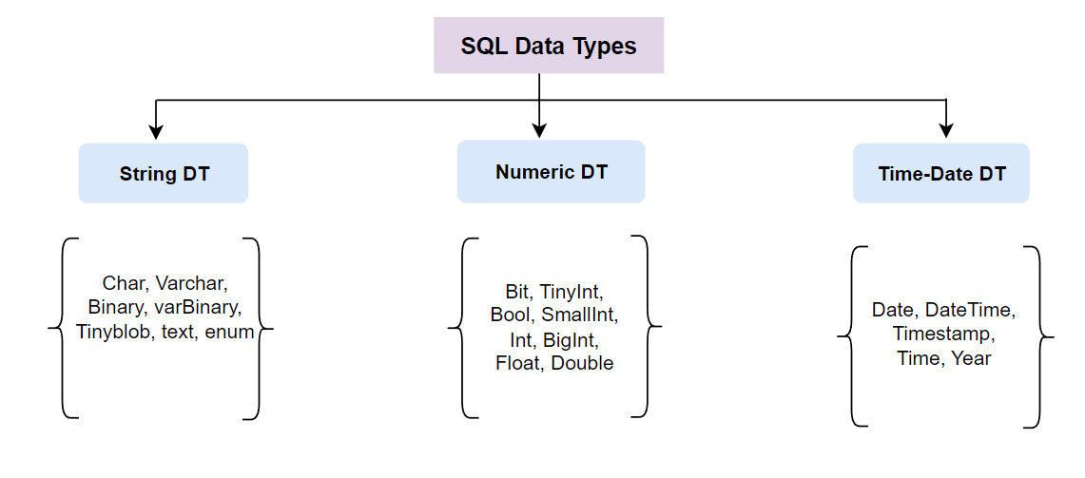
SQL – Data Types
Just like other programming languages, SQL also have the data types, which defines the type of data that needs to stored in a particular variable.
In SQL we broadly have three categories of data types that is : String DT, Numeric DT and Time-Date DT.

Slide 7
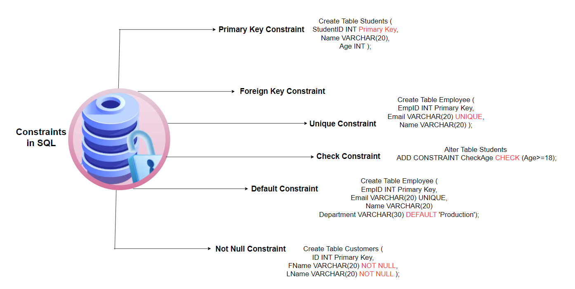
Constraints in SQL

Slide 8
Day 01 - Problem Statement
You are tasked with designing a database system to manage customer data and their associated purchase records. The goal is to ensure that every order in the Orders table is correctly linked to a valid customer in the Customer table through a foreign key constraint on the C_id column. The solution should:
Prevent insertion of orders with non-existent C_id values.
Automatically handle updates or deletions in the Customer table to maintain referential integrity.
Provide insights into the impact of implementing foreign key constraints on database operations like cascading updates and deletions.

Slide 9


Slide 10
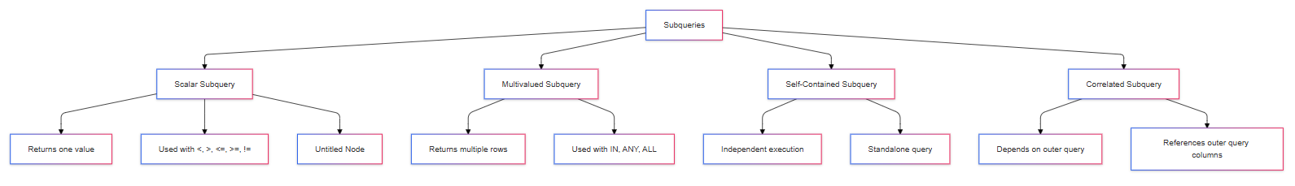
Sub-Queries

Slide 11
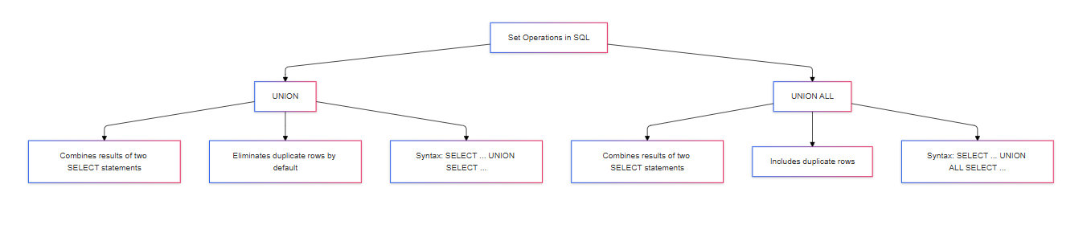
Set Operations

Slide 12
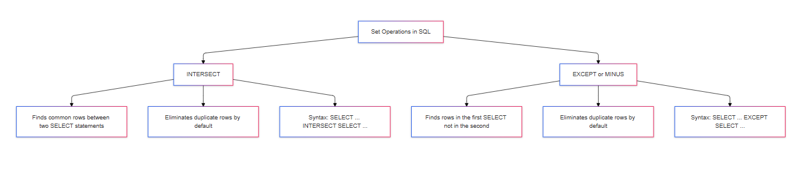
Set Operations

Slide 13
Day 01 – Problem Statements
The e-commerce platform has a database with the following tables:
Products (ProductID, Name, Price, Category)
Customers (CustomerID, Name, Email, Address)
Orders (OrderID, CustomerID, ProductID, Quantity, OrderDate)
Payments (PaymentID, OrderID, PaymentMethod, PaymentDate)

Slide 14
Contd.
PS | Problem Description
1 | Create a database called EcommerceDB and define tables for Products, Customers, Orders, and Payments.
2 | Insert at least 5 products, 5 customers, and 5 orders into their respective tables.
3 | Retrieve all orders made by a customer with the ID 3.
4 | Update the price of the product with ID 2 to 599.99.
5 | Delete all orders for customer ID 4.
6 | Truncate the Payments table to remove all records.
7 | Retrieve all orders placed after 2023-10-01.
8 | Retrieve the distinct categories of products available in the store.
9 | Find all customers who haven't made any payments (i.e., whose PaymentDate is NULL).
10 | Calculate the total amount spent by a customer with the ID 5 using SUM() and GROUP BY.
11 | Retrieve all products ordered by price in descending order.
12 | Find all products whose name contains the word "Laptop".
13 | Join the Orders and Customers tables to find the names of customers who have placed an order.
14 | Retrieve a list of customers and the products they have ordered by performing an inner join between Customers and Orders.

Slide 15
Contd.
15 | Retrieve all customers and the products they have ordered, ensuring that customers with no orders are included.
16 | Retrieve all orders and their corresponding customer information, including orders that do not have customer information.
17 | Find all customers who have ordered a product with a price greater than 1000. Use a subquery.
18 | Create a list of all products that are either in the category "Electronics" or "Furniture" using the UNION operator.
19 | Retrieve the top 3 most expensive products in the store.
20 | Retrieve the average price of products per category, but only include categories that have more than 2 products.

Slide 16
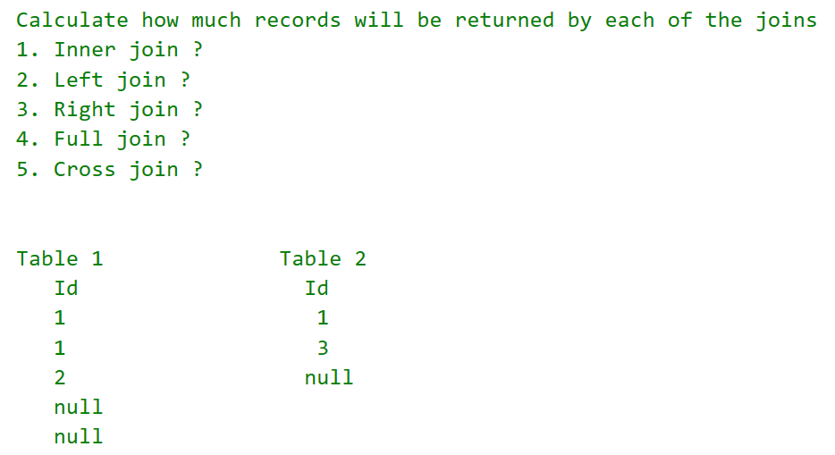
TASK 01

Slide 17
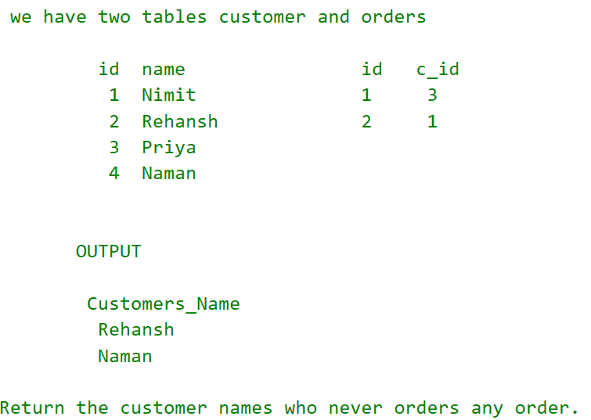
TASK 02

Slide 18
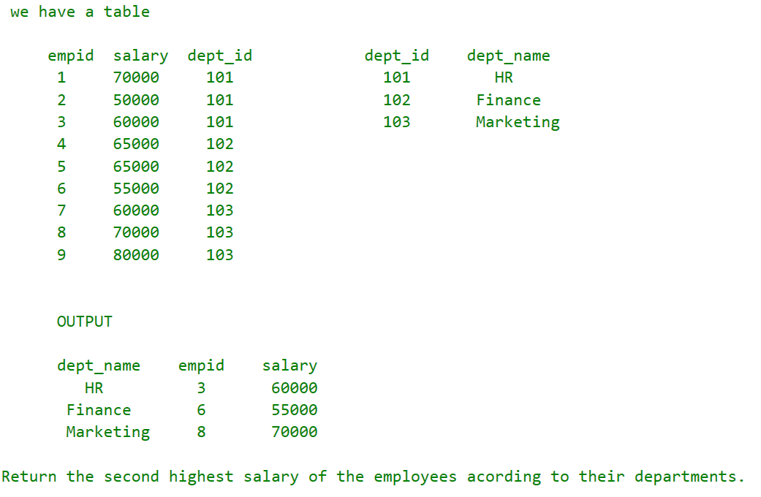
TASK 03

Slide 19
Day 02 – Problem Statements
The online bookstore has the following tables:
Books (BookID, Title, Author, Price, Category)
Customers (CustomerID, Name, Email, Address)
Orders (OrderID, CustomerID, BookID, Quantity, OrderDate)
Payments (PaymentID, OrderID, PaymentMethod, PaymentDate)

Slide 20
Contd.
PS | Problem Description
1 | Write a query to retrieve all orders and their associated customer details by joining the Orders and Customers tables on CustomerID.
2 | Write a query to list all customers along with their orders, even if they haven't placed an order. Use a LEFT JOIN between Customers and Orders.
3 | Write a query to list all orders along with their associated payment details, even if some orders haven't been paid yet. Use a RIGHT JOIN between Orders and Payments.
4 | Write a query to find all books and orders, even if some books have never been ordered or some orders contain books that are no longer available in stock.
5 | Write a query to find authors who have written more than one book, by performing a self join on the Books table.
6 | Write a query to list all books whose price is greater than the average price of books in the same category. Use a correlated subquery to filter books by category.
7 | Write a query to list all customers who have placed at least one order for a book that costs more than $30. Use a subquery in the WHERE clause.
8 | Write a query to retrieve the OrderID and the total value (price * quantity) of each order, using a subquery in the SELECT clause to calculate the total value for each order.
9 | Write a query to list all customers who have placed an order for a book by using the EXISTS keyword.
10 | Write a query to list all customers who have placed an order for books in the 'Science Fiction' category using the IN keyword in a subquery.

Slide 21
Contd.
11 | Write a query to list the total number of books ordered by each customer, along with their name and email, by joining the Orders and Customers tables. Use GROUP BY.
12 | Write a query to list authors who have written more than 3 books, including the number of books for each author, by joining the Books table with itself and using HAVING.
13 | Write a query to find customers who have spent more than the average amount on books. Use a subquery to calculate the average amount spent.
14 | Write a query to find orders where the quantity of books ordered is greater than 2 and the payment was made using Credit Card. Join the Orders, Payments, and Books tables.
15 | Write a query to list the top 5 most expensive books ordered by customers, using a subquery with LIMIT to limit the results.
16 | Write a query to find all customers who have placed an order for books from the 'Fantasy' category, using a subquery to retrieve BookID from the Books table and a JOIN with Orders.
17 | Write a query to list all orders where the Quantity is greater than the average quantity ordered for that book. Use a nested subquery to find the average quantity per book.
18 | Write a query to list distinct customers who have ordered books by the same author using a subquery.
19 | Write a query to retrieve each order along with the total value (price * quantity) and the book title by joining Orders with Books and using a subquery to calculate the total value.
20 | Write a query to list all authors along with the total sales (sum of Price * Quantity) for each book ordered. Use a join between Books and Orders with an aggregated subquery.

Slide 22
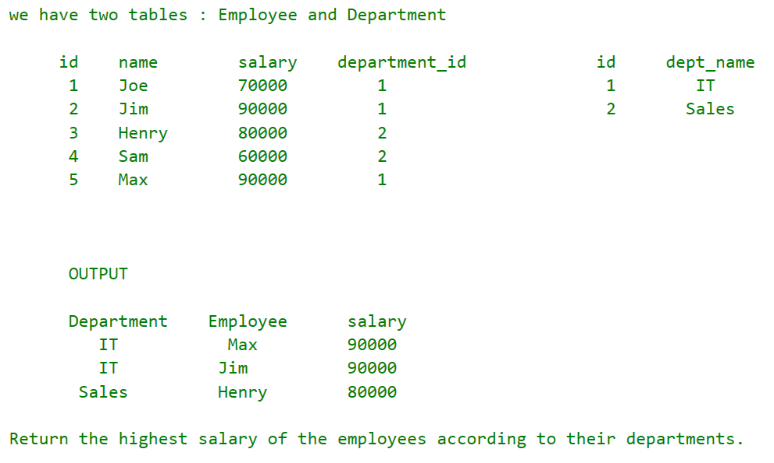
TASK 01

Slide 23
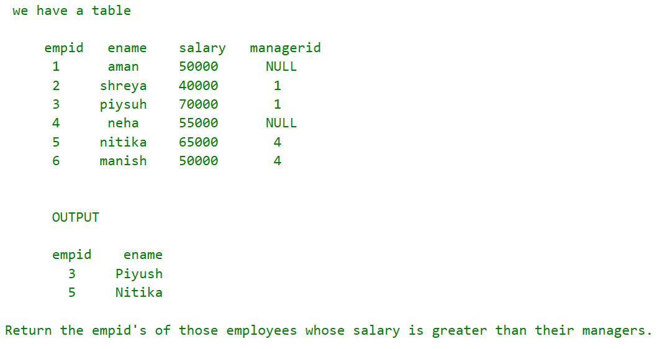
TASK 02

Slide 24
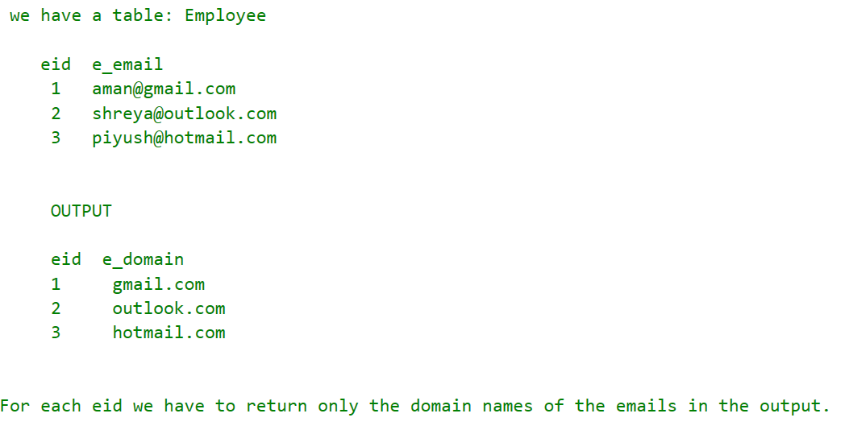
TASK 03

Slide 25
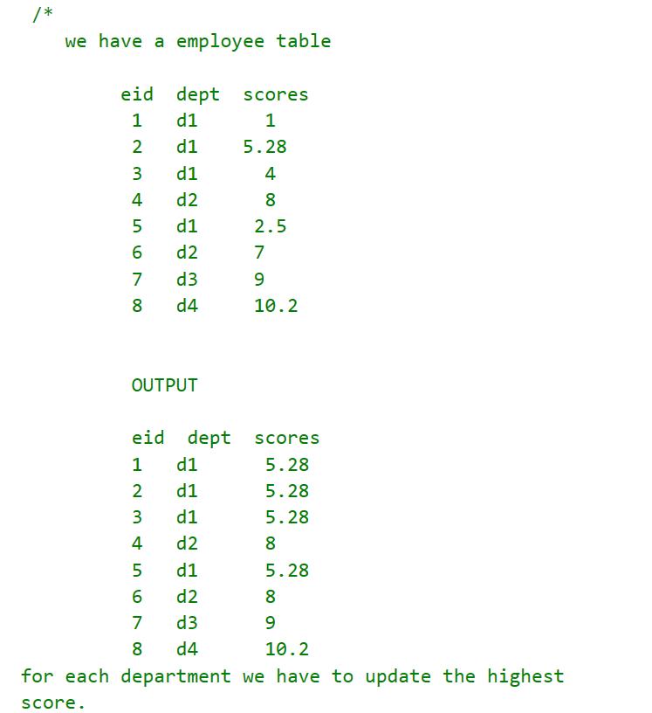
TASK 04

Slide 26
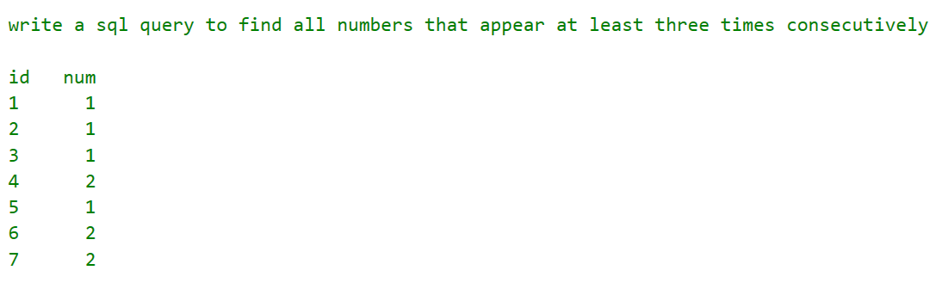
TASK 05

Slide 27
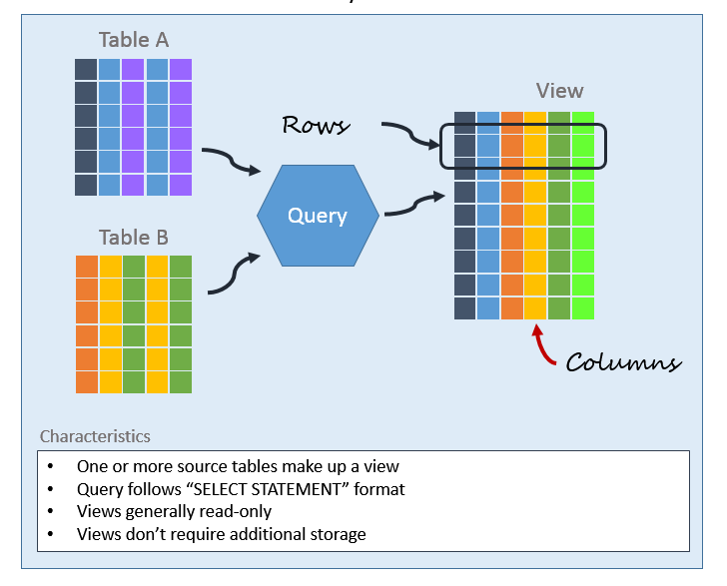
Views in SQL

Slide 28
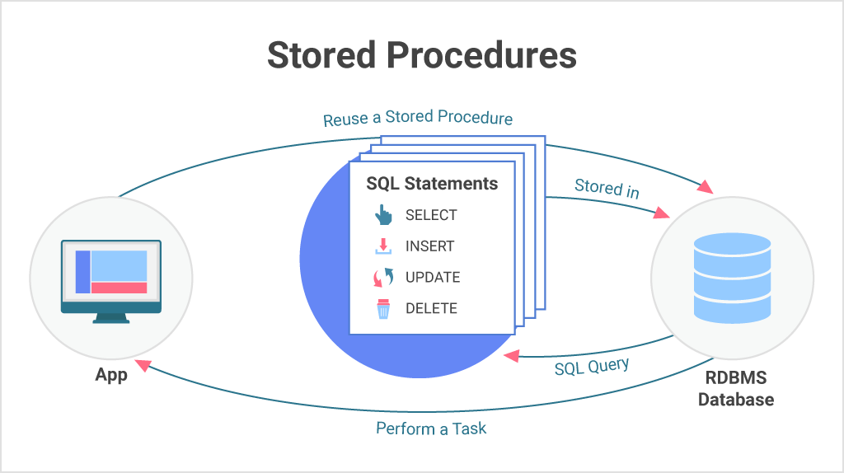

Slide 29
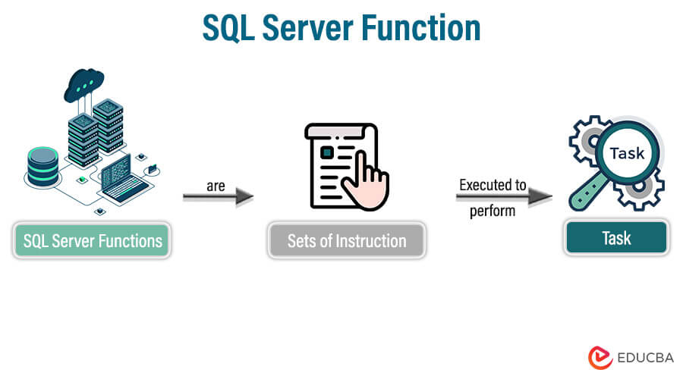

Slide 30
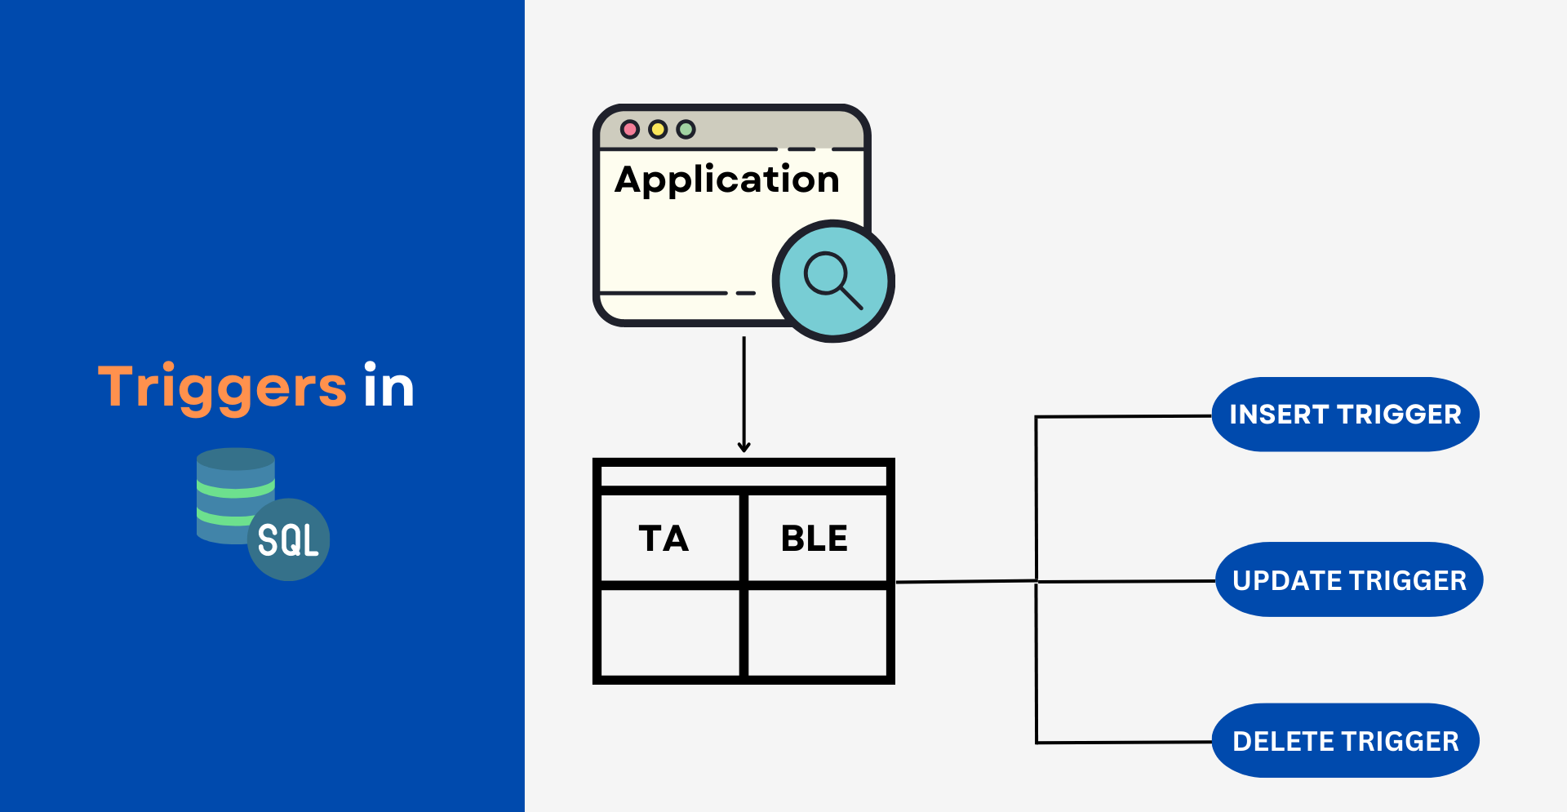

Slide 31
Day 03 – Problem Statements
Library Management System
The LMS has a database with the following tables:
Books(BookID, Title, Author, Price, Category)
Orders(OrderID, CustomerID, BookID, Quantity, OrderDate)
Payments(PaymentID, OrderID, PaymentMethod, PaymentDate)

Slide 32
Contd.
PS | Problem Description
1 | Write a stored procedure to add a new book to the Books table. The procedure should accept parameters Title, Author, Price, and Category and insert them into the table. Ensure the price is greater than 0.
2 | Create a trigger that automatically updates the OrderDate in the Orders table to the current date whenever a new order is inserted.
3 | Add a constraint to the Books table that ensures the Price column cannot be null or negative.
4 | Write a stored procedure to update the price of a book in the Books table. The procedure should accept the BookID and the new Price as parameters and update the price for the corresponding book.
5 | Write a trigger to prevent the deletion of a book from the Books table if the book has any associated orders in the Orders table. If a deletion is attempted, raise an error.
6 | Write a stored procedure that calculates the total amount spent by a customer (sum of prices of all books in their orders). Accept CustomerID as a parameter and return the total amount.
7 | Create a foreign key constraint between Orders.CustomerID and Customers.CustomerID. Ensure that no order can be inserted without a valid customer.
8 | Write a stored procedure to generate a report of the total sales by category. The procedure should return the Category and the total sales (sum of Price * Quantity).
9 | Create a trigger that automatically inserts a record into the Payments table whenever a payment for an order is successfully processed. The trigger should take payment details as input.
10 | Add a constraint to ensure that the Quantity column in the Orders table is always a positive integer greater than 0.

Slide 33
Contd.
PS | Problem Description
1 | Create a stored procedure to insert a new employee into MyEmployees.
2 | Create a stored procedure to update an employee's salary based on their EmpId.
3 | Create a stored procedure to delete an employee based on their EmpId.
4 | Create a stored procedure to retrieve employee details along with their department name.
5 | Create a stored procedure to retrieve employees from a specific city.
6 | Create a stored procedure to count the number of employees in each department.
7 | Create a stored procedure to find the highest salary in each department.
8 | Create a stored procedure to update the department of an employee based on their EmpId.
9 | Create a stored procedure to retrieve employees who have a salary above a certain amount.
10 | Create a stored procedure to retrieve employees whose names start with a specific letter.
11 | Create a stored procedure to get the average salary of employees in a specific department.
12 | Create a stored procedure to get the total salary paid to employees in each city.
13 | Create a stored procedure to delete all employees from a specific department.
14 | Create a stored procedure to find the employee with the highest salary in each city.

Slide 34
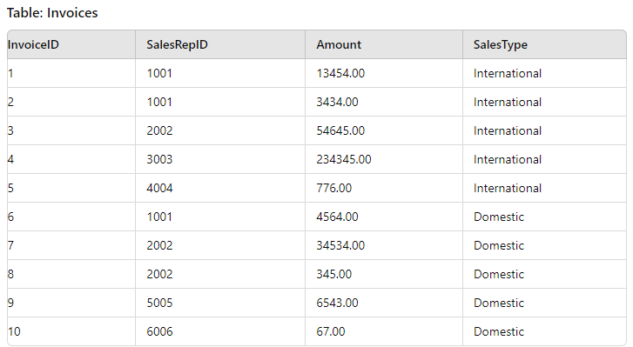
TASK 01
Day 04 – Problem Statements
Return the SalesRepId as either ‘Domestic’ or ‘International’ but not both.
OUTPUT:
SalesRepID
3003
4004
5005
6006

Slide 35
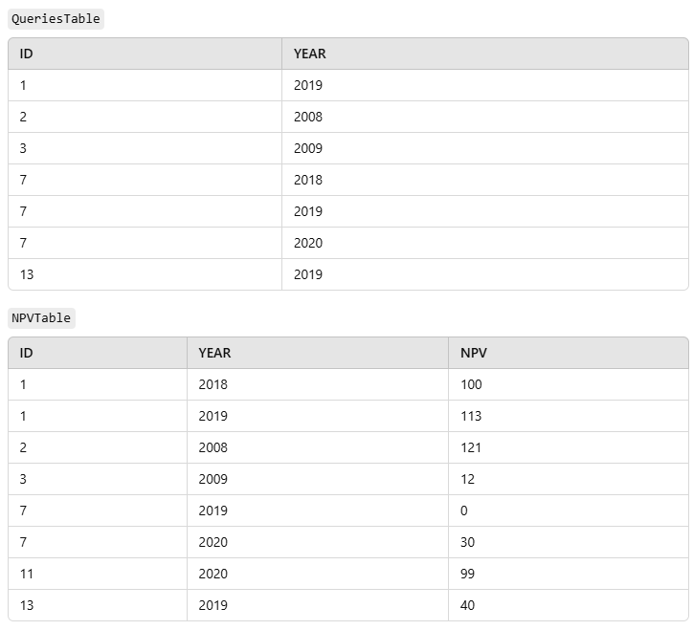
Task 02
TASK:
FIND THE NPV OF EACH QUERY FROM THE QUERIES TABLE. RETURN THE OUTPUT ORDER BY ID AND YEAR IN THE ASCENDING ORDER
NOTE: IF NO NPV IS AVAILABLE FOR A PARTICULAT COMBINATION IN THE NPV TABLE ASSIGN A 0 VALUE OF INSTANCE.

Slide 36
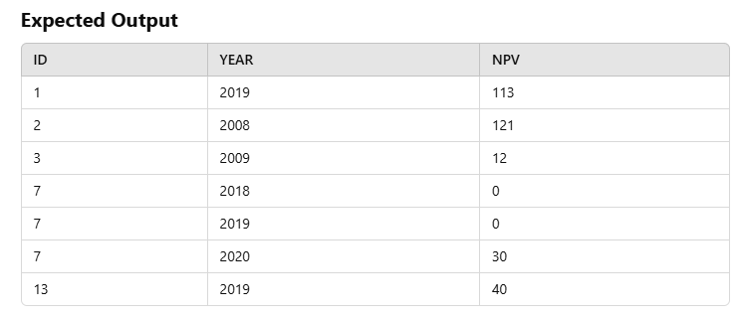
Task 02

Slide 37
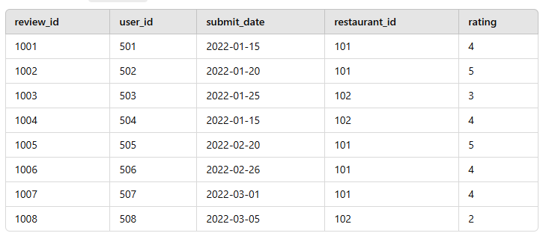
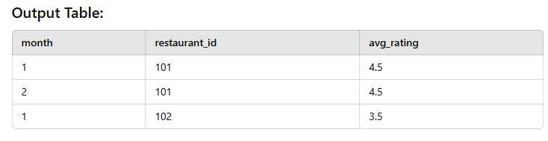
Task 03
TASK: You are a data analyst working with XWZ company. you are assigned to analyze the restaurant ratings over time to understand how the average rating of each restaurant changes monthly.
Objective: you need to calculate the average rating for each restaurant for each month.
Note: Include restaurants that have recieved at least 2 reviews in a given month

Slide 38
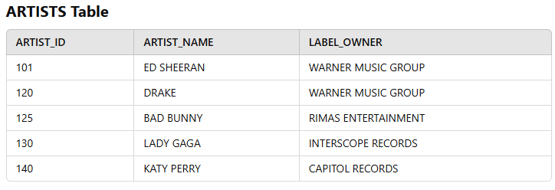
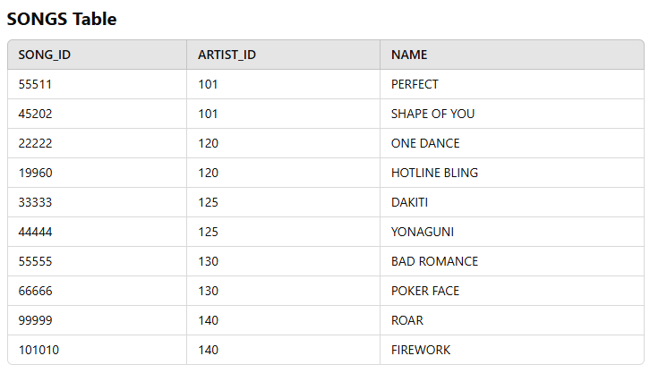
Task 04
TASK: You are a data analyst working with XWZ company. you are assigned to analyze the restaurant ratings over time to understand how the average rating of each restaurant changes monthly.
Objective: you need to calculate the average rating for each restaurant for each month.
Note: Include restaurants that have recieved at least 2 reviews in a given month

Slide 39
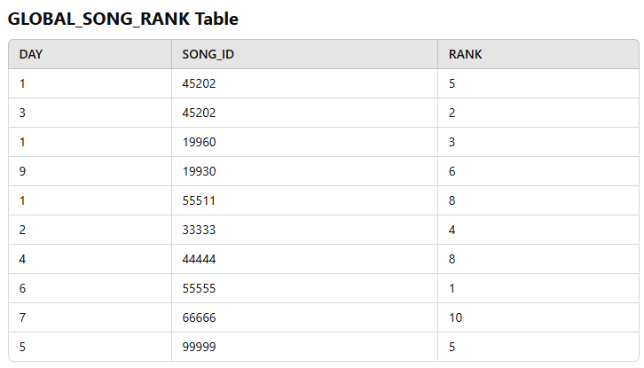
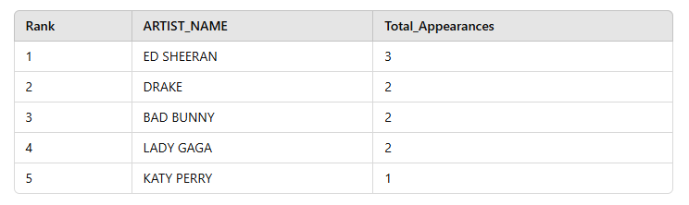
TASK:
OUR OBJECTIVE IS TO IDENTIFY THE TOP 5 ARTISTS WHOSE SONGS APPEAR MOST FREQUENTLY IN THE TOP 10 OF THE GLOBALRANKINGS.
NOTE: IF MULTIPLE SONGS FROM THE SAME ARTISTS ARE IN THE TOP 10, THEY SHOULD ALL COUNT TOWARDS THAT ARTISTS TOTAL APPEARANCES, WE WANT TO RANK THESE ARTISTS BASED ON THE NUMBER OF TIMES THEIR SONGS HAVE APPEARED IN THE TOP 10.
IF THERE ARE TIES, THEY SHOULD HAVE THE SAME RANKING, BUT THE OVERALL RANKING NUMBERS SHOULD REMAIN CONTINOUS.
Expected Output

Slide 40
TASK 05
Consider a scenario where you need to create a procedure that calculates the total sales amount for a specific product category within a given date range. The procedure should accept the product category and start/end dates as input parameters and return the total sales amount.
Tables used will be: Product and Sales
Product (ProductID, ProductName, Category)
Sales (SaleID, ProductID, SaleDate, Amount)

Slide 41
TASK 06
You want to create a stored procedure that inserts a new record into the `Orders` table and updates the `OrderCount` for the corresponding customer in another table named `CustomerStats`.
Tables used will be: Product and Sales
Orders (OrderID, CustomerID, OrderDate, OrderAmount)
CustomerStats (CustomerID, OrderCount)

Slide 42
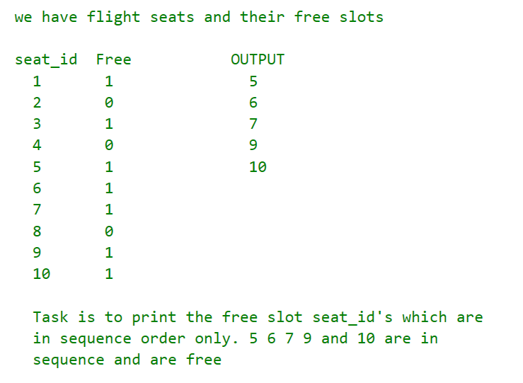
TASK 07
TASK:
Return the SalesRepId as either ‘Domestic’ or ‘International’ but not both.
OUTPUT:
SalesRepID
3003
4004
5005
6006

Slide 43
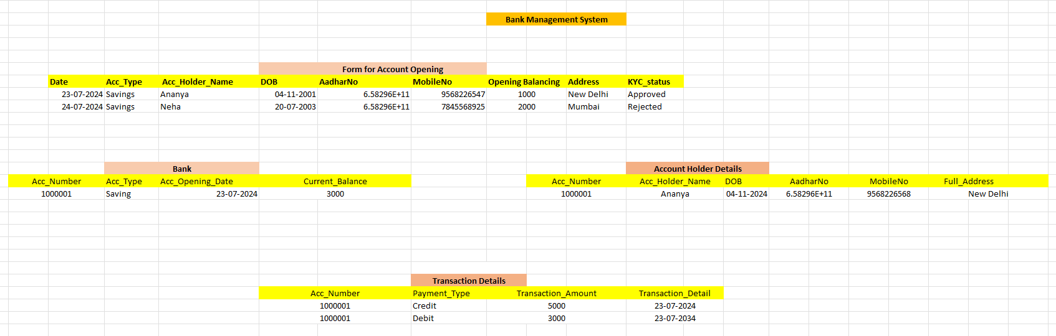
TASK 08 – Bank Management

Slide 44
Miscellaneous Problem Statements (Practice Set)
1 | Display all the information of the emp table.
SQL> | Select * from emp ;
2 | Display unique jobs from EMP table.
SQL> | SELECT DISTINCT Job FROM EMP GROUP BY Job ;
3 | List the details of the emps in asc order of their salaries.
SQL> | SELECT * FROM EMP
 | ORDER BY Sal ASC ;
4 | List the details of the emps in asc order of the Deptnos and desc of Jobs.
SQL> | SELECT * FROM EMP
 | ORDER BY Deptno ASC, Job DESC ;
5 | Display all the unique job groups in the descending order
SQL> | select unique job from emp order by job desc ;
6 | Display all the details of all ‘Mgrs’
SQL> | select * from emp where job = ‘MANAGER’ ;

Slide 45
Contd.
7 | List the emps who joined before 1981.
SQL> | select * from emp where hiredate < ’01-Jan-1981′ ;
8 | List the Empno, Ename, Sal, Daily Sal of all Employees in the ASC order of AnnSal.
SQL> | SELECT Empno, Ename, sal, Sal/30 DailySal
 | FROM Emp ORDER BY Sal*12 ;
9 | Display the empno , ename, job, hiredate, exp of all Mgrs
SQL> | select empno, ename, sal,
 | months_between(sysdate,hiredate)/12 Exp
 | from emp where job = ‘MANAGER’ ;
10 | List the empno, ename, sal, exp of all emps working for Mgr 7839.
SQL> | select empno, ename, sal,
 | months_between(sysdate,hiredate)/12 Exp
 | from emp B where Mgr = 7839 ;
11 | Display the details of the emps whose Comm. Is more than their sal.
SQL> | select * from emp where comm > sal ;

Slide 46
Contd.
12 | List the emps in the asc order of Designations
SQL> | select * from emp order by job ;
13 | List the emps along with their exp and daily sal is more than Rs.100
SQL> | Select emp.*, months_between(sysdate,hiredate)/12 Exp
 | from emp where sal/30 > 100 ;
14 | List the emps who are either ‘CLERK’ or ‘ANALYST’ in the desc order
SQL> | Select * from emp where job in (‘CLERK’,‘ANALYST’) order by job desc ;
15 | List the emps who joined on 1May81,31Dec81, 17Dec81, 19Jan80 in asc order of seniority.
SQL>
 | Select ename,hiredate,months_between(sysdate,hiredate)/12 EXP from emp
 | where hiredate like ’01-MAY-81′ or hiredate like ’31-DEC-81′
 | or hiredate like ’17-DEC-81′ or hiredate like ’19-JAN-80′
 | order by hiredate desc ;
16 | List the emps who are working for the deptno 10 or 20
SQL> | Select * from emp where deptno in (10,20) ;
17 | List the emps who are joined in the year 1981
SQL> | Select * from emp where hiredate like ‘%81’ ;

Slide 47
Contd.
18 | List the emps who are joined in the month of Aug 1980
SQL> | Select * from emp where hiredate like %AUG-80’ ;
19 | List the emps whose annul sal ranging from 22000 and 45000
SQL> | Select * from emp where sal*12 between 22000 and 45000 ;
20 | List the emps those are having five characters in their names.
SQL> | Select * from emp where ename like ‘_____’ ;

Slide 48
Thank You

