Slide 1


Bank of Baroda Hackathon - 2022
Technology Partner
Your Team Name:Smart Knowers
Your team bio : We 3 are from the field of Aritificial Intelligence and Data Science
Date :07/09/2022

Slide 2
Problem Statement?
Why did you decide to solve this Problem statement?
The reason we have choosen this problem statement is drastically increasing in all the Banks it leads to high risk of Banks. To reduce this crisis in Bank we have choosen this proble statement.

Slide 3
User Segment & Pain Points
Which user /advertiser segment would be early adopter of your product & why?
Eventhough our product suits for all our segment first priority would be adopted to banks .The reason is they have facing this issue everyday because lot customers visitng daily and suffers lot.

Slide 4
Pre-Requisite
What are the alternatives/competitive products for the problem you are solving?
For our project, the requirements we needed are laptop or PC with i5 processor. We can run our code in microsoft azure. So, that we need limited requirements with good pixel camera.

Slide 5
Azure tools or resources
Yes for our project, Azure is required to store and transmit the data to the bank manager.

Slide 6
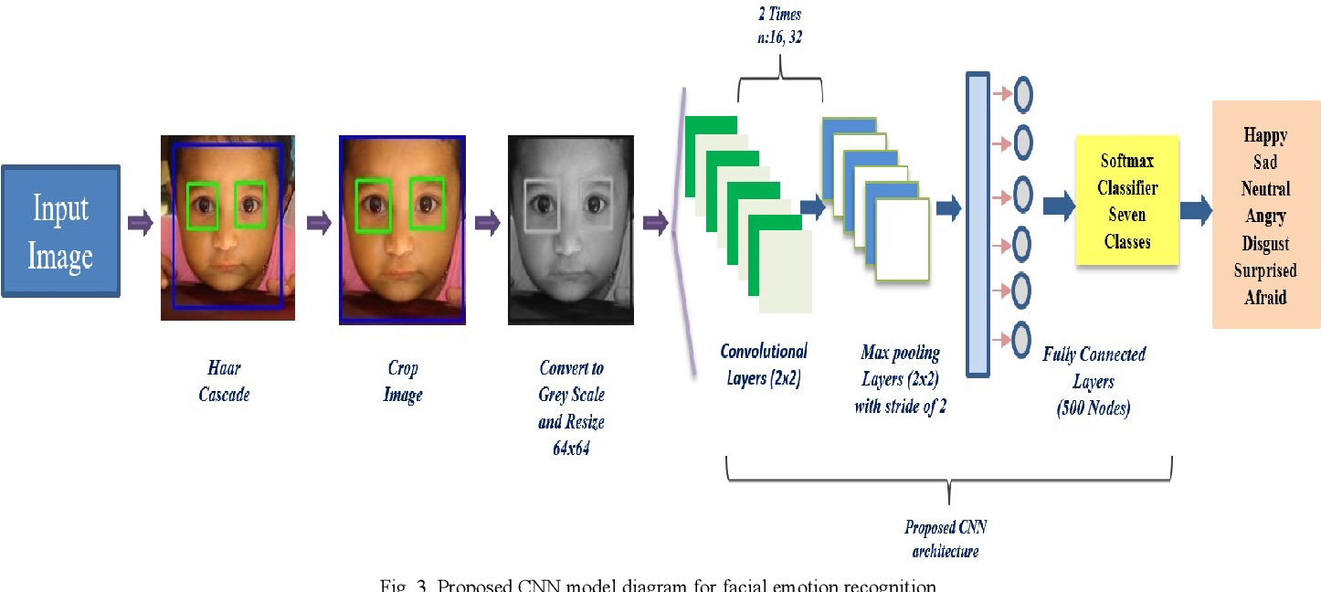
Overview of our project

Slide 7
Key Differentiators & Adoption Plan
The customer’s are entering into the bank it will detect the customer’s emotion at entrance. In case of any rob or theft it makes easier to identify the robbers.

Slide 8
GitHub Repository Link & supporting diagrams, screenshots, if any
Project Code Github Link:
https://github.com/Mahalakshmee/face-emotion

Slide 9
Thank You
Team Members
Mahalakshmee B
Pradeksha R K
Barathkumar J K

