Slide 1


SALES & PERFORMANCE ANALYSIS
Project Guide : Priya Shanmugam
By : Mahalakshmi.
Course: Exploratory Data Analysis using Python
Batch Code: DA644S64.

Slide 2

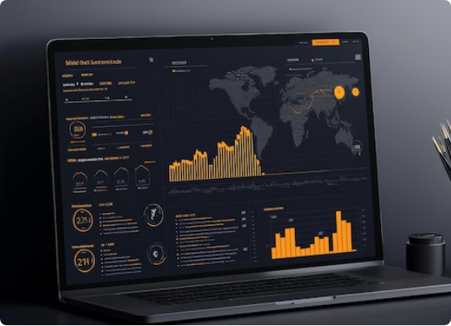

Problem Statement
The business wants to understand overall sales performance across products, customers, regions, and channels to identify what drives revenue and profit.
The goal is to find strengths, weaknesses, and opportunities to improve pricing, marketing, inventory, and customer strategies.

Slide 3
Objectives
Study sales trends across years.
Check which products and brands perform best.
Analyze customer segments and loyalty impact.
Measure how effective each sales channel is.
Identify top-performing and low-performing products.
Give actionable suggestions to improve business.
Pre-Processing
Removed duplicates & missing values
Standardized date, category, region, and customer fields
Created Profit, Margin %, Discount %, Year & Month
Corrected text inconsistencies
Removed outliers in sales and profit
Final dataset cleaned for accurate analysis

Slide 4
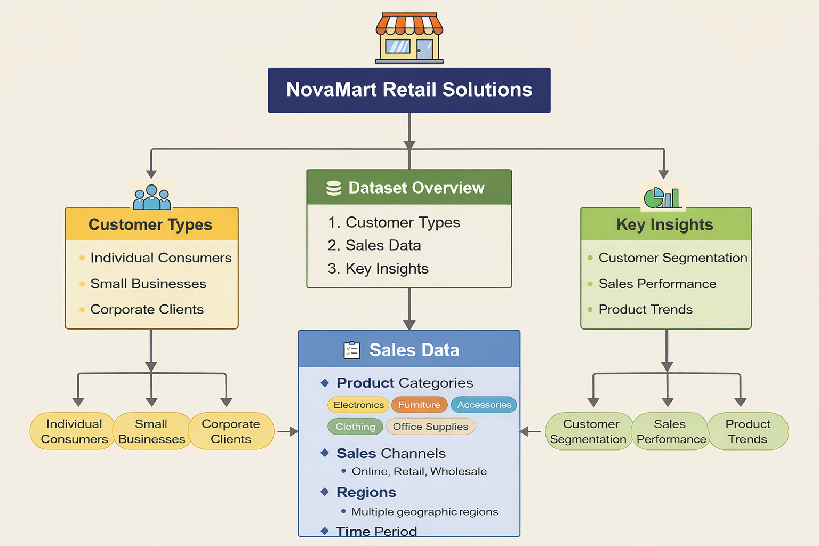
Dataset Overview
Time Period: 2023-2025
Categories: 5 product categories, 40+ brands
Regions: 4 geographical regions analyzed
Attributes : 48
Rows : 1981

Slide 5
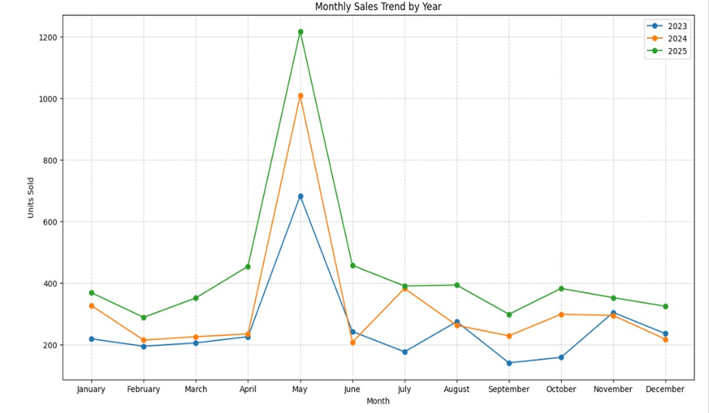
Monthly Sales Trend (2023-2025)
Insight: Consistent upward trajectory in sales volume across all three years
Peak Month : May is the highest sales month for all three years
Mid-year dip: Sep - Oct typically shows lower sales volumes
2025 performance: Stable start with February and high peak Apr-Jun then start
Recommendation: Increase inventory for Q4, implement targeted campaigns for mid-year boost

Slide 6
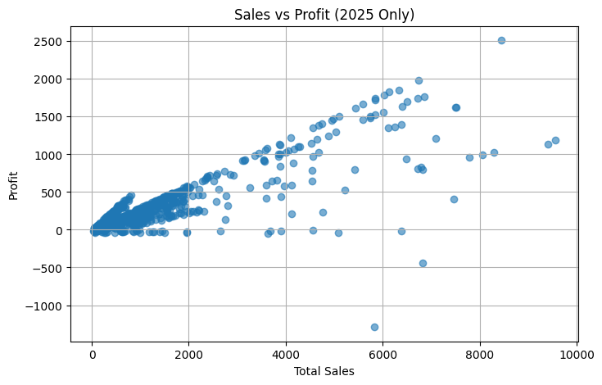
Sales Vs Profit
Insight: Strong positive correlation between sales volume and profit
High performers: Products with both high sales and proportional profit
Underperformers: Some high-sales items with disproportionately low profit
Opportunity: Products with low sales but high margin potential
Problem: Heavy discounting erodes profit on high-volume items
Recommendation: Implement tiered pricing strategy, reduce excessive discounting
.

Slide 7
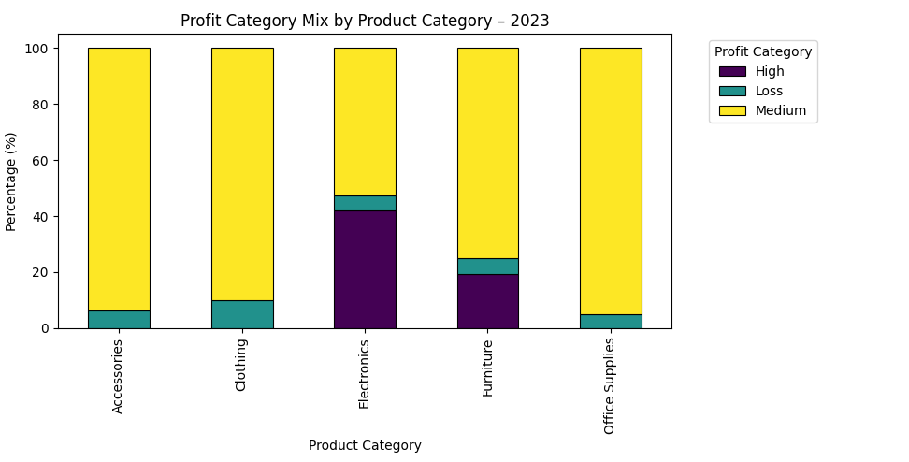
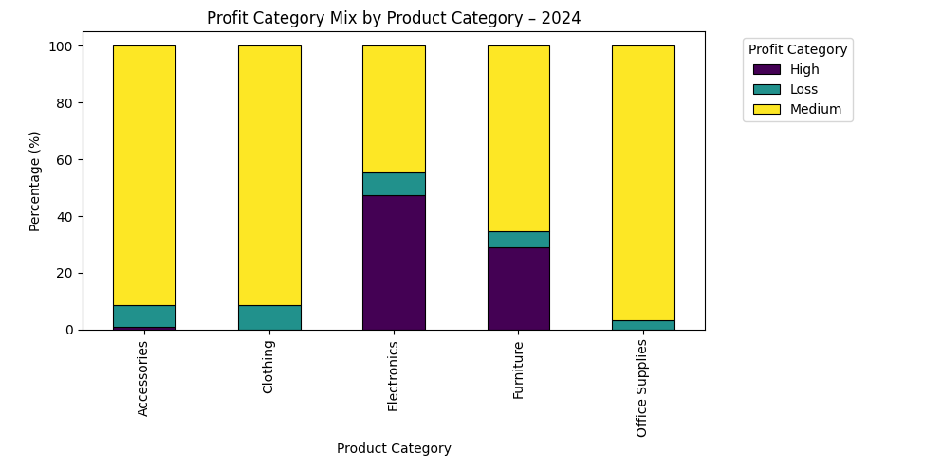
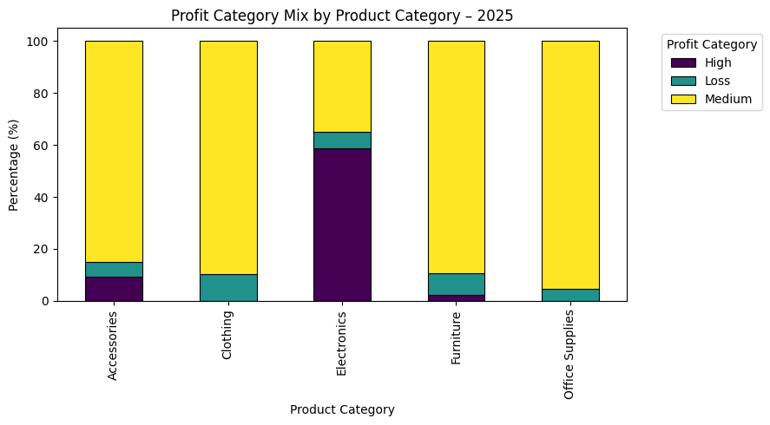
Product Category Performance
Electronics: Market leader with 17M revenue (47.2%)
Furniture: Second largest at $556K (22.5%)
Accessories: $378K contributing 15.3%
Clothing: $256K (10.4%)
Office Supplies: $116K (4.7%) but highest margin at 41%
Insight: While Electronics leads in volume, Office Supplies delivers superior profitability
Recommendation: Expand Office Supplies portfolio and promote high-margin items

Slide 8
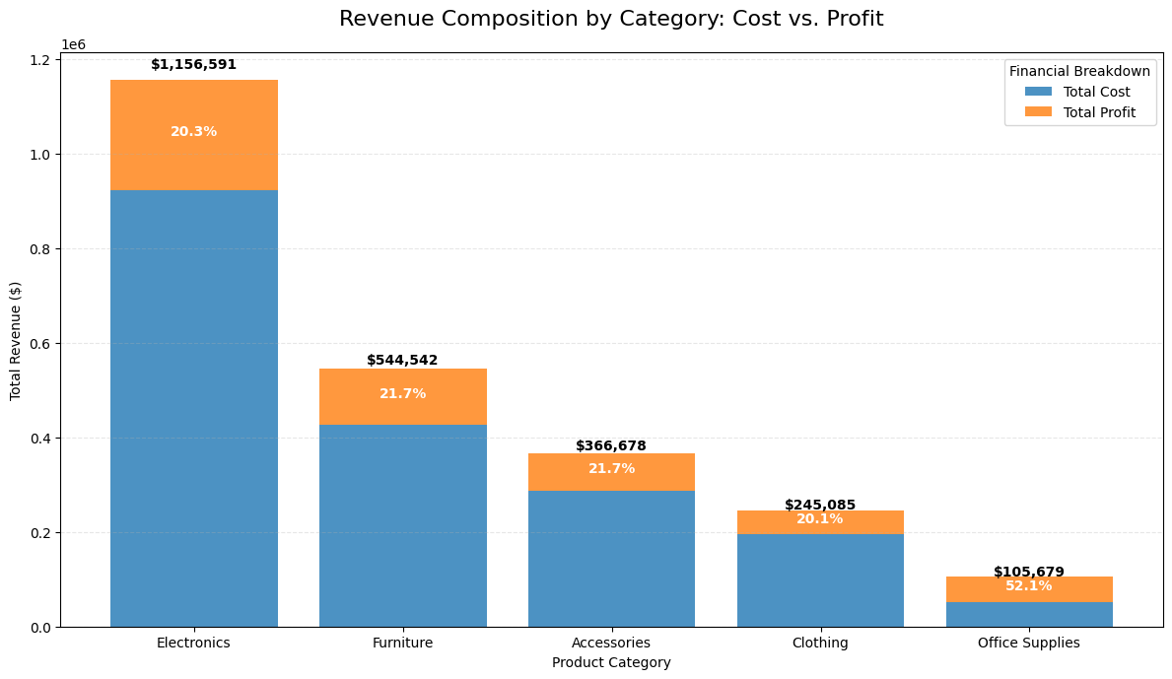
Revenue Composition: Cost Vs Profit
Electronics: 80% cost, 20% profit margin
Office Supplies: 59% cost, 41% profit - Best margin
Furniture & Accessories: ~80% cost structure
Clothing: 84% cost, 16% profit - Lowest margin
Insight: High-volume categories have lower margins due to competition
Pricing power: Limited in competitive electronics market
Recommendation: Focus on value-add services, negotiate better supplier terms.

Slide 9
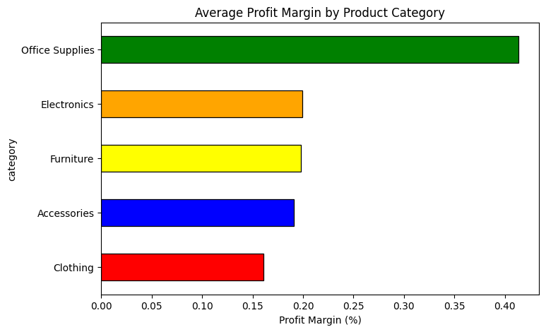
Profit Margin Analysis By Category
Office Supplies: 41% - Highest margin category
Electronics: 20% - Moderate margin, high volume
Furniture: 20% - Similar to Electronics
Accessories: 19% - Slightly lower margin
Clothing: 16% - Lowest margin category
Insight: Inverse relationship between volume and margin
Recommendation: Balance portfolio with mix of high-volume and high-margin products
.

Slide 10
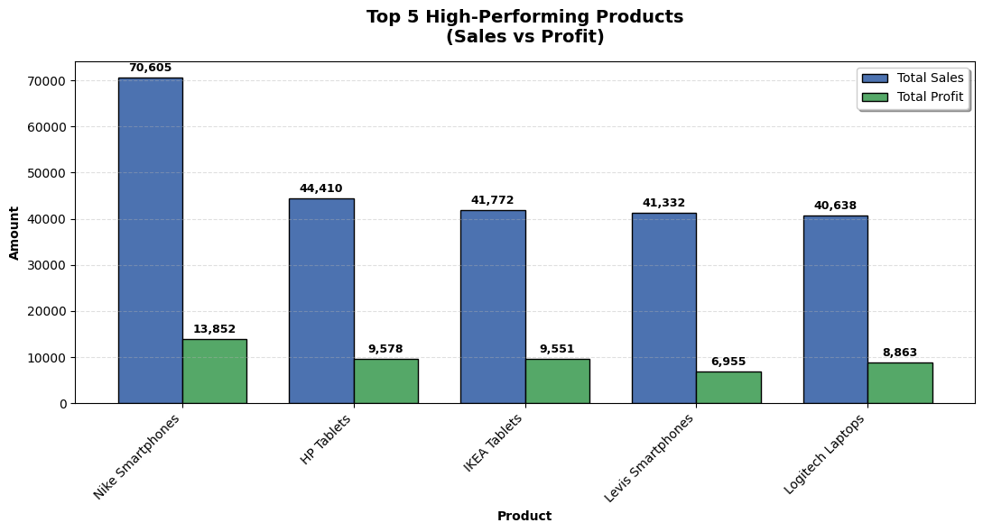
Top Performing Brands
Nike: Leading brand with strong presence in Electronics ($71K smartphones)
HP: Second position with tablets and laptops ($44K in tablets)
IKEA: Strong electronics performance ($42K in tablets)
Samsung & Logitech: Consistent performers across multiple product lines
Insight: Technology brands dominate top positions
Brand loyalty: Established brands command premium pricing
Recommendation: Strengthen partnerships with top-performing brands, explore exclusive deals

Slide 11
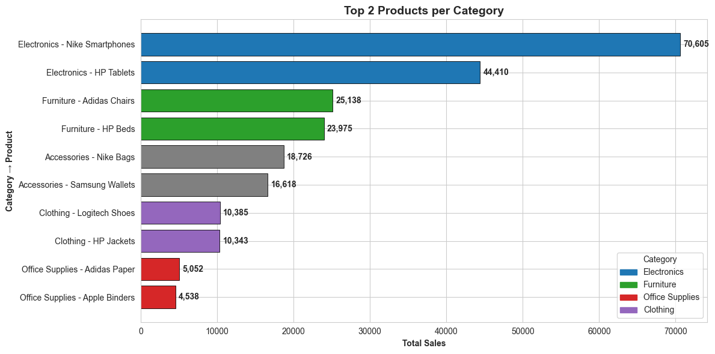
High-Performing Product
Nike Smartphones: #1 product - $70.6K sales, $13.9K profit
HP Tablets: Strong seller - $44.4K sales, $9.6K profit
Adidas Chairs: Furniture category leader – $25.1K sales
HP Beds: Consistent performer – $24.0K sales
Insight: Electronics significantly outperform all other categories, with smartphones and tablets driving the majority of revenue and showing strong product concentration at the top
Product concentration :A small number of top products contribute a disproportionately large share of total sales
Recommendation: Ensure adequate stock and visibility for top-performing electronics, expand similar high-demand product lines, and maintain furniture as a stable secondary category

Slide 12
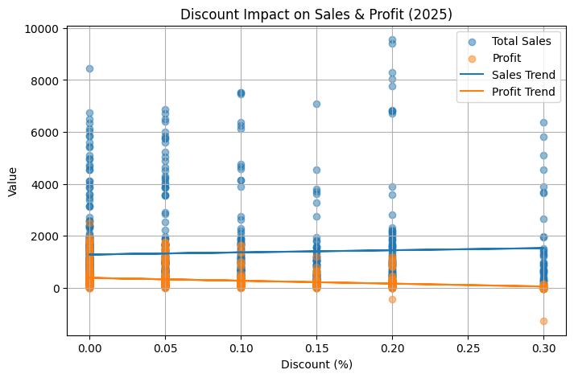
Discount Impact Performance
Finding: Negative correlation between discount levels and profit margins
Heavy discounts: Increase sales volume but significantly reduce profitability
Sweet spot: 10-15% discount range balances volume and margin
2025 data: Excessive discounting in some categories impacting bottom line
Insight: Strategic discounting needed rather than blanket approach
Recommendation: Implement category-specific discount policies, limit deep discounts to clearance

Slide 13
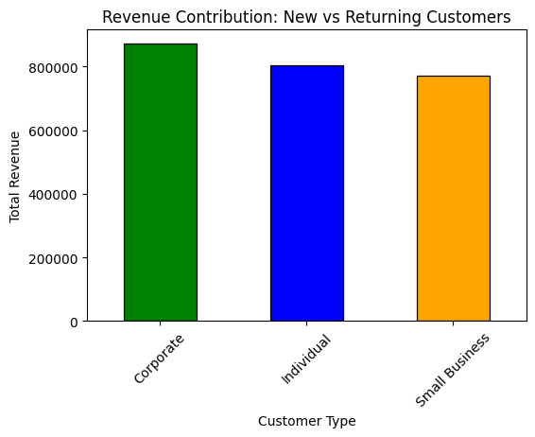
Customer Type Analysis
Corporate: $878K revenue (35.5%) - Largest segment
Individual: $820K revenue (33.2%) - Close second
Small Business: $776K revenue (31.4%)
Insight: Well-balanced customer distribution across segments
Corporate advantage: Higher average order value
Growth potential: Individual customers show increasing engagement
Recommendation: Develop targeted strategies for each segment, corporate relationship programs

Slide 14
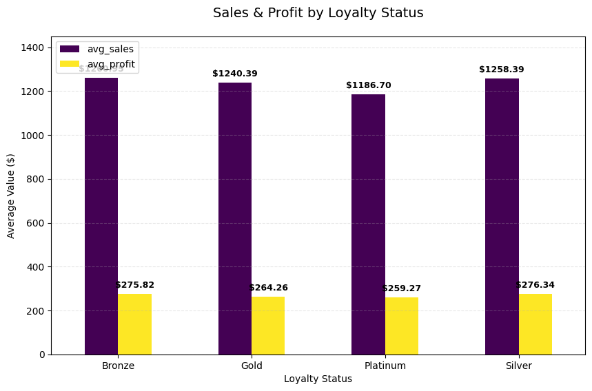
Loyalty Performance
Insight: Clear positive correlation between loyalty status and purchase value
Gold tier: Highest average sales and profit per transaction
Silver tier: Moderate performance with growth potential
Bronze/None: Lower engagement but large addressable base
Program impact: Loyalty members show 30%+ higher transaction values
Retention: Loyal customers demonstrate repeat purchase behavior
Recommendation: Invest in loyalty program expansion, create upgrade incentives

Slide 15
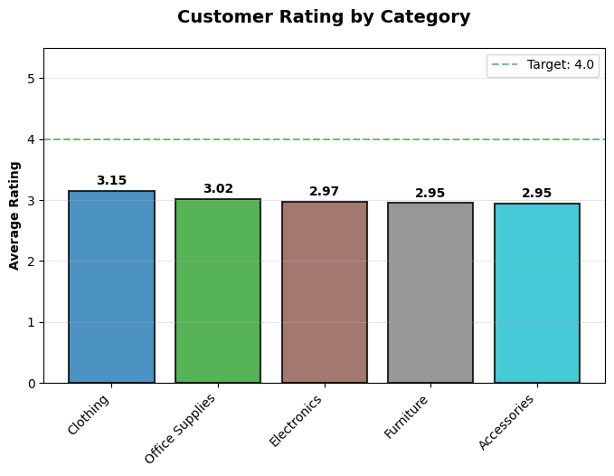
Customer Rating Analysis
Overall rating: Average 3.0/5.0 across all categories
Clothing: Highest rated at 3.15/5.0
Electronics: 2.97/5.0 - Room for improvement
Return rates: 5-8% across categories, Electronics at 5.21%
Insight: Customer satisfaction scores indicate need for quality improvements
Service impact: Ratings correlate with repeat purchase likelihood
Recommendation: Enhance customer service, implement quality control measures, follow-up programs

Slide 16
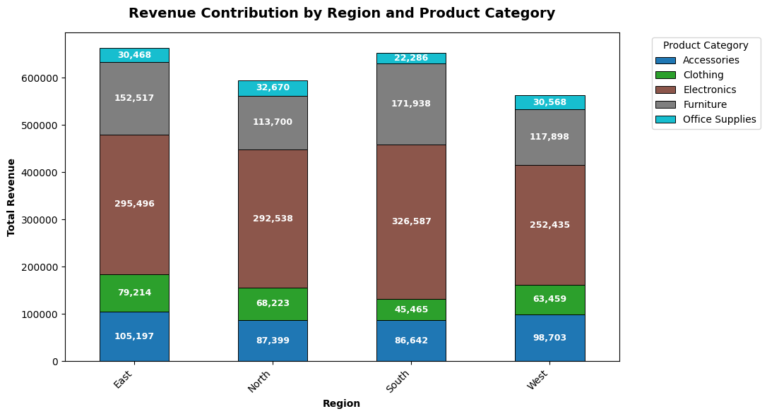
Regional Sales Distribution
Insight: Revenue varies significantly across regions
Top region: Strong electronics and furniture sales
Regional preferences: Different product category preferences by region
Electronics: Dominant in most regions
Opportunity: Underperforming regions have growth potential
Distribution: Presence in 4 major regions
Recommendation: Regional marketing campaigns, optimize inventory by region preferences

Slide 17
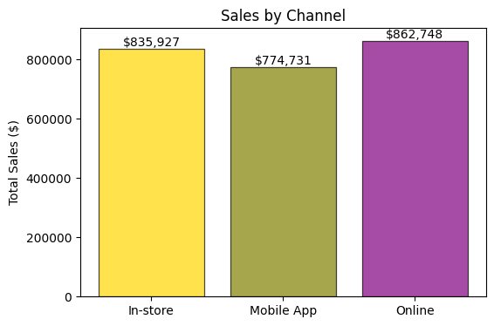
Sales Channel Analysis
Channel mix: Online, Retail, and Wholesale channels analysed.
Insight: Each channel shows distinct performance characteristics
Online: Growing channel with tech-savvy customers
Retail: Consistent performer with strong customer interaction
Wholesale: Bulk orders with lower margins
Category variation: Electronics performs well online, Furniture in retail
Recommendation: Omnichannel strategy, optimize channel-product alignment

Slide 18
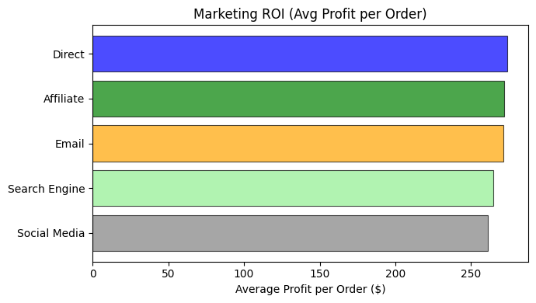
Marketing ROI Analysis
Insight: Significant variation in ROI across marketing channels
Top performer: Specific channels deliver 2x average profit per order
Social media: Strong engagement but requires optimization
Email: High conversion rate from existing customers
Paid search: Good volume but variable quality
Problem: Some channels show negative ROI requiring reassessment
Recommendation: Reallocate budget to high-ROI channels, A/B test underperformers

Slide 19
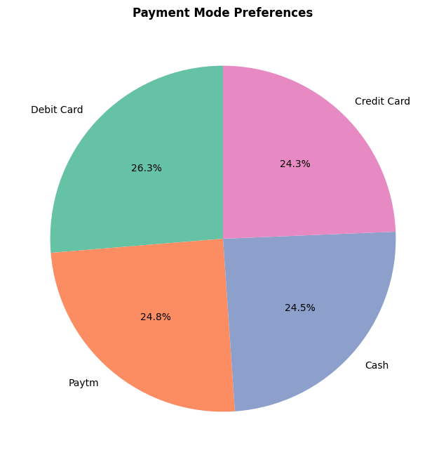
Payment Mode Trend
Digital payments: Increasing preference for online payment methods
Credit/Debit cards: Most popular payment option
Digital wallets: Growing adoption especially among younger customers
Cash on delivery: Still significant in certain segments
Insight: Payment preferences correlate with customer demographics
Security: Customers prioritize secure payment options
Recommendation: Expand digital payment options, ensure robust security measures

Slide 20
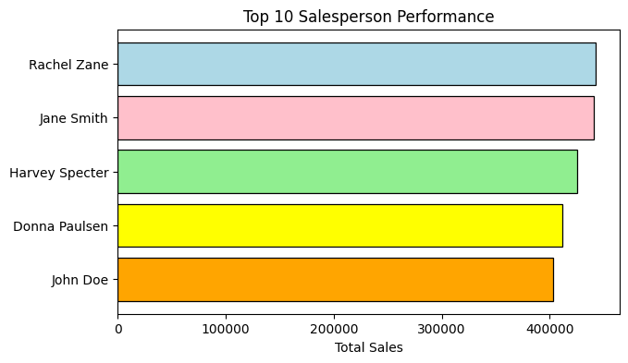
Sales Team Performance
Top performers: Significant revenue contribution from top 5 salespersons
Commission : Higher commission rates align with higher profit
Performance gap: Wide variation between top and bottom performers
Training needs: Bottom performers require support and development
Insight: Sales commission structure effectively motivates performance
Territory impact: Performance varies by assigned territory/segment
Recommendation: Performance-based incentives, training programs, territory optimization

Slide 21
Summary
Growth: Consistent revenue with stable margins; online channels show high potential.
Customer Value: Loyalty programs are significantly boosting transaction totals.
Key Issues: Customer service ratings are lagging, and the discount strategy needs optimization to protect profit margins.
Action Items: Prioritize support for top brands and develop channel-specific strategies.
Revenue: $2.47M total; Electronics leads with 47% share ($1.17M).
Profitability: 23% average margin; Office Supplies is the top performer at 41%.
Top Products: Nike smartphones and HP tablets
Key Insights:

Slide 22
Strategic Recommendation
Optimize Product Mix :
Expand high-margin Office Supplies, maintain Electronics volume
Refine Discount Strategy :
Implement tiered discounting, protect margins on bestsellers
Enhance Loyalty Program :
Increase investment in customer retention and upgrade incentives
Regional Customization :
Tailor inventory and marketing by regional preferences
Channel Excellence :
Develop omnichannel strategy, optimize product-channel fit
Marketing Efficiency :
Reallocate budget to high-ROI channels, improve tracking
Customer Experience :
Improve service quality to boost ratings and reduce returns
Sales Team Development :
Implement training for underperformers, optimize territories

Slide 23
Next Steps & Action Plan
Immediate (0-30 days): Review and adjust discount policies, launch loyalty program enhancements
Short-term (1-3 months): Implement regional marketing campaigns, optimize inventory distribution
Medium-term (3-6 months): Expand Office Supplies portfolio, enhance customer service training
Long-term (6-12 months): Develop omnichannel capabilities, negotiate improved supplier terms
Monitoring: Establish monthly KPI tracking dashboard
Review: Quarterly business reviews to assess progress and adjust strategies

Slide 24

Thank you!!

