Slide 1
DATA ANALYTICS PROJECT
Steel Industry
Electricity Usage
Analysis
Understanding energy patterns to drive smarter operations, reduce costs & build a sustainable future
By : Mahalakshmi
Mentor : Mrs. Priya Shanmugam
Batch : DA644S64
Steel Industry | Energy & Sustainability | 2025

Slide 2
Problem Statement & Objectives
PROBLEM STATEMENT
The steel manufacturing industry is one of the largest consumers of electrical energy. Managing energy consumption efficiently is critical for both cost reduction and environmental sustainability. This project analyses electricity usage patterns across different times of the day, week, and load conditions — to uncover what drives high energy consumption and how it can be better managed.
📊 Understand Usage Patterns
🔢 Explore Possible Scenarios
🧪 Validate Business Assumptions
Find out how often high electricity usage happens and which hours/months are most expensive.
Identify all possible combinations of load types, day types and shifts to plan operations better.
Test if weekday vs weekend usage is truly different to guide smart energy contracts.
🔧 Prepare Data for Modelling
📈 Predict Electricity Usage
🔵 Group Usage Behaviour
Clean, encode and scale data so that machine learning models work accurately.
Build a model that forecasts kWh usage so the company can plan ahead.
Cluster usage into groups (High/Medium/Low) to create targeted energy-saving strategies.
Steel Industry Electricity Consumption | ML Analysis Project

Slide 3
Dataset Overview
Steel industry electricity data — 1 full year of hourly readings
35,040
15
0
3
Total Records
Features
Missing Values
Load Types
Hourly readings for 1 year
Usage, CO2, Power Factor, Load Type…
Dataset is complete — no gaps
Light / Medium / Maximum Load
Key Features in the Dataset
Usage_kWh
How much electricity was used in that hour
CO2(tCO2)
Carbon emissions directly linked to electricity use
Lagging / Leading Reactive Power
Measures of electrical load quality and type
Lagging / Leading Power Factor
Efficiency of electricity usage — lower = more waste
NSM (Number of Seconds from Midnight)
Captures exact time of recording in the day
WeekStatus
Whether the day is a weekday or weekend
Day_of_week
Which specific day of the week it is
Load_Type
Category of usage: Light / Medium / Maximum Load
Hour / Day / Month
Time-based features for pattern analysis
High_Usage
Yes/No flag — is this hour a high-usage period?
Steel Industry Electricity Consumption | ML Analysis Project

Slide 4
Data Preprocessing
BASIC PREPROCESSING
ML PREPROCESSING
1
No Missing Values
1
Feature Encoding
All 35,040 records were complete — no gaps or empty fields found.
Text columns like 'Load Type' and 'Day of Week' were converted into numbers so the model can understand them.
2
No Duplicates
2
Feature Scaling
Every reading was unique — no repeated entries in the dataset.
All values were brought to the same scale so that no single factor dominates the model.
3
Date Conversion
3
Multicollinearity Check
Dates were converted from text into proper date-time format for analysis.
Checked for features that were too similar to each other, which can confuse the model.
4
Feature Extraction
4
Train-Test Split
Hour, Day, and Month were extracted from the date for time-based analysis.
Data was split into training (80%) and testing (20%) sets to evaluate model performance.
5
New Column Created
5
Outlier Handling
A 'High_Usage' flag was added to mark readings above average electricity use.
Extreme values in electricity usage were identified — they were kept as they reflect real peak events.
6
Data Export
6
Correlation Analysis
Cleaned data was saved as a preprocessed file for further ML analysis.
Strong connection found: CO₂ (0.99) and Reactive Power (0.9) closely track Usage_kWh.

Slide 5
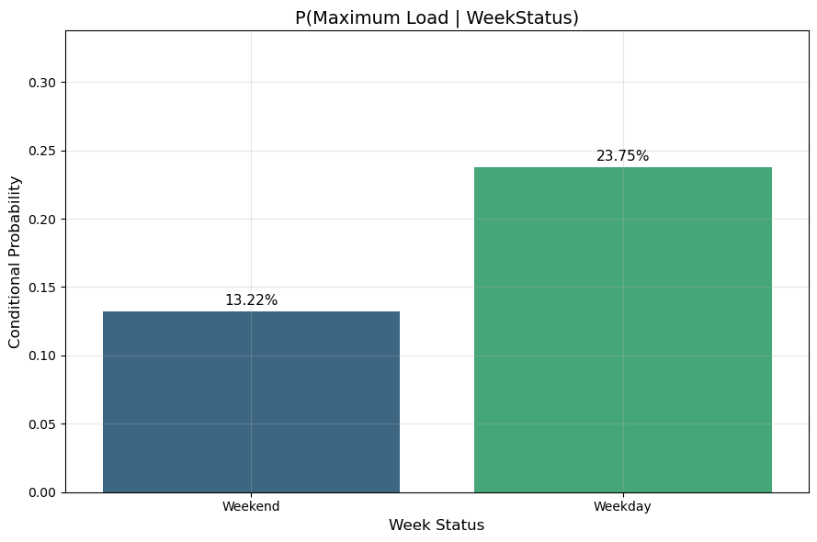
Week wise load comparison
INSIGHTS
Weekend: 13.22% chance of Max Load. Weekday: 23.75%. Max load events are nearly twice as likely on weekdays, confirming operational differences across day types.
💼 BUSINESS INSIGHTS
Max Load probability on weekends: ~13.2% vs ~23.8% on weekdays
Weekends allow for lower-cost, lighter operations
Schedule maintenance or non-critical tasks on weekends
Load shifting from weekdays can reduce peak costs significantly
Steel Industry Energy Consumption Analysis

Slide 6
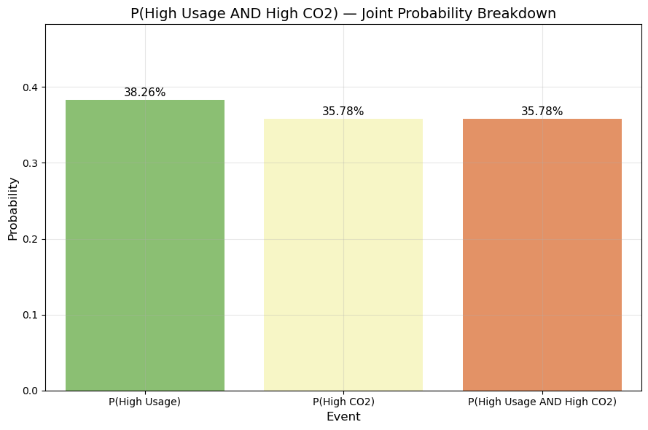
High Usage AND High CO2
💼 BUSINESS INSIGHT
Peak usage drives emissions
Reduce peak load to reduce CO₂ emission
Focus on peak-hour optimization
Use renewables during high demand
Demand forecasting = emission forecasting
📊 STATISTICAL INSIGHT
P(High Usage) = 38.26% > P(High CO₂) = 35.78%
P(High Usage AND High CO₂) ≈ 35.78% → almost equal to High CO₂
Strong dependency: High CO₂ mostly occurs during high usage
P(High CO₂ | High Usage) ≈ 93.5%
Steel Industry Energy Consumption Analysis

Slide 7
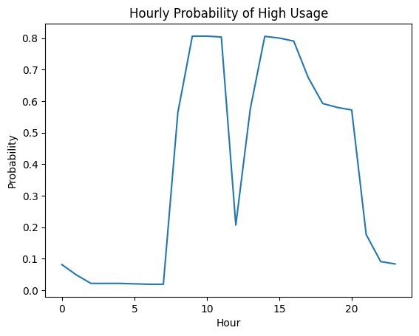
How Often Does High Electricity Usage Happen?
Probability analysis — understanding the frequency of costly consumption periods
38.3%
of all hours are
High Usage hours
61.7%
of all hours are
Normal / Low usage
~4 in 10
hours cost more — every single day
💡 Peak electricity usage is highest between 9 AM – 3 PM. Shifting heavy tasks to early morning or late evening can save significantly.
💡 Late night (2 AM – 6 AM) shows nearly 0% high usage — a perfect window for scheduling energy-intensive maintenance or batch jobs at lower cost.
Steel Industry Electricity Consumption | ML Analysis Project

Slide 8
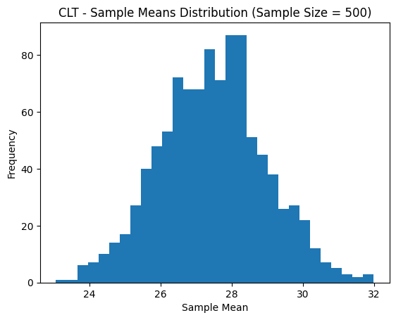
CLT
Central Limit Theorem — Sample Means Distribution
Interpretation
With 1,000 samples of size 500, the distribution of sample means forms a near-perfect bell curve centered around 27–28 kWh, validating CLT for this dataset.
Business Insights
Population data is right-skewed; sample means are normal
CLT enables valid use of t-tests and z-tests on this data
Mean of sample means ≈ true population mean (~27–28 kWh)
Foundation for all parametric hypothesis tests in this project
Steel Industry Energy Consumption Analysis

Slide 9
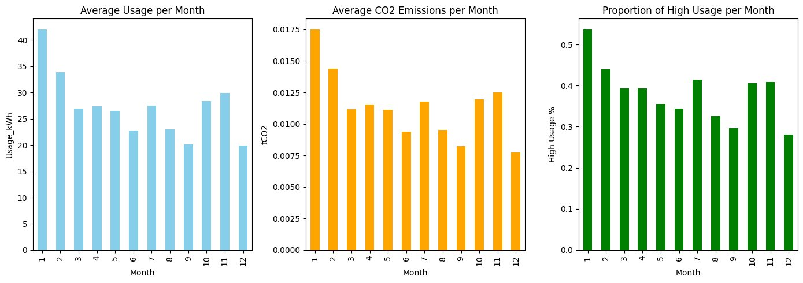
When Is Electricity Usage Highest Across the Year?
Monthly patterns reveal seasonal peaks and planning opportunities
💡 January is the most expensive month — highest average usage (~42 kWh) AND highest CO2 emissions. Plan for extra energy budget in Q1 every year.
💡 August–September are the cheapest months (~20–23 kWh). Schedule energy-heavy projects in summer to reduce annual costs.
💡 January shows the highest proportion of high-usage hours (~53%). Negotiate seasonal energy contracts before winter starts.
Steel Industry Electricity Consumption | ML Analysis Project

Slide 10
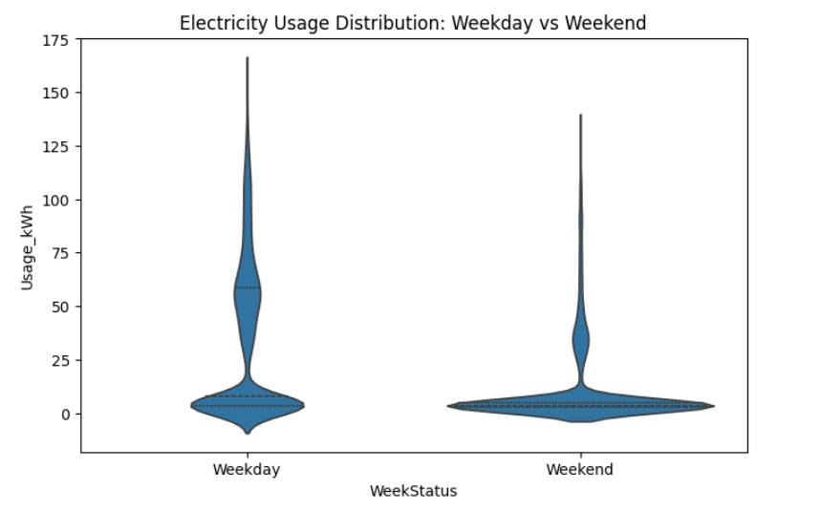
Weekday vs Weekend Electricity Usage Is electricity usage different between weekdays and weekends ?
Weekday usage significantly higher than weekend.
Nearly 3× increase in average consumption.
Greater variability observed on weekdays
T-test p-value < 0.001 → Statistically significant difference

Slide 11
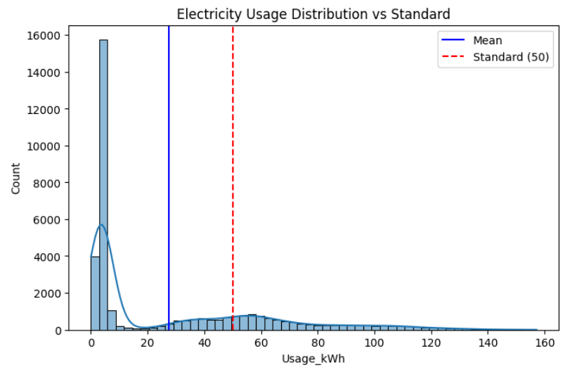
Electricity Usage vs Standard Benchmark Is the average electricity usage significantly different from a standard level?
Average usage ≈ 27.9 kWh (well below standard).
Most values concentrated below 50 kWh.
Right-skewed distribution with few high usage spikes
Z-test p-value < 0.001 → Significant difference from standard
Mean line (≈ 27.9)
Standard line (50 kWh)

Slide 12
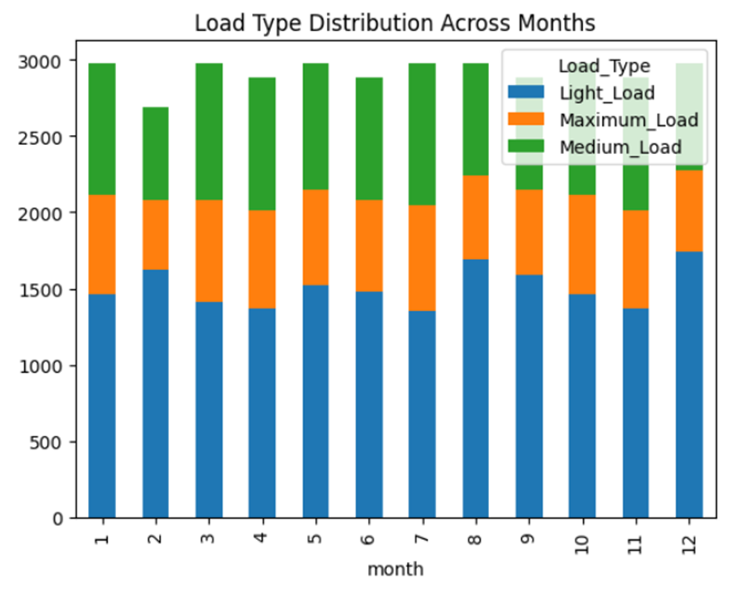
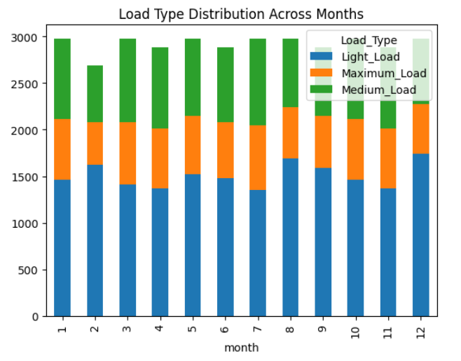
Load Type Variation Across Months Is load type dependent on month?
Load type distribution varies across different months.
Indicates time-based changes in electricity demand.
Suggests presence of seasonal consumption patterns.
Supports better demand forecasting and seasonal resource planning
Chi-square p-value < 0.001 → Load type depends on month

Slide 13
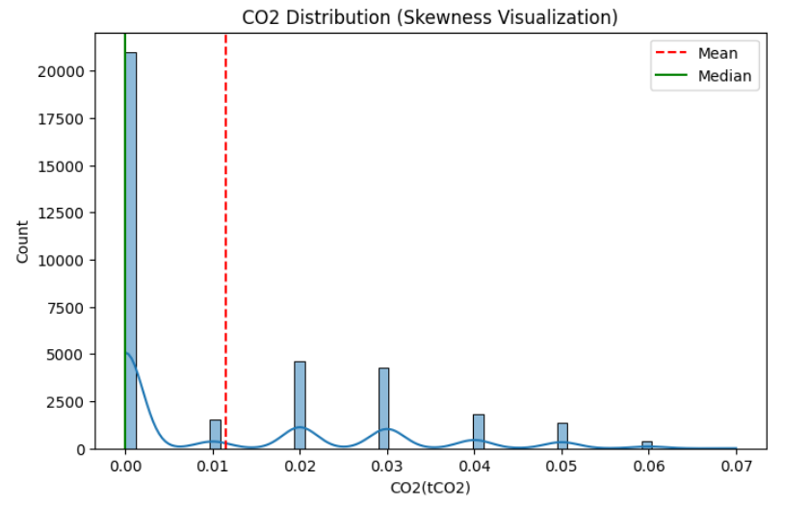
CO2 Emission Distribution Analysis
CO2 values are highly right-skewed.
Most observations are near low emission levels.
Few extreme values create long tail
Normality test p-value < 0.001 → Data is not normally distributed

Slide 14
Model Building – Linear Regression
Model Used: Multiple Linear Regression Target Variable: Usage_kWh
Key Drivers: CO2 → Strong positive relationship Lagging Current Power → High impact High Usage Flag → Significant predictor
Preprocessing Steps: One-hot encoding for categorical variables Feature scaling applied Train-test split (80:20)

Slide 15
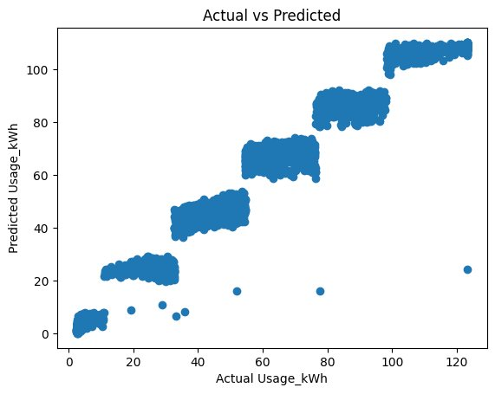
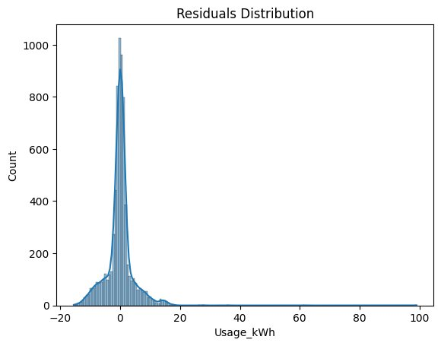
Predicting Exactly How Much Electricity Will Be Used
Forecasting kWh consumption — model performance & results
98%
±4.5 kWh
±2.8 kWh
Accuracy (R²)
Average Error
Typical Error
Model explains 98% of all variation
Predictions off by ~4.5 kWh on average
Most predictions within 2.8 kWh
Predicted vs Actual Usage — points follow the diagonal = accurate
Error distribution — bell curve centred at zero = unbiased model
💡 The model predicts electricity usage with 98% accuracy. Errors are small and unbiased — trustworthy enough for procurement planning and cost forecasting.
Steel Industry Electricity Consumption | ML Analysis Project

Slide 16
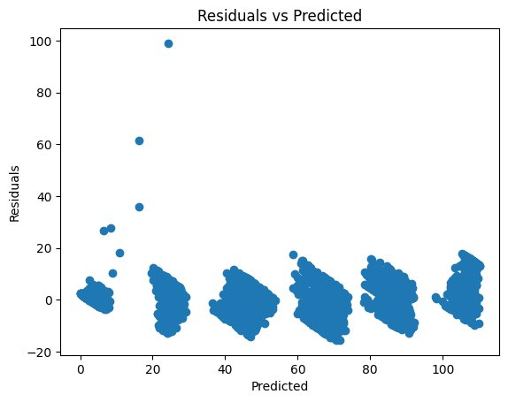
Is Our Prediction Model Working Correctly?
Checking that the model's errors are small, random and unbiased
Reading This Chart
Errors should look random
If the model is good, gaps between predicted and actual values should have no pattern — just random scatter.
No big systematic bias
The model should not always over-predict or under-predict. Errors should be balanced above and below zero.
What the chart confirms
Most errors cluster tightly around zero across all predicted values — the model is well-behaved and reliable.
A few outliers at low values
A few high errors appear at very low usage values (unusual operating conditions). These don't affect overall quality.
💡 The residuals chart confirms our prediction model is working correctly — errors are small and random, meaning forecasts are reliable for operational planning.
Steel Industry Electricity Consumption | ML Analysis Project

Slide 17
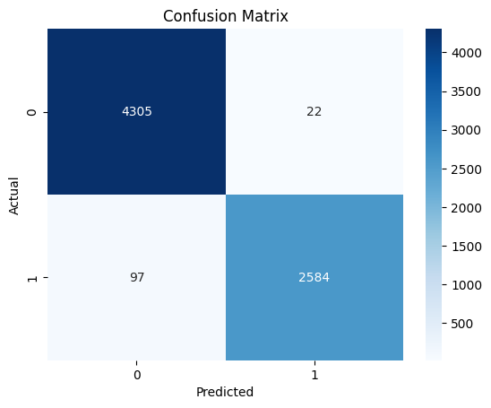
Predict high-cost electricity hours to reduce operational energy expenses and improve planning.
Classification model — identifying expensive hours in advance
98%
99%
96%
98%
1.00
Accuracy
Precision
Recall
F1 Score
AUC Score
The logistic regression model demonstrates excellent performance in identifying high-cost electricity usage hours. With an accuracy of 98% and a near-perfect ROC-AUC score of 1.00, the model can clearly distinguish between normal and high-usage periods.
The high precision (99%) indicates that alerts for high-cost hours are highly reliable, while the strong recall (97%) shows that most expensive periods are successfully detected with minimal misses. The confusion matrix further confirms that both false alarms and missed high-cost hours are very low.
From a business perspective, this means the model can be confidently used as a real-time decision support tool. It enables the company to anticipate high electricity usage in advance, take preventive actions, and optimize operational scheduling.
.

Slide 18
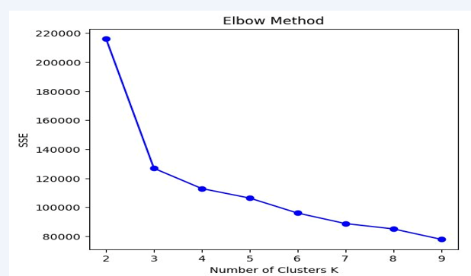
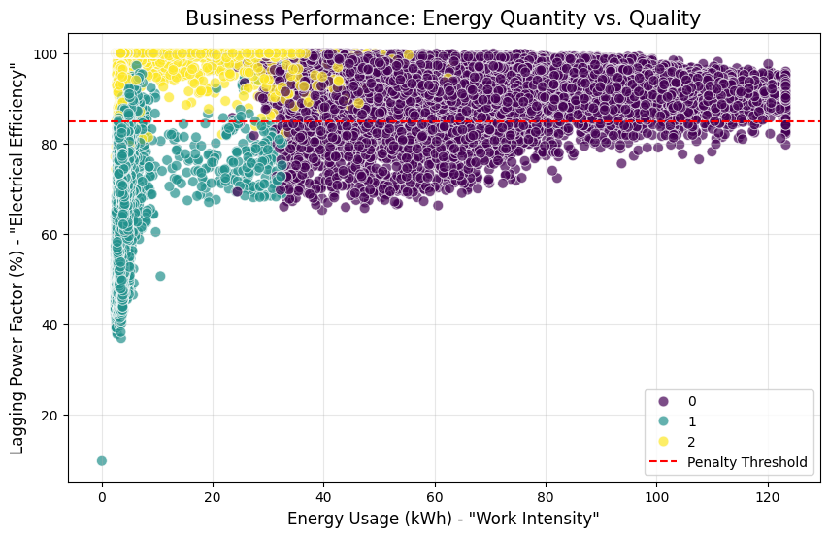
To identify distinct electricity usage patterns for better operational and energy management
Interpretation
The clustering model successfully identifies three distinct patterns of electricity usage, representing different operating conditions of the factory.
Cluster 1 (High Usage) → High energy consumption (~67 kWh) → Represents peak production hours with highest cost
Cluster 2 (Low Usage) → Very low consumption (~4 kWh) → Indicates idle or low-activity periods (night/weekend)
Cluster 3 (Medium Usage) → Moderate consumption (~8 kWh) → Reflects partial operations or transition periods
The evaluation metrics support the quality of clustering:
Silhouette Score (~0.44) → Good separation between clusters
Calinski-Harabasz (High) → Strong cluster structure
Davies-Bouldin (~0.95) → Low overlap between clusters
The scatter plot further shows a clear relationship between:
Energy Usage (quantity) and
Power Factor (efficiency)
👉 High usage is often linked with lower efficiency, indicating potential energy waste.

Slide 19
CONCLUSION & SUMMARY
What We Learned — and What It Means for the Business
⚡
High usage is frequent — 38% of all hours
🗓️
January is the most expensive month
Nearly 4 in 10 hours hit expensive peak levels. This is not occasional — it needs a systematic management strategy.
Winter brings the highest usage and CO2. Seasonal planning and energy contracts should focus on Q1.
🎯
Prediction accuracy is outstanding — 98%
🔔
High-usage hours can be predicted perfectly
The model predicts electricity usage within ±4.5 kWh, providing sufficient accuracy for planning and budgeting.
The classifier consistently identifies high-cost hours, enabling real-time alerts and proactive cost optimization..
📦
Three operating modes exist naturally
💡
Weekdays are significantly costlier than weekends
High / Medium / Low usage groups each need their own energy strategy — one-size-fits-all doesn't work.
Proven by testing — negotiate cheaper weekend tariffs and shift heavy loads to weekends where possible.
Steel Industry Electricity Consumption | Conclusion

Slide 20
Suggestions & Way Forward
Turning insights into action — what the company should do next
Right Now
Next 3–6 Months
6–12 Months
Immediate Actions
Short-Term Improvements
Long-Term Strategy
1
Avoid expensive hours
→ Shift production away from peak time to cut costs immediately.
1
Create different strategies for High / Medium / Low usage → Don’t treat all operations the same — optimize each.
1
Improve forecasting for better planning → Predict usage in advance to control spending.
.
Use night shifts for heavy operations → Run energy-heavy work when electricity is cheapest.
Reduce energy waste (improve efficiency) → Lower electricity bills without reducing output.
2
2
2
Buy electricity smarter → Use predictions to purchase energy at lower prices.
3
Negotiate better contracts for winter (January) → Lock prices early to avoid high seasonal costs.
3
Track electricity usage daily → Use a dashboard to monitor and control costs in real time.
3
Set cost & sustainability targets → Reduce both electricity cost and carbon emissions together.
🎯 Goal: Reduce electricity costs by 15–20% in Year 1 through smart scheduling, live alerts and seasonal planning.
Steel Industry Electricity Consumption | ML Analysis Project

Slide 21
Thank You
Steel Industry Energy Consumption Analysis

