Slide 1
SkillMatch: Resume Matcher and Skill Recommender
A project by :
Ashish kumar Yadav
sharvil m titarmare
Mahalaskshmi krishnamurthi
seela Harshitha
jaswanth ponnekanti

Slide 2
AGENDA :
Problem
Our Solution
Project Objectives
System Architecture
Core Modules
Technology Stack
Platform Walkthrough (Demo)
Results
Conclusion & Future Scope

Slide 3
Problem:
Recruiters are overwhelmed. Manual screening is inefficient and flawed.
Excessive Time: Manually reviewing hundreds of resumes is a significant time drain, leading to delays in hiring.
Human Bias: Unconscious biases related to name, gender, or background can influence screening, leading to a less diverse talent pool.
Inaccuracy: Manual reviews can lead to mismatches between candidate skills and actual job requirements.
Lack of Personalization: Generic Applicant Tracking Systems (ATS) often rely on simple keyword matching, missing qualified candidates who use different terminology.

Slide 4
Solution:
SkillMatch is an AI-powered platform designed to automate and intelligently streamline the recruitment process.
By leveraging Natural Language Processing (NLP) and Machine Learning (ML), SkillMatch:
Parses and understands resumes contextually.
Matches candidates to job descriptions based on skills, experience, and education.
Provides a quantitative compatibility score to rank candidates.
Reduces bias, saves time, and improves hiring accuracy.
(Image similar to the application's clean UI, perhaps the login screen)

Slide 5
Project Objectives:
Our primary goals for SkillMatch were to:
Automate resume parsing and skill extraction using NLP.
Match candidates with job descriptions using ML-based similarity scoring.
Reduce human bias in the initial screening phase.
Provide recruiters with a ranked list of the most suitable candidates.
Enhance job seekers’ chances by highlighting skill-job alignment and areas for improvement.

Slide 6
System Architecture:
Our platform follows a robust, end-to-end process flow:
Resume Input (PDF/DOCX)
Text Preprocessing (Tokenization, Stop-word removal)
Skill & Entity Extraction (NLP Models)
Job Description Analysis
Feature Vector Generation (TF-IDF, Word Embeddings)
Matching Algorithm (Cosine Similarity / ML Ranking)
Compatibility Score & Candidate Ranking
Recruiter Dashboard Output

Slide 7
Core Modules:
SkillMatch is built on a modular architecture:
Resume Parser: Extracts raw text and structured data from various resume formats.
NLP Processor: The brain that identifies and categorizes skills, education, and work experience.
Job Analyzer: Deconstructs job descriptions to pinpoint key requirements and desired skills
Matching Engine: Calculates a detailed compatibility score between the candidate's profile and the job role.
Dashboard & AI Advisor: An intuitive interface for users to view results, get recommendations, and interact with an AI assistant.

Slide 8
Technology Stack :
We used a modern, powerful technology stack to build SkillMatch:
Frontend: React.js
Backend: Django / Flask
Database: PostgreSQL / MongoDB
AI / ML / NLP: spaCy, scikit-learn, Transformers (BERT)
Deployment: AWS / Microsoft Azure

Slide 9
Platform Walkthrough:
Dashboard :
The central hub for all your activities. Get a quick overview of uploaded resumes, completed analyses, and your average match score.
Upload & Analyze :
Step 1: Upload Resumes
Easily drag & drop or select resume files. The system automatically extracts skills and makes them ready for analysis.
Step 2: Enter Job Details
Paste the complete job description to ensure the most accurate analysis and skill matching.

Slide 10
Analysis Results :
Get an instant, data-driven overview of the candidate-job fit. The 32% Match score indicates a clear need for improvement.
Detailed Score Breakdown Dive deeper into how the score is calculated across Technical Skills, Experience, Education, and Semantic Match.
Skills Comparison :
Clearly visualize which required skills were found on the resume and which are missing. This allows for targeted feedback and interview questions.
Actionable Recommendations :
ATS Optimization Feedback: Receive specific keywords to add to a resume to improve its compatibility with traditional Applicant Tracking Systems.
Learning Recommendations: The platform suggests relevant online courses to help candidates fill their skill gaps.
AI Skill Advisor :
An integrated AI chatbot provides personalized guidance. Users can ask about their results, explore career paths, or get tips on how to improve their match score.

Slide 11
Results:
Efficiency Boost: Reduced manual resume screening time by approximately 60%.
Higher Accuracy: Achieved superior accuracy in skill extraction compared to traditional keyword-based ATS.
Data-Driven Decisions: Provided recruiters with a clear, ranked list of candidates, enabling them to focus on the best-fit talent first.
Format Versatility: Successfully parsed and analyzed resumes across multiple formats, including PDF and DOCX.

Slide 12
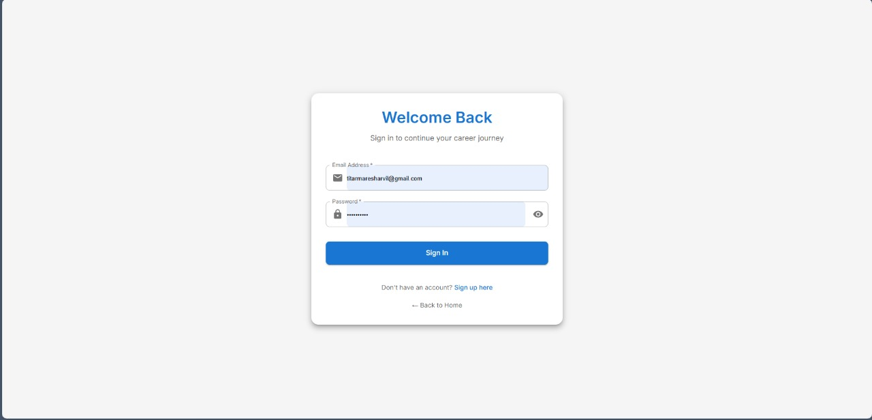
Results:

Slide 13
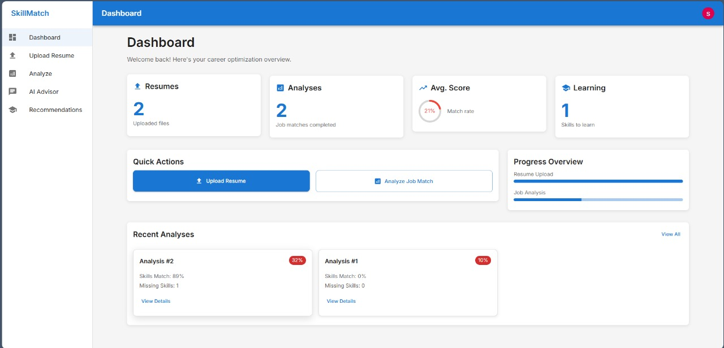
Results:

Slide 14
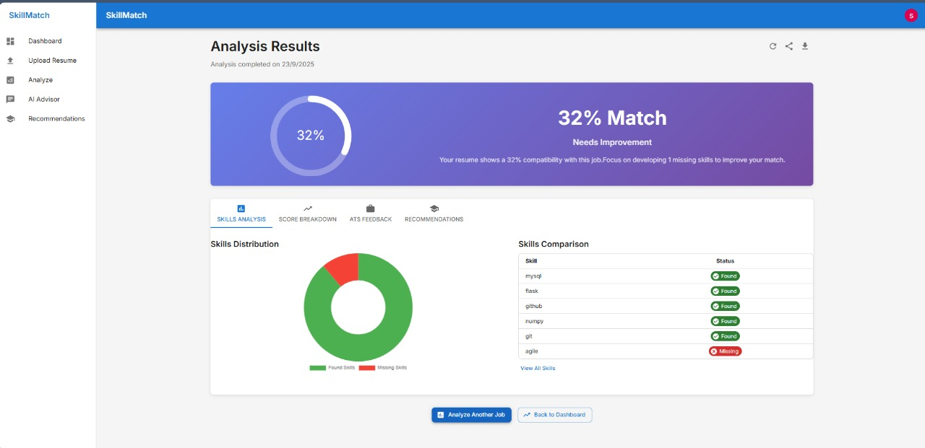
Results:

Slide 15
Conclusion :
SkillMatch effectively automates and optimizes the resume screening process.
It provides a smart, unbiased, and efficient solution for recruiters, while empowering candidates with actionable feedback to advance their careers.

Slide 16
Future Scope :
AI-Powered Scheduling: Integrate chatbots for automated interview scheduling.
Advanced Contextual Matching: Use deep learning models like BERT and GPT for even more nuanced skill matching.
Global Expansion: Add support for multilingual resumes and international job markets.
Upskilling Platform: Develop a recommendation system that suggests skills to learn based on market demand.

Slide 17
THANK YOU

