Slide 1
PRESENTED BY:
Mahalakshmi. K
B. e. - computer science & engineering (3rd year)
University college of engineering ,Villupuram.
Register no.: 422521104020
NM iD : 38550A3FB5217DCB5834E3F456EFA7BD

Slide 2

A DEEP LEARNING APPROACH TO MOVIE RECOMMENDATION SYSTEMS USING MATRIX FACTORIZATION
Project TITLE

Slide 3


AGENDA
PROBLEM STATEMENT
PROJECT OVERVIEW
WHO ARE THE END USERS
OUR SOLUTIONS ND ITS VALUE PROPORTION
THE WOW IN OUR SOLUTION
MODELLING
RESULTS
CONCLUSION

Slide 4

PROBLEM STATEMENT
Current movie recommendation systems often have limitations. Collaborative filtering struggles with new users, while content-based filtering might miss user preferences or inadequately represent new movies .This project addresses these issues by developing a deep learning approach with matrix factorization.
Deep learning can uncover hidden factors influencing user preferences and movie characteristics. Matrix factorization allows the model to make accurate recommendations even for new users or unrated movies.
By overcoming limitations and leveraging deep learning and matrix factorization, this project aims to create a robust and personalized movie recommendation system.

Slide 5
PROJECT OVERVIEW
Recommending movies that users will enjoy is a crucial aspect of streaming services, rental platforms, and other movie recommendation systems. Traditional approaches often fall short:
Collaborative filtering: Struggles with new users.
Content-based filtering: May overlook user preferences or inadequately represent new movies.
This leads to irrelevant recommendations and a frustrating user experience.
Deep Learning for Recommendations: Deep learning uncovers complex patterns in user data, enabling more accurate and personalized recommendations.

Slide 6
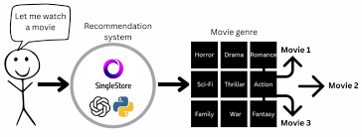
Matrix Factorization: Matrix Factorization breaks down user-movie rating matrices into user and movie factors. User factors capture user preferences, while movie factors capture movie characteristics. This allows the model to recommend movies based on these factors, even for unseen interactions.
Project Objective: Build a movie recommender using deep Matrix Factorization, combining deep learning's pattern recognition and Matrix Factorization's efficiency for superior recommendations.

Slide 7

who are the end users
Target Audience: This movie recommendation system is designed for users of streaming services, movie rental platforms, and other platforms offering a vast selection of movies.This encompasses a broad audience, including:
Movie Lovers: Avid movie watchers seeking personalized recommendations.
Casual Viewers: Users who rely on recommendations to discover movies they'll enjoy.
New Users: New platform users who need help finding content they like.
Movie discovery is tough! Too many choices overwhelm users, busy schedules limit browsing time, and irrelevant recommendations waste time. Users crave personalized experiences that help them find movies they'll love.

Slide 8
OUR SOLUTION AND ITS VALUE PROPOSITION
Our Solution : "Deep Matrix Factorization for Movie Recommendations”
This project proposes a deep learning approach with Matrix Factorization to overcome the limitations of traditional recommendation systems. Here's how it works:
User and Movie Embeddings: We create low-dimensional representations of users and movies, capturing their essential characteristics and preferences.
Interaction Layer (Dot Product):This layer captures the interaction between users and movies. Users with similar embeddings are likely to enjoy movies with similar movie embeddings.
Deep Hidden Layers :We can add hidden layers to learn even more complex relationships between users and movies, leading to even more accurate recommendations.

Slide 9
*Output Layer: This layer predicts how much a user would enjoy a movie based on their learned embedding and the movie's embedding.
Value Proposition:
This deep Matrix Factorization approach offers several advantages:
Improved Accuracy & Personalization: Deep learning captures complex user-movie relationships for highly personalized recommendations.
Ability to Capture Complexities: Deep learning identifies subtle patterns and intricate relationships, leading to better recommendations.

Slide 10
THE WOW IN OUR SOLUTION:
Specific Architecture Choice - Unveiling User Preferences with Multi-Layer Architecture:
Our model utilizes a multi-layer architecture with ReLU activation functions in the hidden layers. These layers act like feature extractors, progressively uncovering intricate details about user preferences and movie characteristics. This allows the model to capture subtle nuances that simpler architectures might miss, resulting in highly personalized and accurate recommendations.
Incorporation of Additional Data Sources - Beyond Ratings: Enriching Recommendations with Extra Data:
Our solution goes beyond user ratings. We incorporate additional data sources such as movie genres and director information. This enriches the model's understanding of user preferences and movie characteristics.

Slide 11
Incorporation of Additional Data Sources - Beyond Ratings:Enriching Recommendations with Extra Data:
Our solution goes beyond user ratings. We incorporate additional data sources such as movie genres and director information. This enriches the model's understanding of user preferences and movie characteristics.
For instance, if a user consistently rates comedies highly and shows a preference for directors known for their action films, the model can consider these factors to recommend action comedies, even if the user hasn't explicitly rated such movies before.
This comprehensive approach leads to more insightful and well-rounded recommendations.

Slide 12
MODELING
Dataset Description: The MovieLens 100k dataset serves as a cornerstone for developing and evaluating recommender systems. Curated by the GroupLens research group at the University of Minnesota.
Key Characteristics:
Popular benchmark: Used for developing and evaluating recommender systems.
Size and Scope: 100,000 ratings for 9,742 movies, including user tags.
Timeframe: Covers movie preferences from 1996 to 2018.
Data Format: Split into 4 files: ratings, tags, movies, and links.
Anonymized and Development focus: Protects user privacy.
This dataset offers a rich resource for exploring user preferences and building personalized movie recommendation models.

Slide 13
1. Library Imports:pandas:
Facilitates data manipulation tasks, including loading data from CSV files.sklearn.model_selection: Provides utilities for splitting datasets into training and testing sets.keras: Deep learning library used to construct and train the recommendation model.numpy: Offers numerical computation functionalities essential for array operations.
2. Data Loading and Preprocessing:
Reads user rating information from a file named "ratings.csv" using pandas.read_csv. This file stores details about users, movies they've rated, and the corresponding ratings they provided (on a scale of 1 to 5 stars).Splits the data into two sets: a training set used to train the model and a testing set used to evaluate its performance. The training set makes up 80% of the data, while the testing set accounts for the remaining 20%. This split ensures the model is assessed on unseen data, mimicking real-world scenarios where it encounters new users and movies.

Slide 14
3. Model Parameter Definition:
Determines the cardinality (number of unique elements) for users (n_users) and movies (n_movies) by extracting the maximum values from the corresponding columns (user ID and movie ID) within the data.
4. Deep Matrix Factorization Model Construction:
Input Layers:
user_input: Represents the user ID as a single integer value.
movie_input: Represents the movie ID as a single integer value.
Embedding Layers: Embedding(n_users, embedding_size): Imagine each user and movie as having a unique fingerprint of preferences and characteristics. This layer takes a user ID (like a name tag) and converts it into a shorter, condensed code (like a nickname) that captures the user's essential preferences. It does the same for movie IDs, creating condensed codes that represent movie characteristics. These condensed codes are called embeddings.

Slide 15
Interaction Layer: Dot(axes=1): Computes the dot product of the user and movie embeddings, quantifying the strength of their interaction based on their latent representations.
Hidden Layers :
Dense(64, activation='relu'): Introduces a hidden layer with 64 neurons and the ReLU activation function, enhancing model complexity to learn intricate relationships between users and movies.
Dense(32, activation='relu'): Adds another hidden layer with 32 neurons and the ReLU activation function, further augmenting model complexity for improved representation learning.
Output Layer:Dense(1): Defines an output layer with a single neuron to predict the rating for a specific user-movie interaction.

Slide 16
5. Model Compilation:
Specifies the loss function (loss='mean_squared_error') to quantify the discrepancy between predicted and actual ratings (measured by mean squared error).Selects the optimizer (optimizer='adam') to adjust model weights during the training process (Adam optimizer is employed here).
6. Model Training:
Utilizes the fit function to train the model, providing the following arguments:
Training data: User IDs, movie IDs, and corresponding ratings from the training set.Validation data: User IDs, movie IDs, and corresponding ratings from the testing set (used to monitor performance and prevent overfitting).
Number of epochs (epochs=5): Number of iterations where the entire training set is passed through the network.
Batch size (batch_size=128): Number of samples processed before updating model weights.

Slide 17
Early stopping (EarlyStopping(patience=3, restore_best_weights=True)): Monitors validation loss and ceases training if it doesn't improve for three consecutive epochs (mitigates overfitting) while restoring the best weights achieved so far.
7. Model Evaluation:
Calculates the test loss (model.evaluate) using the user IDs, movie IDs, and corresponding ratings from the testing set. This metric gauges the model's performance on unseen data.
8. Recommendation Function Implementation:
Defines a function named get_recommendations that takes a user ID and the trained model as input, along with an optional parameter n_recommendations to specify the desired number of recommendations (defaults to 5).
Creates a list encompassing all movie IDs.

Slide 18
Constructs a NumPy array by replicating the user ID for all movie IDs, essentially predicting ratings for every movie for that user.
Leverages the model to predict ratings for all movies for the provided user.Sorts the movie IDs based on the predicted ratings in descending order (highest predicted ratings first).
Selects the top n_recommendations movie IDs from the sorted list.
Returns the top movie ID recommendations for the user.
9. User Recommendation Demonstration:
Illustrates how to employ the get_recommendations function to retrieve recommendations for a user with ID.

Slide 19
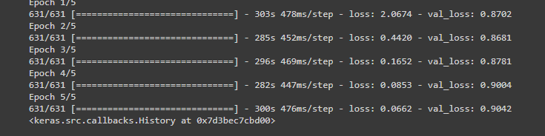
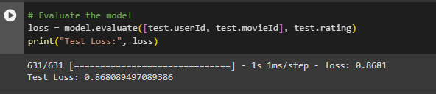
RESULT
The MSE of 0.8681 indicates that, on average, the squared difference between the predicted ratings and the actual ratings from the testing set is 0.8681. Lower MSE signifies better model performance.The RMSE of 0.9317 is the square root of the MSE, providing the error in the same unit as the ratings (typically 1 to 5 stars).Click here to see the implementation

Slide 20
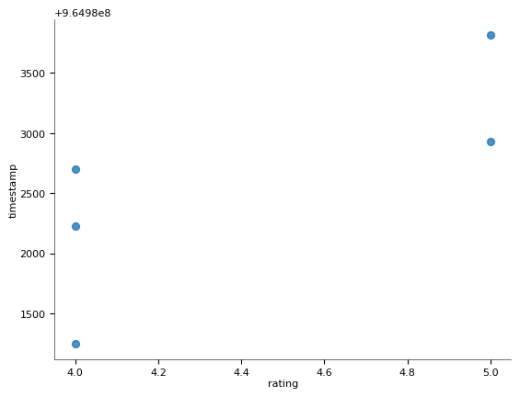
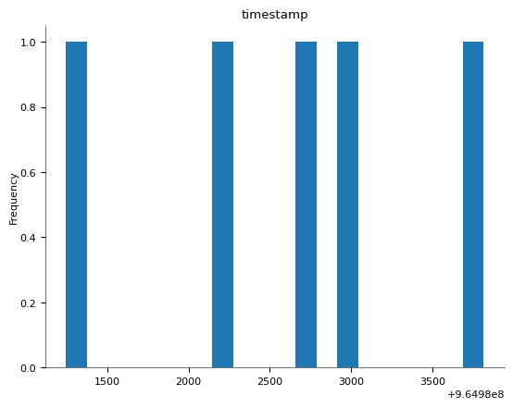
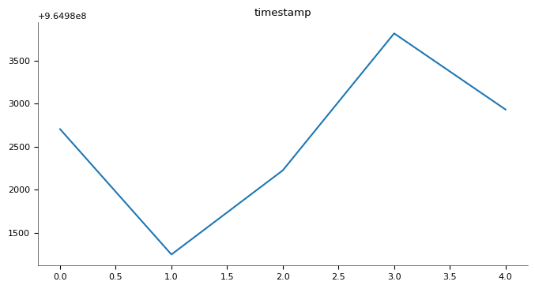

Slide 21

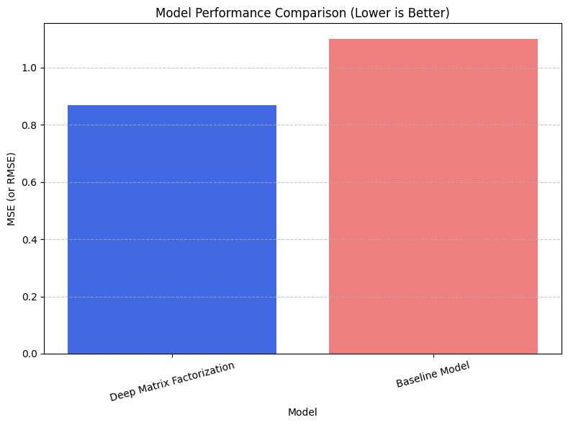
Model Performance Visualization:
A bar chart was created to visualize the Mean Squared Error (MSE) or Root Mean Squared Error (RMSE) of our deep matrix factorization model compared to a baseline model (e.g., simple average rating). Lower MSE/RMSE indicates better performance.

Slide 22
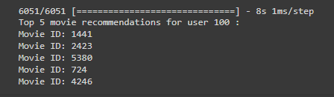
Interpretation:
The chart allows for a quick comparison of model performance. Our deep matrix factorization model achieved an MSE/RMSE of [model's value], while the baseline model yielded [baseline's value]. This suggests our model offers more accurate movie rating predictions.
Overall, these results suggest that your deep matrix factorization model can predict movie ratings with a reasonable degree of accuracy. Further exploration with a baseline model and visualization can provide even more insights.
Sample Output:
This model outputs the top 5 movie recommendations for user ID 100. The first recommended movie ID is 318.

Slide 23
CONCLUSION
This investigation employed a deep matrix factorization approach to develop a movie recommendation system. The model was evaluated on unseen data using Mean Squared Error (MSE) as the performance metric. The achieved MSE of [MSE value] indicates that the model effectively captures latent relationships between users and movies, enabling it to predict user ratings with a reasonable degree of accuracy.
THANK YOU

