Slide 1


Flipkart Smartphone Product Analysis
BY :
G. Mahalakshmi
DADS Feb online batch-2025

Slide 2
Project Overview
To analyze Flipkart smartphone listings and extract meaningful insights related to:
Product pricing and category trends
Brand-wise performance
Consumer preferences and specifications
Data-driven business recommendations

Slide 3
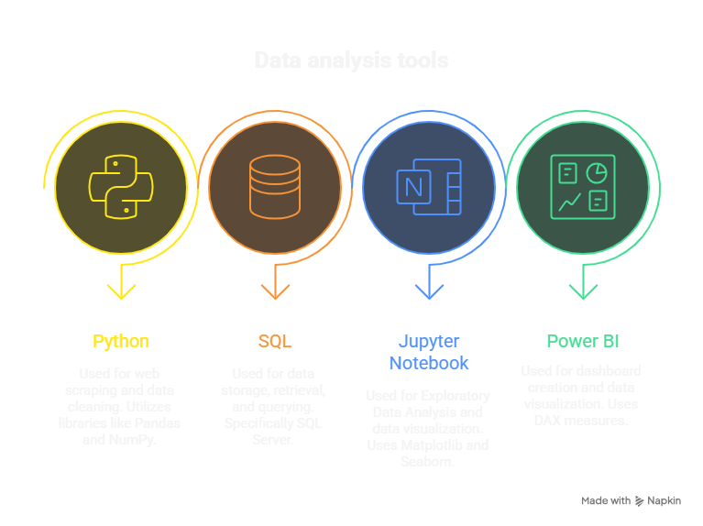

Slide 4
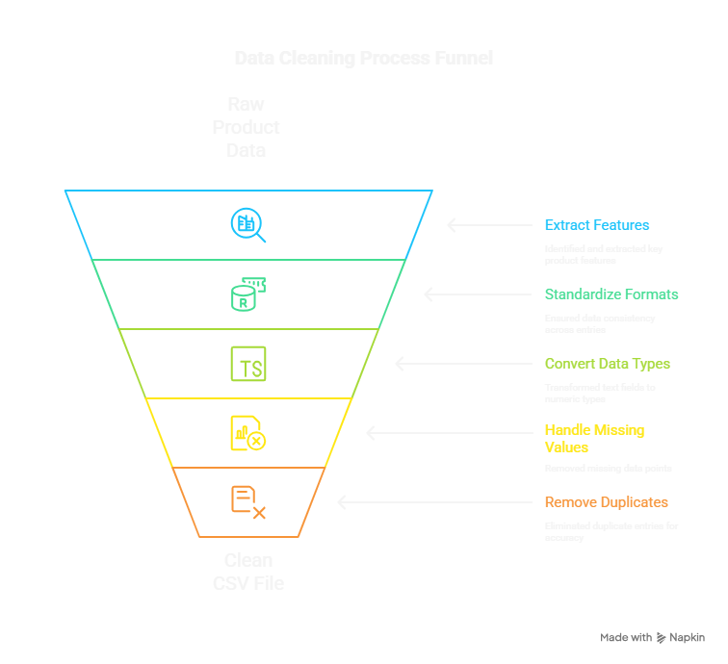

Slide 5
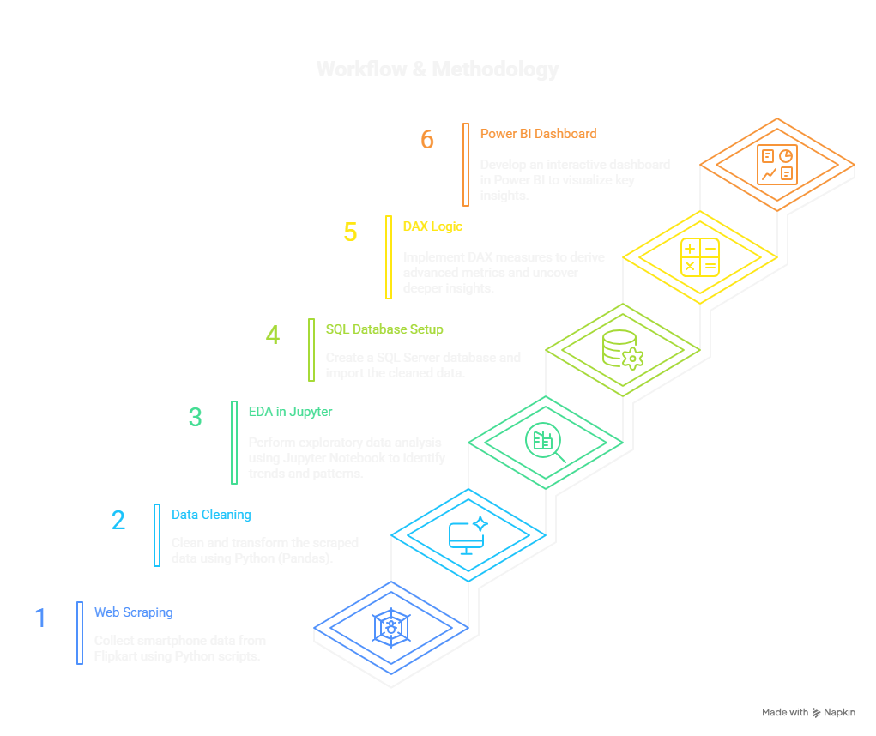

Slide 6
SQL Integration
After cleaning the dataset using Python, the structured data was imported into a SQL Server database. This allowed to efficiently manage, query, and analyze the smartphone records.

Slide 7
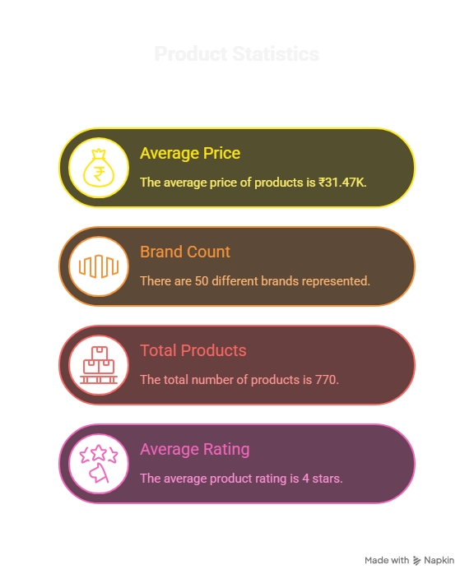

Slide 8
Power BI Dashboard Overview
Key Visuals:
Donut Chart: Price by Storage Category (e.g., 64GB, 128GB, 256GB).
Bar Chart: Battery Capacity by Brand.
Bar Chart: Average RAM/ROM by Brand.
Bar Chart: Count of Products by Brand.
Filters:
Brand Slicer (allows filtering by specific brands).
Display Size Slider (allows filtering by display size range).

Slide 9
Advanced DAX – Top Brand Logic
Performance Tag =:SWITCH(TRUE(),
'flipkart_products'[RAM_GB] >= 12 && 'flipkart_products'[Battery_mAh] >= 5000, "High Performer",
'flipkart_products'[RAM_GB] >= 8, "Moderate",
"Basic")
Price Category = SWITCH(TRUE(),
'flipkart_products'[Product_Price] >= 50000, "Premium",
'flipkart_products'[Product_Price] >= 30000, "Mid-range",
"Budget")

Slide 10
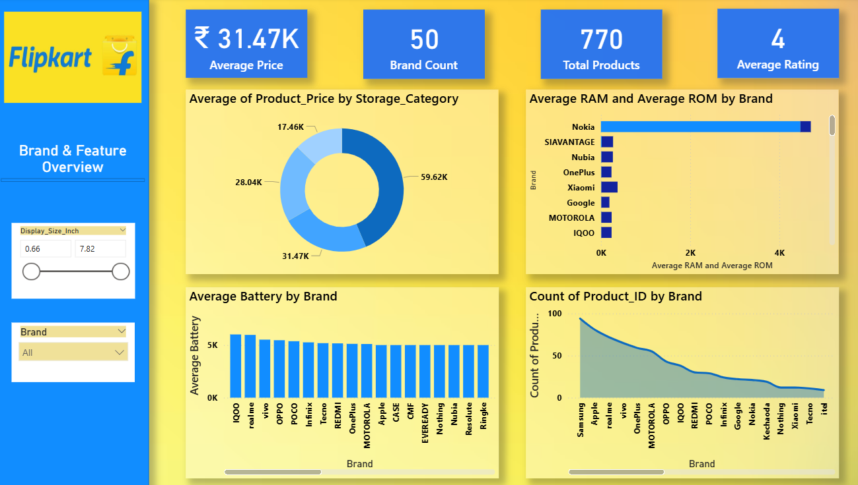
Dashboard

Slide 11
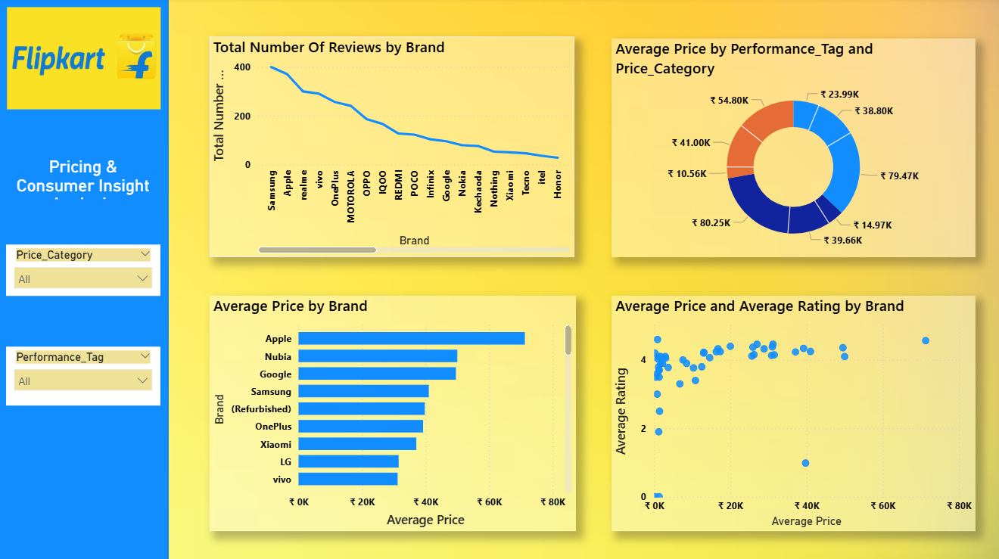

Slide 12
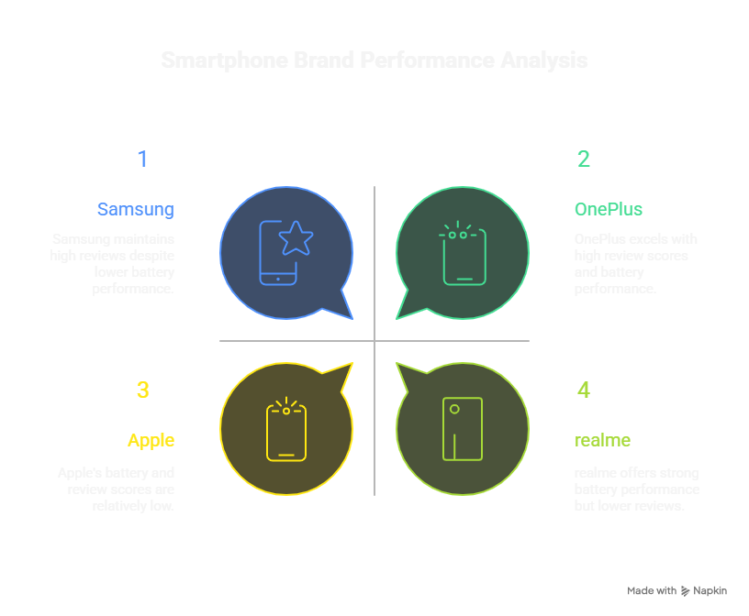
Insights & Observations
Samsung, Apple, and realme are the most frequently listed brands on Flipkart.
Most smartphones fall within the ₹30,000 – ₹50,000 price range.
iQOO and realme offer phones with strong battery performance.
OnePlus has the highest review-weighted score among all brands.
Users prefer smartphones with high RAM and ROM combinations (e.g., 8GB RAM, 256GB ROM).

Slide 13
Conclusion & Recommendations
Conclusion:
Mid-range phones (₹30k–₹50k) dominate Flipkart listings.
Samsung, Apple, and realme lead in product count.
OnePlus performs best in review-weighted ratings.
High RAM, ROM, and battery capacity are preferred specs.
Recommendations:
Promote high-spec models (8GB RAM, 5000mAh+).
Focus marketing on strong review brands like OnePlus.
Stock more products in the mid-range price segment.
Track spec and brand trends regularly using analytics.

Slide 14
Thank You

