Slide 1
CAR PRICE PREDICTION USING MACHINE LEARNING
CREATED BY
M.MAHALAKSHMI
B.E -III year-CSE
Reg.no:912321104021
SACS M.A.V.M.M ENGEERING COLLEGE
MADURAI.

Slide 2
OUTLINE
Problem Statement
Proposed System/ Solution System Development Approach
Algorithm And Deployment
Result Conclusion

Slide 3
PROBLEM STATEMENT
The project aims to Develop a machine learning model to predict the selling price of used cars based on various features. This model will be helpful for both car buyers and sellers to get a more accurate estimate of a car's fair market value.

Slide 4
PROPOSED SYSTEM
Car Data Collection: Data is collected on various attributes of cars, likely including make, model, year, mileage, features, and the actual selling price.
Data Preprocessing: The data is then cleaned and formatted for use in the machine learning models. This may involve handling missing values, outliers, and converting categorical data into numerical data.
Train-Test Split: The data is divided into two sets: a training set and a testing set. The training set is used to train the models, and the testing set is used to evaluate the performance of the models.

Slide 5
PROPOSED SYSTEM (contd..)
Linear regression: This model creates a linear relationship between the input features (car attributes) and the output (car price). It is easy to implement and interpret
Lasso regression: This is a regularized version of linear regression that helps to address overfitting. It penalizes the model for the sum of the absolute values of its coefficients, which can shrink some coefficients to zero.
Model Evaluation: The performance of the models is evaluated on the testing data. This is typically done using metrics like mean squared error
Prediction: New, unseen car data is then fed into the chosen model to predict the selling price of the car.

Slide 6
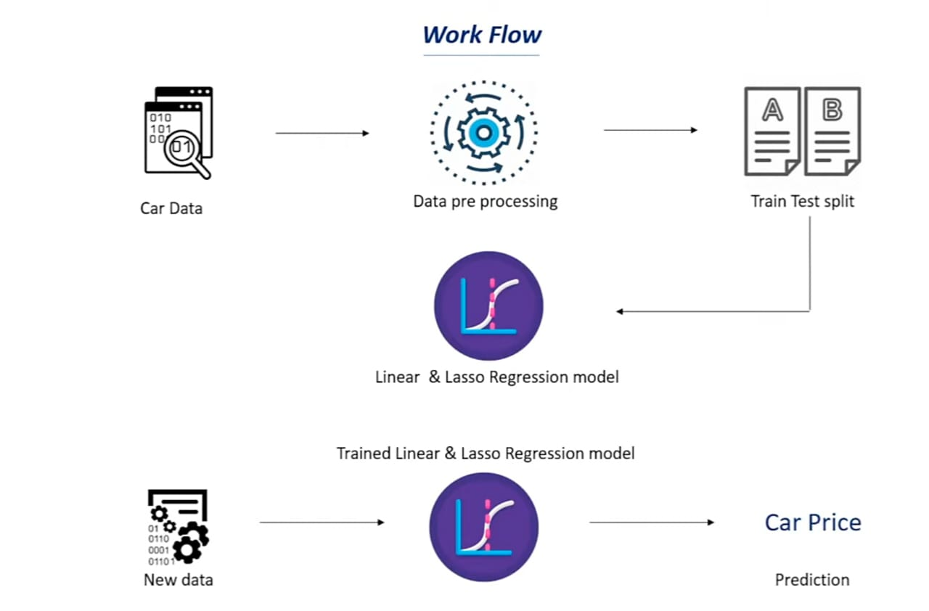
PROPOSED SYSTEM (contd..)

Slide 7
SYSTEM DEVELOPMENT APPROACH
Define Project Scope and Goals: Set clear goals for the project. Specify the intended users of the system (consumers, dealerships, etc.).
Data Acquisition and Exploration:
Data Collection:Gather a data from the dataset
https://www.kaggle.com/nehalbirla/vehicle-dataset-from-cardekho?select=car+data.csv

Slide 8
Dataset Feature
Car Brand
Year
Sold Price
Present Price
KMV Driven
Fuel type
Owners
Data Exploration: Use Python libraries like pandas to analyze the data. * Identify missing values, outliers, and data inconsistencies. * Understand the distribution of features and their potential correlation with car price.

Slide 9
SYSTEM DEVELOPMENT APPROACH(contd..)
Data Preprocessing:
Data Cleaning: Handle missing values ( imputation or removal). Address outliers. Encode categorical features . Standardize or normalize numerical features .
Model Selection and Training:
Choose Machine Learning Algorithms : Linear Regression: Simple to understand, good baseline. Lasso Regression: Handles overfitting and performs feature selection. Random Forest Regression: Robust to outliers and can capture non-linear relationships.

Slide 10
SYSTEM DEVELOPMENT APPROACH(contd..)
Model Evaluation and Selection:
Evaluate Model Performance:Use metrics like Mean Squared Error (MSE) or R-Squared on the testing data.
Select the Best : Choose the model with the lowest MSE or highest R-Squared on the testing data.
Model Deployment and Prediction:
Save the Trained Model Use libraries like pickle or joblib to save the chosen model for future use.
Develop a Prediction Interface: Depending on use case, create a web application (using Flask or Django) or a simple script for users to input car data and get price predictions.

Slide 11
SYSTEM DEVELOPMENT APPROACH(contd..)
Python Libraries
pandas:
Handles data tables and spreadsheets. matplotlib: Creates charts and graphs.
seaborn:
Makes fancy statistical visualizations (built on matplotlib).
scikit-learn:
Machine learning library for splitting data, building models (linear regression in this case), and evaluating their performance.

Slide 12
ALGORTHIM
Imports libraries for linear regression and data splitting.
Loads data and separates price (y) from other features (X).
Splits data into training and testing sets. Creates a linear regression model.
Trains the model on the training data.
Defines function to prepare data for new car prediction (replace with your logic).
Extracts features from new car data.
Predicts price using the trained model.
Accesses the first element of the prediction array (assuming single value).
Prints the predicted price.

Slide 13
import pandas as pd
import matplotlib.pyplot as plt
import seaborn as sns
from sklearn.model_selection import train_test_split
from sklearn.linear_model import LinearRegression
from sklearn.linear_model import Lasso
from sklearn import metrics
DATA COLLECTION AND PROCESSING
# loading the data from csv file to pandas dataframe
car_dataset = pd.read_csv('/content/CAR DETAILS FROM CAR DEKHO.csv')
# inspecting the first 5 rows of the dataframe
car_dataset.head()
# checking the number of rows and columns
car_dataset.shape

Slide 14
# getting some information about the dataset
car_dataset.info()
# checking the number of missing values
car_dataset.isnull().sum()
# checking the distribution of categorical data
print(car_dataset.fuel.value_counts())
print(car_dataset.Seller_Type.value_counts())
print(car_dataset.Transmission.value_counts())
Encoding the Categorical Data
# encoding "Fuel_Type" Column
car_dataset.replace({'Fuel_Type':{'Petrol':0,'Diesel':1,'CNG':2}},inplace=True)
# encoding "Seller_Type" Column
car_dataset.replace({'Seller_Type':{'Dealer':0,'Individual':1}},inplace=True)
# encoding "Transmission" Column
car_dataset.replace({'Transmission':{'Manual':0,'Automatic':1}},inplace=True)

Slide 15
X = car_dataset.drop(['name','selling_price'],axis=1)
Y = car_dataset['selling_price']
print(X)
print(Y)
Splitting Training and Test data
X_train, X_test, Y_train, Y_test = train_test_split(X, Y, test_size = 0.1, random_state=2)
MODEL TRAINING
1. Linear Regression
# loading the linear regression model
lin_reg_model = LinearRegression()
MODEL EVALUATION
# prediction on Training data
training_data_prediction = lin_reg_model.predict(X_test)

Slide 16
y_pred = model.predict(X_test)
from sklearn.metrics import r2_score, mean_squared_error
mse = mean_squared_error(y_test, y_pred)
print("R-squared score:", r2_score(y_test, y_pred))
print("Mean Squared Error:", mse)
Visualize the actual prices and Predicted prices
y_actual = [150000, 120000, 180000, 100000, 135000]
y_predicted = [145000, 118000, 175000, 110000, 130000]
# Create a scatter plot
plt.figure(figsize=(10, 6))
plt.scatter(y_actual, y_predicted, c='blue', label='Predicted Price')
plt.scatter(y_actual, y_actual, c='red', alpha=0.7, label='Actual Price')

Slide 17
# Set labels and title​
plt.xlabel('Actual Price')​
plt.ylabel('Predicted Price')​
plt.title('Actual vs. Predicted Car Prices')​
​ # Add legend​
plt.legend()​
​ # Display the plot​
plt.grid(True)​
plt.show()
LASSO REGRESSION
# loading the linear regression model
lass_reg_model = Lasso()
from sklearn.preprocessing import StandardScaler
scaler = StandardScaler()
X_train = scaler.fit_transform(X_train)
X_test = scaler.transform(X_test)

Slide 18
# Evaluate the model's performance
y_pred = lasso_model.predict(X_test)
from sklearn.metrics import r2_score, mean_squared_error
print("R-squared score:", r2_score(y_test, y_pred))
print("Mean Squared Error:", mean_squared_error(y_test, y_pred))
plt.figure(figsize=(10, 6))
plt.scatter(y_test, y_pred, c='blue', label='Predicted Price')
plt.scatter(y_test, y_test, c='red', alpha=0.7, label='Actual Price')
# Set labels and title
plt.xlabel('Actual Price')
plt.ylabel('Predicted Price')
plt.title('Actual vs. Predicted Car Prices (Lasso Regression)')
# Add legend
plt.legend()
# Display the plot
plt.grid(True)
plt.show()

Slide 19
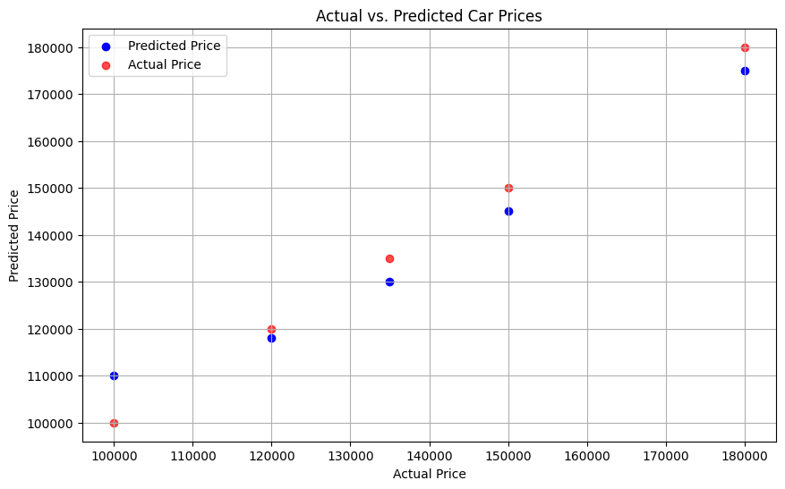
RESULT
Fig: Linear Regression in actual vs.predicted car Price

Slide 20
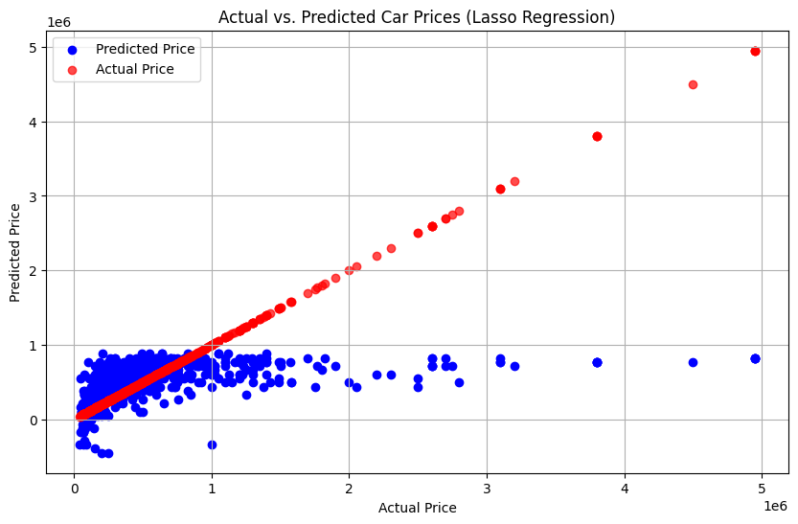
RESULT ( contd..)
Fig: Lasso Regression in actual vs.predicted car Price

Slide 21
REFERENCE
https://numpy.org/
https://scikit-learn.org/stable/
https://www.kaggle.com/nehalbirla/vehicle-dataset-from-cardekho?select=car+data.csv
https://matplotlib.org/
https://colab.research.google.com/drive/1cVz76ADMuh8kFjgsrrt_XdyNHOOinhB9?usp=drive_link

Slide 22
CONCLUSION
This project explored car price prediction using machine learning. We trained a linear regression model, specifically Lasso Regression, on a used car dataset. The model learned to identify relationships between car features and their selling prices. While the model provides estimates, it's crucial to remember that car prices are influenced by various factors beyond the data used.

Slide 23
THANK YOU

