Slide 1
Employee Data Analysis using Excel
STUDENT NAME: Mahalakshmi.K
REGISTER NO: 122204093
DEPARTMENT: b.com corporate secretaryship
COLLEGE : Shri Krishnaswamy college for women

Slide 2
PROJECT TITLE
Employee Gender Analysis using Excel

Slide 3
AGENDA
Problem Statement
Project Overview
End Users
Our Solution and Proposition
Dataset Description
Modelling Approach
Results and Discussion
Conclusion
3/21/2024 Annual Review

Slide 4
PROBLEM STATEMENT
1. Import and clean employee data from our HR system
2. Create a gender category field (Male, Female, Non-Binary, etc.)
3. Calculate and visualize the gender distribution across various departments and job roles
4. Identify areas with gender imbalances and potential biases
5. Develop a report highlighting key findings and recommendations for improving gender diversity

Slide 5
PROJECT OVERVIEW
Objective:
Analyze the gender diversity of our organization's workforce using Excel to identify areas with gender imbalances and potential biases, and provide actionable recommendations for improvement.
Benefits:
- Improved understanding of gender diversity in the organization
- Identification of areas for improvement
- Data-driven recommendations for promoting gender equality
- Enhanced reputation and competitiveness

Slide 6
WHO ARE THE END USERS?
1. HR Managers
2. Diversity and Inclusion Officers
3. Talent Management Teams
4. Organizational Development Specialists
5. Senior Leadership
6. Department Heads
7. Data Analysts
8. Researchers
9. Compliance Officers
10. Business Intelligence Developers

Slide 7
OUR SOLUTION AND ITS VALUE PROPOSITION
Unlock the power of data-driven insights to promote gender diversity and inclusion in your organization. Our Employee Gender Analysis using Excel solution provides a comprehensive and easy-to-use tool to:
- Data-driven insights to inform gender diversity initiatives
- Easy-to-use Excel-based solution for effortless analysis and visualization
- Identify areas of imbalance and bias to target initiatives
- Track progress and measure initiative effectiveness
- Enhance reputation and competitiveness through improved gender diversity and inclusion

Slide 8
Dataset Description
1.sum of joining year masters
2.Sum of age of masters
3.sum of joining year of PhD
4.sum of age of masters.
5.sum of age of bachelor.
6.sum oof joining year of bachelor.

Slide 9
THE "WOW" IN OUR SOLUTION
- Enjoy a seamless user experience, with an intuitive and user-friendly interface that requires no advanced Excel skills.
- Easily integrate your existing HR data and systems, with our solution's flexible and customizable framework.
- Focus on driving gender diversity and inclusion initiatives, while our solution handles the heavy lifting.
3/21/2024 Annual Review
9

Slide 10
MODELLING
- Pivot tables and charts for data summarization and visualization
- Conditional formatting for data highlighting and anomalies detection
- Formula-based calculations for data analysis (e.g., percentage differences, ratios)
- Macros or VBA scripts for automation and efficiency
10

Slide 11
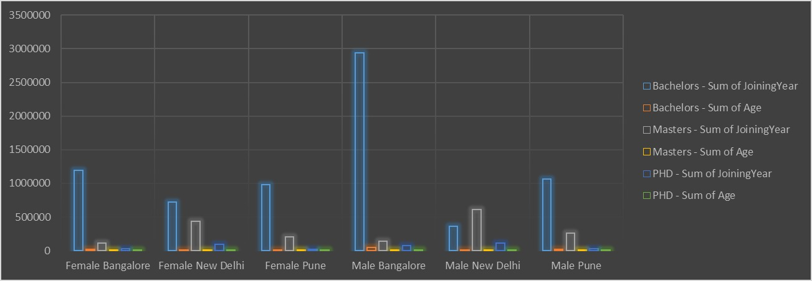
RESULTS
11

Slide 12
conclusion
1. Analyze gender distribution across departments and job titles
2. Calculate gender pay gaps and promotion/termination rates
3. Identify areas with high turnover or retention rates
4. Develop predictive models to forecast diversity metrics
5. Create interactive dashboards for data exploration and visualization
By using Excel for employee gender analysis, organizations can make data-driven decisions, drive positive change, and create a more inclusive workplace culture.

