Slide 1

ZENMIND
AI FOR STRESS MANAGEMENT

Slide 2
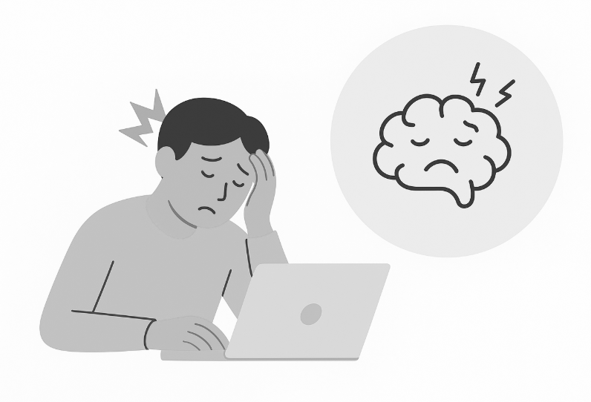
PROBLEM STATEMENT
What if your phone could sense your stress before you do, and help you stop it in its tracks?
MAIN PROBLEM:
2.Are your wellness apps
too generic to
actual help?
4.What if you could prevent stress instead of just reacting to it?
1.Is your stress already peaked before you even notice it?
3.Do you have to stop and manually log your feelings?

Slide 3
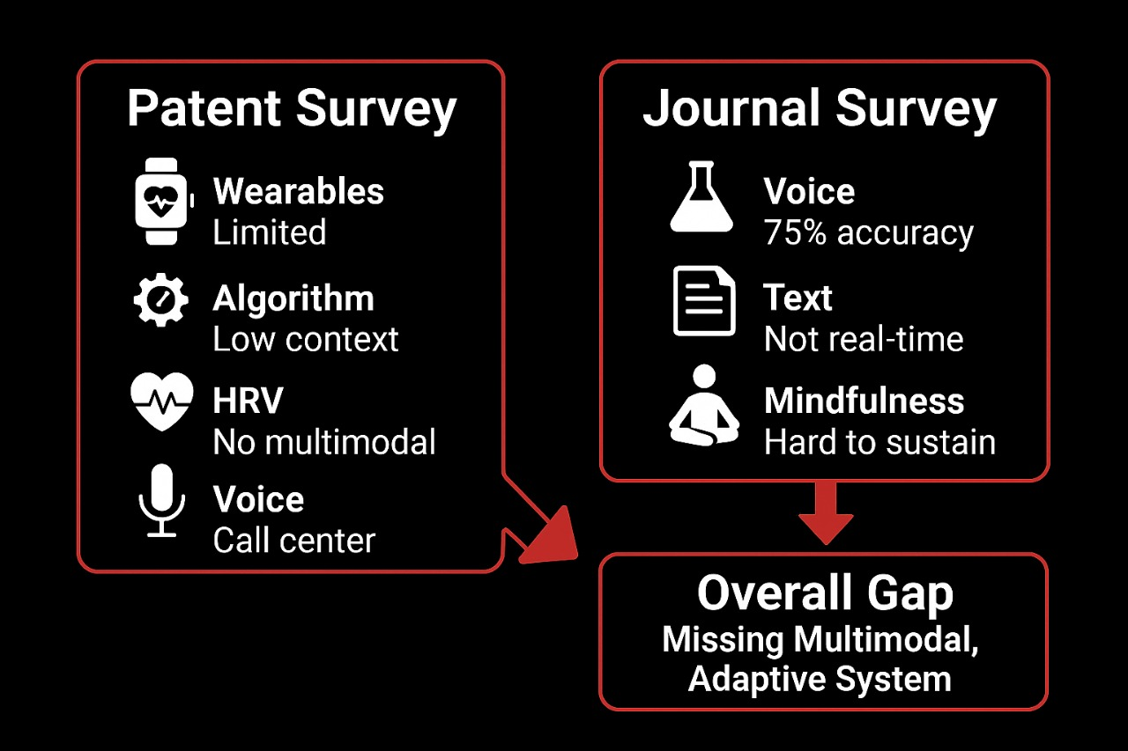
PATENT SURVEY

Slide 4
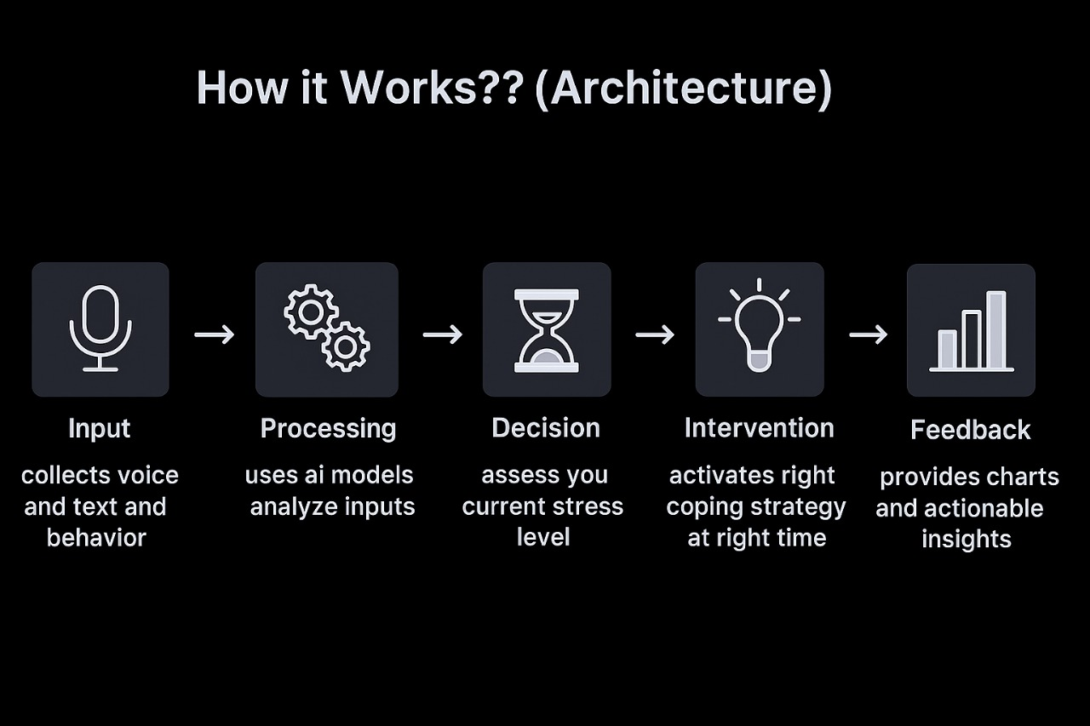
PROPOSED SOLUTION
OVERVIEW:
Intelligent and empathetic app that supports people before, during, and after stressful moments-our solution
Our system learns unique stress patterns and proactively offers you the right nudge -before stress escalates
KEY FEATURES:
1. Multimodal Stress Detection
Continuously analyzes voice tone, text sentiment, and behavior patterns
2.Real-Time Adaptive Interventions
Provides personalized nudges such as guided breathing, mindfulness prompts, humor
3. Trend Visualization
Offers users daily, weekly, and monthly dashboards
highlighting stress triggers and progress
4. Privacy-First Design
Ensures on-device processing, encrypted storage, and
user-controlled permissions

Slide 5
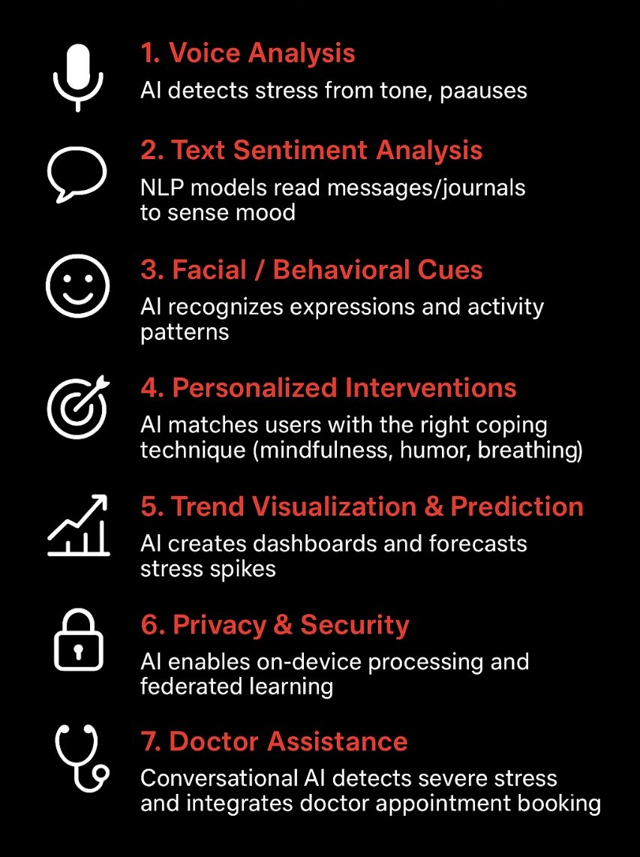
AI INTEGRATION

Slide 6
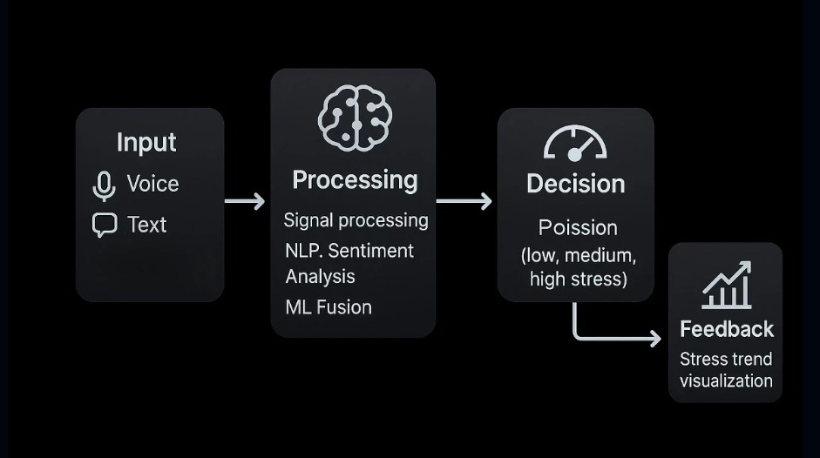
INNOVATION

Slide 7
PRODUCT COMPARISON
Feature / Product | Calm | Headspace | Woebot | Fitbit/Oura | ZenMind (Our App)
Multimodal Stress Detection (voice + text + behavior) | ✖ | ✖ | ✖ | ✖ | ✅
Real-Time Adaptive Interventions | ✖ | Limited | ✖ | ✖ | ✅
Proactive (early stress detection) | ✖ | ✖ | ✖ | ✖ | ✅
Trend Visualization & Insights | ✖ | ✖ | ✖ | Limited | ✅
Privacy-First (on-device processing) | ✖ | ✖ | ✖ | ✖ | ✅
Personalized Coping Strategies | Limited | Limited | ✖ | ✖ | ✅

Slide 8
IMPACT
INDIVIDUAL IMPACT:
PREVENT
PERSONALIZES
EMPOWERS
ORGANIZATIONAL IMPACT:
REDUCES
BOOSTS
MODERNIZES
SOCIETAL IMPACT:
ADVANCES(UN SGD3)
REDUCES
MODELS THE ETHICAL

Slide 9
FEASIBILITY
TECHNICAL FEASIBILITY
Multimodal inputs: voice, text, behavior
Ready AI models for emotion/sentiment
On-device processing ensures privacy
Real-time feedback supported on modern devices
OPERATIONAL FEASIBILITY
Transparent data use builds user trust
Expert-designed interventions
Requires skilled AI & UX team
Passive, seamless user experience
ECONOMIC FEASIBILITY
Economic Feasibility
Prototype cost: 2L-3L
Revenue from freemium, subscriptions, enterprise licensing
High demand for proactive stress management
Strong potential for enterprise/wellness partnerships

Slide 10
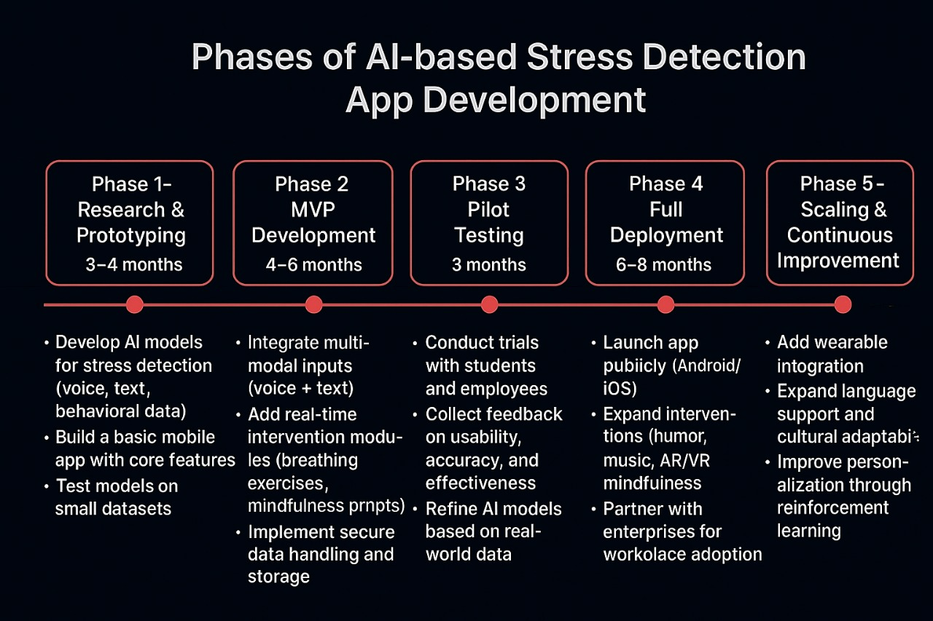
TIMELINE

Slide 11
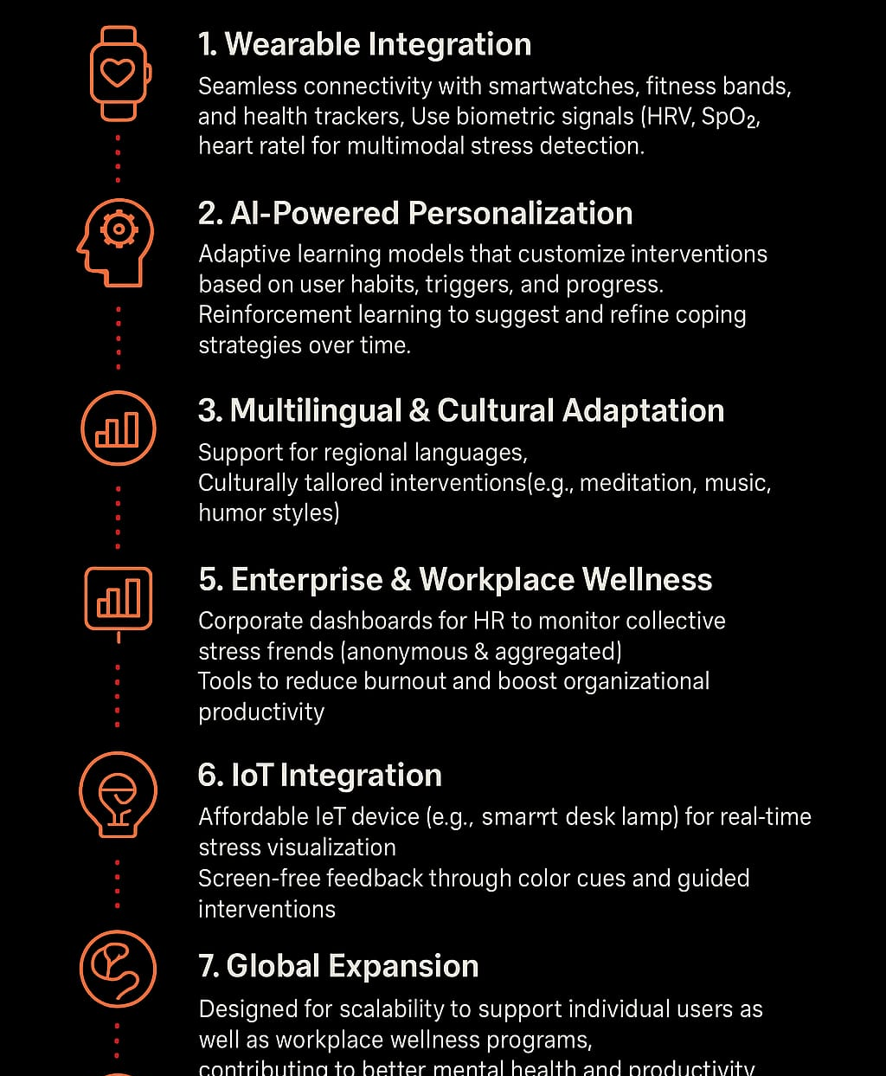
FUTURE SCOPE

Slide 12
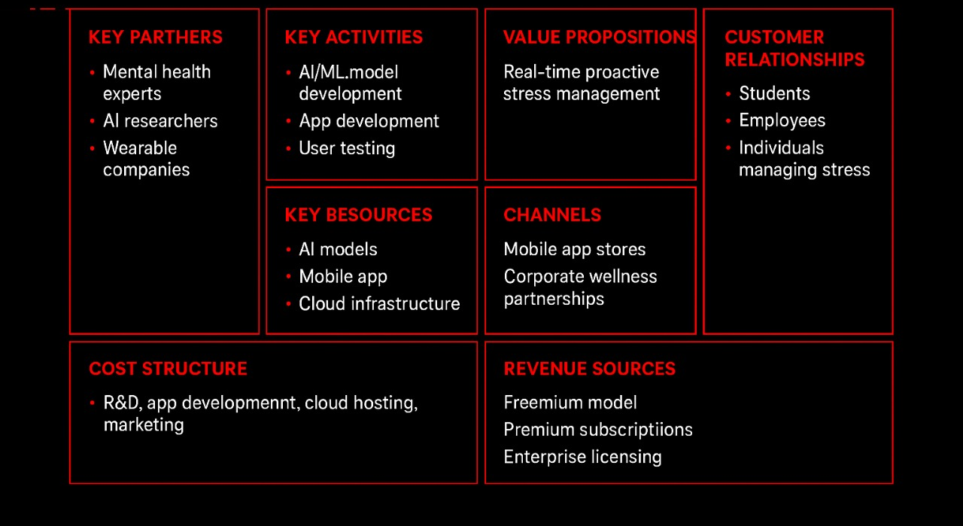
BUSINESS MODEL

Slide 13
THANK YOU
RAJALAKSHMI ENGINEERING COLLEGE
CHENNAI,TAMILNADU
MENTOR
DR V SAMPATH KUMAR
TEAM MEMBERS
1.MAHALAKSHMI S 3.JANANI V R
2.MEENAKSHI S S 4.KRITHIKA M A

