Slide 1

Real or Not?
NLP with Disaster Tweets

Slide 2
Topic & Team
Our project is about using machine learning and natural language processing to predict which Tweets are actually about a real disaster and which are not.
Our dataset contain about over 10,000 tweets.
Our Team
Mahalavanya Sriram
Chandan Mannem
Aparajitha Sriram

Slide 3
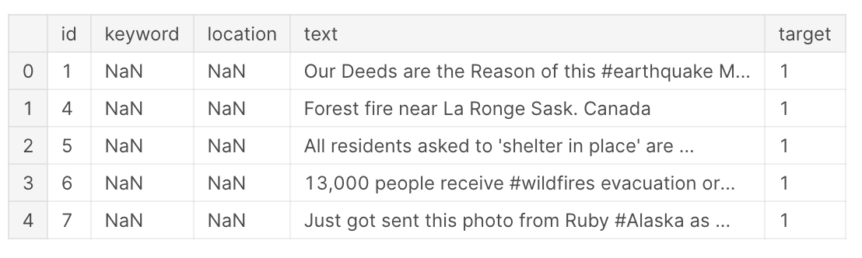
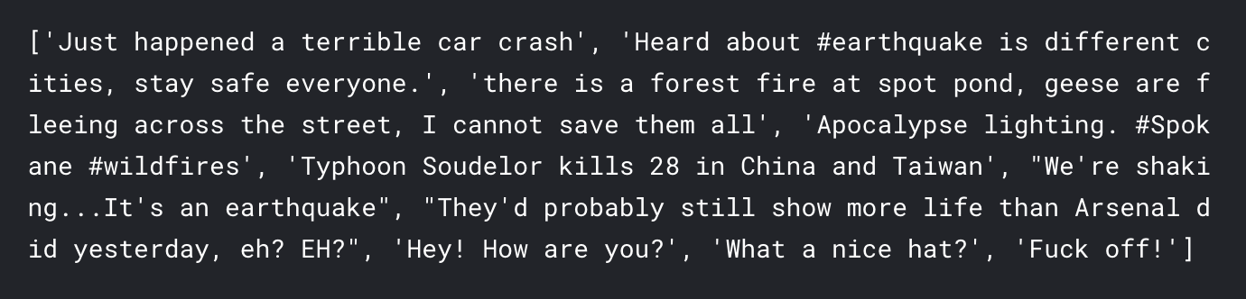

Slide 4
Data Pre Processing and Visualization
The following were the steps we performed for understanding the data better
Visualizations (Histograms, Bar charts , etc.)
Embeddings/ Vectorisation (count vectors, TF-IDF vectorization , Continuous Bag of words, GloVe, Fasttext)
Topic modelling (Latent Dirichlet allocation)
Word Cloud
Scatter text (a special type of interactive visualization)
Link to a sample scatter text scattertext_html

Slide 5
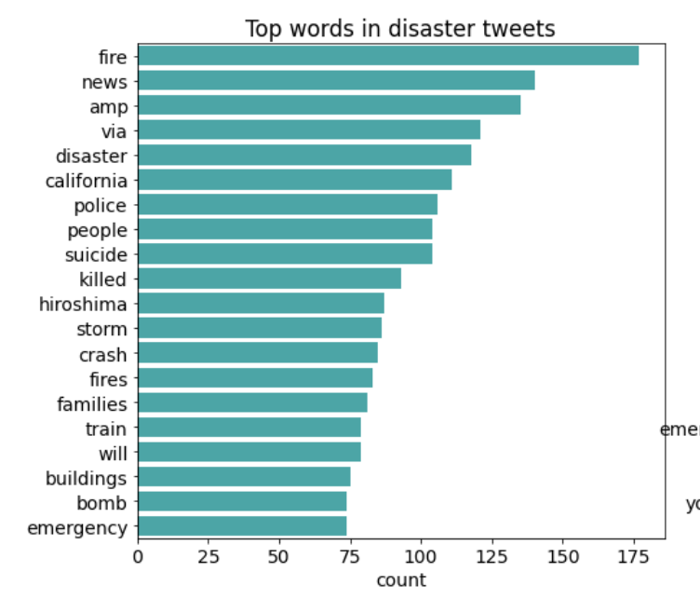
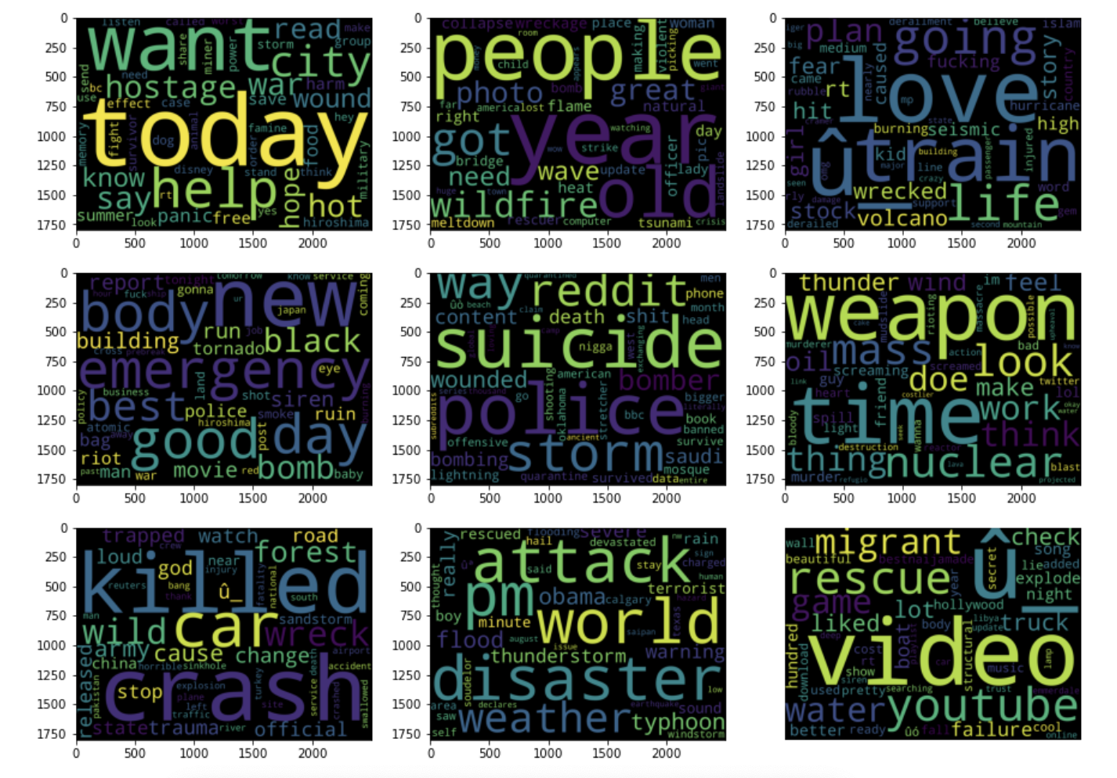
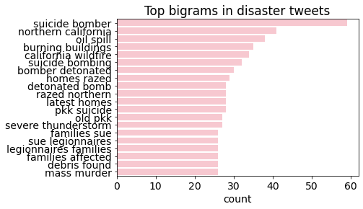
Word cloud after topic modelling and data cleaning

Slide 6
Findings after Data Exploration
We observed the most frequent words in unigrams and bigrams are different. Bigram seems more meaningful than unigram for most frequent words in disaster tweets.
We also observed that http links are also playing important part in tweet for disaster analysis. Based on set of links we can say that this tweet is related to disaster.
Also, hashtags are also important.
Removal of NLP Stop Words mislead the prediction. Not necessary for our use case.

Slide 7
Implementation Methods
All our implementation methods
Simple Linear Classification - Logistic Regression
A multinomial naïve-bayes
Support Vector Machine
Bidirectional LSTM
BERT (Bidirectional Encoder Representations from Transformers)
BERT + K- Fold Cross Validation

Slide 8
Observation from error analysis
On a detailed error analysis we made the following conclusions
Ambiguity and subjectivity play an important role
Some need more contexts to fully understand, e.g. html
Non-ascii words and Emoji missing.
Semantic misconstrue (Sarcastic, metaphoric...)
Keyword influence or Misleading hashtag (#)
A lot of misclassified messages are news, which is less useful than Tweets from disaster eye-witnesses and the usage of which is debatable
Some events may not really happen
Message is too short

Slide 9
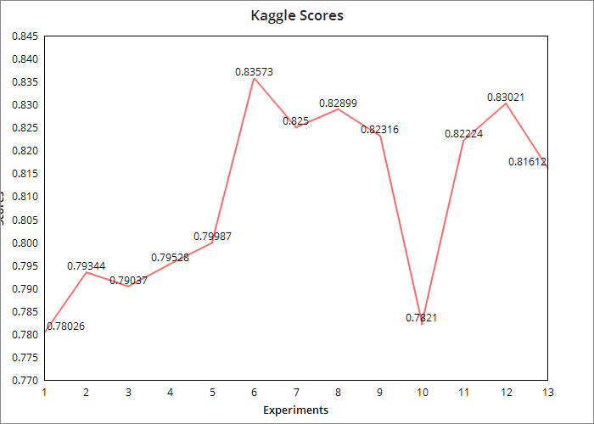
Scores
BERT + GloVe
Current Leaderboard :
We are in the 188th rank out of the 1419 teams, with an accuracy of 0.83573.
<-----Logistic Reg, NB, SVM, LSTM----> <----- BERT with diff embeddings + K Fold cross val----->

Slide 10
Team’s Takeaway
Future Work & Real World Use Cases
We implemented many interesting things like scatter text, the BERT model.
We tried different libraries and explored many new topics in NLP despite us being new to NLP.
We had fun!
Sentiment analysis, emotion analysis
Useful in dealing with disaster relief and recovery. Many disaster relief organizations monitor Twitter’s data.
Useful in providing insights about people’s emotions and how they are related to occurrences of natural disasters.

