Slide 1

Department of Computer Science and Engineering
(Cyber Security)
COURSE NAME: WEB PROGRAMMING
ACADEMIC YEAR: 2026-2027
Project Name: HomeBite (Food Ordering and Operations)
NAME: Mahalaxmi VPK
REG NO: 241901052

Slide 2
PROBLEM STATEMENT / OBJECTIVE
Problem Statement:
Homemade food sellers may manage menus and orders manually through calls or messages.
Manual tracking can lead to missed orders, quantity mistakes, and difficulty updating availability.
Customers need a simple way to browse dishes, choose quantities, and submit delivery or pickup details.
Objectives:
Display available dishes with descriptions, categories, prices, and images.
Allow customers to search/filter dishes, manage a cart, and place orders.
Store orders and menu data in a MySQL database.
Provide an admin interface to manage menu items and update order status.

Slide 3
TOOLS, TECHNOLOGIES AND IMPLEMENTATION
React - Builds reusable UI components such as food cards, cart, checkout, and admin views.
JavaScript-Handles state, filtering, quantity updates, form submission, and API calls.
Bootstrap + CSS-Responsive layout, styling, icons, and interface components.
PHP Rest-style API - Receives HTTP requests, validates data, and exposes menu/order operations.
MySQL + PDO - Persists menu items, orders, and order items; prepared statements handle queries.
XAMPP + Node.js + Vite - XAMPP runs Apache/MySQL/PHP locally; Node/npm and Vite run the React dev server

Slide 4
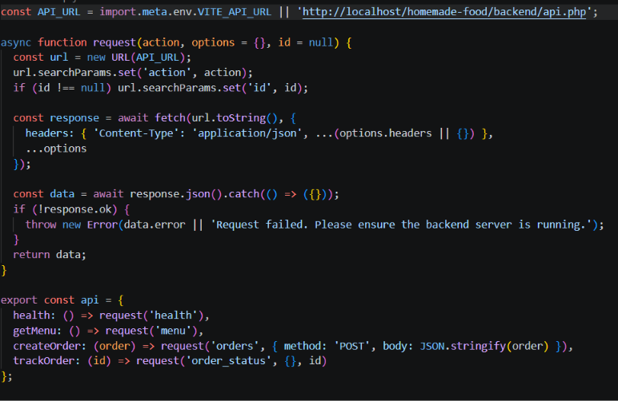
Implementation
Code Snippets:

Slide 5
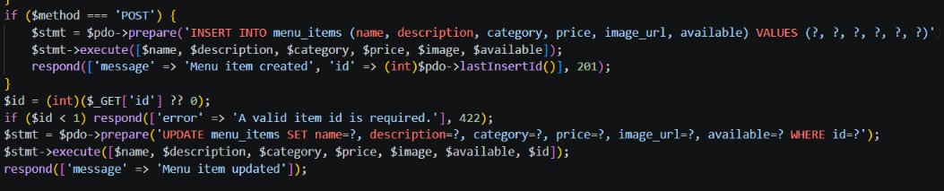
Implementation

Slide 6
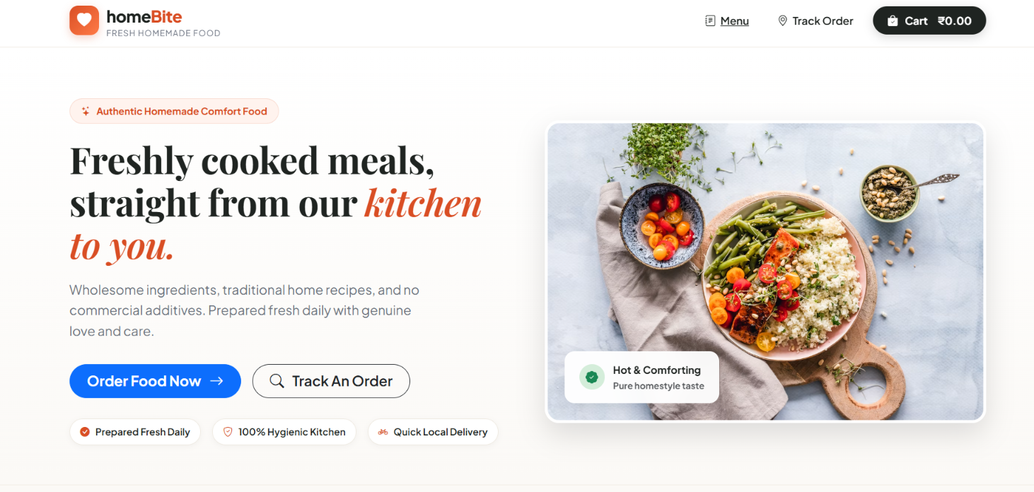
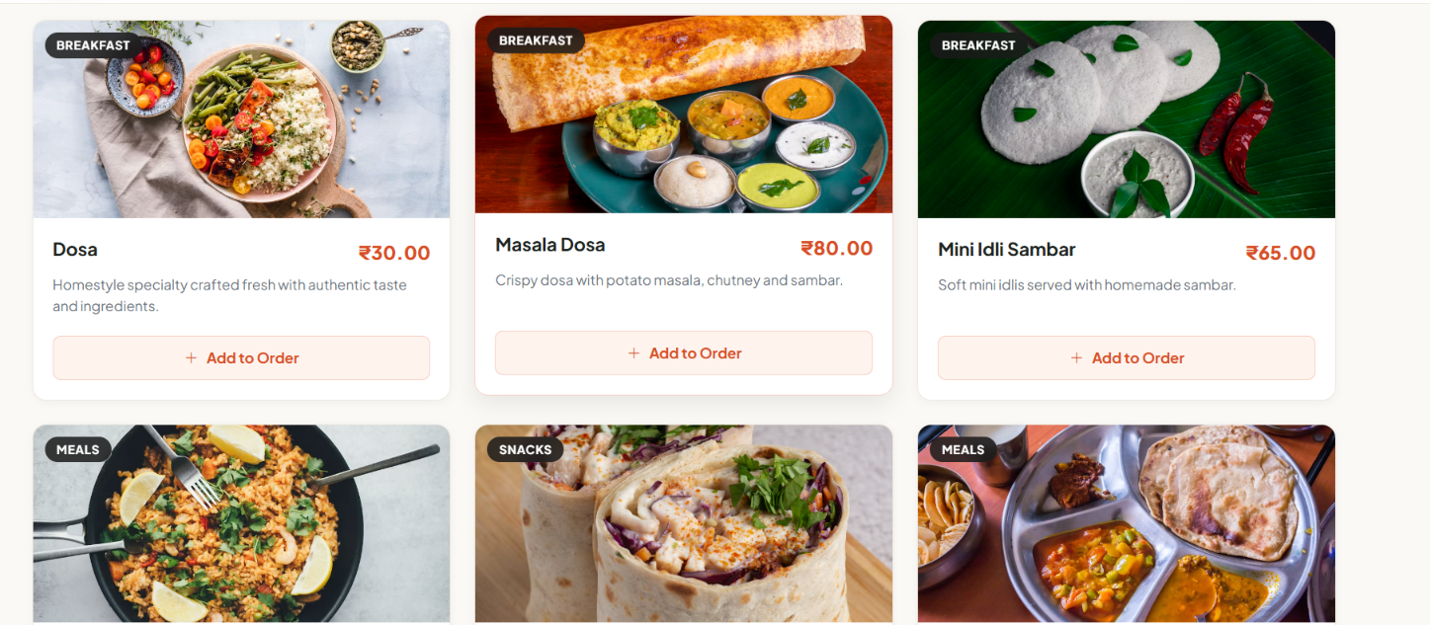
Project Screenshots

Slide 7
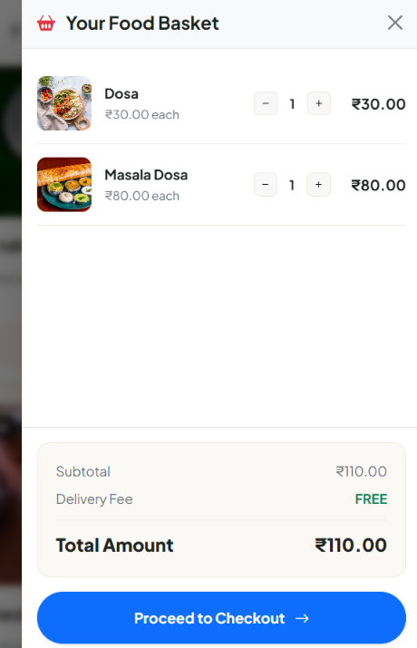
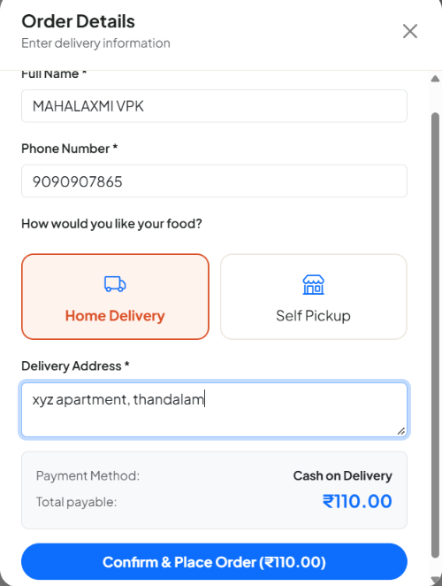
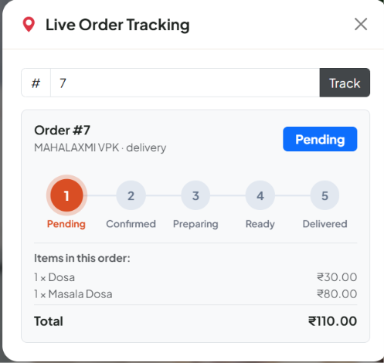
Project Screenshots

Slide 8
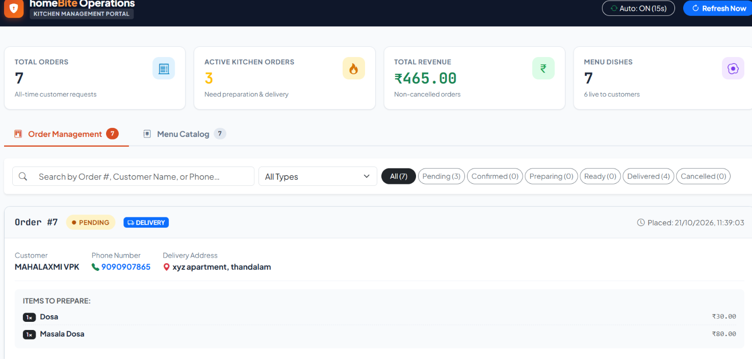
Project Screenshots:
Admin Dashboard:

Slide 9
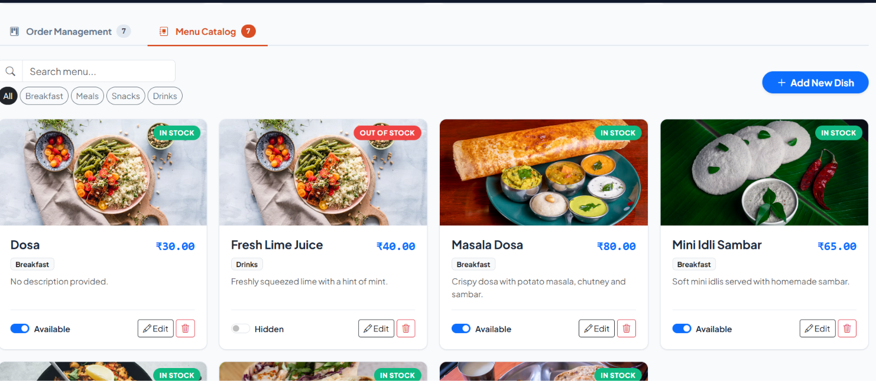
Project Screenshots

Slide 10
OUTCOME
Browse menu items with category filtering and text search.
Add items to cart, change quantities, remove items, and calculate totals.
Submit pickup or delivery orders and receive an order number.
Admin can add, edit, and delete menu items and update order statuses.
Dashboard statistics summarize products, orders, pending orders, and revenue.

