Slide 1
Ideathon project idea
M Mohammed saad (24691A31M3)
Saniya Syeda(24691A31O4)
Dept of Artificial Intelligence(MITS)

Slide 2
Problem Statement
Mess kitchens and food services often overproduce or underproduce food.
This leads to food wastage, financial losses, and operational inefficiencies.
Traditional planning methods fail to capture hidden demand patterns.

Slide 3
Why This Problem Matters
• Large quantities of food are wasted daily.
• Wasted food increases operational costs.
• Food waste contributes to environmental damage and carbon emissions.

Slide 4
Problem Background
Over the year food demand follows patterns influenced by weather, exams, holidays, events and many more features.
However most food services prepare fixed quantities ignoring these patterns.

Slide 5
PredNServe
We introduce ->
AI-based Food Demand Prediction System to Reduce Waste

Slide 6
Our Solution – PrednServe
PrednServe analyzes historical food consumption patterns along with contextual data.
It predicts future demand so kitchens can prepare optimal quantities.

Slide 7
Data Inputs Used
• Historical consumption data
• Attendance patterns
• Exam schedules
• Weather conditions
• Special events
• Day of week trends

Slide 8
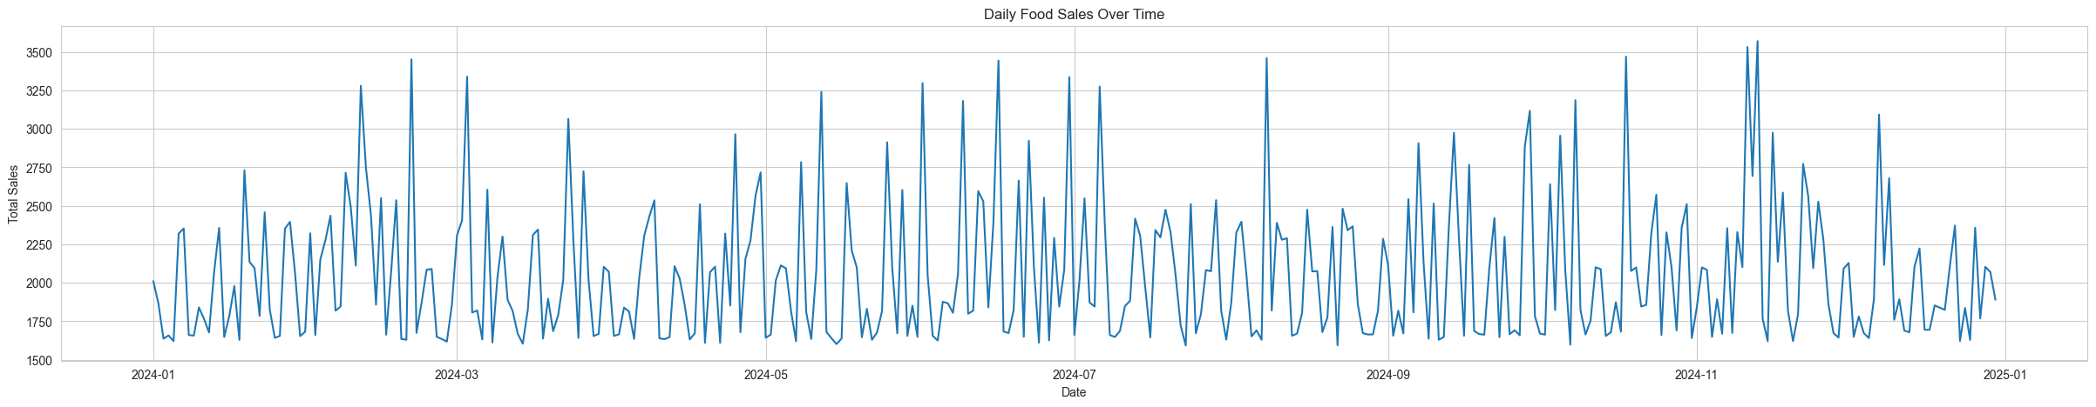
Visualization of patterns in data
May indicate events, or any
Hidden pattern
Daily food sales overtime
Total sales

Slide 9
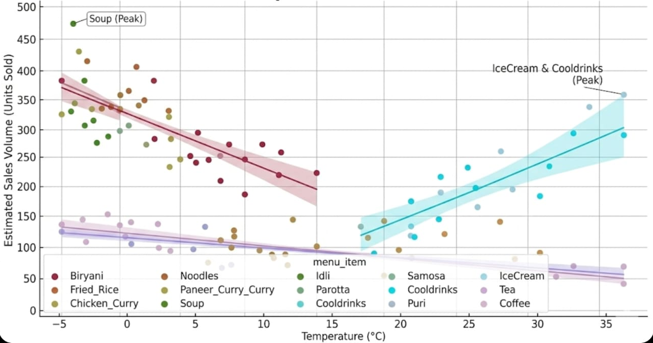
Effect of ambient temperature on menu item sales volume

Slide 10
Machine Learning Approach
Regression-based models learn patterns from historical data.
Models such as Linear Regression or Random Forest predict future food demand.

Slide 11
System Architecture
Data Collection → Data Processing → Machine Learning Model → API → Dashboard
Backend: FastAPI
Database: SQLite
Frontend: Streamlit/Web Dashboard

Slide 12
Expected Impact
Reduce food waste by 15–25%
Lower operational costs
Better planning for kitchens
Improved sustainability

Slide 13
Future Scope
• IoT sensors for real-time monitoring
• Multi-campus learning models
• Procurement optimization
• Mobile dashboard for administrators

