Slide 1

Note: The data and information in this document is reflective of a hypothetical situation and client. This document is to be used for KPMG Virtual Internship purposes only.
Sprocket Central Pty Ltd
Data analytics approach
[Division Name] - [Engagement Manager], [Senior Consultant], [Junior Consultant]

Slide 2
Note: The data and information in this document is reflective of a hypothetical situation and client. This document is to be used for KPMG Virtual Internship purposes only.
Agenda
Introduction
Data Exploration – discovering relationships between data & features
Model Development – data transformations & modelling
Interpretation – reporting of key findings

Slide 3
Note: The data and information in this document is reflective of a hypothetical situation and client. This document is to be used for KPMG Virtual Internship purposes only.
Introduction
New customers analysis
These are the features used for recommendation to the new customers:
Age distributions
Number of purchases in 3 years / percentages purchases
Job industry category
Wealth segments
Number of cars owned in each states
Place any supporting images, graphs, data or extra text here.

Slide 4
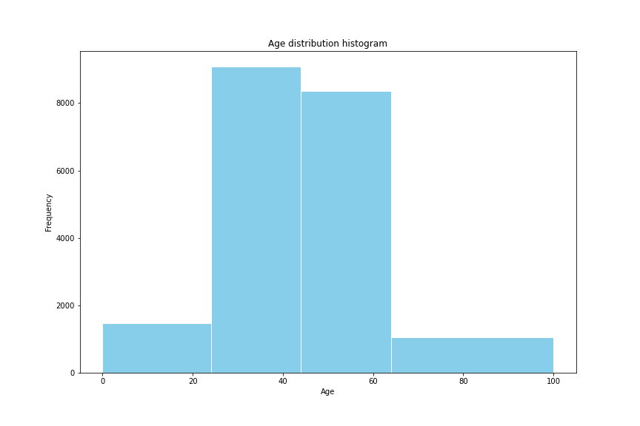
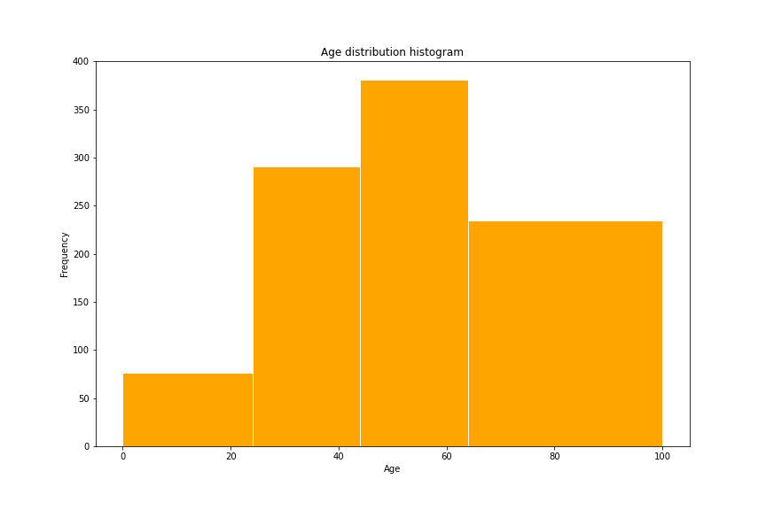
Note: The data and information in this document is reflective of a hypothetical situation and client. This document is to be used for KPMG Virtual Internship purposes only.
Data Exploration
Customers’ age distribution
The percentage of <25 is similar to the original customer groups.
There are fewer customers in the age group 25-44 years old.
Most new customers are in the age group 45-64 years old.
There are much more customers in the age group >=65.

Slide 5
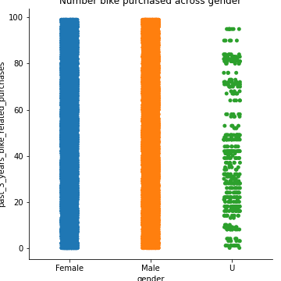
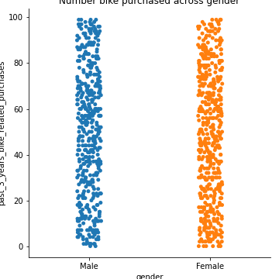
Note: The data and information in this document is reflective of a hypothetical situation and client. This document is to be used for KPMG Virtual Internship purposes only.
Model Development
Bike purchases within the last 3 years
In the new customers groups, there are slightly more female (50.6%/ 25,212 bikes) compared to male (47.7%/ 23,765 bikes) buyers.
The distribution the two group very similar, so depending on the marketing strategy, you could either try to attract more male buyers or focus on female retention rates.

Slide 6
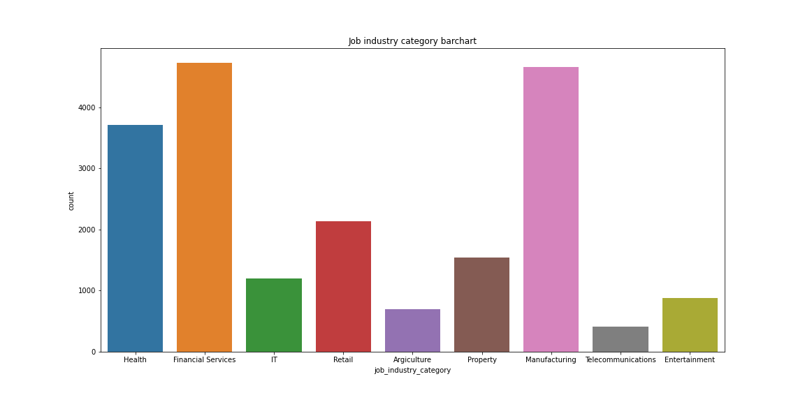
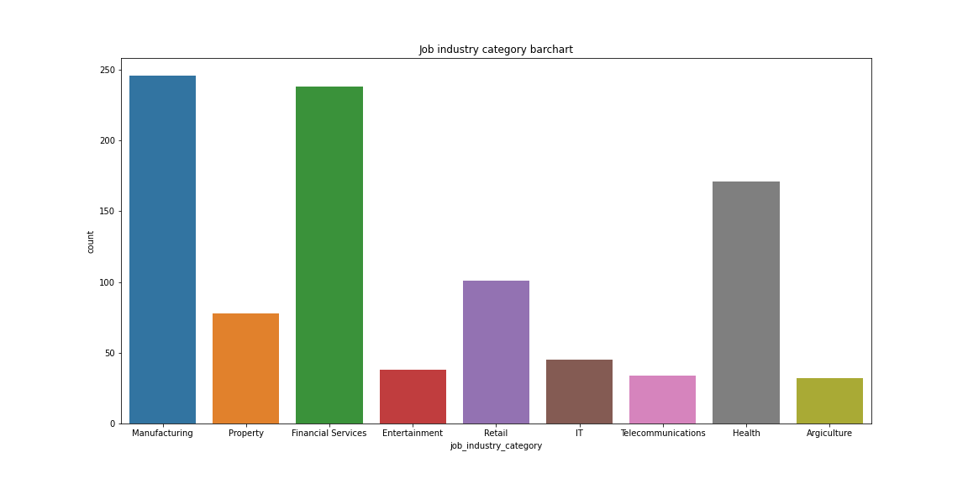
Note: The data and information in this document is reflective of a hypothetical situation and client. This document is to be used for KPMG Virtual Internship purposes only.
Interpretation
Job industry category
The industry profile of the new customers are shares some similarities to the old customers.
The top three industry for the original group are: Financial services, Manufacturing and Health (respectively).
The top three industry for the new group are: Manufacturing, Financial services and Health (respectively).

Slide 7
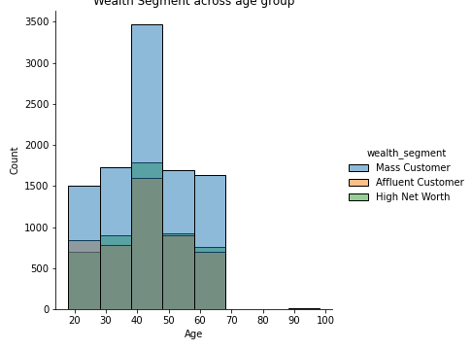
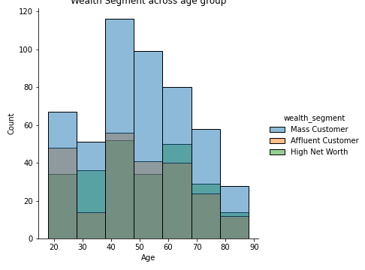
Note: The data and information in this document is reflective of a hypothetical situation and client. This document is to be used for KPMG Virtual Internship purposes only.
Interpretation
Wealth segments
The average and median age of the new group is older.
Across all ages, the number of ‘Mass’ customers makes up the largest group, safe for ages.
There are relatively lower proportion of ‘Mass’ customers compared with ‘High Net’ and ‘Affluent’ customers in the new groups.
We should focus on focus more on the two aforementioned groups.

Slide 8
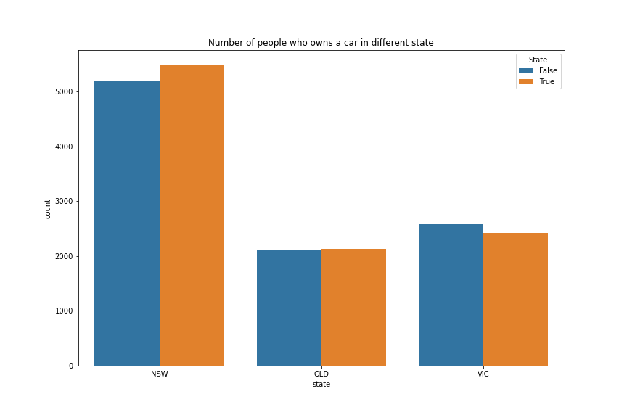
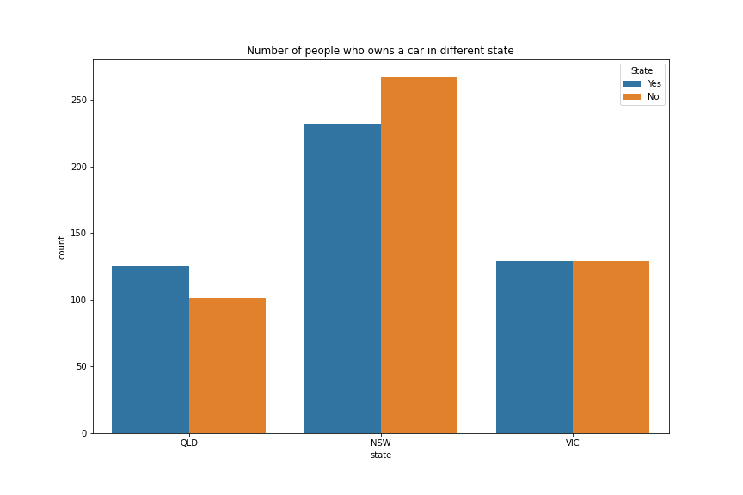
Note: The data and information in this document is reflective of a hypothetical situation and client. This document is to be used for KPMG Virtual Internship purposes only.
Interpretation
Numbers of cars owned in each state
NSW has the most number of owned cars, but proportionally has more customers who doesn’t own cars.
VIC is the next highest in the number of owned cars, and there relatively equal proportion who doesn’t own cars.
QLD has the least number of owned cars, so we could target this state.

Slide 9
Note: The data and information in this document is reflective of a hypothetical situation and client. This document is to be used for KPMG Virtual Internship purposes only.
Appendix

Slide 10
Note: The data and information in this document is reflective of a hypothetical situation and client. This document is to be used for KPMG Virtual Internship purposes only.
Appendix
https://github.com/MahaleVivek/KPMG-Virtual-Internship-Program/tree/main/module2

