Slide 1
SECURE CAMPUS FILE SHARING & DOCUMENT MANAGEMENT SYSTEM
Final Project Review Presentation
SMART SHARING SECURED STORAGE ACADEMIC WORKSPACE
Presented by:
MAHALINGAM S (Reg. No: 232MCAN0099 | Roll No: 23MCA5099)
MASTER OF COMPUTER APPLICATIONS (MCA)
Guided by:
Dr. K. KARTHIKEYAN, MSc., MPhil., PhD., SET.,
Assistant Professor of Computer Science Puratchi Thalaivi Amma Government Arts and Science College, Palladam - 641664.

Slide 2
THE CHALLENGE & THE VISION
THE PROBLEM
• Scattered Communication Channels
Academic materials are distributed over unmanaged chats, personal drives, and email chains.
• Malicious File Transmission
Insecure systems easily spread software bugs, malware, and malicious script formats.
• No Centralized Organization
Assignments, question papers, and syllabus copies sit unorganized in single locations.
• Missing Tracking & Audit Logs
Staff cannot verify who uploaded, modified, or downloaded sensitive official documents.
THE VISION
✔ Unified Academic Drive
A central repository for isolated department drives and virtual folders.
✔ Safe & Sandbox Storage
Filename obfuscation and check filters prevent unauthorized backend execution.
✔ Auto-Sorting Index Engine
An NLP-based file categorizer sorts files automatically on upload (e.g. Lab Records, Syllabus).
✔ Accountable Action Trail
Maintains real-time history logging of every single file interaction for safety.

Slide 3
CORE PLATFORM FEATURES
ISOLATED WORKSPACES
—
✦ Department-level virtual drives
✦ Private storage folders for users
✦ Hierarchical nested folders
✦ Clean, modern UI layout
SMART AUTO-SORTING
—
✦ Parses upload filename patterns
✦ Recognizes keywords automatically
✦ Sorts into: Assignments, Lab Records, Syllabus, Lecture Notes
✦ Reduces manual directory sorting
ROLE-BASED VISIBILITY
—
✦ Student dashboard for coursework
✦ Faculty control panel for classes
✦ Admin control system dashboard
✦ Restricted access permissions

Slide 4
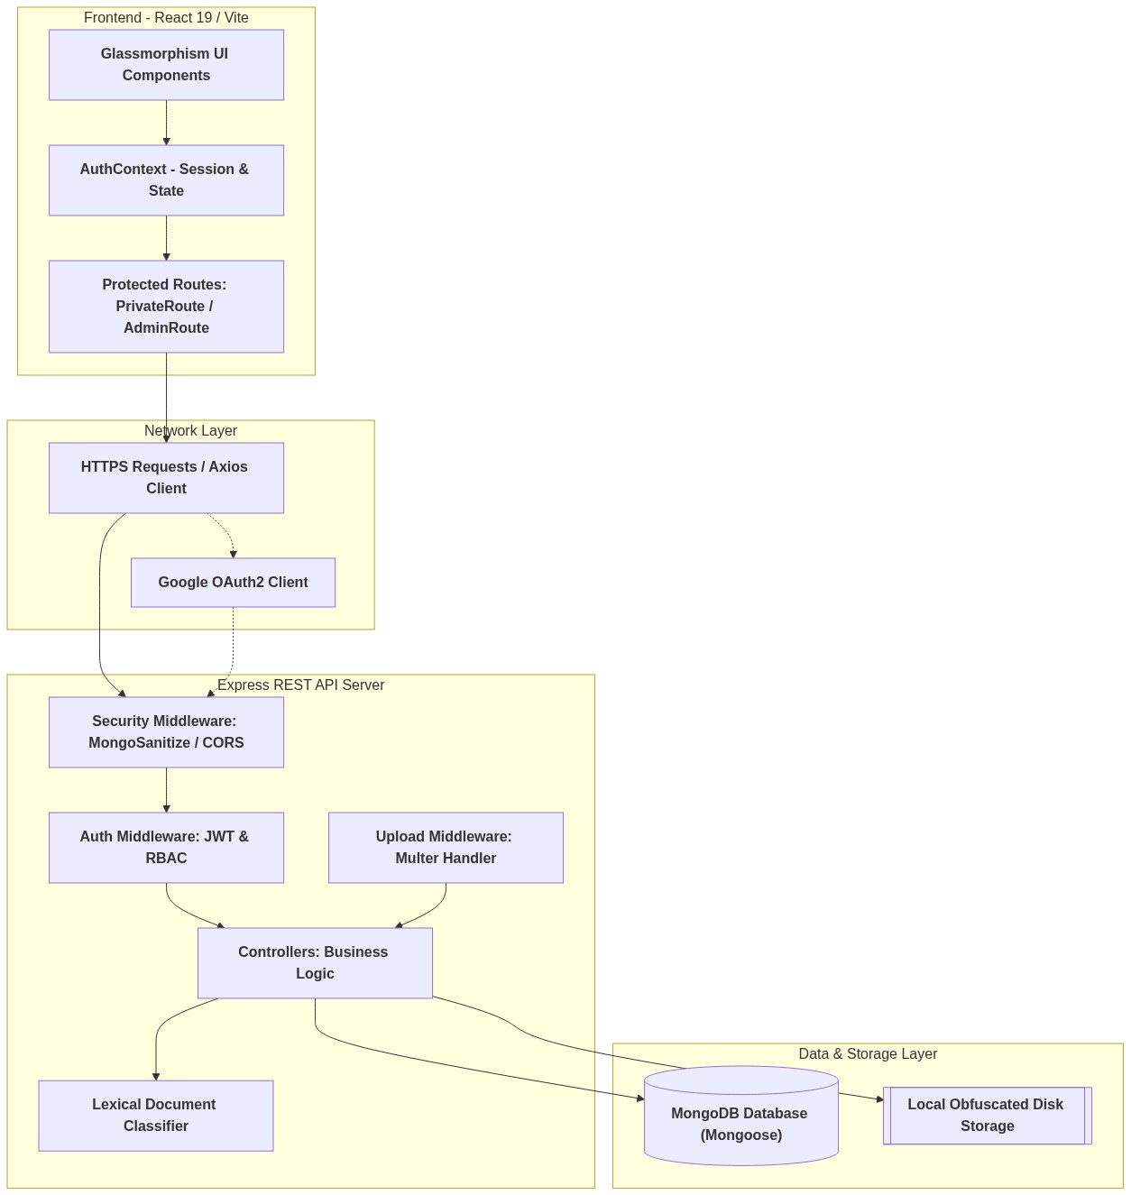
HIGH-LEVEL SYSTEM ARCHITECTURE

Slide 5
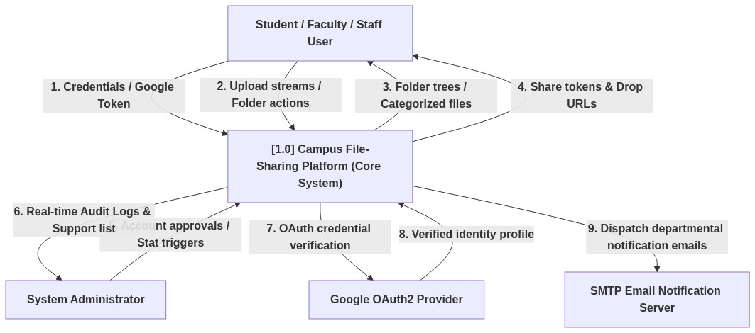
DATA FLOW DIAGRAM (LEVEL 0 - CONTEXT)

Slide 6
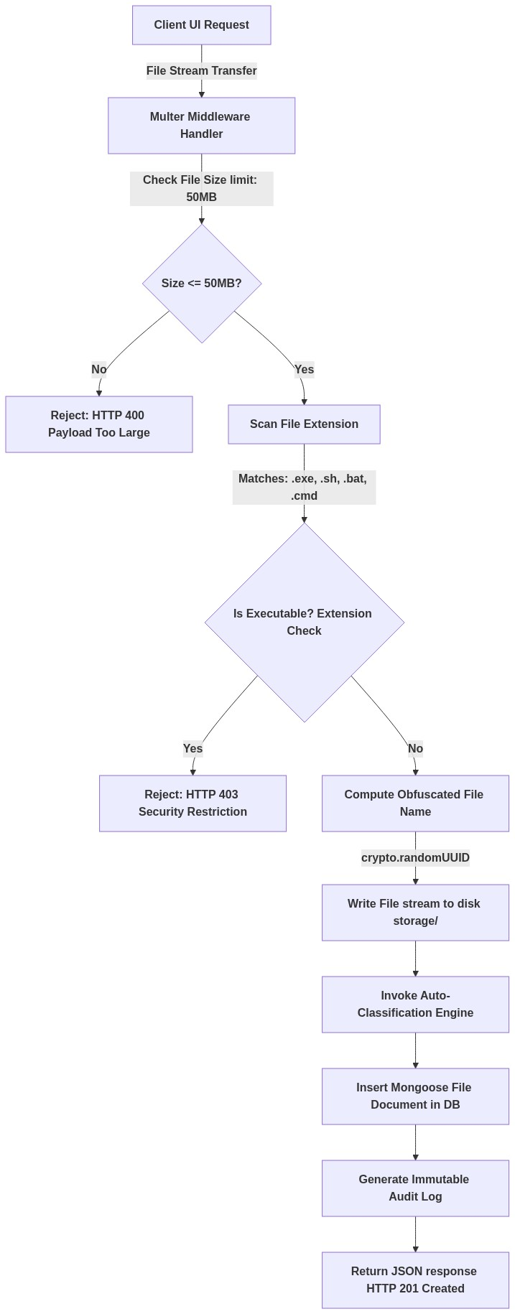
SECURE UPLOAD & OBFUSCATION FLOWCHART

Slide 7
SPECIAL ACADEMIC COLLABORATION TOOLS
ANONYMOUS COURSEWORK DROPBOXES
★ Faculty Setup Control
Faculty creates a dropbox folder, setting a secure cutoff submission deadline.
★ Secure Upload-Only Link
A custom hash URL (/drop/:token) is given to students. They drop coursework directly.
★ Student-to-Student Isolation
Students cannot view or read other submissions in the folder, ensuring total grading privacy.
★ Automated Cutoff Enforcement
System strictly blocks uploads when the deadline is crossed.
CONTROLLED FILE SHARING
✔ Temporary Tokenized Links
Files share via secure hash keys, bypassing direct path access of standard servers.
✔ Time-Limited Expiry
Configure share validity windows (e.g., automatically expire in 2, 12, or 24 hours).
✔ Download Quantity Limiters
Links self-destruct after reaching a download count threshold (e.g., single download link).
✔ Instant Revocation Dashboard
File owners can cancel any shared link instantly from their control panel.

Slide 8
SECURITY & ACCOUNTABILITY
FILE SHIELDING
—
✦ Obfuscates file filenames to UUIDs on disk
✦ Strips extension paths to stop traversal
✦ Rejects executable formats (.exe, .sh)
✦ Enforces strict upload size limit (50MB)
VERIFICATION BADGES
—
✦ Official files vetted by administrators
✦ Special 'Verified' badges in directory feeds
✦ Protects students from opening fake files
✦ Maintains authentic institutional channels
IMMUTABLE AUDITING
—
✦ Automatic diary of system operations
✦ Logs User, Action, Target, IP, & Time
✦ Helps track file leakage or illegal uploads
✦ Clean query screen for administrative audits

Slide 9
KEY BENEFITS TO THE INSTITUTION
STUDENT & FACULTY EXPERIENCE
• Premium Glassmorphism Interface
Modern visual aesthetics built with dark theme and blur elements.
• Universal Responsive Screen Compatibility
Flawless usability across mobile phones, tablets, and computers.
• Organized Resource Access
Eliminates confusion by having files sorted in correct drawers (CSE, MCA, ECE).
• Collaborative Helpdesk
Direct integrated ticket screen to request staff assistance.
ADMINISTRATIVE & SAFETY VALUE
✔ Zero Execute Security Risks
Physical server files cannot run executable scripts, maintaining sandbox safety.
✔ Strict Identity Registration Gate
User registration validation binds emails to authentic institutional users.
✔ Dynamic Audit-Driven Monitoring
Admins keep track of storage growth and delete/audit log details instantly.
✔ Automated Time Cleanups
Backend sweeps database regularly to wipe expired sharing tokens.

Slide 10
CONCLUSION & REVIEW SUMMARY
PROJECT HIGHLIGHTS
✔ Centralized Digital Drive System
Successfully replaces disorganized email and chat file share threads.
✔ Filename-Based Lexical Sorter
Saves student/teacher time by sorting file categories instantly on upload.
✔ Tokenized Deadlined Dropboxes
Solves coursework collections securely while preserving privacy.
✔ Comprehensive Security Controls
Provides defense-in-depth including sanitization and obfuscation.
THANK YOU
SECURE CAMPUS FILE SHARING & DOCUMENT MANAGEMENT SYSTEM
Guided by:
Dr. K. KARTHIKEYAN, MSc., MPhil., PhD., SET.,
Assistant Professor of Computer Science Puratchi Thalaivi Amma Government Arts and Science College,
Palladam - 641664.

