Slide 1
SECURE CAMPUS FILE SHARING & DOCUMENT MANAGEMENT SYSTEM
Final Project Review Presentation
MERN STACK FULL-STACK WEB APP SECURE & AUDITED
Presented by:
MAHALINGAM S (Reg. No: 232MCAN0099 | Roll No: 23MCA5099)
MASTER OF COMPUTER APPLICATIONS (MCA)
Guided by: DR.T.PARIMALAM (Associate Professor & Head)
PG & Research Dept. of Computer Science, Nandha Arts and Science College, Erode

Slide 2
PROJECT OVERVIEW & KEY CHALLENGES
THE CAMPUS PROBLEM
• Fragmented Sharing Channels
Academic resources are scattered across emails, chat apps, and physical USB drives.
• Security Vulnerabilities
Risks of executable file injections, malware distribution, and NoSQL query injection.
• No Access Controls (RBAC)
Students, faculty, and administrative staff share the same paths without isolated environments.
• Lack of Audit Trail
No immutable tracking of file uploads, downloads, or shares, compromising compliance.
THE SYSTEM SOLUTION
✔ Isolated Workspace Drives
Separate Department Drives and private folders for organized digital storage.
✔ Advanced Security Protections
Uses filename obfuscation, Multer middleware restrictions, and MongoDB sanitization.
✔ Granular Role-Based Access
Explicit levels of operation tailored for Students, Faculty, Staff, and Admins.
✔ Intelligent Auto-Classification
Integrated NLP lexical engine reads filenames to auto-categorize uploads.
✔ Expiring Links & Drop Folders
Supports secure tokenized share links and anonymous coursework Dropboxes.

Slide 3
SYSTEM ARCHITECTURE OVERVIEW
FRONTEND LAYER
React 19 & Vite
—
• Premium Glassmorphism UI
• Dynamic CSS Mesh Background
• Responsive Tailwind Layouts
• Axios HTTP Client
• Google OAuth Popup Component
NETWORK & ROUTING
Express API Router
—
• RESTful API Architecture
• JWT Session Validation
• RBAC Custom Middleware
• Multer File Stream Handler
• MongoSanitize Guard
NLP & LOGIC ENGINE
Lexical Classifier
—
• Heuristic keyword parsing
• MIME fallback validation
• Tokenized sharing system
• Auto-clean expired links
• Dropbox submission handler
DATA & STORAGE
MongoDB & Disk Store
—
• Mongoose ODM Schema validations
• Indexes (email, shareToken)
• Local Disk Storage Obfuscation
• UUID file mapping
• Immutable Audit Logging

Slide 4
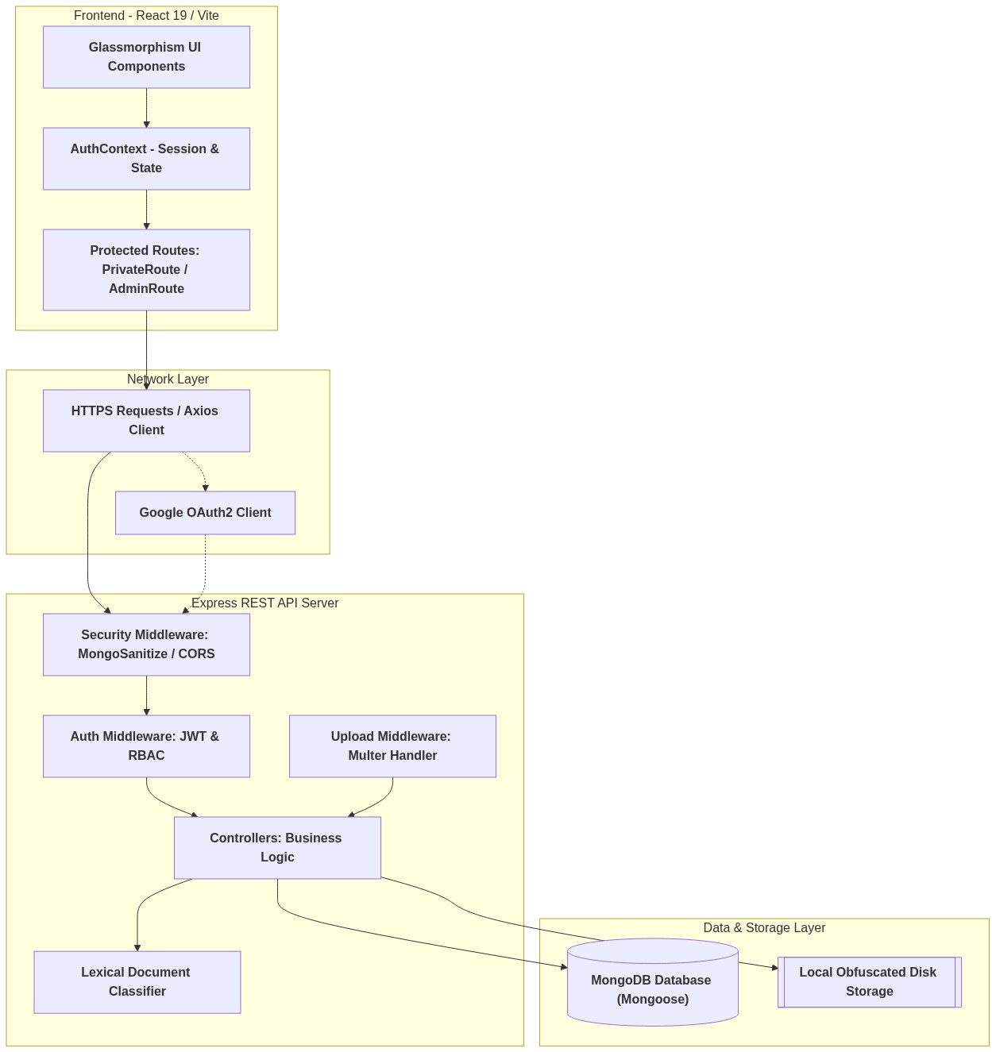
HIGH-LEVEL ARCHITECTURE DIAGRAM

Slide 5
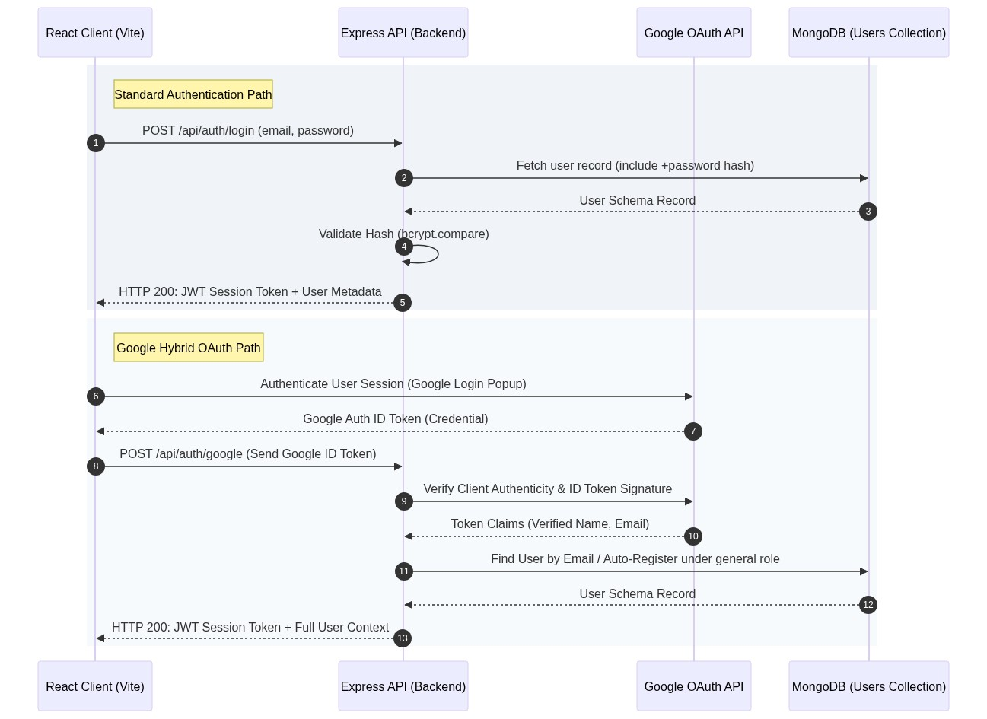
AUTHENTICATION & IDENTITY MANAGEMENT FLOW

Slide 6
CORE DATABASE SCHEMA & ER MODEL
DATABASE ENTITY RELATIONS
■ USER (1) ── (N) FILE
A user can upload and own multiple files in the system.
■ USER (1) ── (N) FOLDER
Folders are created and owned by specific user accounts.
■ USER (1) ── (N) AUDIT_LOG
All user actions trigger entries in the audit logs database.
■ FOLDER (1) ── (N) FILE
Virtual directories catalog files via folderId Mongoose references.
■ FILE (1) ── (N) SHARED_LINK
Granular share configurations generated for file tokens.
■ Polymorphic Schemas
Help tickets and audit records map dynamically to trigger entities.
MONGOOSE COLLECTION BLUEPRINTS
• User Model (User.js)
Stores name, email (UK), role (student, faculty, staff, admin), department, password (select: false).
• File Model (File.js)
Stores originalName, storageName (UUID, UK), folderId, ownerId, mimeType, sizeBytes, category, department, shareToken, downloadLimit, downloadCount.
• Folder Model (Folder.js)
Tracks name, parentId (self-ref tree), ownerId, isDropFolder, deadline (Date), shareToken, department, isPublicToDepartment.
• AuditLog Model (AuditLog.js)
Immutable logs of user actions. Tracks userId, action (upload, download, share, etc.), entityType, entityId, details, ipAddress.

Slide 7
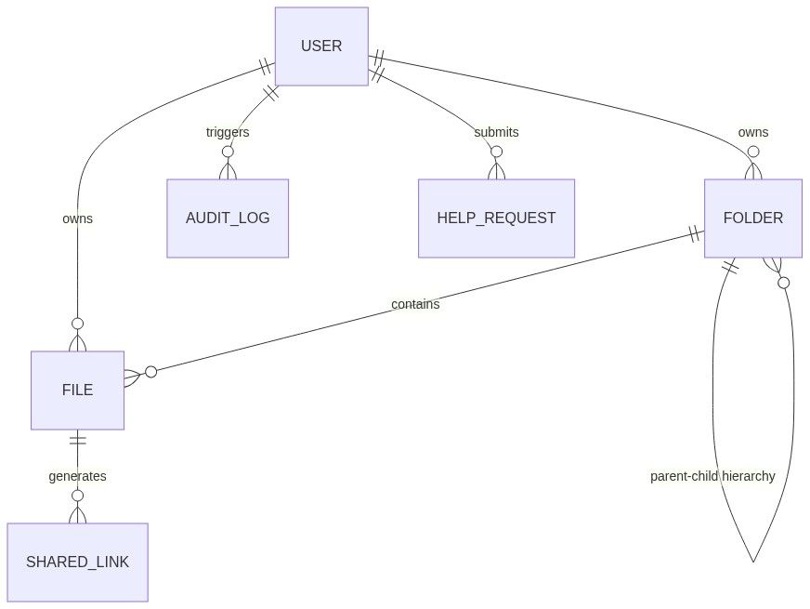
ENTITY RELATIONSHIP (ER) DIAGRAM

Slide 8
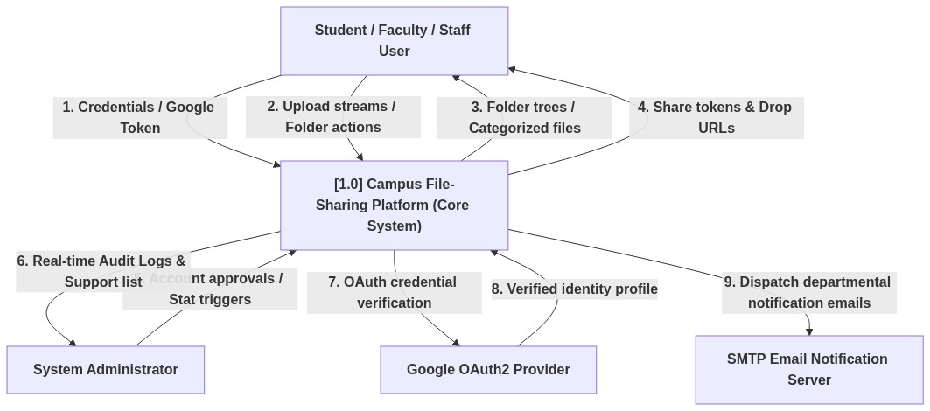
DATA FLOW DIAGRAM (LEVEL 0 - CONTEXT)

Slide 9
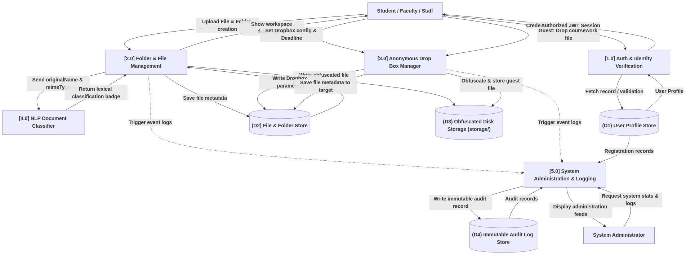
DATA FLOW DIAGRAM (LEVEL 1 - FUNCTIONAL)

Slide 10
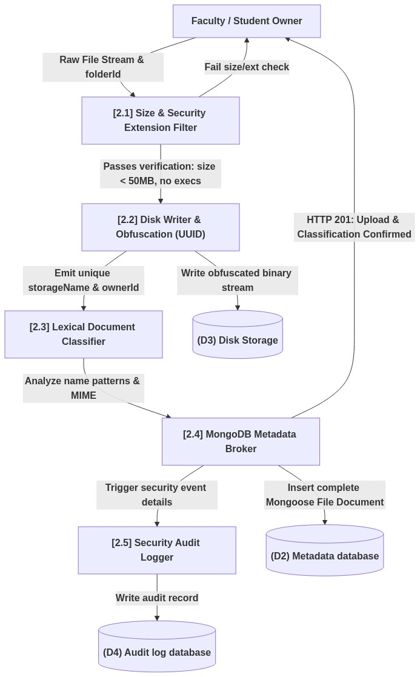
DATA FLOW DIAGRAM (LEVEL 2 - UPLOAD & VERIFICATION)

Slide 11
WORKFLOW: SECURE UPLOAD & OBFUSCATION STEPS
1. Stream Transfer
▼
Client UI sends file stream via Axios multipart FormData to the backend server.
2. Multer Filter
▼
Checks maximum file size (50MB) and rejects executable formats (.exe, .sh, .bat).
3. Obfuscation
▼
Renames physical file to a random crypto UUID, stripping original extension on disk.
4. NLP Classify
▼
Passes original file name and MIME to classifier engine to determine category.
5. Write & Audit
▼
Saves File Model metadata in MongoDB and writes an immutable, tracking Audit Log.

Slide 12
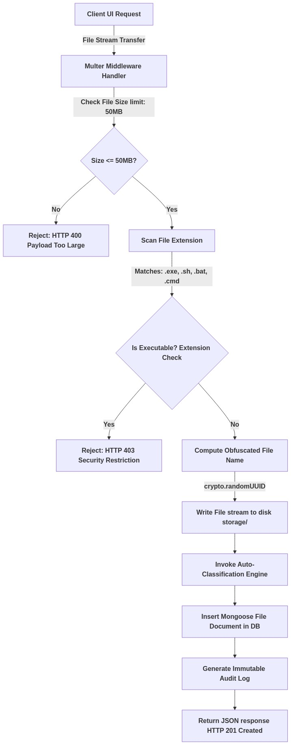
SECURE UPLOAD & SECURITY FILTERING FLOW

Slide 13
NLP-LEXICAL DOCUMENT CLASSIFICATION
CLASSIFIER LOGIC ENGINE
Filename Pattern Mapping
Reads original name tokens in lowercase. Priority keywords map straight to academic divisions:
• 'assignment', 'hw', 'homework'
Categorized as Assignments
• 'lab', 'record', 'experiment'
Categorized as Lab Records
• 'syllabus', 'curriculum'
Categorized as Syllabus
• 'question', 'paper', 'exam'
Categorized as Question Papers
MIME Type Fallback Rules
If no keywords match, maps files by standard MIME category rules:
• image/* → Images | video/* → Videos
application/pdf → Documents
• spreadsheet / excel / csv
Categorized as Spreadsheets
CLASSIFIER CODE SNAPSHOT
const classifyFile = (filename, mimeType) => { const name = filename.toLowerCase(); if (name.includes('assignment') || name.includes('hw')) return 'Assignments'; if (name.includes('lab') || name.includes('record')) return 'Lab Records'; if (name.includes('exam') || name.includes('paper')) return 'Question Papers'; if (name.includes('syllabus')) return 'Syllabus'; // Fallback Category Mapping based on MIME if (mimeType.startsWith('image/')) return 'Images'; if (mimeType.includes('pdf')) return 'Documents'; if (mimeType.includes('excel')) return 'Spreadsheets'; return 'Uncategorized'; };

Slide 14
ANONYMOUS COURSEWORK DROP FOLDERS
FACULTY WORKSPACE SETUP
★ Dropbox Configuration
Faculty members create a normal virtual folder and toggle the Dropbox settings, adding a submission cut-off deadline.
★ Tokenized Drop Links
The API generates a secure URL hash token e.g., `/drop/:token` which is shared with students.
★ Security Isolation
External/unauthenticated users can drop file streams into the box but cannot view other files inside the folder.
SUBMITTER / GUEST OPERATION FLOW
✔ URL Access Check
The server verifies that current Date.now() is within the configured folder deadline range.
✔ Clean Submission Panel
Submitter views a simple file drop card. Other student submissions are completely hidden for privacy.
✔ Owner Assignment & Auditing
Uploaded file owner is set to the Faculty Creator, file is placed in target folderId, and audit entry logs the IP address.

Slide 15
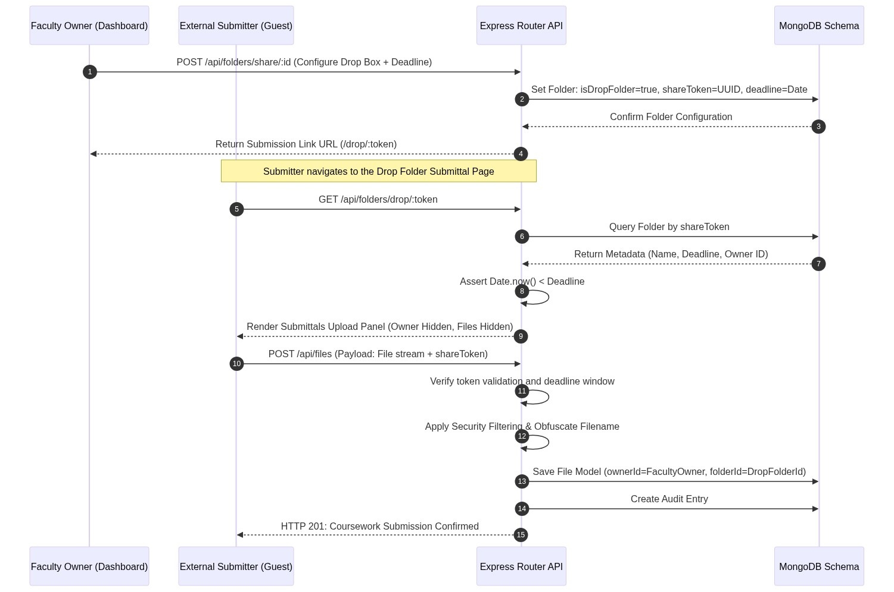
ANONYMOUS DROP FOLDER SUBMISSIONS FLOW

Slide 16
REST API ENDPOINTS & ACCESS CONTROL
AUTHENTICATION (/api/auth)
—
POST /register — Setup accounts
POST /login — Issue JWT
POST /google — OAuth Auto-Register
GET /me — Session profile metadata
DELETE /me — Account termination
RESOURCES (/api/files & /folders)
—
POST /files — Upload with checks
GET /files/download/:id — Secure fetch
POST /files/share/:id — Share token
POST /folders — Create directory trees
POST /folders/share/:id — Active Dropbox
ADMIN & SUPPORT (/api/admin & /help)
—
GET /admin/logs — Immutable action trail
GET /admin/stats — File/user statistics
PATCH /admin/users/:id/approve — RBAC gate
PATCH /admin/files/:id/verify — Verify document
POST /help/request — Ticket pipeline

Slide 17
SECURITY ARCHITECTURE & VULNERABILITY MITIGATION
MITIGATING CAMPUS SECURITY THREATS
✘ NoSQL Database Injection
Attackers inject malicious query operators into email or password fields to bypass login schemes.
✘ Directory Traversal Attacks
Attackers pass custom paths in requests to read configurations and secret files outside target paths.
✘ Malicious File Execution
Uploading backdoor scripts (.php, .exe, .sh) which can run on the hosting server instance.
INTEGRATED SYSTEM DEFENSES
✔ Global MongoSanitize Middleware
Express servers run `express-mongo-sanitize` on all requests. Automatically strips prohibited keys ($ and .) used in DB injections.
✔ Filename UUID Obfuscation
No file retains its user-uploaded path. Obfuscated UUIDs are stored on disk in disk-storage. Original associations sit strictly behind DB security.
✔ Multer Extension Blocklists
Enforces checks rejecting files with blocked extensions. Mime-type signatures verify content legality prior to disk writing.

Slide 18
UI/UX DESIGN SYSTEM & AESTHETICS
GLASSMORPHISM CARDS
—
✦ Floating panel representation via styling
✦ Backdrop blur rules (blur(16px))
✦ Minimalist 1px border lines
✦ Deep Slate transparent layers
✦ High contrast interactivity
DYNAMIC MESH GRADIENT
—
✦ Harmonious slate HSL dark theme
✦ Animated background mesh canvas
✦ Smooth transition states on hover
✦ Inspires clean workspace interactions
✦ Eliminates static layout fatigue
COLORED SYSTEM BADGES
—
✦ Assignments: Emerald Green
✦ Circulars: Amber Yellow
✦ Lab Records: Intense Cyan
✦ Syllabus: Royal Purple
✦ Lecture Notes: Sapphire Blue

Slide 19
INSTALLATION & CONFIGURATION BLUEPRINT
ENVIRONMENT SETTINGS
# Backend - backend/.env PORT=5000 MONGO_URI=mongodb+srv://<db_user>:<pwd>@cluster... JWT_SECRET=high_entropy_secret_key_value EMAIL_USER=institutional-email@gmail.com EMAIL_PASS=gmail_app_specific_password # Frontend - frontend/.env VITE_API_URL=http://localhost:5000/api VITE_GOOGLE_CLIENT_ID=google-oauth-client-id-key
CLI SETUP & DEPLOYMENT
■ Backend Package Install
cd backend && npm install
■ Frontend Package Install
cd frontend && npm install
■ Database Wipe & Seed Script
cd backend && node wipe-and-seed.js (Seeds students, faculty, files, directories)
■ Promote User to Admin
node make-admin.js --email=user@domain.edu
■ Launch Systems Locally
Backend: npm run dev (Runs server on PORT 5000) Frontend: npm run dev (Runs Vite on PORT 5173)

Slide 20
CONCLUSION & FINAL REVIEW SUMMARY
KEY PROJECT HIGHLIGHTS
✔ Seamless Academic Workflow
Centralized, secure space replacing scattered emails and chats.
✔ NoSQL & Extension Defense
Production-hardened upload sanitization blocking backdoors.
✔ Heuristic Categorization
NLP classifier parses files to auto-organize academic directories.
✔ Google OAuth Integration
Hybrid identity validation combining standard login with Google accounts.
✔ Expiring Link Audits
Automatic cleanups of expired links and real-time audit logging.
THANK YOU & QUESTIONS
SECURE CAMPUS FILE SHARING & DOCUMENT MANAGEMENT SYSTEM
PG & Research Department of Computer Science
Nandha Arts and Science College, Erode
Open to Queries & Feedback

