Slide 1
STUDENT VOTING SYSTEM
Name : Mahalingam.G
RollNo : 17Mss028
Class : III-Year
Department : MSc(Software System)
Guide name : Dr.K.V .Rukmani MCA,ME,PhD

Slide 2
INTRODUCTION
A Voting System is a Application used to register and tabulate votes.
In the Manual Voting System the Student can cast their vote through Manual.
In this Project the administrator adds all voters list in the database. After adding ,the administrator provides login details with voter Id(rollno) to the users.
The voters can vote for the candidates by entering their login Id and password.

Slide 3
ABSTRACT
This project is based on the Student voting system using VB.net as Front End and SQL as Back End .
Each person has their individual identity and so duplication is avoided
Admin already stored the voter identity in the database .
The admin can add voter identity using admin login . The voters can vote for the candidates by entering their login id and password .
An Admin login is used in order to fetch the result of the winner and all other statistics such as of who all are voted and so on.

Slide 4
Problem Description:
Manual it takes more time.
Expensive process.
It takes more effort and physical space to keep track of paper document .
Lack of security .
Duplication of entry .

Slide 5
Proposed system :
In the proposed system we can get the result without manual counting .
Computerized counting is simple .
Computerized voting can reduce or remove unwanted human error .
Secure and convenient way to cast their Votes .
Time saving .
Working load reduced .
Information available at time .
It provides security to the data .

Slide 6
PROJECT OVERVIEW USER MODULE:
The user module allows users to log in, and cast their vote .
The user module supports user roles, which can be set up with fine-grained permissions allowing each role to do only what the administrator permits. Each user is assigned one or more roles.
Registered users need to authenticate by supplying their username and password , to login.

Slide 7
Admin Module:
In this project the Admin module allows the administrator to add the candidate Names and user login.
It also allow to add voter name in the database .
And also to view the Result stored in the Database ,Students accounts management and control.
To change or Reset Password is also done by Administrator.

Slide 8
HARDWARE REQUIREMENT:
Processor : Intel dual core or above
Processor Speed : 1.0GHz or above
RAM : 1 GB RAM or above
Hard Disk : 128 GB hard disk or above
SOFTWARE REQUIREMENT:
Front End : Vb. Net
Back End : SQL
Operating System : Windows 7 or above

Slide 9
FORM DESIGN

Slide 10
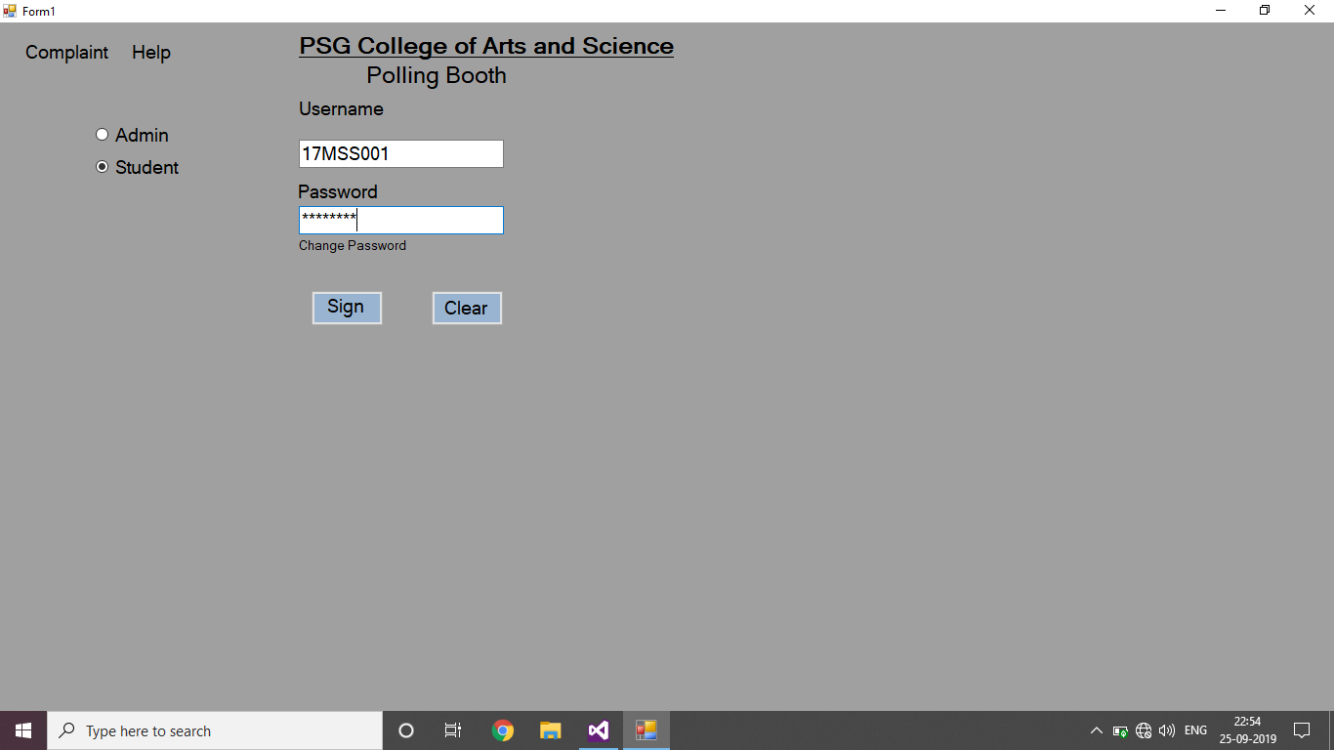
FORM1 DESIGN

Slide 11


Slide 12
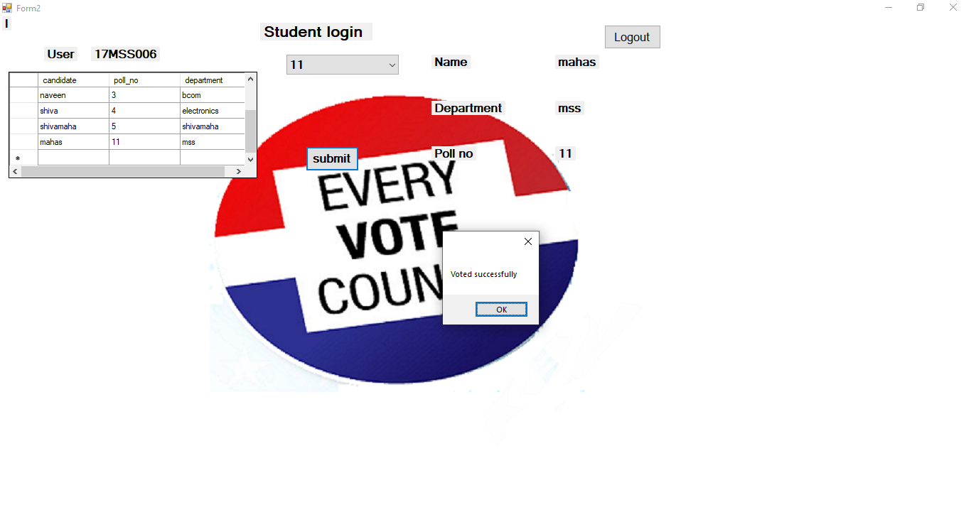
FORM2 DESIGN
logout

Slide 13
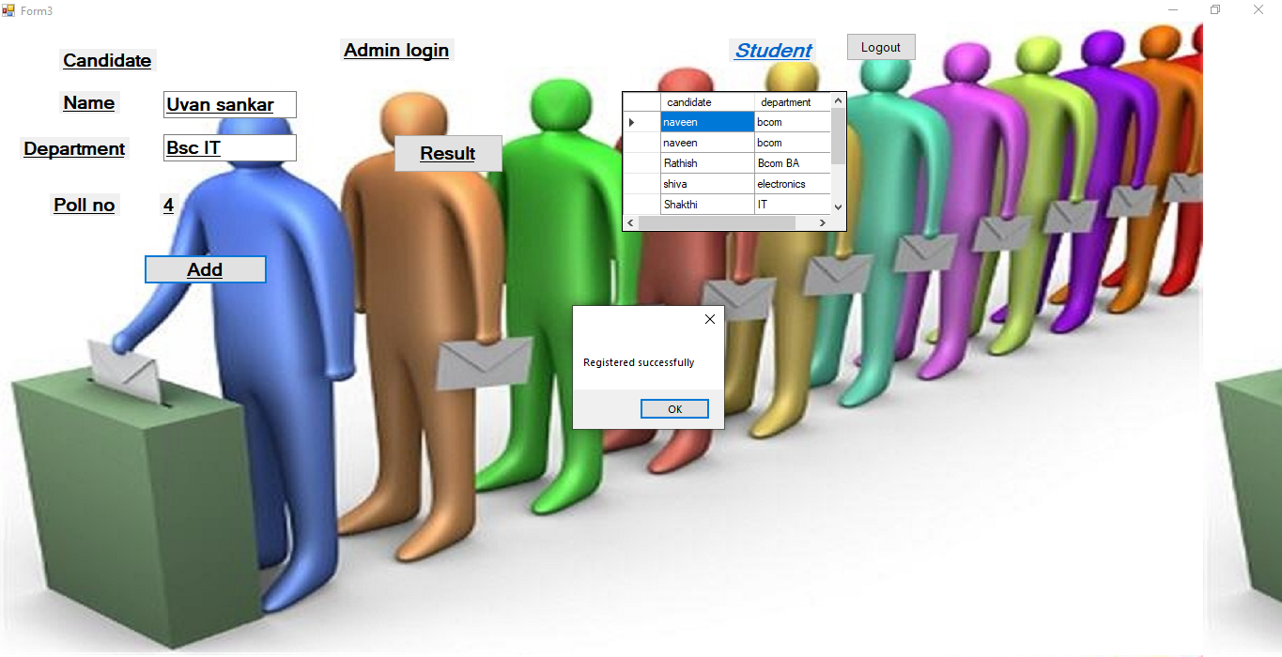
FORM3 DESIGN

Slide 14
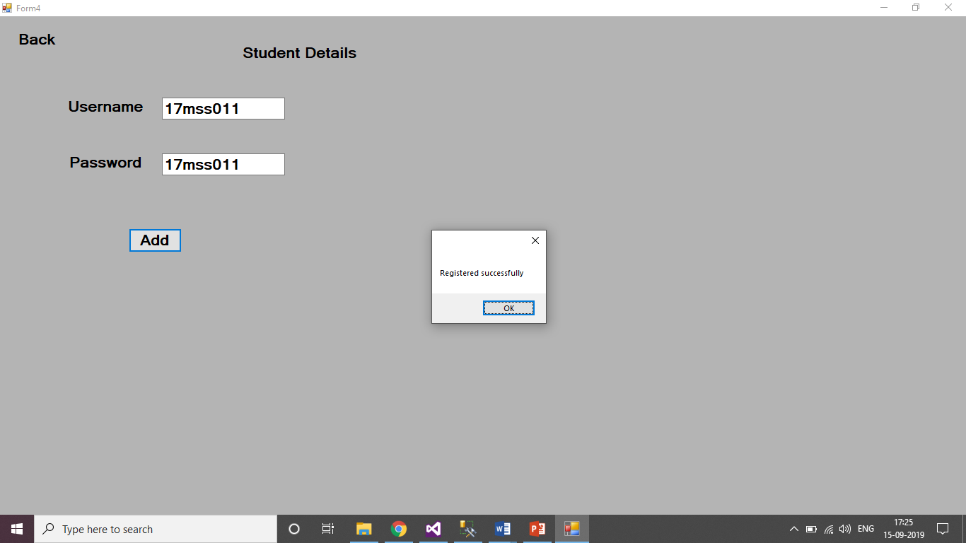

Slide 15
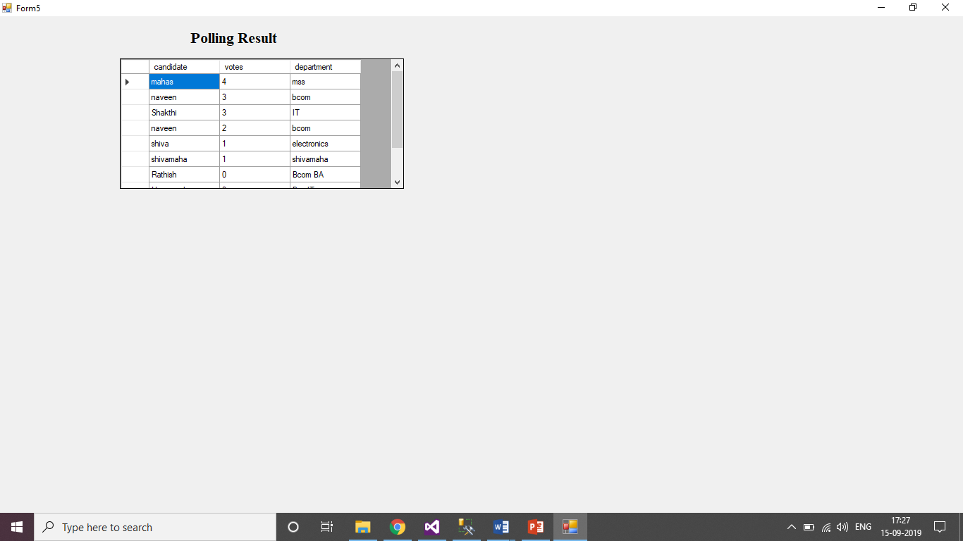

Slide 16
Admin Table :
FIELD | DATA TYPE | CONSTRAINS | DESCRIPTION
Username | Varchar(50) | Not NULL | Roll no of the Administrator
Password | Varchar(50) | Not NULL | Password of the Administrator

Slide 17
Login 1 table:
FIELD | DATA TYPE | CONSTRAINS | DESRIPTION
Roll no | Vachar(50) | Not NULL | Rollno of the student
Password | Vachar(50) | Not NULL | Password of the student
Voted for | Vachar(50) | Not NULL | Person who voted for

Slide 18
Result table:
FIELD | DATA TYPE | CONSTRAINS | DESCRIPTION
Candidates | Vachar(50) | Not NULL | Name of the candidate
Votes | Vachar(50) | Not NULL | Number of votes of an individual candidate
Poll no | int | Primary key | Poll number of the candidate
Department | Vachar(50) | Not NULL | Department of the Candidate

Slide 19
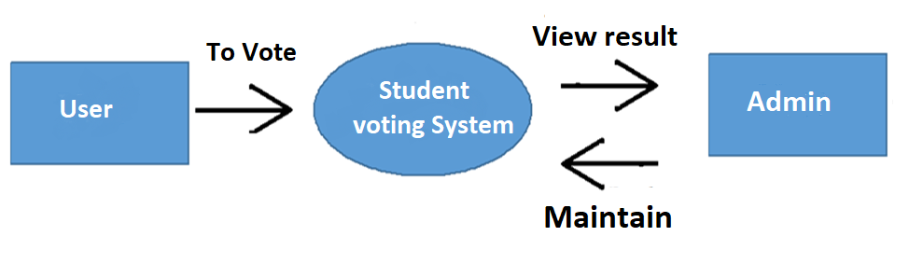
Data Flow Diagram
Level-0

Slide 20
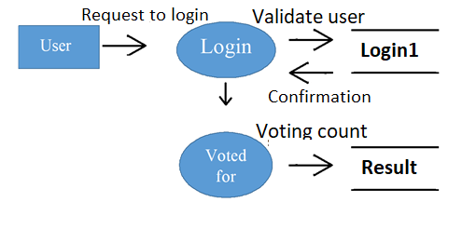
Level-1

Slide 21
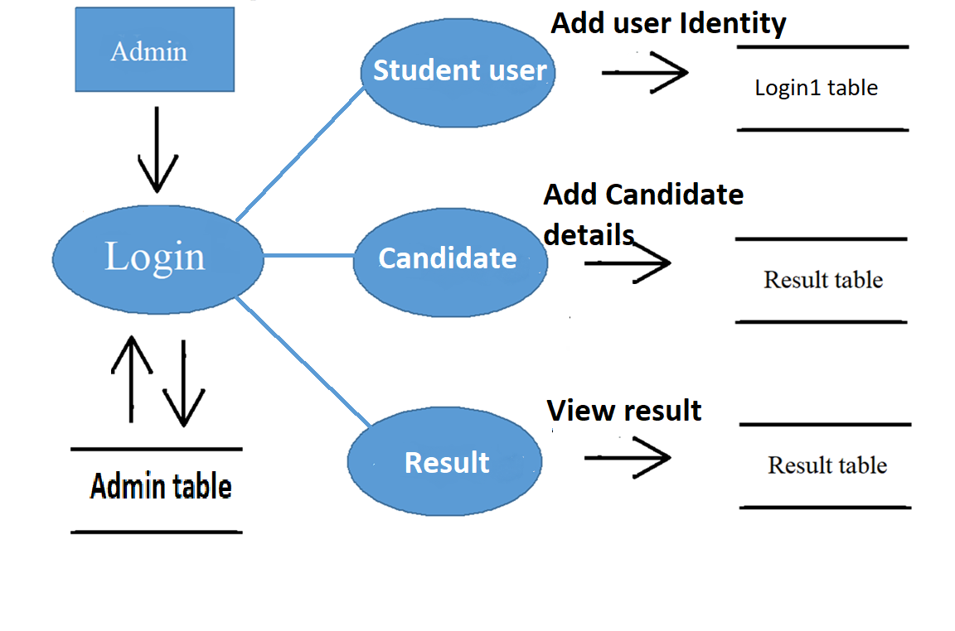
Level- 2

Slide 22
E-R Diagram:
POLL_NO
USERNAME
VOTES
CANDIDATE
1
ACCESS
M
ADMIN
RESULT
1
DEPARTMENT
PASSWORD
VOTES
M
1
LOGIN 1
ROLL NO
VOTED_FOR
PASSWORD

Slide 23
Thank you

