Slide 1
Angular

Slide 2

Agenda
What is Angular ?
Why Angular !!
Features
Components
Modules
Service
Directives
Data Binding
Routing
pipes
Type-Script & ES6
Evaluation of Angular vesion 2 – 9
Angular vs react

Slide 3

What is Angular?
Angular is a JavaScript open-source front-end web application framework.
Angular helps build interactive and dynamic single page applications.
Angular uses HTML to define the UI of the application.
In Angular, testing is extremely simple.
Angular framework is embedded with original MVC (Model-View-Controller) software architectural setup.

Slide 4
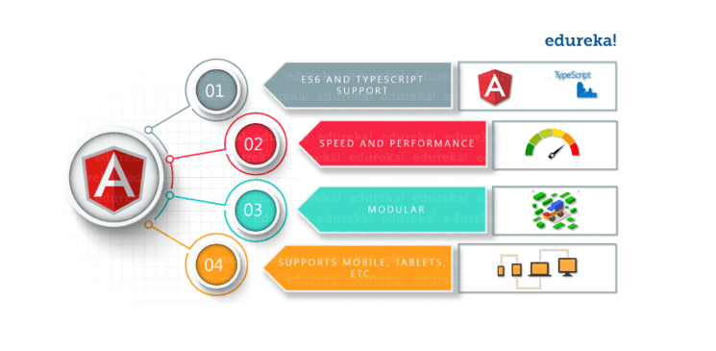
Why Angular !!
Angular 2.0 is written in Typescript.
Components
Service
Easy to learn
Two way Data Binding
Performance
Testability
Benifits of Angular.
Notes:
React uses one-way data binding

Slide 5

Features of Angular
Service Worker Support.
MVC Architecture
Efficient Two-Way Data Binding
Angular CLI (Command Line Interface)
Dependency Injection
Typescript
Directives
Internationalization.
Modules, components and services are classes that use decorators.

Slide 6

Type Script!!
TypeScript is a typed superset of javascript.
This is pure object oriented with classes, interfaces and statically typed like Java.
TypeScript also automatically populates the root file configuration for easy compilation
In comparison to JavaScript, TypeScript has richer enums, interfaces, generics, hybrid types, union/intersection types, access modifiers, etc.

Slide 7
Components
An Angular Application is a tree of Components are self-contained building blocks of web application.
This helps in better maintaining the application over a period of time.
Components use services, which provide specific functionality not directly related to views.
root component that connects a component hierarchy with the page document object model (DOM) and reusable

Slide 8
Routing
It Defines a navigation path among the different application states.
The router maps URL-like paths to views instead of pages.
The router interprets a link URL according to your app's view navigation rules and data state.
ng new routing-app –routing
const routes: Routes = [
{ path: 'first-component', component: FirstComponent },
{ path: 'second-component', component: SecondComponent },
];

Slide 9
Directives
A directive is a class with a @Directive() decorator.
It help to renders the dynamic Angular templates based on the instruction.
Create custom HTML tags serving as custom widgets.
We can manipulate DOM attributes as per needs
Attribute directives
Alter the appearance or behavior of an existing element.
In templates they look like regular HTML attributes.
<input [(ngModel)]="hero.name">
Structural directives
Alter layout by adding, removing, and replacing elements in the DOM.
<li *ngFor="let hero of heroes"></li>

Slide 10
Data Binding
Event binding
Property binding
lets your app respond to user input in the target environment by updating your application data.
<label (click)="selectHero(hero)">
</label>
lets you interpolate values that are computed from your application data into the HTML.
<app-hero-detail [hero]="select Hero"></app-hero-detail>

Slide 11
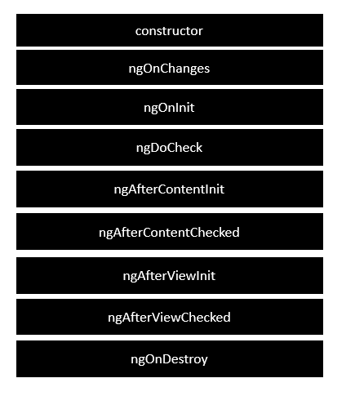
Life-Cycle Methods
ngOnChanges − When the value of a data bound property changes, then this method is called.
ngOnInit − This is called whenever the initialization of the directive/component after Angular first displays the data-bound properties happens.
ngDoCheck − This is for the detection and to act on changes that Angular can't or won't detect on its own.
ngAfterContentInit − This is called in response after Angular projects external content into the component's view.
ngAfterContentChecked − This is called in response after Angular checks the content projected into the component.
ngAfterViewInit − This is called in response after Angular initializes the component's views and child views.
ngAfterViewChecked − This is called in response after Angular checks the component's views and child views.
ngOnDestroy − This is the cleanup phase just before Angular destroys the directive/component.

Slide 12
ES 6
Use const or let instead of var
Classes
Object Destructuring – [import ReactDOM from 'react-dom']
Arrow Functions (=>)
es6 explicit return (same as above)
const sayHello = () => {
return 'i am saying hello'; }
es6 implicit return 1-liner (same as above)
const sayHello = () => 'i am saying hello';
Notes:
const: This variable can not be reassigned. JavaScript will throw an error if we try to reassign a new value
let: This variable can be reassigned. This is similar to var

Slide 13
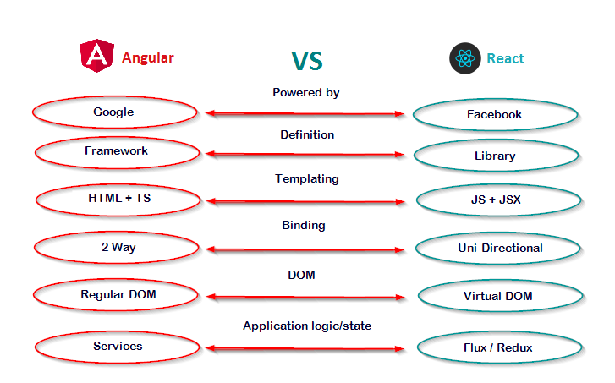
Angular vs react

Slide 14
Event Handling
The events get triggered from the html page and are sent across to Angular JS class for further processing.
Status: boolean = true; clicked(event)
{ this.Status = false; }
<div> {{Status}} <button (click) = "clicked()">Click</button> </div>

Slide 15
Error Handling
Angular 2 applications have the option of error handling.
This is done by including the ReactJS catch library and then using the catch function.
Code sample
private handleError(error: Response)
{
console.error(error);
return Observable.throw(error.json().error());
}

Slide 16

Transforming Data
Angular pipes can be used to transform data.
Propertyvalue | pipes
lowercase
uppercase
slice
currency
Date
percentage
minIntegerDigits − This is the minimum number of Integer digits.
minFractionDigits − This is the minimum number of fraction digits.
maxFractionDigits − This is the maximum number of fraction digits.

Slide 17
Angular - CLI
Command Line Interface (CLI) can be used to create our Angular JS application.
It also helps in creating a unit and end-to-end tests for the application.
To install the CLI
npm install –g angular-cli
To Create Angular Application
ng new Project_name

Slide 18
To Start
After installation and changes made in our basic Angular app we can start our Application by following command in Angular CLI.
“ng serve”

Slide 19
Thank You

