Slide 1
Java Server Pages(JSP )

Slide 2

Agenda
Introduction to JSP
Features of JSP
How JSP differ from HTML
Example

Slide 3

Introduction to JSP
JSP technology is used to create web application just like Servlet technology
Extension to Servlet.
It provides more functionality than servlet such as expression language, JSTL, etc.

Slide 4
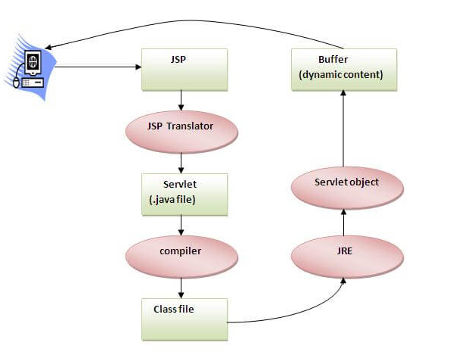
JSP Lifecycle
Translation of JSP Page
Compilation of JSP Page
Classloading (the classloader loads class file)
Instantiation (Object of the Generated Servlet is created).
Initialization ( the container invokes jspInit() method).
Request processing ( the container invokes _jspService() method).
Destroy ( the container invokes jspDestroy() method).

Slide 5
Features of JSP
Extension to Servlet
Easy to maintain
we can easily separate our business logic with presentation logic
Fast Development: No need to recompile and redeploy
Less code than Servlet

Slide 6
JSP Scripting elements
<% java source code %>
<html>
<body>
<% out.print("welcome to jsp"); %>
</body>
</html>
<%= statement %>
<html>
<body>
<%= "welcome to jsp" %>
</body>
</html>
<%! field or method declaration %>
<html>
<body>
<%!
int cube(int n){
return n*n*n*;
}
%>
<%= "Cube of 3 is:"+cube(3) %>
</body>
</html>
Scriptlet tag
Expression tag
Declaration tag

Slide 7
How JSP differ from HTML
JSP allow us to write java code and methods.
To run JSP we need server.
JSP is a server side programming technology.
A JSP page consists of HTML tags and JSP tags.

Slide 8
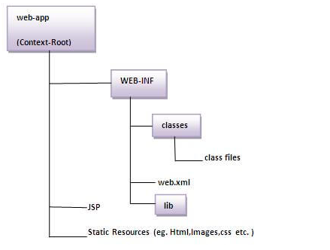
Folder Structure

Slide 9
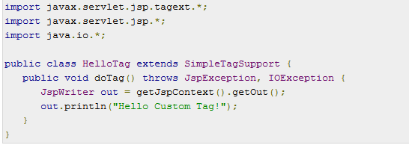
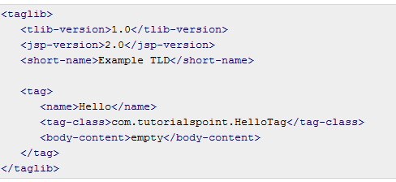
JSP - Custom Tags HellowTag.Java custom.tld

Slide 10
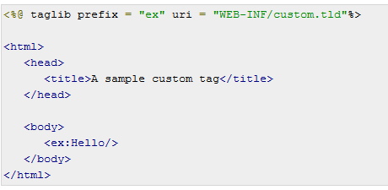
JSP - Custom Tags JSP
Call the above JSP and this should produce the following result −
Hello Custom Tag!

