Slide 1
Self Introduction
Mahalingam V S

Slide 2
Agenda
01
02
03
04
About Me
Education
Experience
Hobbies & Goals

Slide 3
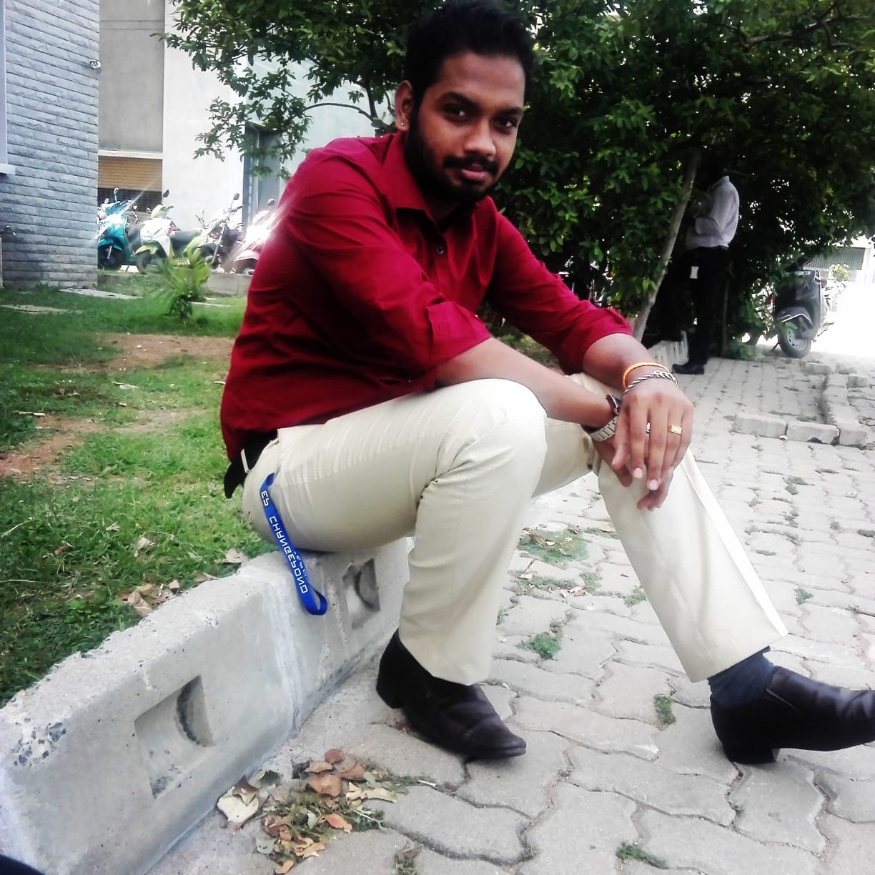
About me
Personal profile
. I am from Thanjavur
Achievements
District Volley ball player
Education
Master of Computer Application
Work experience
Senior Software Developer in Changepond Technology

Slide 4
Education
UG
Schooling
PG
Completed my schooling at chinmaya vidhyalaya Trichy
Bsc computer science in Swami vivekanandha collage Thanjavur
Master of Computer application at AAMEC thiruvarur

Slide 5
01
MY COMPANY
American Mega Trends
You can enter a subtitle here if you need it

Slide 6

Roles & Responsibility
Tested the Functionality of Application
Written Test Cases
Involved in project Development Activities
Selected as a Tester
Roles &
Responsibility
Intern

Slide 7
02
MY COMPANY
Changepond Technology
You can enter a subtitle here if you need it

Slide 8
Roles & Responsibility
Developed Individual modules
Software Engineer
Involved in Internal project Development Activities
Senior Software Developer
Roles &
Responsibility
Trainee

Slide 9
Project1- Kansas Content Builder
Client
Duration
Role
Kansas UniveRsity,
Us
july 2018 – NOV 2019
Application Developer
Technology
Team size
Java\JEE, spring MVC, hibernate, HTML, JSP, Postgres 9.3.
12

Slide 10
Describtion
01
02
CB is based on Educational domain. It is being used by Kansas University of United States to prepare the content of the examinations.
CB avails to create a Task, Testlet and Test. Review Management is available to review the content if anything has to be changed then it will be reported in this module.

Slide 11
Project 2 - Kansas CB 2.0
Client
Duration
Role
Kansas UniveRsity,
Us
DEC 2019 – Till Date
Application Developer, low-Level Team Management, Scrum Master.
Technology
Team size
React, Redux, Node js, Bootstrap, Git, CKEditor, Jest, HTML5, Postgres 11, Flyway
35

Slide 12
Describtion
01
02
Content Builder (CB) 2.0 is a web application. It is an enhancement of the content builder application. It is built on React and Node js Technology.
We have implemented and updated the tools with latest technology and added some more new Environments like Accessibility, Code compiler QTI export / import

Slide 13
Responsibilities
1
2
Involved in Analyzing the User Stories and divide it based on the complexity and size.
Assign the User Stories to the corresponding team members.
4
5
Preparing Technical Specification Documents. Bug fixing and Production Support.
Developing the User Stories and do Unit Testing. Once completed then to make the appropriate changes in Rally. So that the client aware the status of the User Stories.
6
Taking sessions and guiding the team in react, Handling the juniors. Maintaining Weekly status report.

Slide 14
POC
Ethereum Blockchain
Unit Testing Frameworks like mocha, chai, sinon, jest
Corda Blockchain

Slide 15
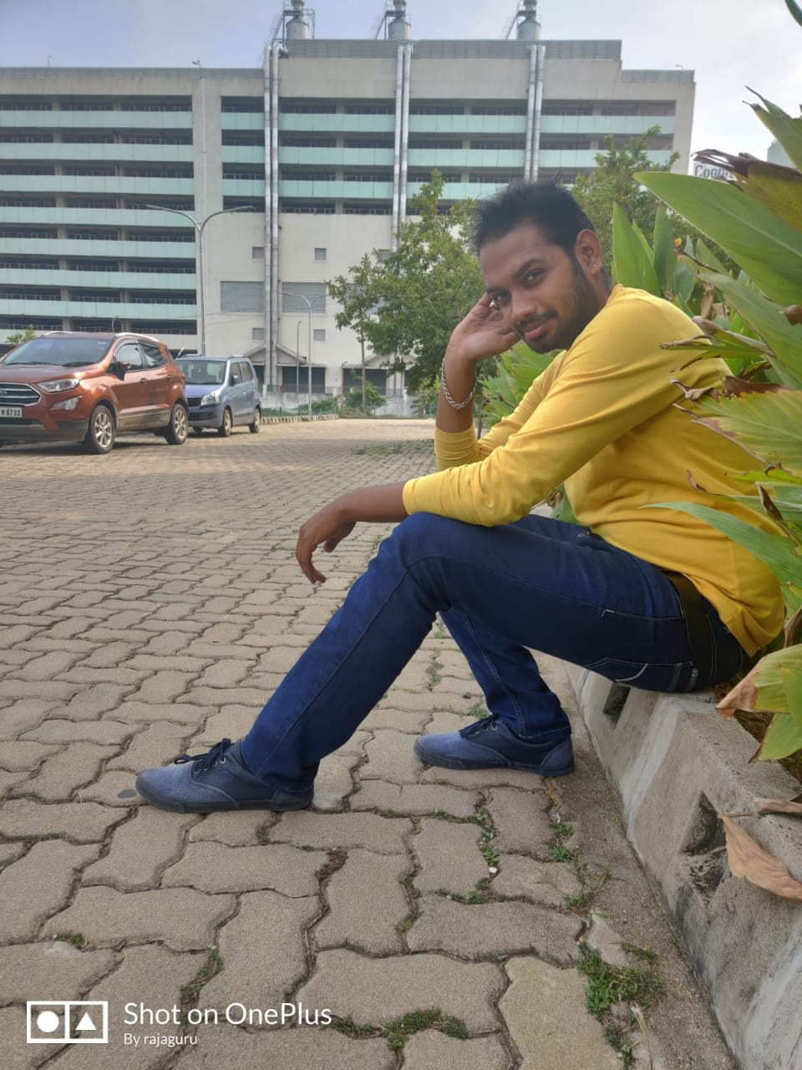
MY Strength
LOYALTY
EFFICIENCY
COMMITMENT
Will be loyal to my work as well as in my life
Easily adopt with any kind of people and situvation
Will be sincere and punctual In my commitments

Slide 16
Achievements
Won many prizes in state level symposium for the event of Quiz, Debugging, paper presentations.
District level volley champion.
Event organizer in the collage.
Guest lecture class taken for BE students.

Slide 17
GOALS
spRituality
ARichitect
AgRicultuRist
Having moRe faith in spRituality and like to sing bhajans
I want to be best softwaRe architect
I want to settle my life as a FaRmeR

Slide 18
Thank You Have a Good Day

