Slide 1
React

Slide 2

Agenda
What is React ?
Why React !!
Jsx
ES 6
Prerequisites of React
Components
Class
Class Component lifecycle
Function
State & Props
Event Handling
Rendering Elements
Hooks
Advance Concepts

Slide 3
What is React?
Open-source JavaScript library that is used for building UI.
React allows developers to create large web applications that can change data, without reloading the page.
fast, scalable, and simple.
It works only on user interfaces in the application.
Virtual Document Object Model.
Single-Way data flow.
Notes:
a set of immutable values are passed to the components renderer as properties in its HTML tags ( Props)

Slide 4
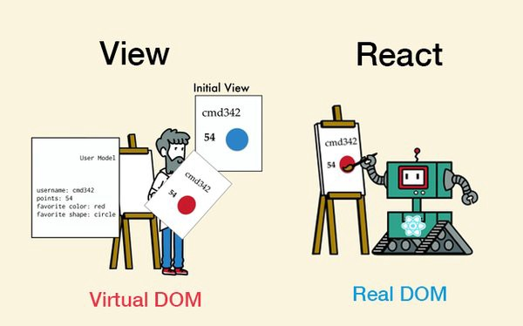
Why React !!
Simplicity
Easy to learn
Data Binding
Performance
Testability
some important features of React.
Virtual DOM
react library only renders components that actually change
Notes:
React uses one-way data binding

Slide 5
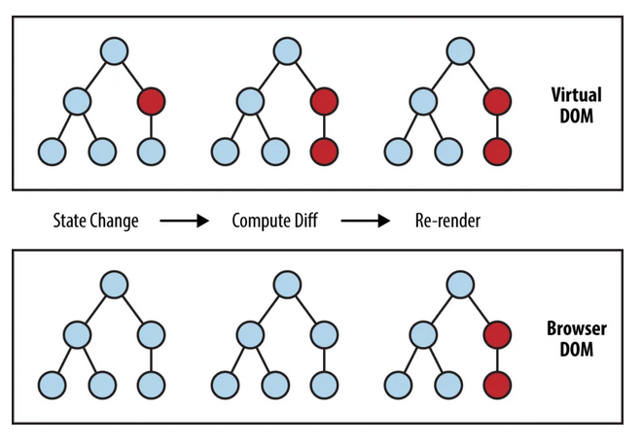
Virtual Dom vs Real Dom

Slide 6
Benefits of React !!
To Avoid expensive usage of DOM.
Minimize the access to the DOM.
Update the element offline before inserting to the DOM.
Easy to understand what a component will render
Notes:
React uses one-way data binding

Slide 7
JSX (javascript xml)
Easy to Combine HTML and JS
Instead of artificially separating technologies by putting markup and logic React with loosely coupled units called “components” that contain both
JSX is a simple JavaScript that allows HTML quoting and uses these HTML tag syntax to render subcomponents
Translates to plain JavaScript using react-tools
Code sample
const name = 'Josh Perez';
const element = <h1>Hello, {name}</h1>;
ReactDOM.render( element, document.getElementById('root') );
Notes:
No compulsory to use JSX in react,

Slide 8
ES 6
Use const or let instead of var
Classes
Object Destructuring – [import ReactDOM from 'react-dom']
Arrow Functions (=>)
es6 explicit return (same as above)
const sayHello = () => {
return 'i am saying hello'; }
es6 implicit return 1-liner (same as above)
const sayHello = () => 'i am saying hello';
Notes:
const: This variable can not be reassigned. JavaScript will throw an error if we try to reassign a new value
let: This variable can be reassigned. This is similar to var

Slide 9
Prerequisites of React
Knowledge of HTML & CSS , JavaScript
Some knowledge about the DOM
Some knowledge about Node & npm (and installed)
To Create react app
npx create-react-app my-app
cd my-app
npm start
We can able to see our react app with basic package with some ordered folder structure
Notes:
npx on the first line is not a typo — it’s a package runner tool that comes with npm 5.2+.

Slide 10
Components
Components are self-contained building blocks of web application.
We can write UI into independent, reusable pieces
Components are JavaScript functions.
Components can be classified to
Function Component (Stateless)
Class component (Stateful)

Slide 11
Functional Component
Functional components are purely presentational and are simply represented by a function.
Additional features.
they are basically functions,
they do not hold and/or manage state
all they do is output UI elements
Code Snippet
const Greeting = () => <h1>Hi, I’m a dumb component!</h1>;
Or
function Welcome(props)
{
return <h1>Hello, {props.name}</h1>;
}

Slide 12
Class Component
components are created using ES6’s class syntax.
Additional features.
the ability to contain logic (methods that handle onClick events),
local state
Container because they usually hold/contain numerous other (mostly functional) components
Code Snippet
class Greeting extends React.Component
{ render(){ return <h1>Hi, I’m a smart component!</h1>; } }
Notes:
Class components have a considerably larger amount of markup. Using them excessively and unnecessarily can negatively affect performance as well as code readability, maintainability and testability.

Slide 13
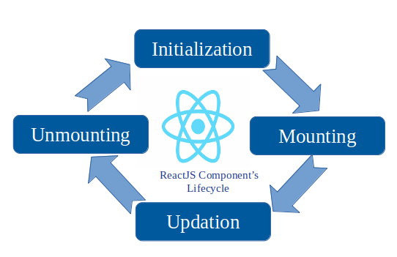
Class Component Life-cycle
Initialization:
the stage where the component is constructed with the given Props and default state. This is done in the constructor of a Component Class.
Mounting:
the stage of rendering JSX returned by the render method itself.
Updating:
the stage when the state of a component is updated and the application is repainted.
Unmounting:
As the name suggests Unmounting is the final step of the component lifecycle where the component is removed from the page.

Slide 14
State & Props
State
special built-in object, allows components to create and manage their own data.
components cannot pass data with state, but they can create and manage it internally.
class Test extends React.Component {
constructor() {
this.state = {
id: 1,
name: "test“
};
}
render() {
return (
<div> <p>{this.state.id}</p> <p>{this.state.name}</p> </div>
); }
}
Props
Props is short for properties
they are used to pass data between React components.
React’s data flow between components is uni-directional.
class ParentComponent extends Component {
render() {
return (
<ChildComponent name="First Child" />
);
}
}
const ChildComponent = (props) => {
return <p>{props.name}</p>;
};
Notes:
uni-directional (from parent to child only).
State shouldn’t be modified directly – the setState( ) should be used
State affects the performance of your app, and therefore it shouldn’t be used unnecessarily

Slide 15
Differences between props and state
state
props
Components receive data from outside with props,
Props are used to pass data.
Data from props is read-only and cannot be modified by component that is receiving it from outside
Props can only be passed from parent component to child (unidirectional flow)
They can create and manage their own data with state.
state is for managing data.
State data can be modified by its own co
Modifying state should happen with the setState ( ) method mponent, but is private
Notes:
is private (cannot be accessed from outside)

Slide 16
Rendering Elements
Unlike browser DOM elements, React elements are plain objects, and are cheap to create.
React DOM takes care of updating the DOM to match the React elements.
const element = <h1>Hello, world</h1>;
ReactDOM.render(element, document.getElementById('root'));
React usually have a single root DOM node.
It calls ReactDOM.render() every second from a setInterval() callback.
We use
import ReactDOM from 'react-dom‘ to use react-dom
Notes:
Render a React element into the DOM in the supplied container and return a reference to the component (or returns null for stateless components).
If the React element was previously rendered into container,
this will perform an update on it and only mutate the DOM as necessary to reflect the latest React element.

Slide 17
Event Handling
React events are named using camelCase, rather than lowercase.
< button onClick={this.handleClick} >
only accepts a single function
The event argument [e argument automatically passed into the handler whenever the event is emitted. ]
handleInput = (e) => { this.setState({inputText: e.target.value}); }
<input onChange={this.handleInput} value={this.state.inputText} />

Slide 18
Hooks
Hooks are a new addition in React 16.8.
They let you use state and other React features without writing a class.
With hooks, you can still use local state to manage data for UI reactivity.
component that maintains its own internal state data
import React, { useState } from 'react';
function Example() {
// Declare a new state variable, which we'll call "count“
const [count, setCount] = useState(0);
return (
<div> <p>You clicked {count} times</p>
<button onClick={() => setCount(count + 1)}> Click me </button>
</div>
);
}
Notes:
Many things are there to explore in hooks in depth this is just a basic of hooks.

Slide 19
Forwarding Refs
Ref forwarding is a technique for automatically passing a ref through a component to one of its children.
To create a ref to store the textInput DOM element
this.textInput = React.createRef();
<input type="text” ref={this.textInput} />
<input type="button” value="Focus the text input"
onClick={this.focusTextInput} />

Slide 20
Fragments
Fragments used to group a list of children without adding extra nodes to the DOM..
<
With Fragments | Without Fragments
<React.Fragment> <td>Hello</td> <td>World</td> </React.Fragment> | <div> <td>Hello</td> <td>World</td> </div>
<table> <tr> <td>Hello</td> <td>World</td> </tr> </table> | <table> <tr> <div> <td>Hello</td> <td>World</td> </div> </tr> </table>
Output
Output

Slide 21
Higher-Order Components
HOC for reusing component logic.
Higher-order component transforms a component into another component.
Code sample
const EnhancedComponent = higherOrderComponent(WrappedComponent);

Slide 22
Pure Components
Pure Components reduces the number of render operation in the application..
It gives a considerable increase in performance of the Application.
Code sample
class Welcome extends React.PureComponent { render() { return <h1>Welcome</h1> } }

Slide 23
Error Boundaries
Error boundaries are React components that catch JavaScript errors anywhere in their child component tree.
log those errors, and display a fallback UI.
Error boundaries catch errors during rendering, in lifecycle methods, and in constructors of the whole tree below them.
Code sample
logErrorToMyService(error, errorInfo);

Slide 24
Portals
Portals provide a first-class way to render children into a DOM node that exists outside the DOM hierarchy of the parent component.
Code sample
ReactDOM.createPortal(child, container)
Output
<div id="app-root"></div>
<div id="modal-root"></div>

Slide 25
Context
Context is designed to share data that can be considered “global” for a tree of React components.
Code sample
React.createContext
const MyContext = React.createContext(defaultValue);
Context.Provider
<MyContext.Provider value={/* some value */}>

Slide 26
To Start
After installation and changes made in our basic react app we can start our react app by following command in node terminal.
“npm start”

Slide 27
Thank You

