Slide 1
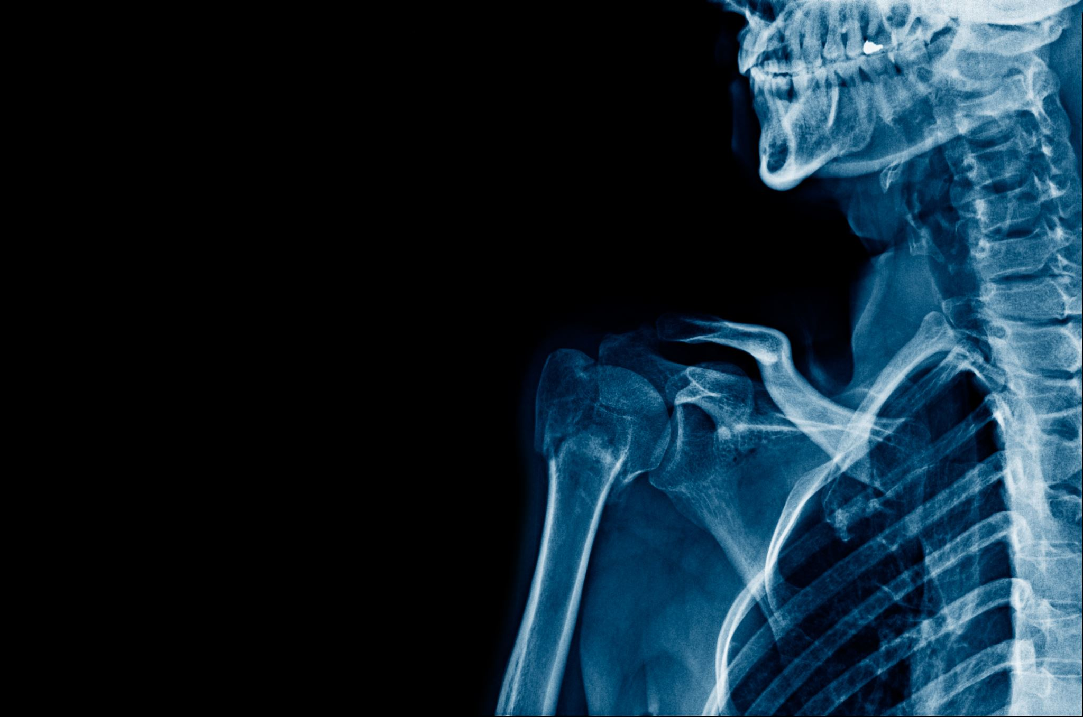
LungNet: Deep Learning Approach for Thoracic Disease Classification
By: Aradhya Alva Rathnakar Bhavan Kumar Basavaraju Mahamaya Panda Shashi Kumar Kadari Mallikarjuna

Slide 2
Introduction and problem statement
Aim: Revolutionize thoracic disease classification via deep learning.
Challenge: Accurately diagnosing lung diseases (e.g., pneumonia, effusion, lung cancer) remains difficult.
Problem: Manual interpretation by radiologists is time-consuming and prone to error.
Limitation: Traditional computer-aided diagnostic systems struggle to capture intricate patterns in thoracic imaging data.

Slide 3
motivation
Urgency: Timely and accurate diagnosis is critical in preventing disease progression and improving patient prognosis. Delays in diagnosis can lead to adverse health outcomes and increased healthcare costs.
False Positives: The presence of false positives in X-ray images due to noise sources like equipment artifacts or patient motion further complicates the diagnostic process, potentially leading to unnecessary tests or treatments.
Addressing these challenges is essential for enhancing the quality of healthcare delivery, reducing healthcare costs, and ultimately saving lives.

Slide 4
Proposed solution
Two-Stage Approach:
Segmentation: Utilize U-Net architecture to segment lung regions from X-ray images.
Classification: Employ an ensemble model (DenseNet121 and ResNet50) for disease classification.
Benefits:
Enhances accuracy and efficiency of disease classification.
Addresses limitations of manual interpretation and traditional diagnostic systems.
Innovation:
Comprehensive solution combining segmentation and classification.
Utilizes robust feature extraction and noise tolerance mechanisms (e.g., dropout layers, batch normalization).
Impact:
Fills critical gap in literature combining segmentation and classification.
Potentially transforms thoracic disease diagnosis and improves healthcare delivery.

Slide 5
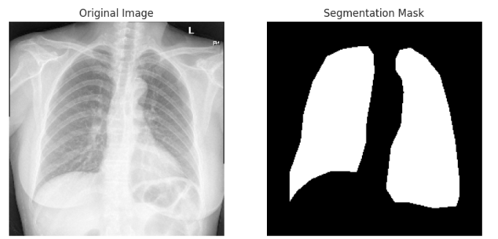

Source Data – Lung segmentation
Kaggle: Chest Xray Masks and Labels
Source: https://www.kaggle.com/datasets/nikhilpandey360/chest-xray-masks-and-labels

Slide 6
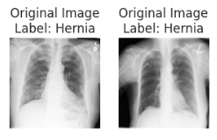

Source Data – disease classification
NIH Clinical Center
Source: https://nihcc.app.box.com/v/ChestXray-NIHCC

Slide 7
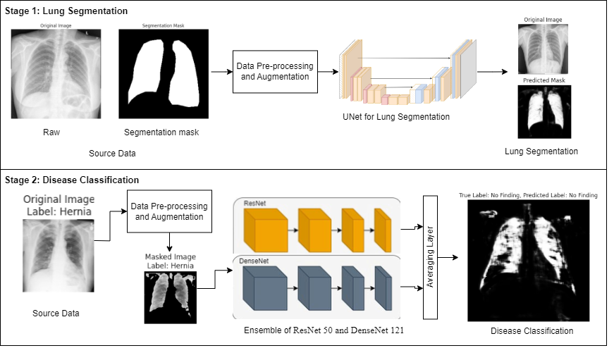
Methodology

Slide 8
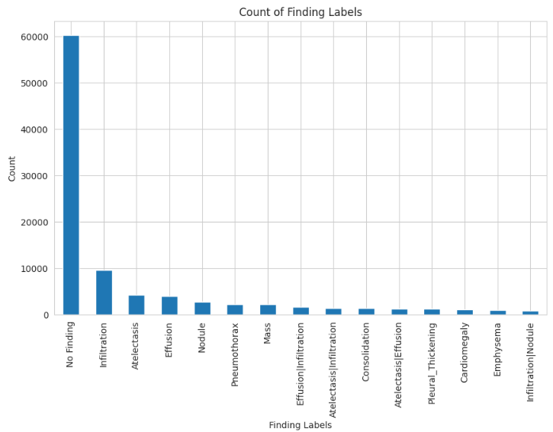
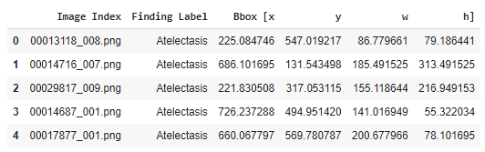
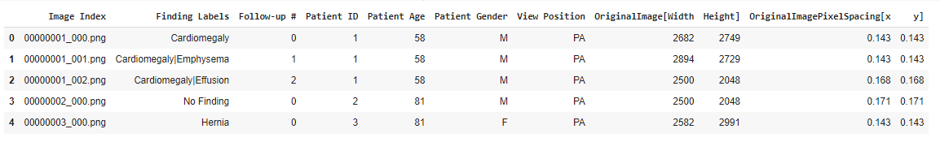
Data Discovery and analysis
Disease region on the X-ray image
Top 15 diseases identified
Disease Classification Data

Slide 9
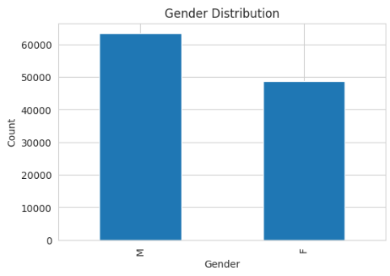
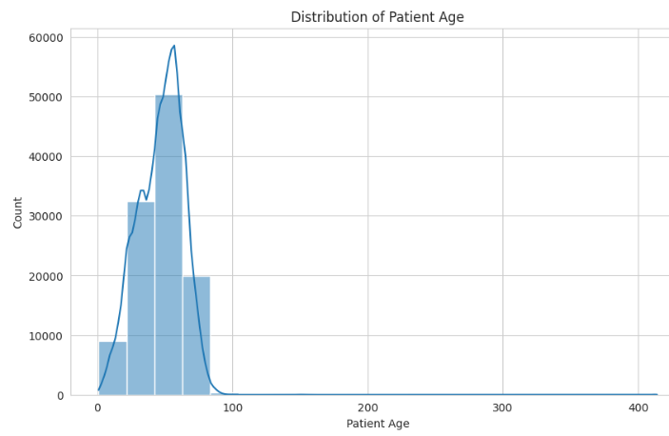
Data Discovery and analysis – Disease classification

Slide 10


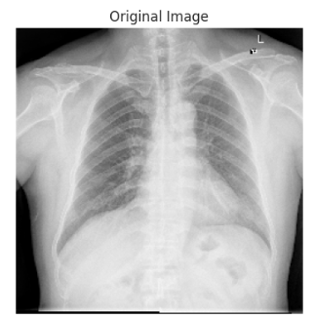
Data pre-processing
Handling age outliers
Cleaning gender column
After normalizing pixel values

Slide 11
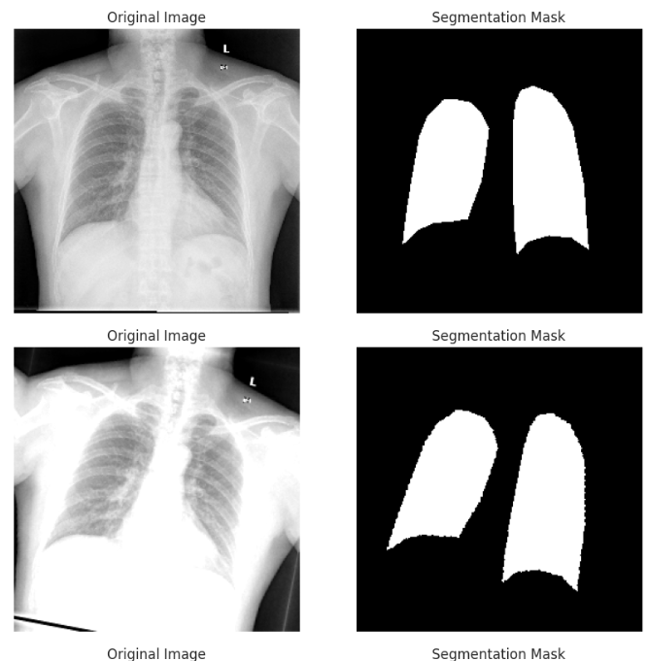
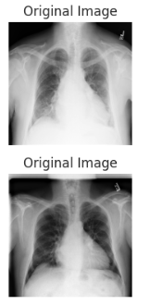
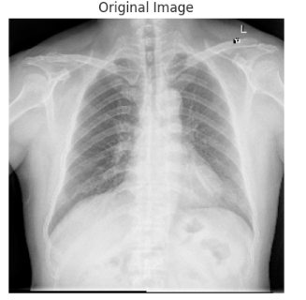
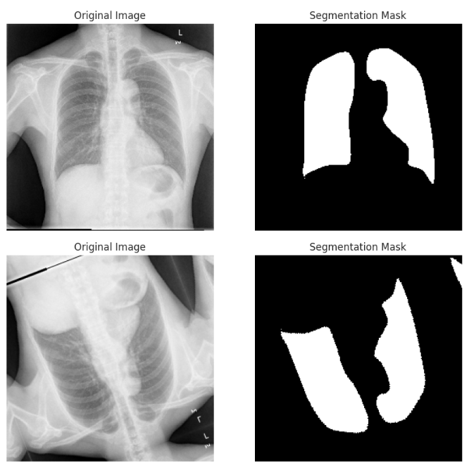
Data pre-processing
X-ray in grey-scale
Use only x-rays which have masks associated with it for segmentation.
Data Augmentation using Albumentation library: -Horizontal flip -Vertical flip -RandomRotate -RandomBrightnesscontrast -Resize

Slide 12
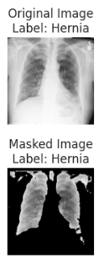
Data pre-processing for disease classification using u-net model
Use only x-rays which have disease label for classification dataset
Data Augmentation using Albumentation library: -Horizontal flip -Vertical flip -RandomRotate -RandomBrightnesscontrast -Resize
X-ray in grey-scale

Slide 13
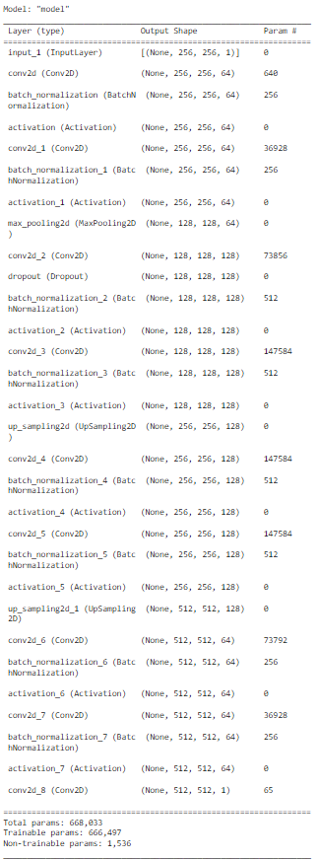
Segmentation: UNet Model
Unet vs Segnet
Unet architecture:
Encoder
Decoder
Outputs
Mean IoU score
SegNet model summary
Notes:
Encoder: The encoder part of the U-Net architecture consists of several convolutional layers followed by max-pooling layers. These layers are responsible for extracting features from the input images while reducing the spatial dimensions of the feature maps.
Decoder: The decoder part of the U-Net architecture consists of several upsampling (or transposed convolution) layers followed by convolutional layers. These layers are responsible for gradually increasing the spatial dimensions of the feature maps while also refining the features learned by the encoder to generate segmentation masks.
Outputs: The output of the U-Net model is a segmentation mask that has the same spatial dimensions as the input image. Each pixel in the segmentation mask represents the predicted class (e.g., foreground or background) for the corresponding pixel in the input image.

Slide 14
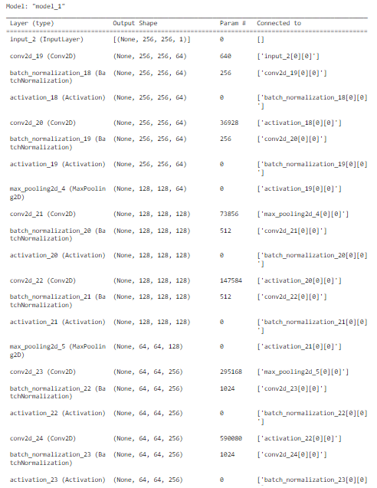
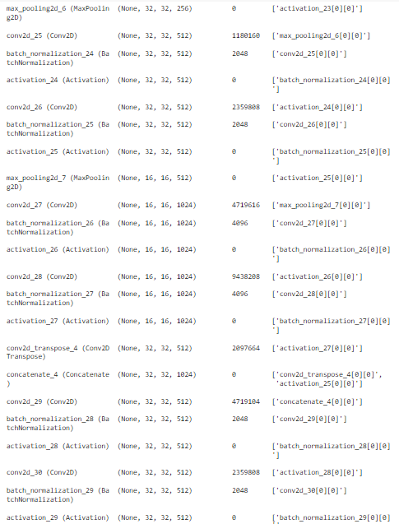
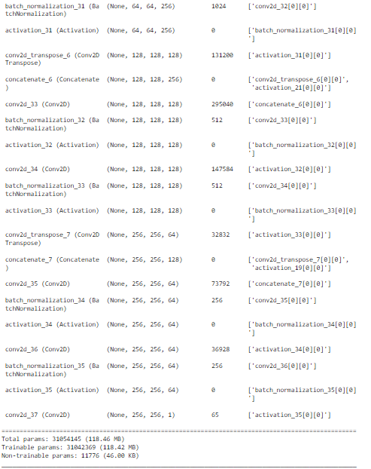
UNET MODEL Summary

Slide 15
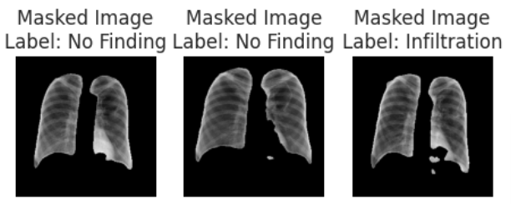

Segmentation: UNet Model
Skip connections: Concatenate feature maps from the encoder to the corresponding decoder layers
Sigmoid in output layer: Squashes the output values in range [0,1]
Loss function: Binary cross-entropy loss (log loss)
mean_IoU (Evaluation Metric): Intersection over Union, determines overlap between predicted and ground truth mask.
Notes:
Skip connections: Skip connections, also known as residual connections, are connections that skip one or more layers in a neural network. In U-Net, skip connections are used to concatenate feature maps from the encoder to the corresponding decoder layers. This helps preserve spatial information and enables the model to recover fine details during upsampling.
Sigmoid in output layer: The sigmoid activation function is used in the output layer of the U-Net model to generate pixel-wise predictions. It squashes the output values to the range [0, 1], representing the probability that each pixel belongs to the foreground class (i.e., the class of interest).
Loss function: The loss function used in U-Net is typically binary cross-entropy loss, also known as log loss. This loss function is well-suited for binary classification tasks, such as image segmentation, where each pixel is classified as foreground or background.
mean IoU (Evaluation Metric): IoU (Intersection over Union) is a common evaluation metric used in image segmentation tasks. It measures the overlap between the predicted segmentation mask and the ground truth mask. Mean IoU calculates the average IoU across all classes and is used to assess the overall performance of the segmentation model.

Slide 16
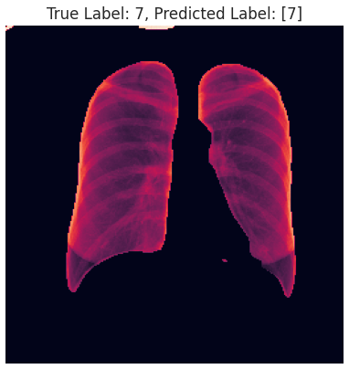
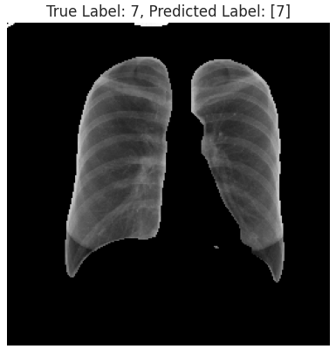
Disease classification: Ensemble: Resnet – 50 + densenet 121
Data preparation for modeling:
Image Preprocessing (Making image shape compatible)
Segmentation (Load the UNet Model)
Image mask with threshold
Ensemble model:
Transfer Learning - Resnet 50 and Densenet 121
Concatenate Layer - GAP (Resnet 50 and Densenet 121)

Slide 17
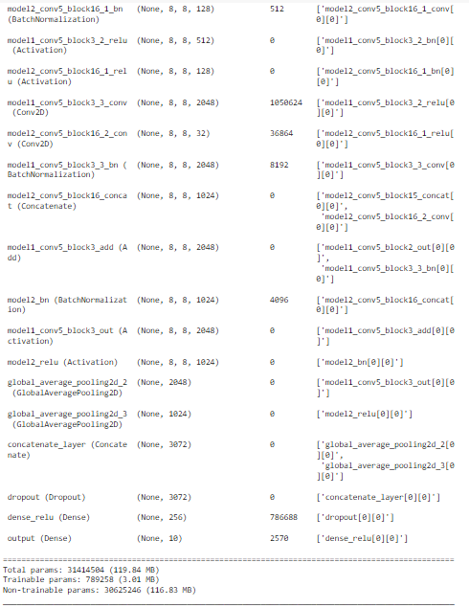
MODEL SUMMARY: Ensemble model

Slide 18

Hyperparameter tuning
Random Search Tuning:
Random search works by randomly sampling hyperparameter combinations from a predefined search space.
Random search efficiently explores the hyperparameter space by randomly sampling hyperparameter combinations.
Implementation of tuning in the proposal:
The objective of the hyperparameter tuning is "val_mean_io_u", indicating the mean intersection over union (IoU) metric computed on the validation set.
The direction for optimization is set to "max", aiming to maximize the mean IoU value.
The tuner conducts multiple trials, evaluating each trial's performance based on the specified objective metric.

Slide 19
Results
Model | Evaluation Metrics | Proposal Results | Research Paper Results
Ensemble Model (ResNet 50 + DenseNet 121) | Test Accuracy | 0.8536306619644165 | [18] 0.825 (DenseNet-121 model)
 |  |  | [18] 0.8964 (ResNet-18 model)
 |  |  | [19] 0.835 (Densenet121 model)
 | Test Recall | 85%
UNet Model | Mean_IoU score | 0.4063 (before tuning) 0.96 (after tuning) | [20] 93.3%
 | F1 Score | 0.9694 | [21] 0.73
 | Accuracy | 0.9844 | [21] 95.4%

Slide 20
conclusion
LungNet's ensemble model demonstrates competitive performance, achieving an accuracy of approximately 85%.
While not surpassing the reported accuracies of ResNet-18 and DenseNet-121 from survey, LungNet's accuracy remains comparable, highlighting its effectiveness in thoracic disease classification.
The ensemble model effectively addresses challenges like vanishing gradient and overfitting.
Despite slight variations in accuracy compared to base papers, LungNet's focus on precise segmentation and classification enhances its potential for practical clinical applications.
LungNet's precise segmentation and disease classification hold potential for transforming thoracic disease diagnosis.

Slide 21
Future scope
Fine-tune to improve classification accuracy by leveraging their learned features.
Enhance model interpretability with techniques like Grad-CAM and attention mechanisms, while also considering deployment factors such as integration with healthcare systems and adherence to regulatory and ethical standards for medical applications.
Utilize active learning to effectively leverage complex patterns and improve model robustness for medical image datasets with 500+ diverse classes.

Slide 22
References
[1] https://ieeexplore.ieee.org/document/10434261
[2] https://ieeexplore.ieee.org/document/9350516
[3] https://ieeexplore.ieee.org/document/10142364
[4] https://arxiv.org/abs/1711.05225
[5] https://arxiv.org/abs/1801.09927
[6] https://www.sciencedirect.com/science/article/pii/S2589721721000180?via%3Dihub
[7] https://doi.org/10.3390/healthcare11111561
[8] https://pubmed.ncbi.nlm.nih.gov/31930429/ [9] https://ieeexplore.ieee.org/document/10092740 [10] https://ieeexplore.ieee.org/document/9112221 [11] https://www.ncbi.nlm.nih.gov/pmc/articles/PMC5649634/
[12] https://ieeexplore-ieee-org.libaccess.sjlibrary.org/document/8099852
[13] https://ieeexplore-ieee-org.libaccess.sjlibrary.org/document/8291609
[14] https://ieeexplore.ieee.org/document/10092740
[15] https://pubmed.ncbi.nlm.nih.gov/30810231/ [16] https://nihcc.app.box.com/v/ChestXray-NIHCC [17] https://www.kaggle.com/datasets/nikhilpandey360/chest-xray-masks-and-labels [18] https://www.ingentaconnect.com/content/ben/cpd/2022/00000028/00000004/art00005 [19] https://koreascience.kr/article/JAKO202026061057999.page [20] https://ieeexplore.ieee.org/document/9853695 [21] https://bmcmedimaging.biomedcentral.com/articles/10.1186/s12880-020-00529-5

Slide 23
Thank you

