Slide 1
IMN Project :
Pedestrian detection
By : Mahamdi Mohammed && Boukabene randa

Slide 2
Plan:
1.Theoratical study :
* History (Low level computer vision) .
* Old technologies ()
* YOLO general purpose object detection.
* Yolo the last version
2.Technical realization :
* our solution
* demonstration
* code review , ui review
3. Conclusion :

Slide 3
1.The theoretical study :

Slide 4
The demanded work:
Collect a large amount of data.
Train the deep-learning model on the collected data.
Test the work on a video.

Slide 5
* History (Low level computer vision) .
Telling the difference.
Humans vs Computer .

Slide 6
* Old technologies
Not old but recent !
AI Vs Machine Learning Vs Deep Learning.
original R-CNN, Fast R- CNN, and Faster R-CNN.
SSDs
YOLO !

Slide 7
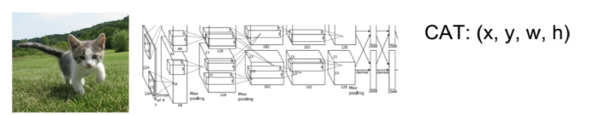
Detection algorithms:

Slide 8
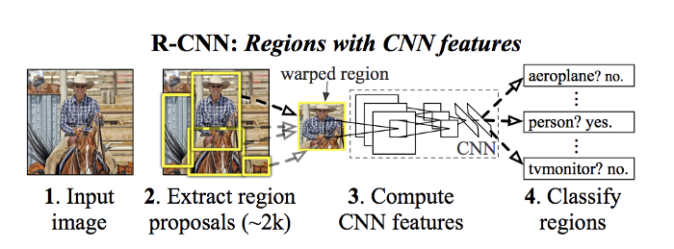
R-cnn:

Slide 9
Selective Search:
1. Generate initial sub-segmentation, we generate many candidate regions
2. Use greedy algorithm to recursively combine similar regions into larger ones
3. Use the generated regions to produce the final candidate region proposals

Slide 10
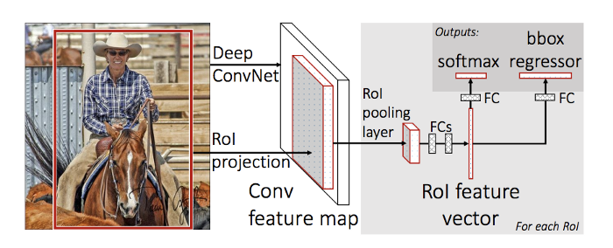
Fast R-cnn:

Slide 11
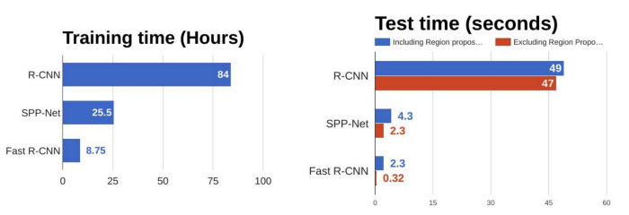
R-cnn Vs Fast R-cnn:

Slide 12
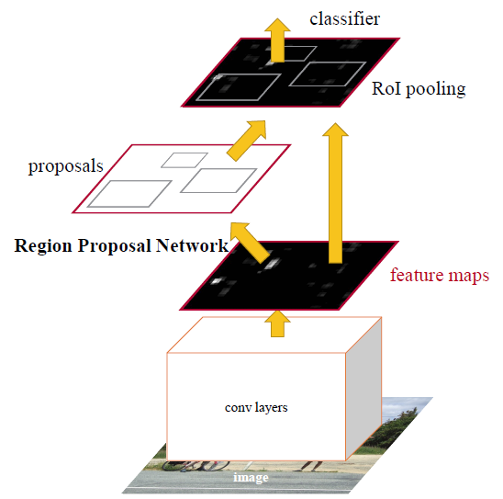
Faster R-cnn:

Slide 13
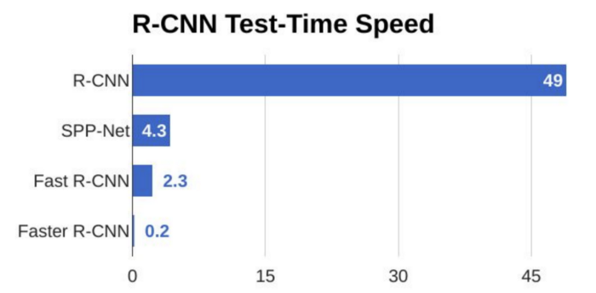
Faster R-cnn:

Slide 14
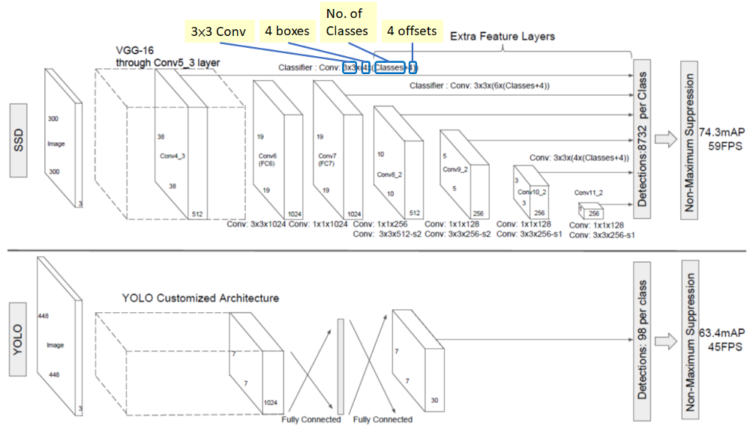
Ssds:

Slide 15
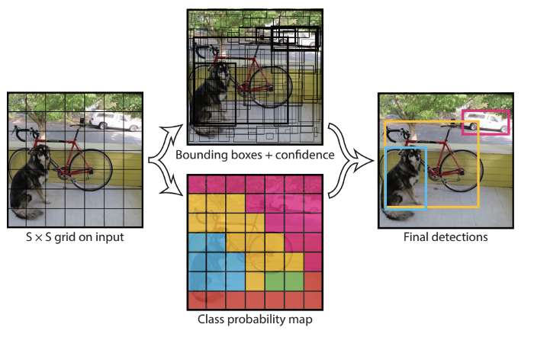
Yolo object detection :

Slide 16
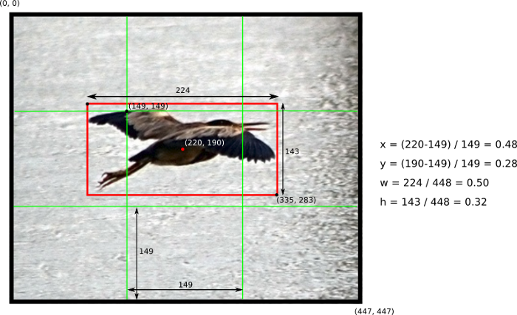
Yolo : The Predictions Vector

Slide 17
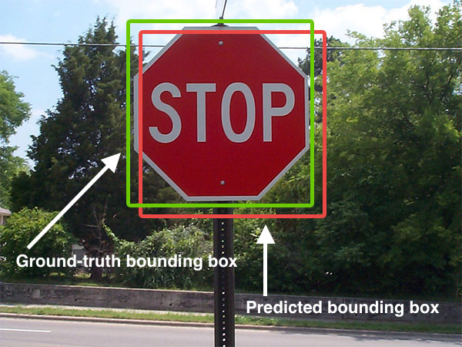
IOU :

Slide 18
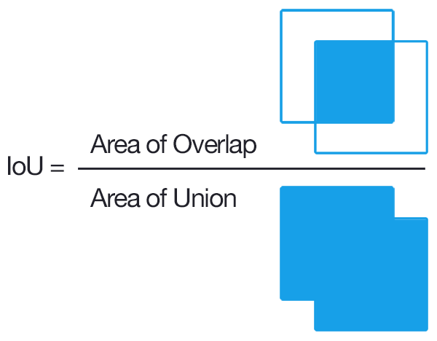
IOU :

Slide 19
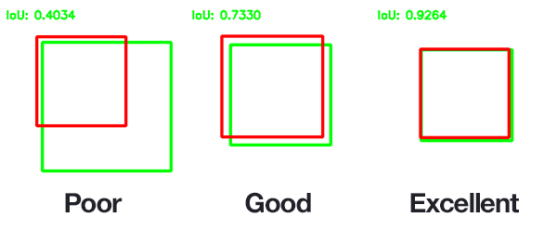
IOU :

Slide 20
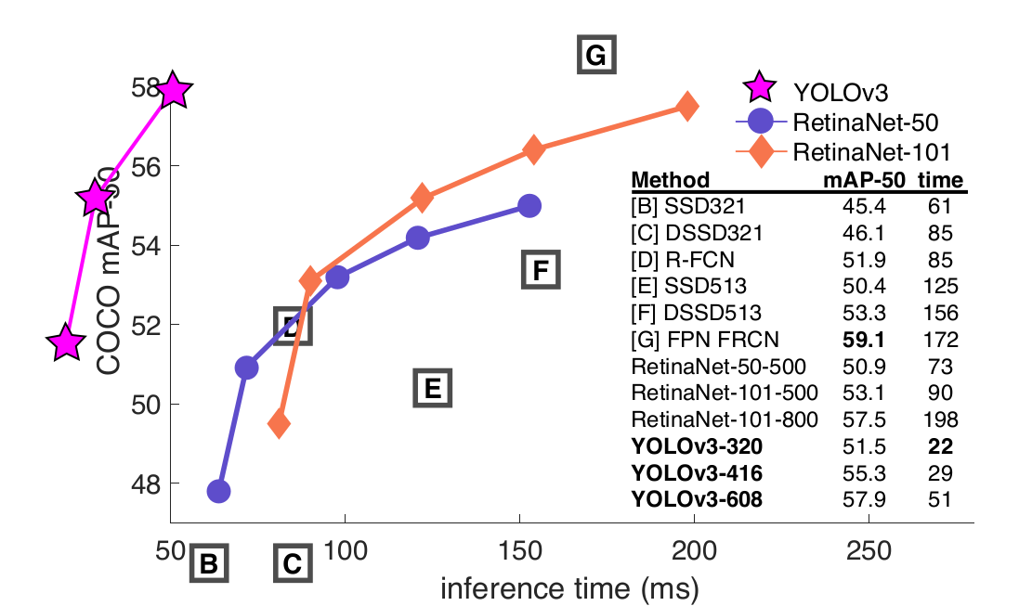
The yolo Network

Slide 21
the technical realization :

Slide 22
Our work :
Get the COCO data-set
Get rid of the other categories different than person
Train the model on google colab :https://colab.research.google.com/
Import the values file in our code
Write the forward function
Draw the boxes in opencv2
Ui (html + css + js + jquey + eel)
Open-sourcing our code

Slide 23
Let’s see the code!

Slide 24
Lets see the Code !

Slide 25
The Conclusion:
That’s not just a TP …
Deep-learning neural nets will play a very
important rule in the future of AI.

Slide 26
More about CNN
For extra info , just follow :

Slide 27
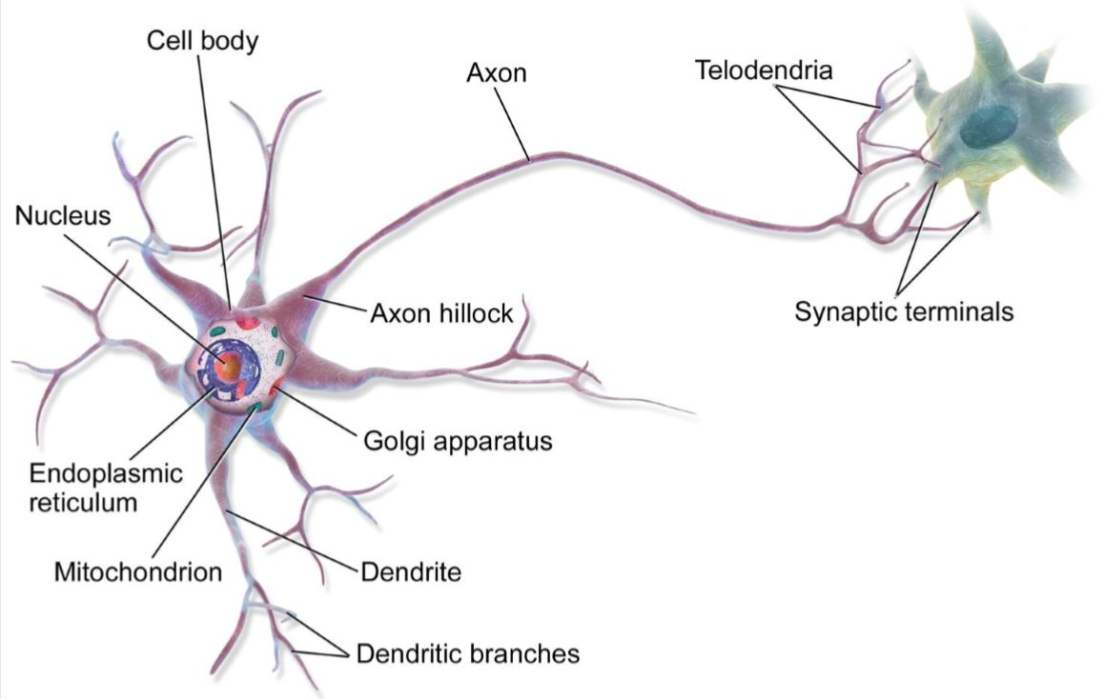
Biological Neurons

Slide 28
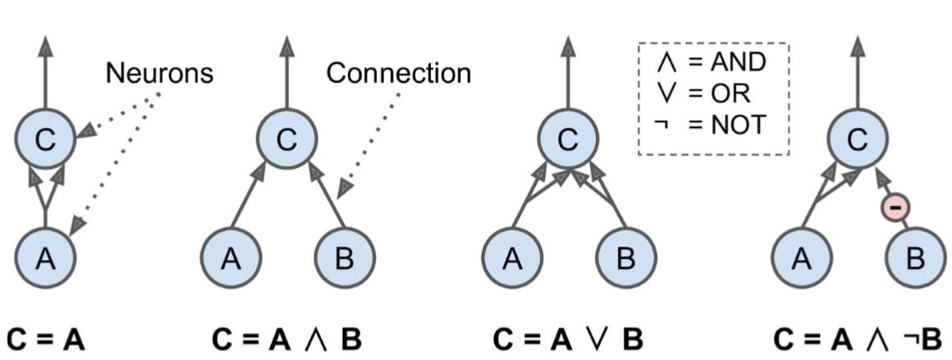
Logical Computations with Neuron

Slide 29
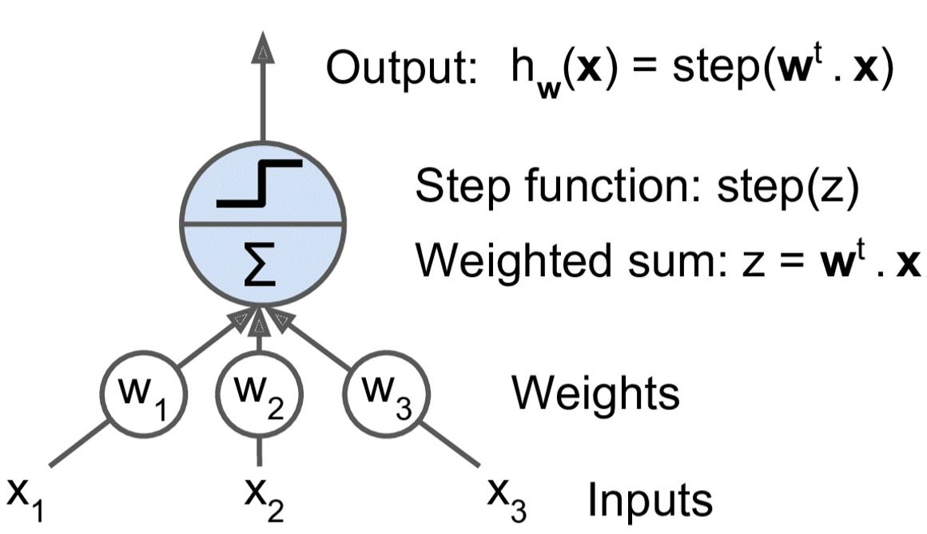
The Perceptron

Slide 30
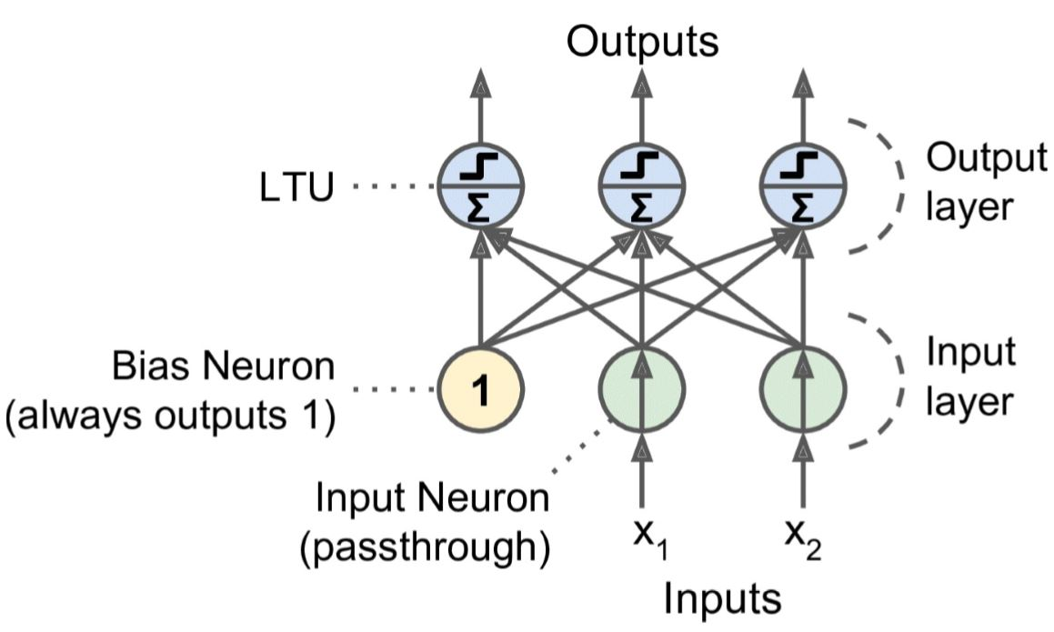
Training Algorithm

Slide 31
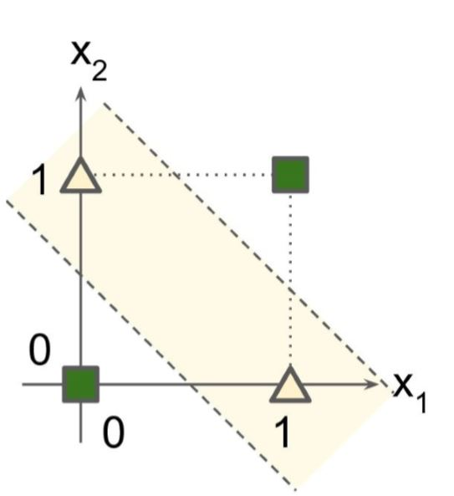
Marvin Minsky & Seymour Papert 1969
XOR problem :

Slide 32
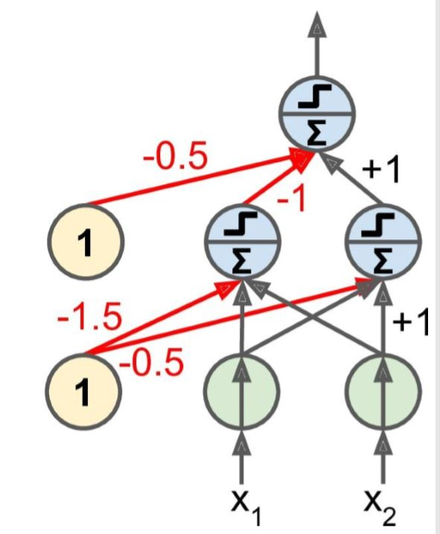
Solution : MLP

Slide 33
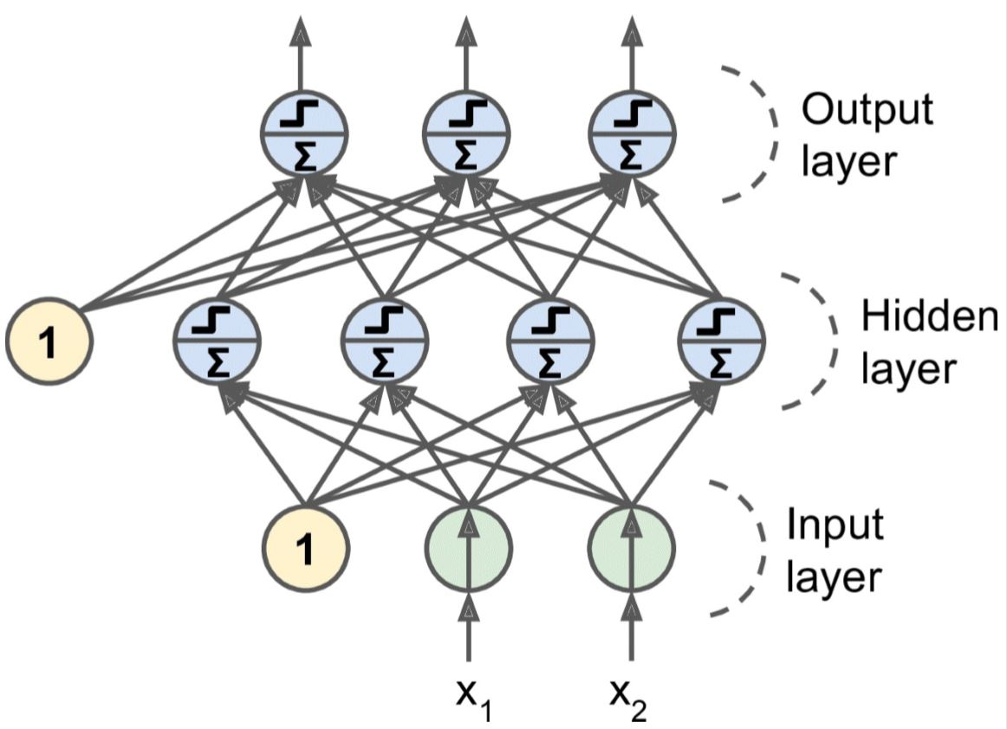
Multi-Layer Perceptron & Backpropagation

Slide 34
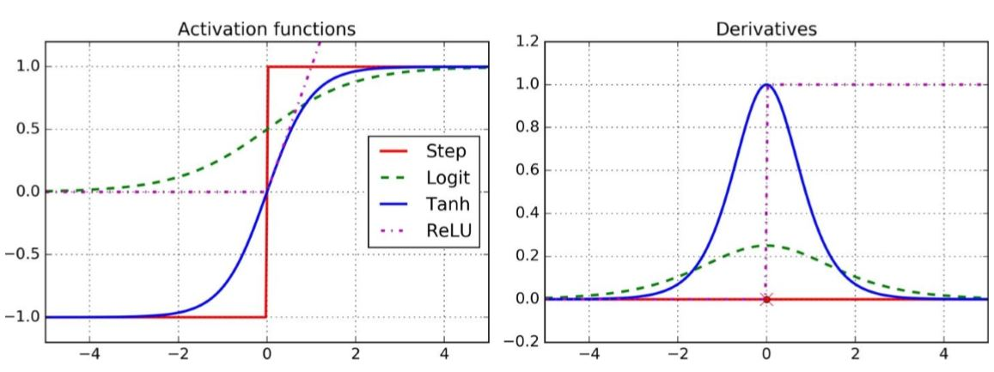
Activation functions

Slide 35
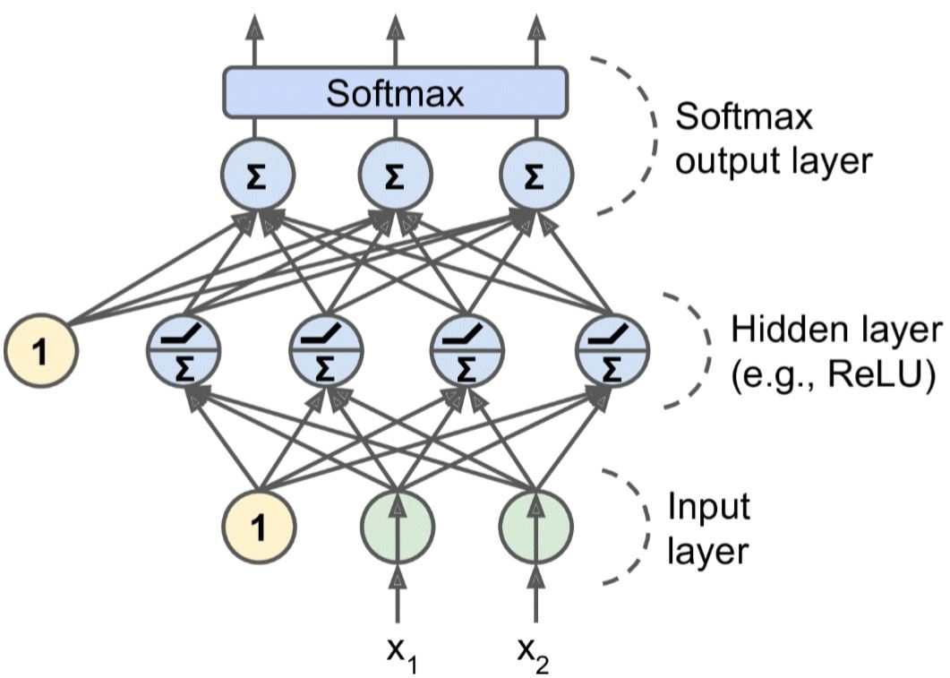
Deep neural networks

Slide 36
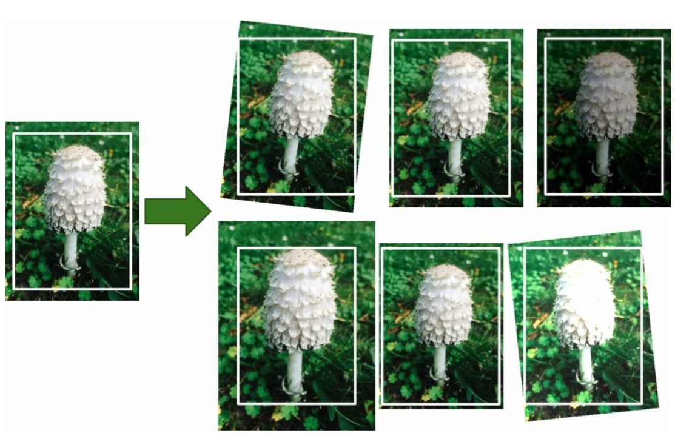
Data Augmentation

Slide 37
Convolutional Neural Networks
IBM’s Deep Blue supercomputer beat the chess world champion Garry Kasparov back in 1996.
Convolutional neural networks (CNNs) emerged from the study of the brain’s visual cortex, and they have been used in image recognition since the 1980s.
They power image search services, self-driving cars, automatic video classification systems, and more.

Slide 38
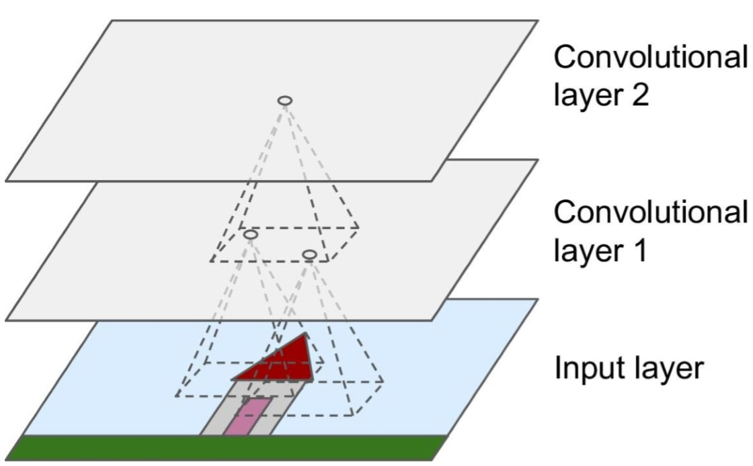
CNN :

Slide 39
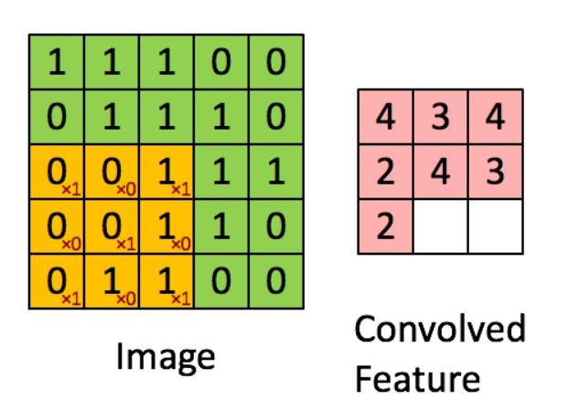
filters

Slide 40
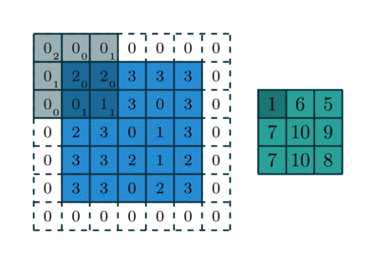
Stride and padding

Slide 41
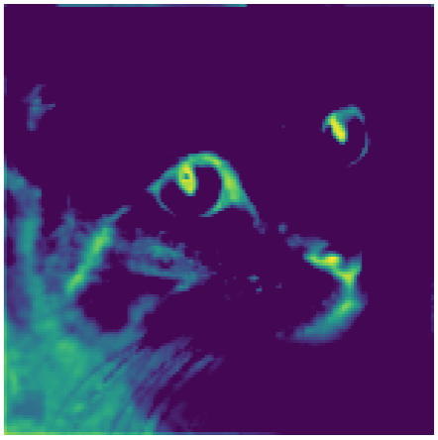
Example:

Slide 42
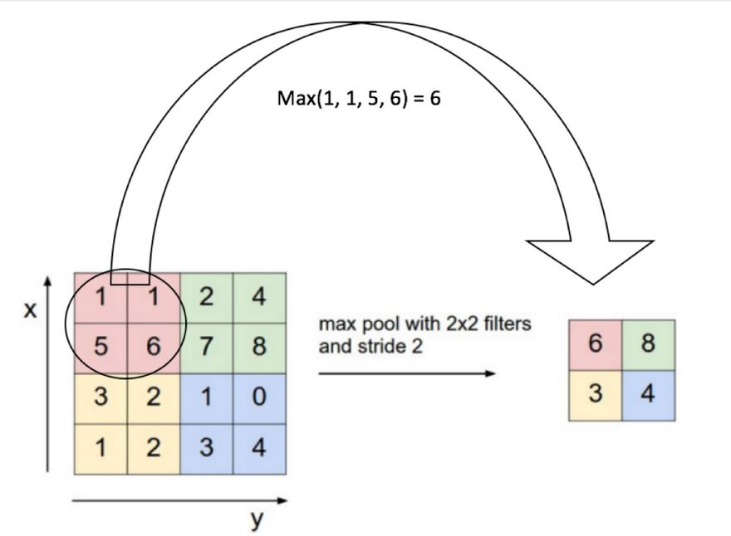
Max Pooling:

Slide 43
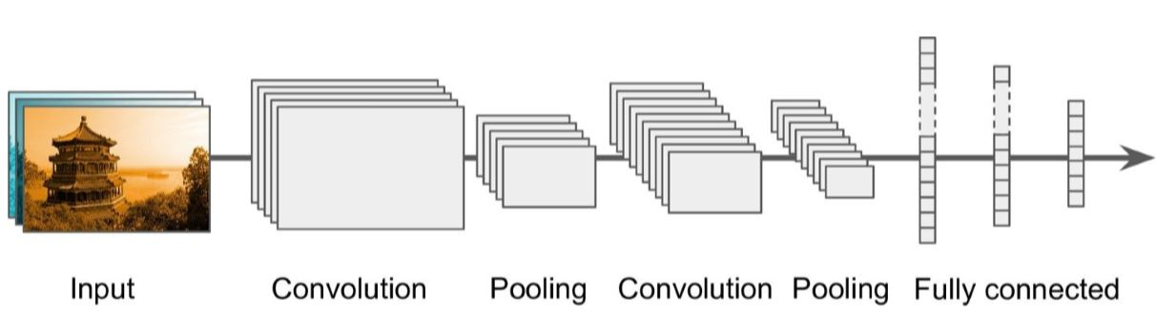
CNN Architectures:

Slide 44
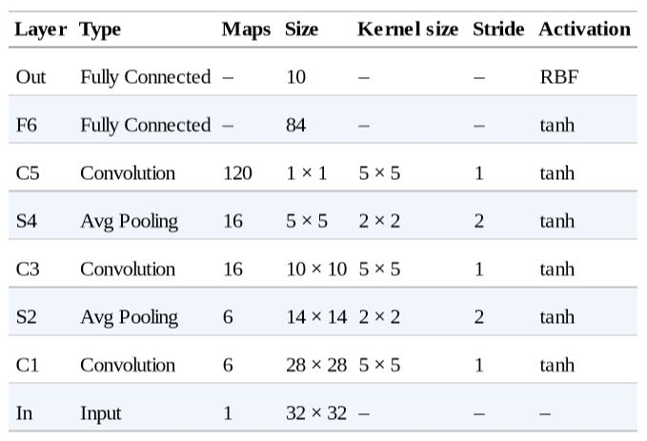
Example: LeNet-5(1998)

Slide 45
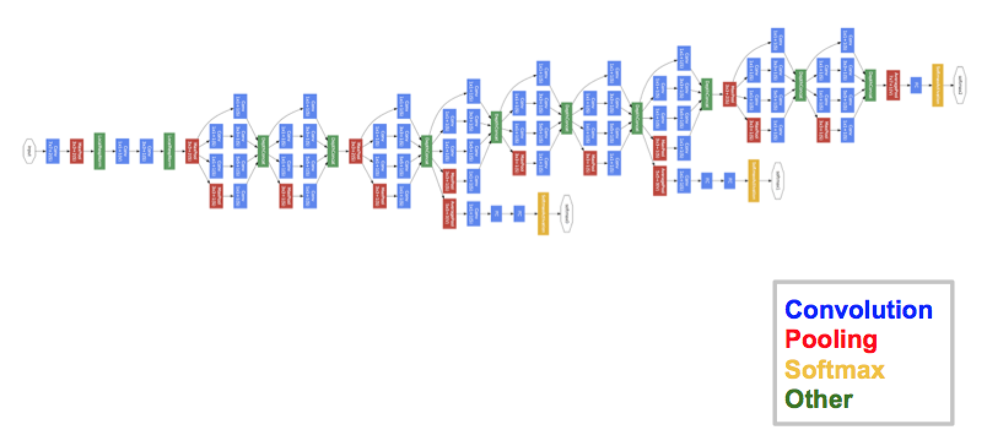
GoogLeNet:

Slide 46
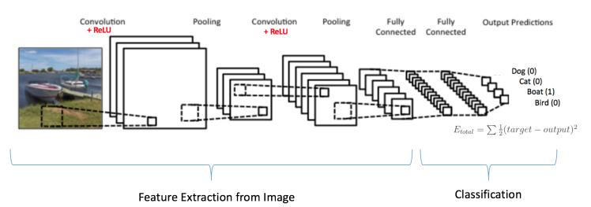
Example:

Slide 47
More examples:
https://medium.com/@sidereal/cnns-architectures-lenet-alexnet-vgg-googlenet-resnet-and-more-666091488df5

Slide 48

1. The choice of programming language:
C,C++,C#,Java,Python ...
There are a number of reasons why the Python programming language is popular with professionals who work on machine learning systems.

Slide 49
#1 : Readability and less complexity.
#2 : Packages everywhere !
#3 : many features that are attractive for scientific computing.
You can easily understand it and make someone understand very fast.
Numpy,scikit,librosa,pandas,matplotlib,tensorflow, pytorch,Django ...
Python has a simple and consistent syntax which makes programming more accessible to people who are not software engineers.

Slide 50



2.Choosing framework for building Neural Networks :

Slide 51
2.Choosing framework for building Neural Networks :
*-Tensorflow and PyTorch are open-source.
*-the computational graphs.
*-Tensorflow has a more steep learning curve than PyTorch.
*-Tensorflow has a much bigger community behind it than PyTorch.
*-Pytorch is so easy to debug.

