Slide 1
M.TECH PROJECT REVIEW
AI-Driven RTL Test Generation,
Coverage Analysis and Verification
PyVerilog AST → Hermes AI → Icarus Verification → Coverage Feedback → Mutation Testing
12 / 12
98%
14 / 14
workflow gates PASSED
mean AI coverage · 5 trials
chosen mutants killed · corrected
Simulation-only UART TX/RX case study | Evidence: 10 October 2026

Slide 2
02
The verification challenge
Why automation needs a deterministic checker and honest experimental controls
Problem
Manually authored stimuli leave protocol corners untested.
Weak random baselines
Payload-only tests spend effort on repetitive loopback behavior.
LLM risk
Unconstrained AI output is not a verified hardware test.
Observability risk
A covered scenario may still miss a transient fault if the checker is disabled.
Research goal: executable, constrained, coverage-guided RTL verification with independently checked results.
M.TECH · PHASE-BASED RTL VERIFICATION
2

Slide 3
03
Five research questions
Architecture, verification effectiveness, fault sensitivity and valid comparison
RQ1
Can Hermes produce valid executable UART scenarios?
RQ2
How does coverage compare with strong directed and random controls?
RQ3
Do scenarios detect real injected RTL faults?
RQ4
Can feedback close a measured, uncovered bin?
RQ5
What architecture/PPA differences exist independent of AI?
Scope: 8N1 UART TX/RX · CPB 8, 16, 32, 64 · no FPGA or silicon measurements
M.TECH · PHASE-BASED RTL VERIFICATION
3

Slide 4
04
Phase-based project flow
Do not confuse the historical day-wise log with the reviewer-facing development explanation
PHASE 1
PHASE 2
PHASE 3
PHASE 4
RTL Design
→
RTL Knowledge
→
AI Verification
→
Research Evaluation
Baseline + optimized UART TX/RX
PyVerilog AST → JSON
Hermes → validator → Icarus
Coverage, feedback, mutants, PPA
EVIDENCE: original 18/18 technical audit • phase workflow 12/12 • read-only Phase 4E audit PASS
All historical results preserved; new experiments use timestamped result folders.
M.TECH · PHASE-BASED RTL VERIFICATION
4

Slide 5
05
Related work and selected base paper
Closest prior art already covers LLM test generation and feedback
AutoBench · 2024
Automated HDL testbench generation
CorrectBench · 2025
Functional self-correction of testbenches
LLM4DV · 2025
LLM-generated hardware stimuli and coverage
ChatTest · 2026
Coverage-aware LLM test augmentation
AssertMiner-pro · 2026
RTL AST-guided hierarchical assertion mining
Our scope differs: structured UART scenarios + deterministic Icarus oracle + repeatability + mutation evidence
M.TECH · PHASE-BASED RTL VERIFICATION
5

Slide 6
06
Base paper versus proposed work
AssertMiner-pro is a conceptual methodological reference, not a reproduced algorithm
ASSERTMINER-PRO
THIS UART IMPLEMENTATION
AST / hierarchical guidance
PyVerilog UART knowledge model
LLM output: module assertions
LLM output: whitelisted scenario JSON
Goal: fine-grained specification mining
Goal: executable functional coverage
Evidence: published assertion-centered study
Evidence: Icarus + repeatability + 14 mutants
Do not claim numerical improvement over AssertMiner-pro; the outputs and benchmark scopes differ.
M.TECH · PHASE-BASED RTL VERIFICATION
6

Slide 7
07
UART RTL and behavior
Simulation-only, parameterized 8N1 serial TX/RX
TX
RX
serial frame
start + 8 data + stop
start · data_in[7:0]
busy · done · tx
rx · data_out[7:0]
valid · framing_error
CPB = 8
CPB = 16
CPB = 32
CPB = 64
Four frozen RTL source snapshots: baseline TX/RX and optimized TX/RX
M.TECH · PHASE-BASED RTL VERIFICATION
7

Slide 8
08
AST-derived knowledge and test objectives
What is automated before any model request
INPUT
Four UART RTL modules
↓
PARSE
PyVerilog AST
↓
MODEL
UART structural knowledge JSON
↓
OBJECTIVES
10 defined protocol coverage bins
↓
PROMPT
Hermes constrained scenario request
Hash-verified source model
M.TECH · PHASE-BASED RTL VERIFICATION
8

Slide 9
09
Hermes → validated testbench → simulator
LLM response is a proposal. The simulation oracle decides pass/fail.
1
Prompt
UART AST knowledge + objectives
2
Hermes AI
10 JSON scenario proposals
3
Validator
Allowed actions, payloads, schema
4
Generator
Self-checking Verilog testbench
5
Icarus + vvp
Assertions and functional-bin hits
Hermes bridge + schema validation + Icarus checking · all four CPB settings
M.TECH · PHASE-BASED RTL VERIFICATION
9

Slide 10
10
Fair comparison design
Ten initial scenarios per suite; simulation cycles and model cost reported separately
10
10
10
10
SCENARIOS
SCENARIOS
SCENARIOS
SCENARIOS
Payload random
Protocol random
Balanced directed
Hermes AI
10 seeds
10 seeds
1 curated suite
5 fresh model calls
Caveat: equal test counts do not imply equal cycles, preparation time, tokens or monetary cost.
M.TECH · PHASE-BASED RTL VERIFICATION
10

Slide 11
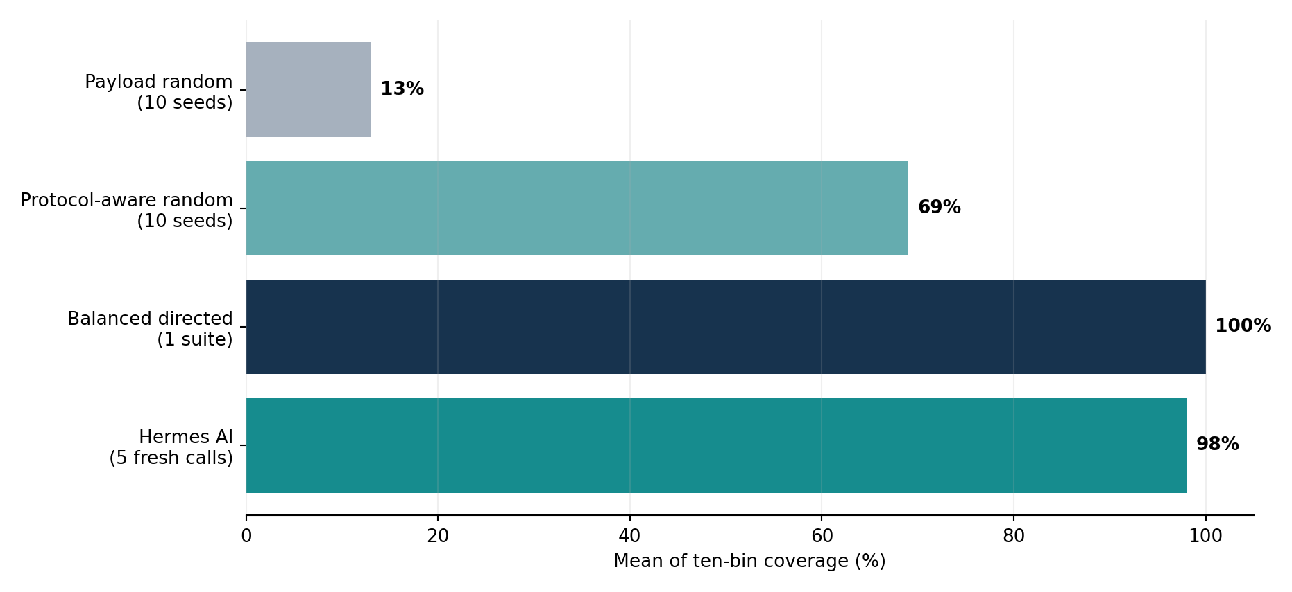
11
Coverage: model vs baseline
Defined ten-bin functional coverage, not full RTL statement/branch coverage
98%
Fresh Hermes · 5 calls
100%
Balanced directed · 1 suite
AI does not beat the strong directed control.
Payload random: 13% mean · Protocol-aware random: 69% mean
M.TECH · PHASE-BASED RTL VERIFICATION
11

Slide 12
12
Independent Hermes repeatability
Five live model generations; valid outputs and passing Icarus simulations
100%
100%
100%
100%
90%
TRIAL 1
TRIAL 2
TRIAL 3
TRIAL 4
TRIAL 5
98%
182,040
4 / 5
Mean ten-bin coverage
Zero failed checks
Full-coverage trials
M.TECH · PHASE-BASED RTL VERIFICATION
12

Slide 13
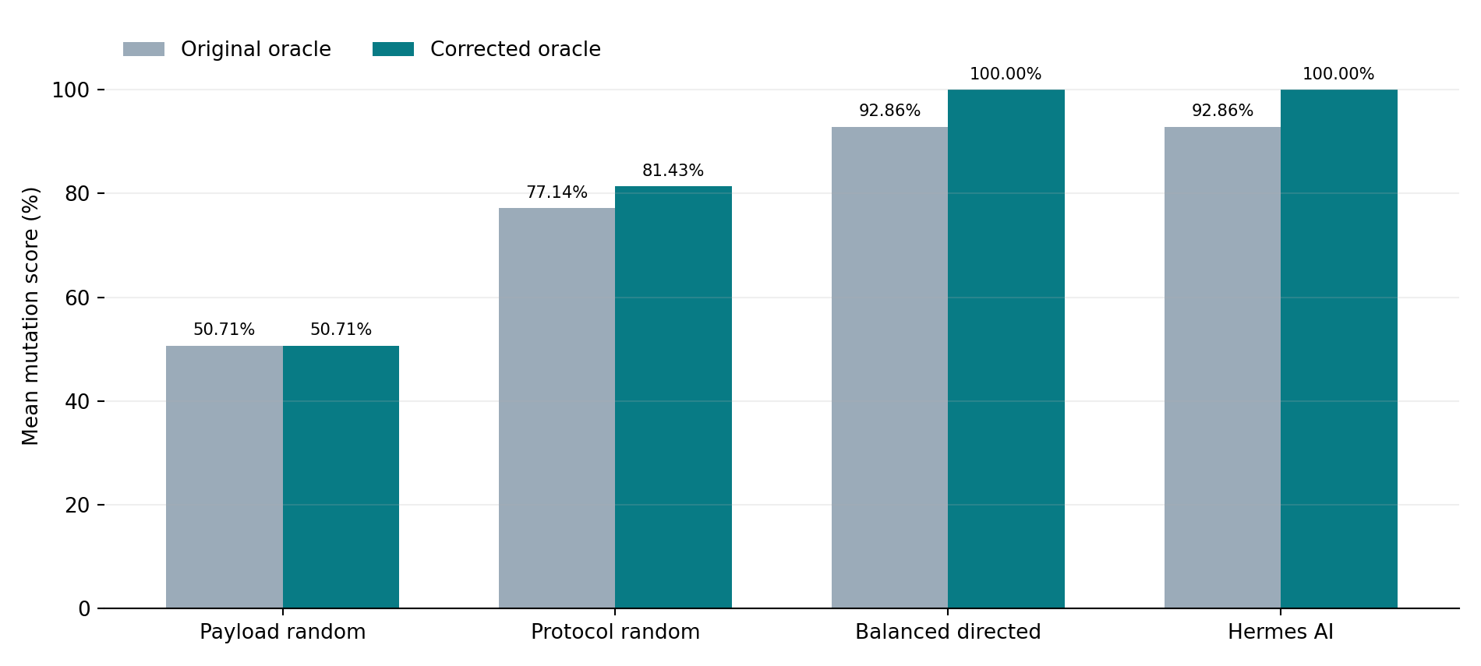
13
Mutation-based fault sensitivity
27 test suites · 14 fault operators · 4 CPB values
1,512
Mutant simulations
108
Clean controls passed
Corrected checker: AI = directed = 14/14 mutant types
Mutation score applies only to fourteen chosen operators; it does not guarantee no other RTL faults.
M.TECH · PHASE-BASED RTL VERIFICATION
13

Slide 14
14
Why 100% coverage was not enough
Independent diagnosis of reset observability in the verification oracle
ORIGINAL CHECKER
CORRECTED RESET ASSERTION
TX_RESET_BUSY_FAULT
0 / 108 detected
52 / 108 detected
reset-only comparison
An active-transfer reset mismatch was ignored by the original continuous checker.
The independent reset-cycle probe killed the mutant at CPB 8, 16, 32 and 64.
Lesson: test stimulus, coverage metric and observation oracle are distinct verification components.
M.TECH · PHASE-BASED RTL VERIFICATION
14

Slide 15
15
Real coverage feedback experiment
Hermes Trial 5 missed edge_81: loopback byte 0x81 (decimal 129)
BEFORE
AI FEEDBACK
DIRECTED
90%
→
100%
=
100%
10 AI scenarios
11 AI scenarios + 1 call
11 directed scenarios
Demonstrated: executable AI-assisted closure. Not demonstrated: higher final coverage than matched directed feedback.
M.TECH · PHASE-BASED RTL VERIFICATION
15

Slide 16
16
Architecture/PPA is a separate contribution
Nangate45 technology-mapped pre-layout estimates — not AI-generated silicon gains
Baseline TX + RX
450.604 µm²
370.282 µW
Both optimized
440.230 µm²
392.761 µW
Hybrid TX base + RX opt
425.600 µm²
366.547 µW
Hybrid: area −5.55%
Est. power −1.01%
Reported estimates depend on mapped library, synthesis/activity assumptions and flow.
M.TECH · PHASE-BASED RTL VERIFICATION
16

Slide 17
17
Supported contribution vs. research limits
Defensible novelty is an auditable integration and evaluation, not firstness
SUPPORTED
NOT SUPPORTED
AST → constrained Hermes → simulator pipeline
First-ever LLM coverage-feedback method
5 fresh trials; 98% mean defined-bin coverage
Better than expert directed verification
Corrected 14-mutant oracle evaluation
Generalization to independent RTL families
Real 90% → 100% feedback closure
100% verification of all possible faults
Measured pre-layout UART architecture tradeoff
Silicon power/PPA improvement caused by AI
M.TECH · PHASE-BASED RTL VERIFICATION
17

Slide 18
18
Phase-based evidence and reproducibility
Two independent audit layers plus user-verified experiment JSON files
Technical gate
evaluation/workflow_status.json (12/12 PASS)
Initial baseline + AI
phase_03_ai_verification/results/evaluation_summary.json
10-seed random controls
evaluation/repeatability/phase4c_*/...summary.json
5 fresh AI runs
evaluation/repeatability/hermes_trials/phase4c2_*/...summary.json
Corrected mutants
evaluation/fault_injection/phase4d5_reset_checker_*/...json
AI feedback
evaluation/feedback_closure/phase4d7_*/...report.md
Phase 4E audit
phase_04_uart_novelty/research/PHASE4E_EVIDENCE_AUDIT.json
Original day-wise files are historical evidence, not the review structure. Keep manifests, tool versions and provenance.
M.TECH · PHASE-BASED RTL VERIFICATION
18

Slide 19
19
Conclusions and project next steps
Technical verification passed; submission-readiness is separate
All four phases implemented and the phase-workflow audit reports 12/12 PASS.
Hermes produces validated UART test cases with strong repeatability and explicit feedback closure.
Corrected-oracle fault sensitivity matches balanced-directed tests for 14 selected mutants.
Before final submission: institute template, tool/model provenance, clean checkout, data/privacy and licensing audit.
Claim only what was measured. Preserve both the positive results and the methodological limitations.
M.TECH · PHASE-BASED RTL VERIFICATION
19

Slide 20
20
Selected references
Full bibliographic details and DOI links are in the accompanying thesis draft
[R1] AutoBench — ACM/IEEE MLCAD 2024 — doi:10.1145/3670474.3685956
[R2] CorrectBench — IEEE DATE 2025 — doi:10.23919/DATE64628.2025.10992873
[R3] LLM4DV — IEEE FCCM 2025 — doi:10.1109/FCCM62733.2025.00048
[R4] ChatTest — IEEE DATE 2026 — doi:10.23919/DATE69613.2026.11539733
[R5] AssertMiner-pro — Elsevier Integration 2026 — doi:10.1016/j.vlsi.2026.102797
[R6] Enhancing Search-Based Testing — Springer ASE 2025 — doi:10.1007/s10515-025-00531-7
[R7] LLMs for Verification, Testing, and Design — IEEE ETS 2025 — doi:10.1109/ETS63895.2025.11049311
For journal/conference submission, read full nearest-prior-art methods and validate publication claims.
M.TECH · PHASE-BASED RTL VERIFICATION
20

Slide 21
THANK YOU
Questions on the four phases, evidence, and research limitations?
12/12 internal workflow gates passed · submission format and clean checkout remain

