Slide 1


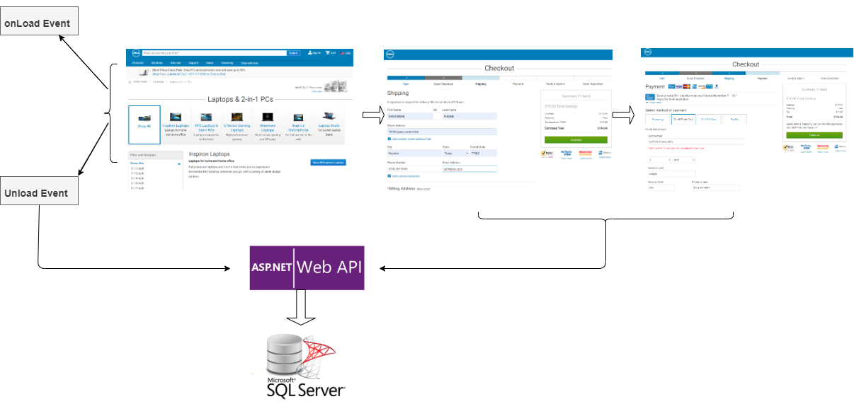

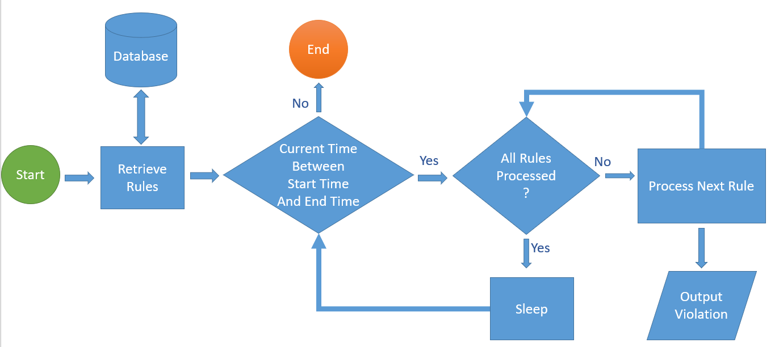
SITE RELIABILITY ENGINEERING
Gokul Mutyala, Parvez Salim, Ha Vu
University of Houston-Clear Lake
INTRODUCTION
ARCHITECTURAL DESIGN
Site Reliability Engineer (SRE), applies Software Engineering principles to IT Operations and Infrastructure. It seeks to ensure high availability, scalable, and an easy-to-maintain website by monitoring Dell’s website. 3 phases: data collection, data analysis and Real-Time Monitoring. In the data collection phase, information such as session ID, entering and leaving web page time stamps, referral links are collected using JavaScript and web Api.
This is an event driven design. There are multiple events associated with each webpage. To capture the how long a user stays on a page, we utilize the OnLoad and OnUnload event respectively to capture the start and time of each visited page.
One we have the start and end time, we construct a JSON object and do a POST request to the Web API using JavaScript. The Web API saves the visited time into the database.
Similarly, we use Javascript and call the same Web API to capture user personal information and credit card number when they check out.
To analyze the data, we create rules in as stored procedure in SQL Server.
Our monitoring process executes each rule and outputs violation to the monitoring console.
PROJECT PHASE
Future Enhancements
Enhance notification process to send notification via texts or emails.
Create visualization dashboard to help Dell website analysts to easily monitor the health of dell.com.
ACKNOWLEDGMENT
Our sincere thanks to Dawood, our mentor
for believing in us and supporting us in all means.
We are grateful to our capstone professor and
mentor Dr. Gary D. Boetticher for supporting us
throughout the project and giving us valuable
feedback from time to time.
Finally, we thank the University of Houston-Clear
lake for giving us this opportunity in gaining
knowledge and building successful career.
Monitoring
CONTACTS
Gokul Satyaraj Mutyala – mutyalag2392@uhcl.edu
Ha Vu – vuh2044@uhcl.edu
Mahammad Parvez Salim- salimm3027@uhcl.edu

