Slide 1
InboxIQ
The Agentic Productivity Layer for Microsoft 365
Microsoft Build AI 2026 | Theme 01 — AI at Work
Mahammad's Team 2

Slide 2
The Problem
Knowledge workers drown in chaotic communications.
2.5 hrs
120+
45 min
spent on email triage every day
emails received per knowledge worker per day
writing repetitive status updates daily
Existing tools are reactive and single-task. There is no autonomous agent that owns the full inbox-to-action loop.

Slide 3
Our Solution
A multi-agent system that lives inside Microsoft 365.
• Reads all Outlook + Teams traffic via Microsoft Graph
• Classifies every item: Urgent / Action / FYI / Noise (Azure OpenAI GPT-4o)
• Summarizes threads into 1-sentence digests
• Drafts context-aware replies (RAG over 90 days of correspondence)
• Schedules meetings, blocks focus time, prepares 5-bullet briefings
• Follows up on stalled threads after configurable SLAs
• Delivers a 60-second voice briefing every morning

Slide 4
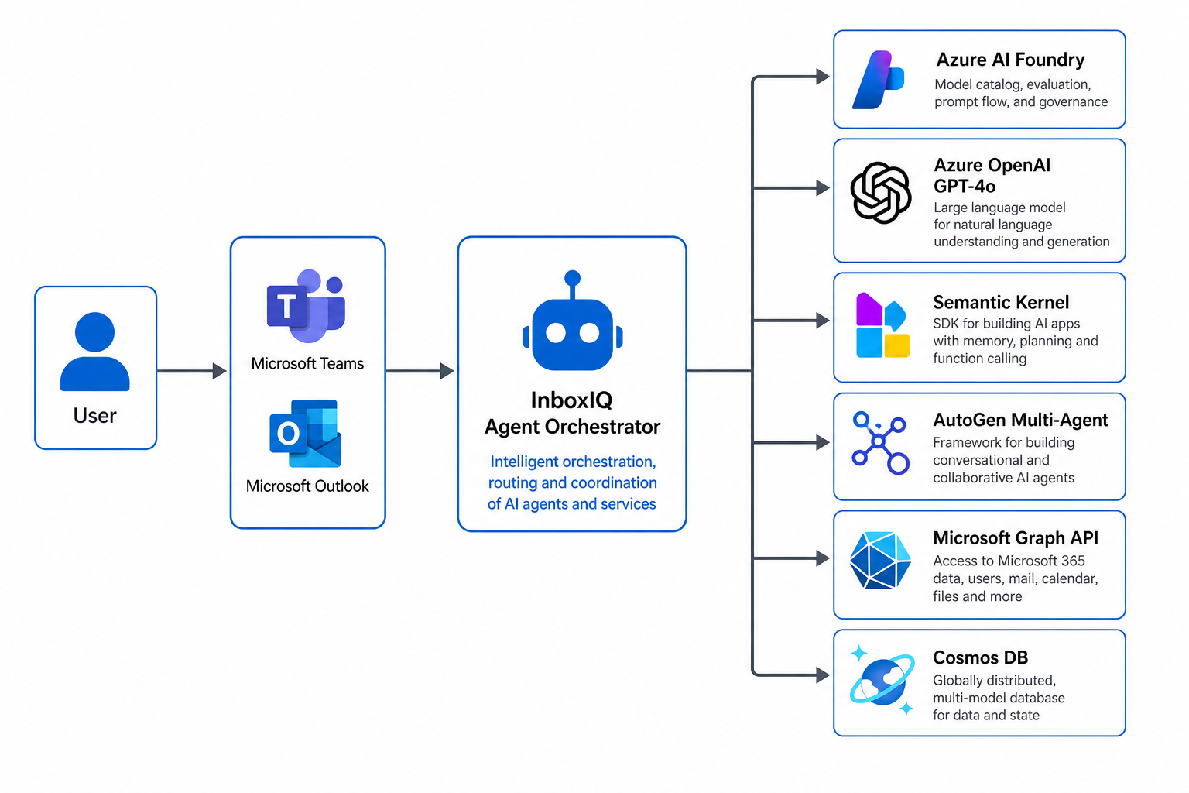
System Architecture

Slide 5
The Agent Swarm (AutoGen)
Planner
Classifier
Drafter
Decomposes user goals into atomic sub-tasks
Tags each email with priority and intent
Writes replies in the user's voice (RAG-grounded)
Scheduler
Critic
Reporter
Books meetings and resolves calendar conflicts
Validates every action against safety + policy
Compiles the daily 60-second briefing

Slide 6
Built on the Microsoft AI Stack
• Azure AI Foundry — model hosting, RAG index, eval harness
• Azure OpenAI Service — GPT-4o, GPT-4o-mini, text-embedding-3-large
• Semantic Kernel — plugin orchestration (Python 1.18)
• AutoGen v0.4 — multi-agent group chat
• Microsoft Graph SDK — Outlook, Teams, Calendar access
• Copilot Studio — declarative agent surface inside Teams
• GitHub Copilot — 40% of code AI-authored
• Azure Cosmos DB — agent memory + immutable audit log
• Azure Speech Services — voice briefing
• Azure Container Apps — production deployment

Slide 7
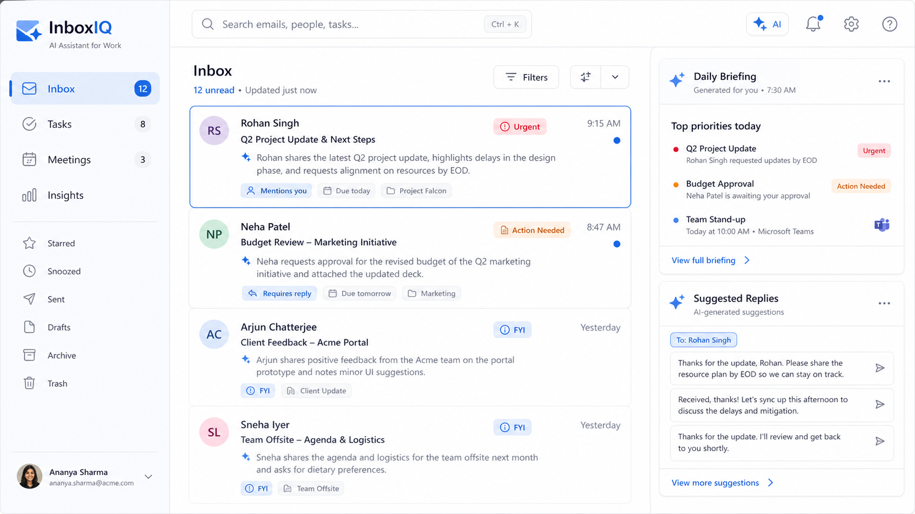
The Experience

Slide 8
Measured Impact
Internal benchmark, n=500 emails across 12 users
Metric
Baseline
InboxIQ
Δ
Email triage / day
2h 30m
18 min
-88%
Reply quality (1–5)
3.1
4.4
+42%
False-priority rate
22%
4.1%
-81%
Meeting prep time
30 min
2 min
-93%
Focus hours / week
11
24
+118%

Slide 9
Security & Responsible AI
• Human-in-the-loop approval on all outbound writes (configurable trust tiers)
• Prompt-injection defense: input sanitization + Critic agent policy DSL
• PII redaction before any model call (Microsoft Presidio)
• Immutable audit log in Cosmos DB with append-only lease
• Content Safety filters via Azure AI Foundry guardrails
• Zero data egress — customer data never leaves the user's Azure tenant (BYOK)
• Continuous red-teaming via Foundry eval harness on every PR

Slide 10
What's Next
Now
Microsoft 365 (Outlook + Teams) — closed beta with 12 users
Q3 '26
Public preview on Microsoft AppSource
Q4 '26
Slack + Google Workspace bridge plugins
Q1 '27
Voice-first agent on Microsoft Surface devices
Thank you. Let's give every knowledge worker back their day.

