Slide 1
Student Name: Nazil
Roll No.:154
Batch:A3

Slide 2
What is cyber security?
Cyber security's core function is to protect the devices we all use (smartphones, laptops, tablets and computers), and the services we access - both online and at work - from theft or damage.
It's also about preventing unauthorised access to the vast amounts of personal information we store on these devices, and online.
Cyber security is how individuals and organisations reduce the risk of cyber attack.

Slide 3
Why is it important?
Cyber security is important because smartphones, computers and the internet are now such a fundamental part of modern life, that it's difficult to imagine how we'd function without them.
From online banking and shopping, to email and social media, it's more important than ever to take steps that can prevent cyber criminals getting hold of our accounts, data, and devices.

Slide 4
The Different Types of Cybersecurity.
1. Network Security:
Most attacks occur over the network, and network security solutions are designed to identify and block these attacks.
2. Cloud Security:
As organizations increasingly adopt cloud computing, securing the cloud becomes a major priority.
3. Endpoint Security:
The zero-trust security model prescribes creating micro-segments around data wherever it may be.
4. Mobile Security
Often overlooked, mobile devices such as tablets and smartphones have access to corporate data, exposing businesses to threats from malicious apps, zero-day, phishing, and IM (Instant Messaging) attacks.

Slide 5
The Evolution of the Cyber Security Threat Landscape
Gen V Attacks:
Gen I (Virus):In the late 1980s, virus attacks against standalone computers inspired the creation of the first antivirus solutions.
Gen II (Network): As cyber attacks began to come over the Internet, the firewall was developed to identify and block them.
Gen III (Applications): Exploitation of vulnerabilities within applications caused the mass adoption of intrusion prevention systems (IPS)
Gen IV (Payload): As malware became more targeted and able to evade signature-based defenses, anti-bot and sandboxing solutions were necessary to detect novel threats.

Slide 6
Malware
The different generations of cyberattacks have been defined mainly by the evolution of malware.
Malware authors and cyber defenders are playing a continual cat and mouse game, where attackers try to develop techniques that overcome or bypass the latest in security technology.
Often, when they succeed, a new generation of cyberattacks is created
Modern malware is swift, stealthy, and sophisticated.
The detection techniques used by legacy security solutions (such as signature-based detection) are no longer effective, and, often, by the time security analysts have detected and responded to a threat, the damage is already done.

Slide 7
Cyber Security Trends
The prevailing trends in cybersecurity often stem from a combination of reactions to prominent cyber threats, emerging technologies, and enduring security objectives.
There are 2 types of Security Trends :
AI Security
Hybrid Mesh Firewall Platform

Slide 8
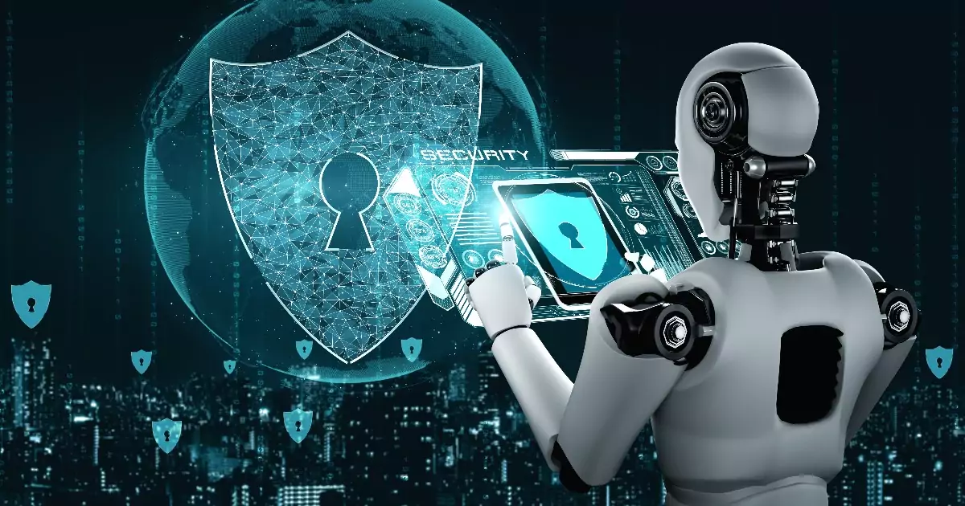
AI Security.
The ascent of AI profoundly influences cybersecurity, encompassing both offensive and defensive aspects.
On the offensive front, cyber threat actors have already employed tools like ChatGPT to enhance and streamline cyberattacks, contributing to a notable year-over-year surge in attacks across the board.

Slide 9
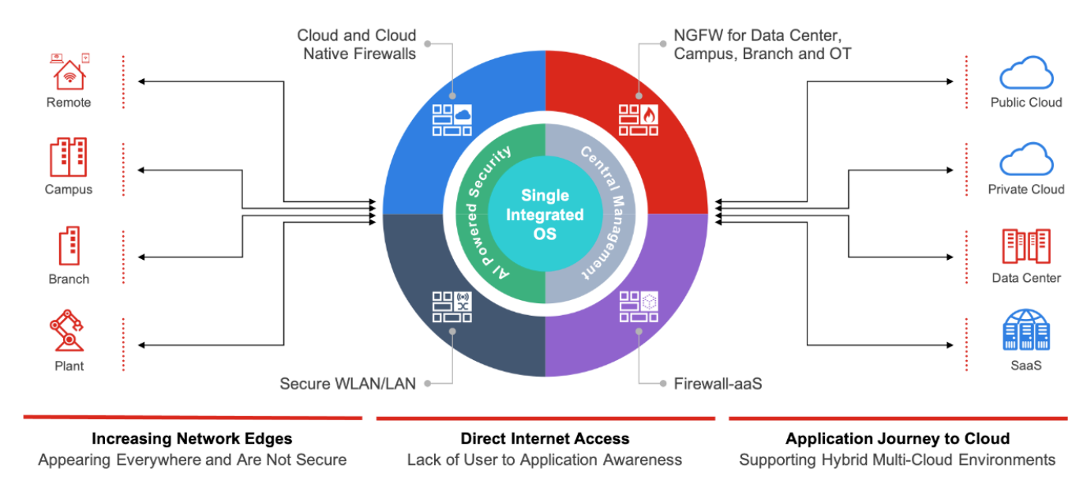
Hybrid Mesh Firewall Platform
Organizations are progressively adopting hybrid mesh firewall platfrom, integrating diverse firewall types into a unified, centrally managed security architecture.
This approach allows organizations to implement firewall solutions tailored to specific environments while simultaneously ensuring centralized oversight, administration, and enforcement of policies across their entire infrastructure.

Slide 10
Advantage and Disadvantage of Cyber security:
Advantages of Cyber Security:
Disadvantages of Cyber Security:
Data Safety from Hackers
Safeguarding Online Transactions
Preventing Identity Theft
Mitigation of Financial Losses
Decreased Data Theft Hazard
Complexity
Cost
False Sense of Security
Privacy Concerns
User Inconvenience
Skill Shortage

Slide 11
Common Cyber Threats
The cyber security landscape is complex, with millions of known threat actors and documented Tactics, Techniques and Procedures (TTP), and new types of attacks emerging every day.

Slide 12
Principles of Cyber Security
The primary objective of cyber security is to protect data. The security community commonly refers to a triangle of three related principles that ensure data is secure, known as the CIA triad:
Confidentiality — ensuring sensitive data is only accessible to those people who actually need it, and are permitted to access according to organizational policies, while blocking access to others.
Integrity — making sure data and systems are not modified due to actions by threat actors, or accidental modification. Measures should be taken to prevent corruption or loss of sensitive data, and to speedily recover from such an event if it occurs.

Slide 13
Building a Cyber Security Strategy
Addressing the cyber security problem in your organization starts from a strategy, which should be supported by senior management and shared with the entire organization.
Here is a process you can use to build your security strategy:
Perform an inventory of computing assets—identify which applications and data your organization possesses, and the consequences if they should be attacked or compromised. Create a list of assets that need to be protected.
Identify compliance requirements—is your organization subject to any regulations or industry standards that affect cybersecurity? Identify the compliance requirements related to cybersecurity and add them to your list of protected assets.

Slide 14
Prioritize risks—given the systems you need to protect, your compliance responsibilities, and the common threats, map out your biggest risks. Which are the systems that are the most valuable to the business and most likely to be attacked? These are the first risks you should target with your cybersecurity program.
Build a cybersecurity team—leverage existing staff in your organization with cybersecurity skills, hire new staff and involve consultants if necessary. Create a capable team that is able to execute on a cybersecurity plan to improve your security posture.

Slide 15
Cyber Security Trends
1. Cyber Security and Machine Learning
In the past, cyber security systems relied on manually defined rules and human inspection to identify and classify security incidents. This was effective but limited, because it required a high level of expertise to manage security tools, and overloaded security staff.
2. API Security
Application Programming Interfaces (APIs) allow computing systems to communicate with each other and share data. An entire API economy has emerged that allows organizations to share data and software capabilities with each other.

Slide 16
3. Advanced Bot Protection
Bots are systems that access websites and perform automated actions. Some bots are legitimate, for example, the Googlebot crawls websites in order to add them to Google’s search index. But other bots are malicious, used by threat actors to launch attacks against millions of vulnerable websites.
Bots account for 58% of web traffic today, and a full 22% of web traffic is attributed to bad bots. Bad bots can be installed on end-user devices compromised by attackers, forming massive botnets. These devices might be home computers, servers, and IoT devices such as game consoles or smart TVs. Attackers leverage networks of compromised devices to launch DDoS and many other types of attacks.

Slide 18
Types of Cyber Security
Network security
Cloud Security
Application Security
Web Security
IOT Security

