Slide 1
“BOOKABLE”
By
MAHAMMED JAWAAD
6th Sem BCA ‘A’ Section

Slide 2
Empathy Phase

Slide 3
What Customers wants?
Currently venue booking system is manual and only accessible to staff. The client has to travel to the company offices in order to schedule, book and organize an event such as Birthday Party, Marriage, Reception, Ring Ceremony. Clients pay cash to book for an event which is inconveniencing when customers are many at the company. It takes lots of time of customer because they have to search such event organizer and contact them individually so an online event management system is needed which will enable the customer make booking, schedule events online at any preferred time.

Slide 4
Mission
Simplify venue booking experience
To connect right people
Enhance the lives of users
Save user time

Slide 5


STAKEHOLDERS
Customer
Venue Manager

Slide 6

Person 1
(Customer)
SIVA BALAN
"Our greatest asset is the customer!”
Age : 21
Location: Banglore
Education: BCA
Status: Unmarried
Hobbies: Playing , listening Music , Watching movies

Slide 7
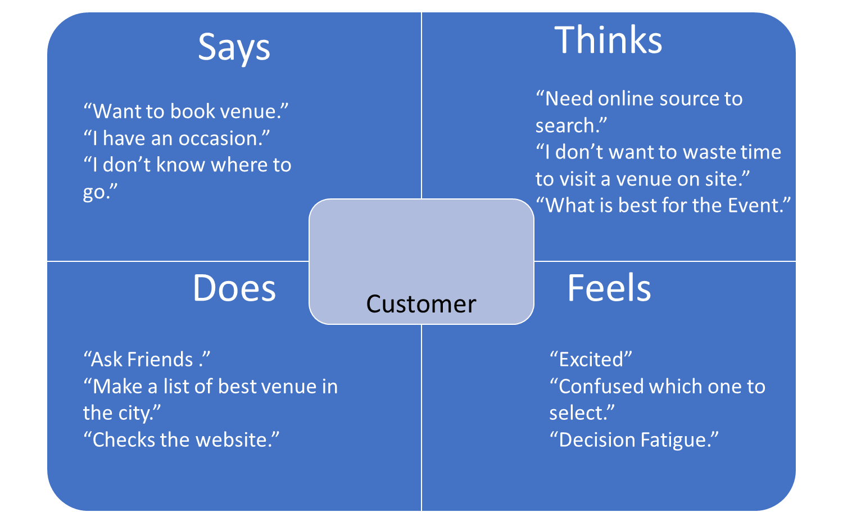

Slide 8
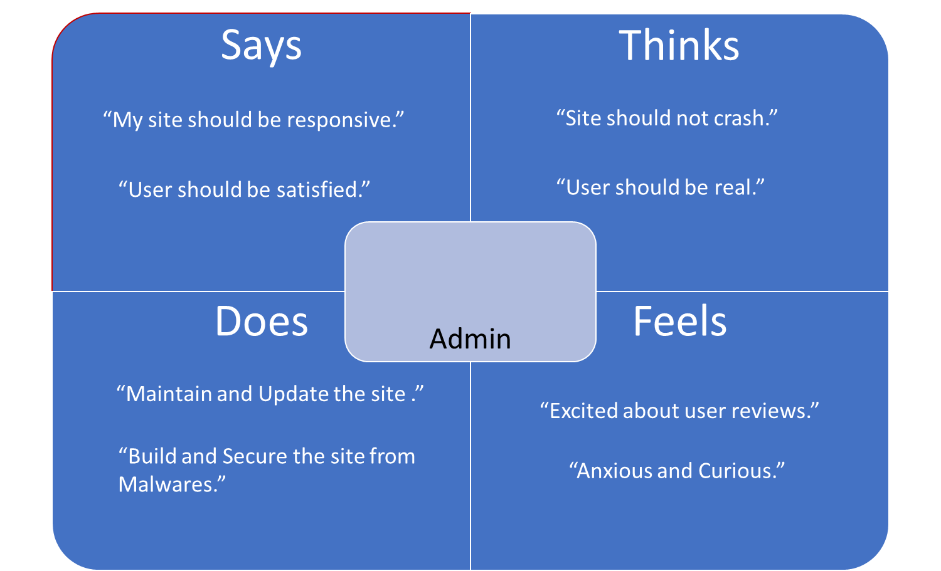

Slide 9
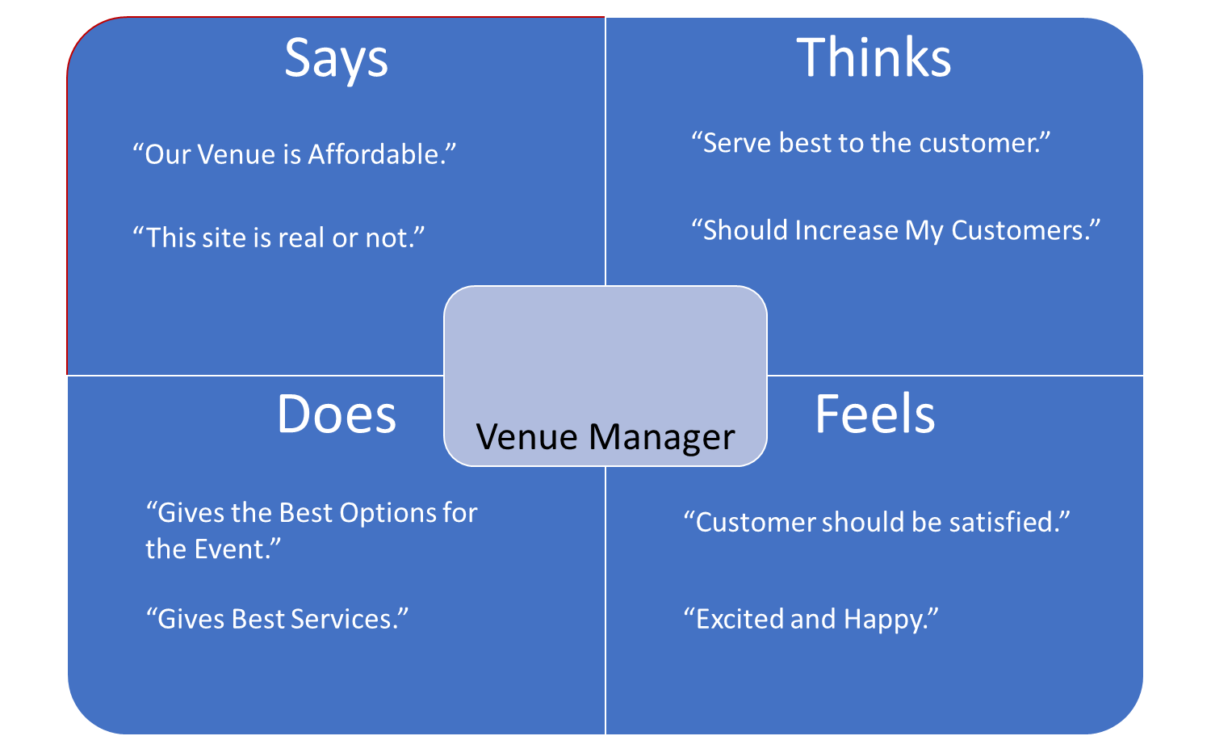

Slide 10
Define Phase

Slide 11
The goal of Define Phase
The Define Phase is all about implementing methods of synthesizing raw data and creating a meaningful problem statement.

Slide 12
PROBLEM STATEMENT
An online venue booking system which will enable user to book and enlist their venue online at any preferred time.

Slide 13
USER | NEEDS | INSIGHTS
Customer | Best venue option in my area Best services provide by venue As shown in picture same in real | Best of options to choose from and can access all information about the venue. To know all the services available in the venue and wants to make sure that the pictures shown on site are same in real. To know parking options available or not and if available mention the capacity/size of parking area.

Slide 14
USER | NEEDS | INSIGHTS
Venue Manager | Provide best picture of over venue More number of bookings Good feedback by customers | Venue manager wants to insure that he provide best pictures of his venue. Venue manager wants to have more bookings so that he can earn, make profit and increase the value of venue. Venue manager needs good feedback of his venue

Slide 15
USER | NEEDS | INSIGHTS
Admin | Provide best site to his users Site should be responsive and should not crash Needs various software resources | Admin wants to insure that users should be real/ valid. Admin wants to insure that venue picture, address provided by venue manager should be real. Admin wants that his site should work flexibly.

Slide 16
Solution to the problem statement
At bookable, we make venue booking effortless experience.
Through our user friendly technology, dedicated venue service you can find your ideal venue at assured prices.
All you have to do is browse, shortlist and check availability, and book the venue.

Slide 17
Ideate Phase

Slide 18
Ideation Phase
Ideation is the third stage of the design thinking process where participants in a design thinking workshop come up with ideas on how to solve a specific user problem. The design thinking process is made up of three phases: empathize, ideate, and prototype.
The ideation phase of design thinking is guided by the user problems that were defined during the empathize phase. Ideation is about the exploration and identification of potential solutions. Not all ideas will be viable solutions, and that’s okay. The primary goal of ideation is to spark creativity and innovation.

Slide 19
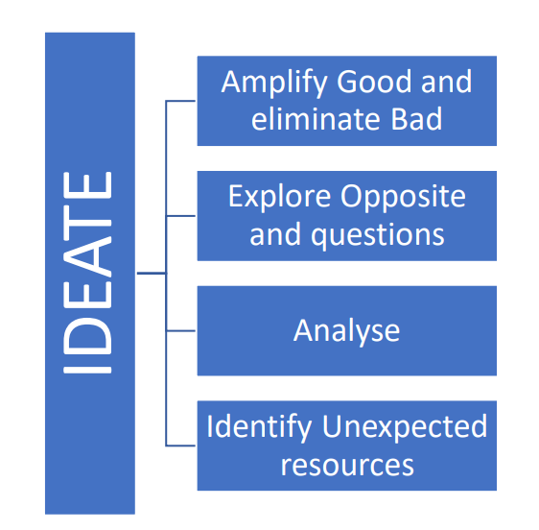

Slide 20
Brainstorming Ideas
Concept - 1
Add Promotion
Everyone’s favorite form of paid advertising is digital advertising because it is both easy to promote and easy to measure. Clicks and visits don't always lead to sales - you will need to convince the user to 'convert' once they reach your website’s fav

Slide 21
Brainstorming Ideas
Concept - 2
We build offices at prior locations where we include multiple venues of that particular location so that people can come there and book their venue .

Slide 22
Brainstorming Ideas
Concept - 3
Bookable
The Online Venue Booking System has been developed to replace the manual process of booking venue such as hotel room or any other facility of hotel. The old system does not serve the customer in a better way. Rather it makes customer data vulnerable. Customers can also book online without registering into the system. This system keep proper record of customers for emergency and security purposes. The hotel's advertising efforts is now accompanied by a virtual tour created on system.

Slide 23
Mind Mapping
Cancellation
Affordability
Recommendations
Bookable
Security
Privacy

Slide 24
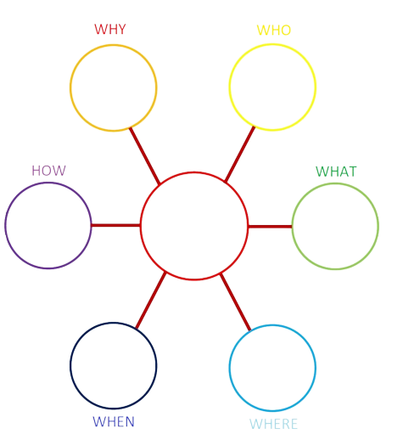
No platform
for small venues
Customers who needs venue
Venue managers serves venues
Venue booking
Website
24 x 7
Searched area

Slide 25
“Thank You”

