Slide 1

UNIVERSITY RAG ASSISTANT
AI-powered answers for academic questions
SDAIA PROJECT · RAG

Slide 2



The Problem
Academic answers are out there — but they're hard to find quickly and reliably.
Scattered information
Academic policies, course guides, and requirements live across many disconnected documents and PDFs.
Generic AI falls short
General-purpose chatbots often hallucinate or simply lack institution-specific knowledge.
Slow manual search
Students and staff waste time digging through handbooks to answer simple, everyday questions.

Slide 3

Our Solution
University RAG Assistant lets you upload your own academic documents. It automatically indexes them and answers natural-language questions — grounded only in your uploaded content.
Upload custom .txt documents in seconds
Retrieval-Augmented
Generation (RAG)
Ask questions in plain English
Answers sourced directly from your materials
Instead of guessing, the assistant retrieves the most relevant passages from your documents, then asks the language model to answer using only that evidence.
Runs with local, offline-capable embeddings
No hallucinated answers. No outdated web knowledge.

Slide 4




Tech Stack
A lightweight, local-first pipeline from interface to answer.
Streamlit
ChromaDB
Sentence-
Transformers
OpenRouter
(gpt-4o-mini)
Python 3.13+
Interactive web interface
Vector database for storage
Local semantic embeddings
Grounded answer generation
Core application language

Slide 5




How It Works
From raw document to grounded answer in five steps.
1
2
3
4
5
›
›
›
›
Upload
Chunk
Embed
Store
Answer
Add your .txt academic documents.
Text is split into meaningful segments.
Each chunk becomes a semantic vector.
Vectors are indexed in ChromaDB.
Relevant chunks are retrieved and gpt-4o-mini writes the answer.
The result: answers backed by evidence from your own institution's materials — not generic web knowledge.

Slide 6
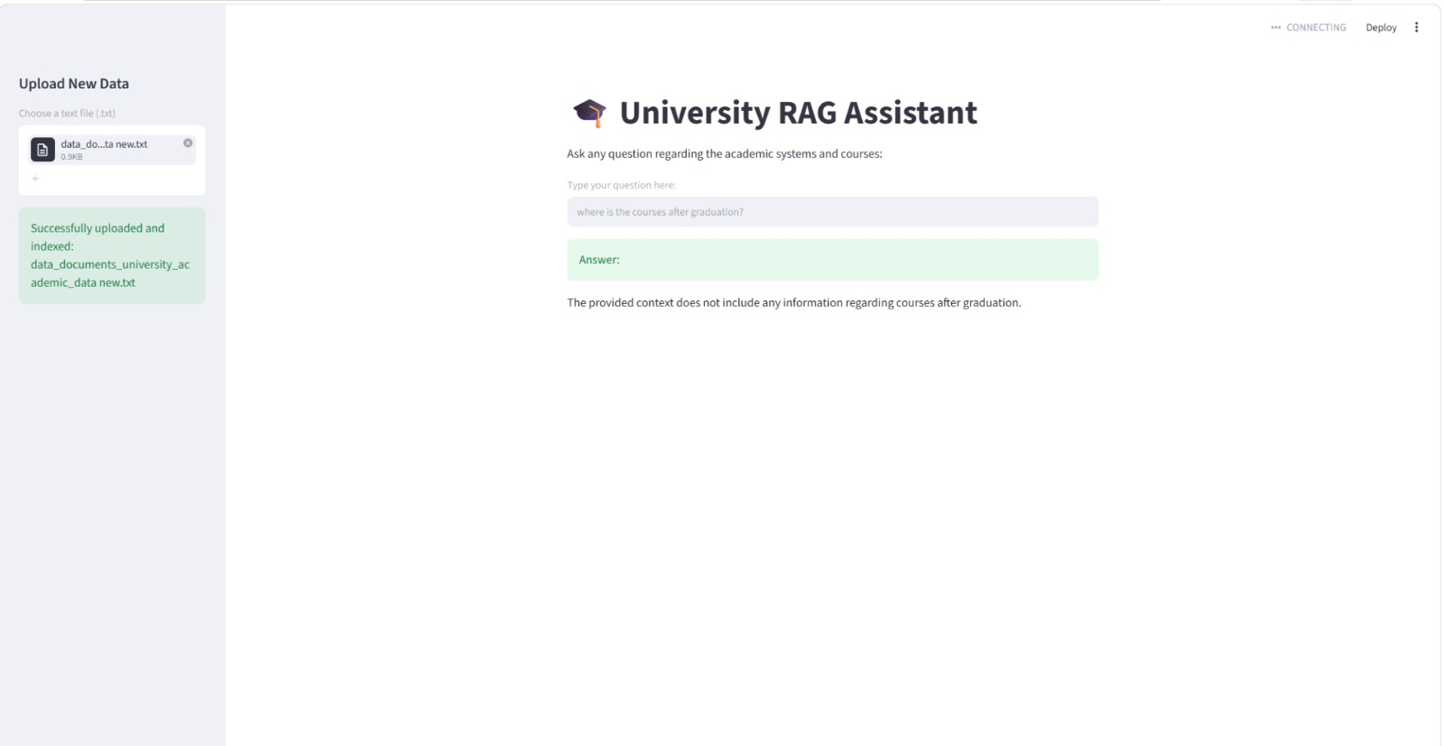
See It In Action
Ask any question about academic systems and courses
Get instant, context-aware answers from your data
Upload new files anytime to expand the knowledge base
If the answer isn't in your documents, the assistant says so — instead of guessing

Slide 7
Key Takeaways & What's Next
KEY TAKEAWAYS
WHAT'S NEXT
Combines retrieval + generation for accurate, grounded answers
Support more file formats (PDF, DOCX)
Fully customizable knowledge base per institution
Multi-language question answering
Local embeddings reduce cost and external dependency
Admin dashboard for content management
Thank You

