Slide 1
Project Presentation
Project Title : Sniffer
Course Title : Software Development Lab |||
Course Code : CSE - 336
Presented By,
Name : Md. Mahamudul Hasan Roky
ID : 191311075
Semester : 9th
Batch No. : 20
Dept. of CSE, VU
Presented To,
Name: Md. Nour Nabi
Lecturer,
Dept. of CSE, VU

Slide 2

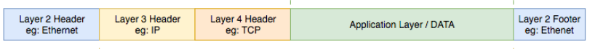

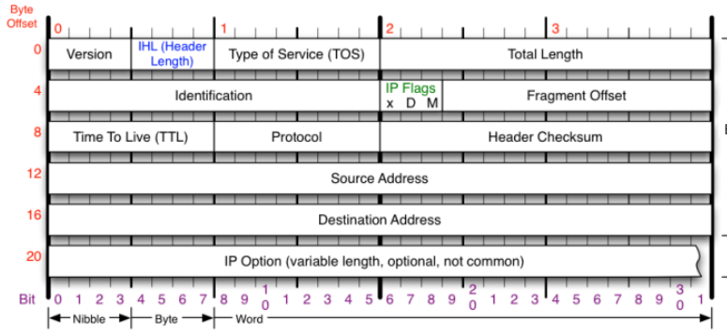
Think about a packet?

Slide 3


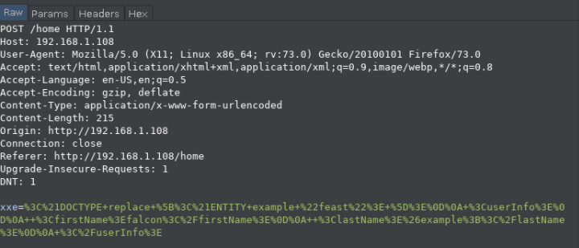

Try to think like an offensive way?
Promiscuous mode
Client & Server cache
Client & Server cookie
Encryption Method
External Entity (XXE)
Extensive Markup Language (XML)
<?xml version="1.0"?>
<!DOCTYPE replace[<!ENTITY name "Anarul Islam">]><userinfo>
<firstName>Rakibul</firstname><lastname>&name</lastname></userinfo>
Command Injection (CI)
Structured Query Language Injection(SQLI)
<?xml version="1.0" encoding="UTF-8"?> <stockCheck><productId>381</productId></stockCheck>

Slide 4
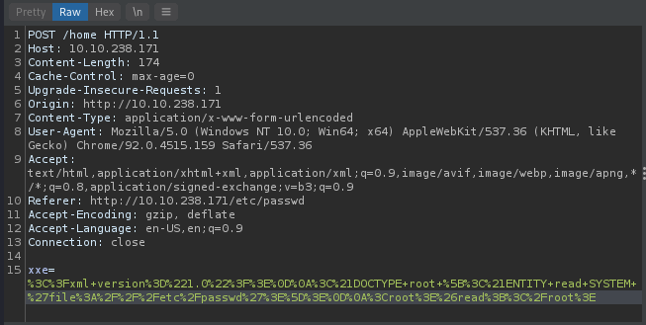
<?xml version="1.0"?>
<!DOCTYPE stockCheck [<!ENTITY xxe SYSTEM file://home > ]>
<?xml version="1.0"?> <!DOCTYPE root [<!ENTITY read SYSTEM 'file:///etc/passwd'>]> <root>&read;</root>

Slide 5
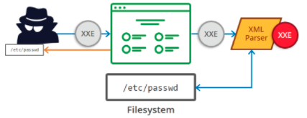
Actual Scenario:

Slide 6


Don’t use for military server.
Avoid using free PPTP VPN
Avoid changes anything in system firewalls.
Or, any kind of illegal purposes.
Restrictions
Acknowledgements
Enables NIC’s Promiscuous Mode
Receives Packets in local ports
Avoids receiving responses in reserved ports for OS daemons.
Language
Platform
Sniffer
Captures incoming and outgoing packets
Shows source & destination port with address.
Captures payloads in XXE form
Advantages
Accuracy
70%

Slide 7
Performance
Capturing
OS
Familiarity
Access Ports
Bugs
(Military Purposes)

Slide 8


