Slide 1

Enhancing Building Energy Efficiency with IoT-Driven
Hybrid Deep Learning Models for Accurate Energy
Consumption Prediction
IoT Networks Project Phases 2 & 3 Presentation
by Mahan Bayhaghi
Sharif University of Technology
Dept. of Computer Engineering
Fall 2025

Slide 2
Dataset and Preprocessing
Data Source: Utilized publicly available energy data from the EIA (Energy Information Administration).
Time Series Formatting: Data structured into sequences with a defined look-back window.
MinMax Scaling: used to standardize the input features between 0 and 1.
Why MinMax Scaling?
  Neural networks, especially LSTMs, converge faster and perform more consistently when input data is normalized, preventing larger values from dominating the learning process.

Slide 3
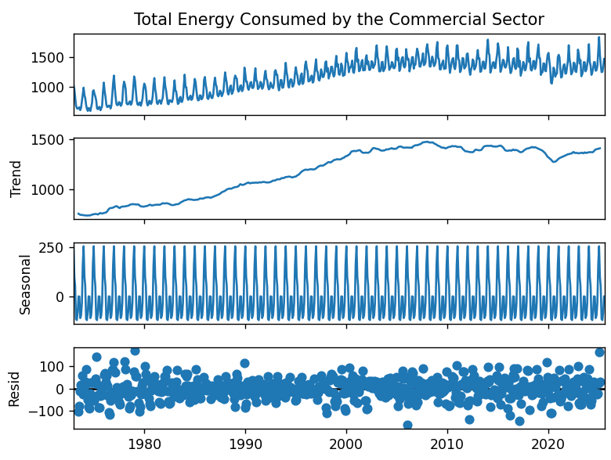
Dataset EDA

Slide 4
Paper’s Claims
Model Name | Prediction Performance
CNN | Weak. Fails to capture temporal dependencies
BiLSTM | Better than CNN yet have lags (delays)
CNN-BiLSTM (Proposed) | Proposed method Better than both standalone CNN and BiLSTM Captures both temporal and spatial dependencies
Ensemble Models (LGBM, XGBoost, CatBoost) | Inherently great for prediction Capturing more meaningful features (lags and means) Yet fails against proposed model

Slide 5
Performance Metrics
MSE / RMSE: Sensitive to large errors due to squaring, ideal for identifying significant deviations from actual values.
MAE: Represents the average absolute error, offering a linear score that is intuitive for estimating operational costs and typical error magnitudes.
R-squared (R²): Indicates the proportion of variance in the dependent variable explained by the model. A value closer to 1 signifies a better fit.
MAPE: Expresses prediction accuracy as a percentage of the actual values, making it useful for comparing forecast performance across different datasets or scales.

Slide 6
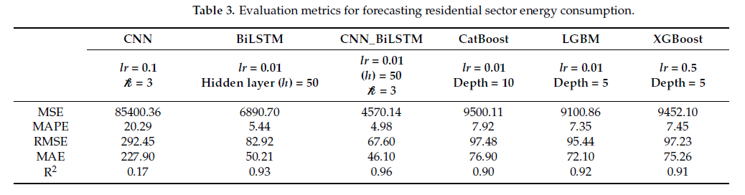
Paper’s Findings

Slide 7
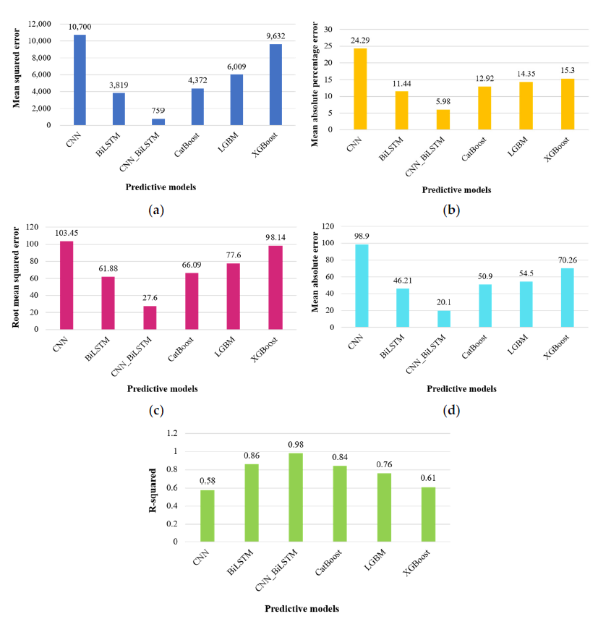
Paper’s Findings (cont.)

Slide 8
Phase 2 & 3 Roadmap
01
02
03
04
05
06
Standalone CNN
Standalone BiLSTM
CNN-BiLSTM
GB Family
Plotting
Analysis

Slide 9
Standalone CNN: 1D-CNN
Paper’s Approach:
  1D-CNN as spatial feature extractor
  Weight sharing for parameter reduction
  1D max-pooling for feature compression
  Grid Search for hyperparameter optimization
My Implementation:
  Three FC layers with Dropout
  Flexible sequence lengths (1, 3, 12)
  Full Grid Search with Early Stopping
  Pipeline: MinMaxScaler → sequence prep → PyTorch format

Slide 10
Standalone CNN: Implementation
Model Architecture (Simple1DCNN class):
  Two 1D convolutional layers with Batch Normalization and ReLU activation
  Flattening layer followed by three fully connected layers with Dropout (configurable rate)
  Final output layer with single neuron for regression
Key Hyperparameters (Grid Search):
  conv_filters: Number of filters in conv layers (tested: 1, 32, 64)
  kernel_size: Convolution window size (tested: 3, 5)
  fc1_units/fc2_units: Dense layer sizes (tested: [4,8] and [2,4] combinations)
  dropout_rate: Regularization (tested: 0.05, 0.1)
  learning_rate: Optimizer step size (tested: 0.05, 0.1)

Slide 11
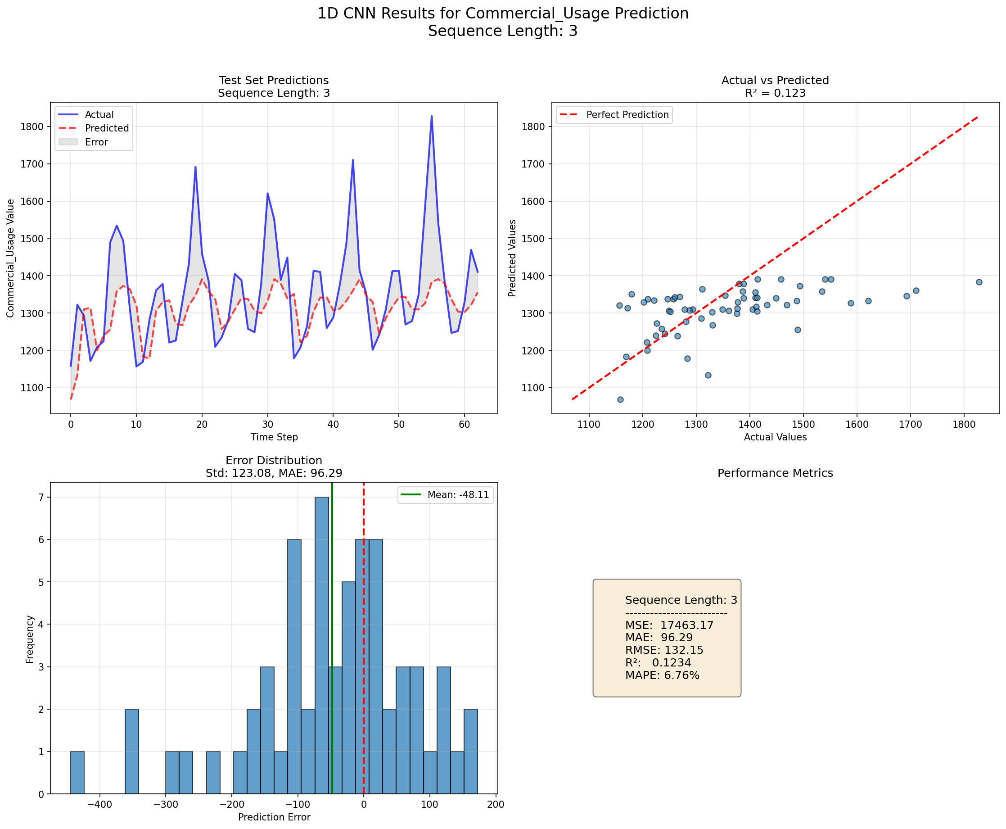
Standalone CNN: 1D-CNN (cont.)

Slide 12
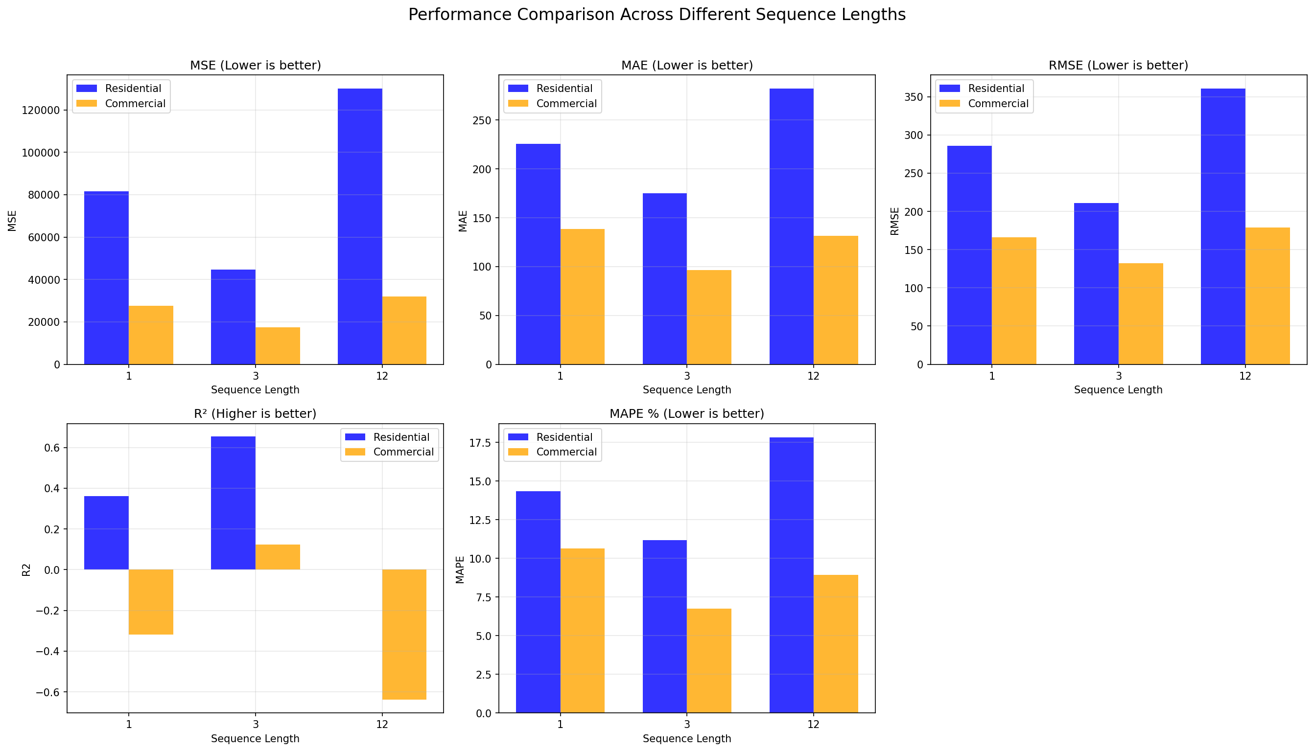
Standalone CNN: 1D-CNN (cont.)

Slide 13
Standalone BiLSTM
Paper's Approach:
  Bidirectional processing: forward + backward
  Grid Search for hyperparameter optimization
My Implementation:
  2-layer BiLSTM → concatenated hidden states
  Three FC layers with ReLU & Dropout
  Gradient Clipping for stability

Slide 14
Standalone BiLSTM: Implementation
Model Architecture (BiLSTMModel class):
  Bidirectional LSTM layer (output size = hidden_size * 2)
  Multiple stacked LSTM layers with dropout between layers
  Three fc layers with ReLU activation and dropout for regression output
Key Hyperparameters (Grid Search):
  hidden_size: LSTM memory cells (tested: 32, 50, 64) - controls model capacity
  num_layers: Stacked LSTM depth (tested: 2, 3) - deeper temporal abstraction
  fc1_units/fc2_units: Dense layer sizes (tested: [8,16] and [4,8] combinations)
  dropout_rate: Regularization (tested: 0.1, 0.2, 0.3) - prevents overfitting
  learning_rate: Optimizer step size with ReduceLROnPlateau scheduler (factor=0.5, patience=5)

Slide 15
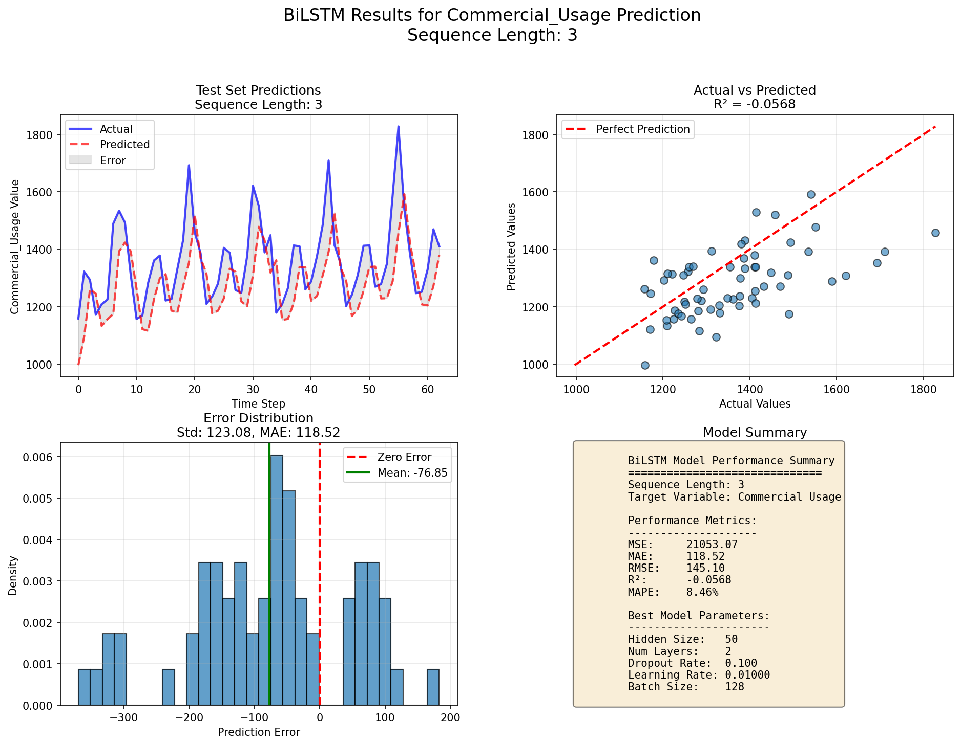
Standalone BiLSTM (cont.)

Slide 16
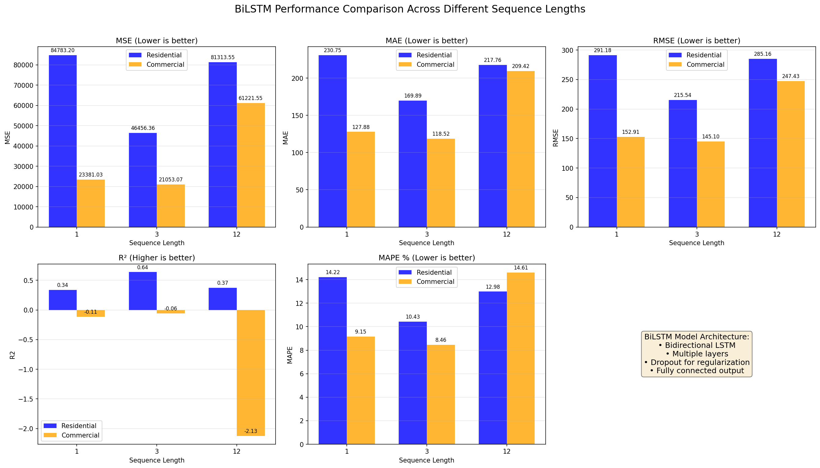
Standalone BiLSTM (cont.)

Slide 17
Proposed CNN-BiLSTM
Paper's Approach:
  1D-CNN: Spatial feature extraction
  BiLSTM: Temporal dependency learning
  Grid Search for optimal hyperparameters
My Implementation
  Deep CNN Backbone: 3-layer Sequential CNN
    Increasing filters (Filters → 2x → 4x)
    BatchNorm + Dropout per layer

Slide 18
Proposed CNN-BiLSTM: Implementation
Model Architecture (CNNBiLSTM class):
  3-layer CNN with BatchNorm, ReLU, and Dropout for spatial feature extraction (conv_filters doubling each layer: 32→64→128)
  Optional attention layer that computes weighted sum of LSTM outputs (vs. using last time step)
Key Hyperparameters (Grid Search):
  CNN Section: conv_filters (tested: 2, 4, 8, 16, 32) and kernel_size=3 for local pattern extraction
  LSTM Section: lstm_hidden_size (tested: 50, 64, 100) and lstm_num_layers (tested: 2, 3, 4)
  Regularization: dropout_rate=0.1, weight_decay=1e-5 (L2 regularization), gradient clipping (max_norm=1.0)
  Training: learning_rate=0.01 with ReduceLROnPlateau scheduler, batch_size=128

Slide 19
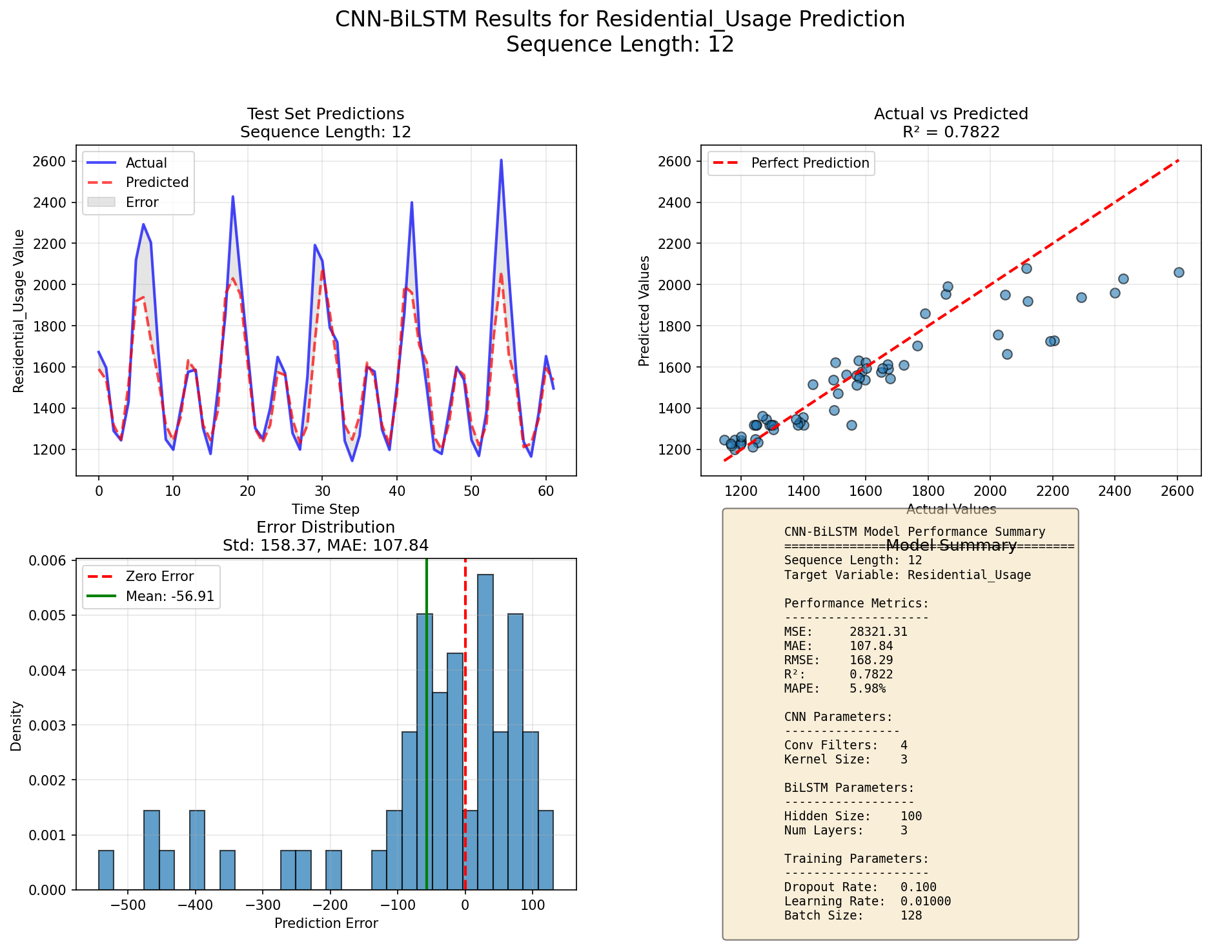
Proposed CNN-BiLSTM (cont.)

Slide 20
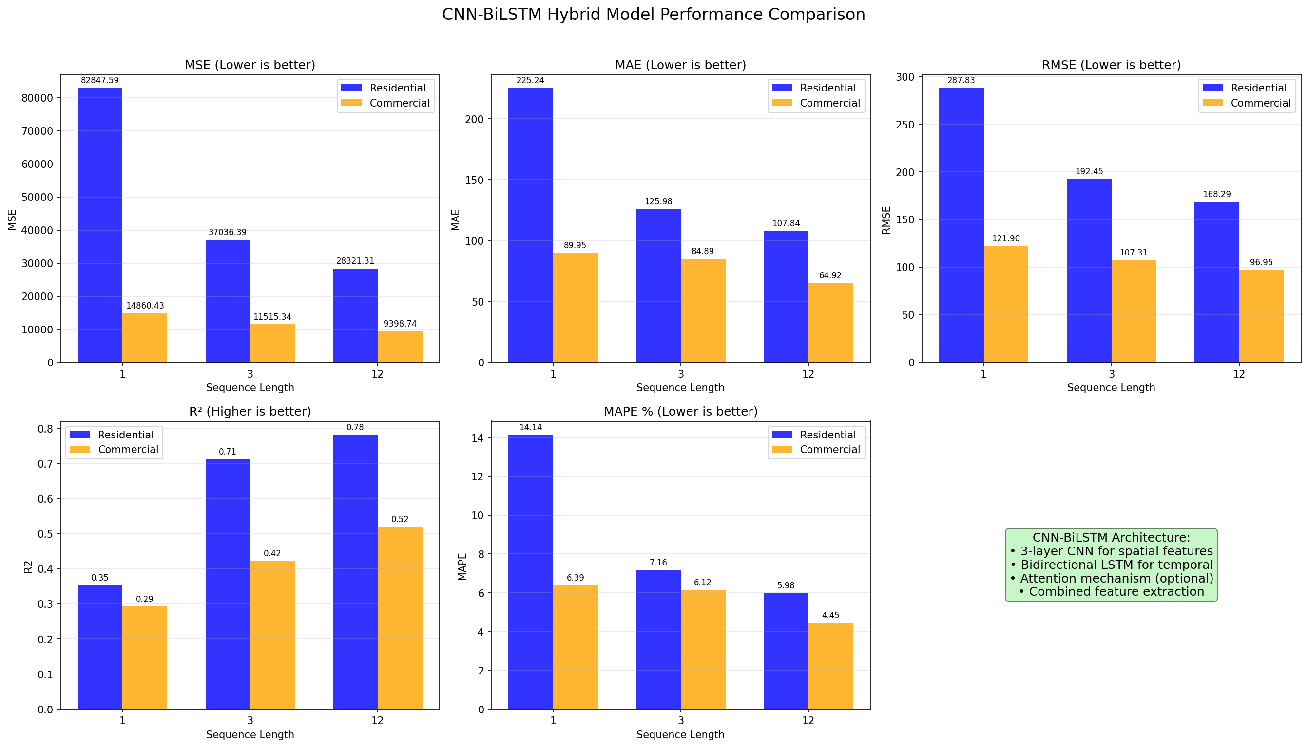
CNN-BiLSTM (cont.)

Slide 21
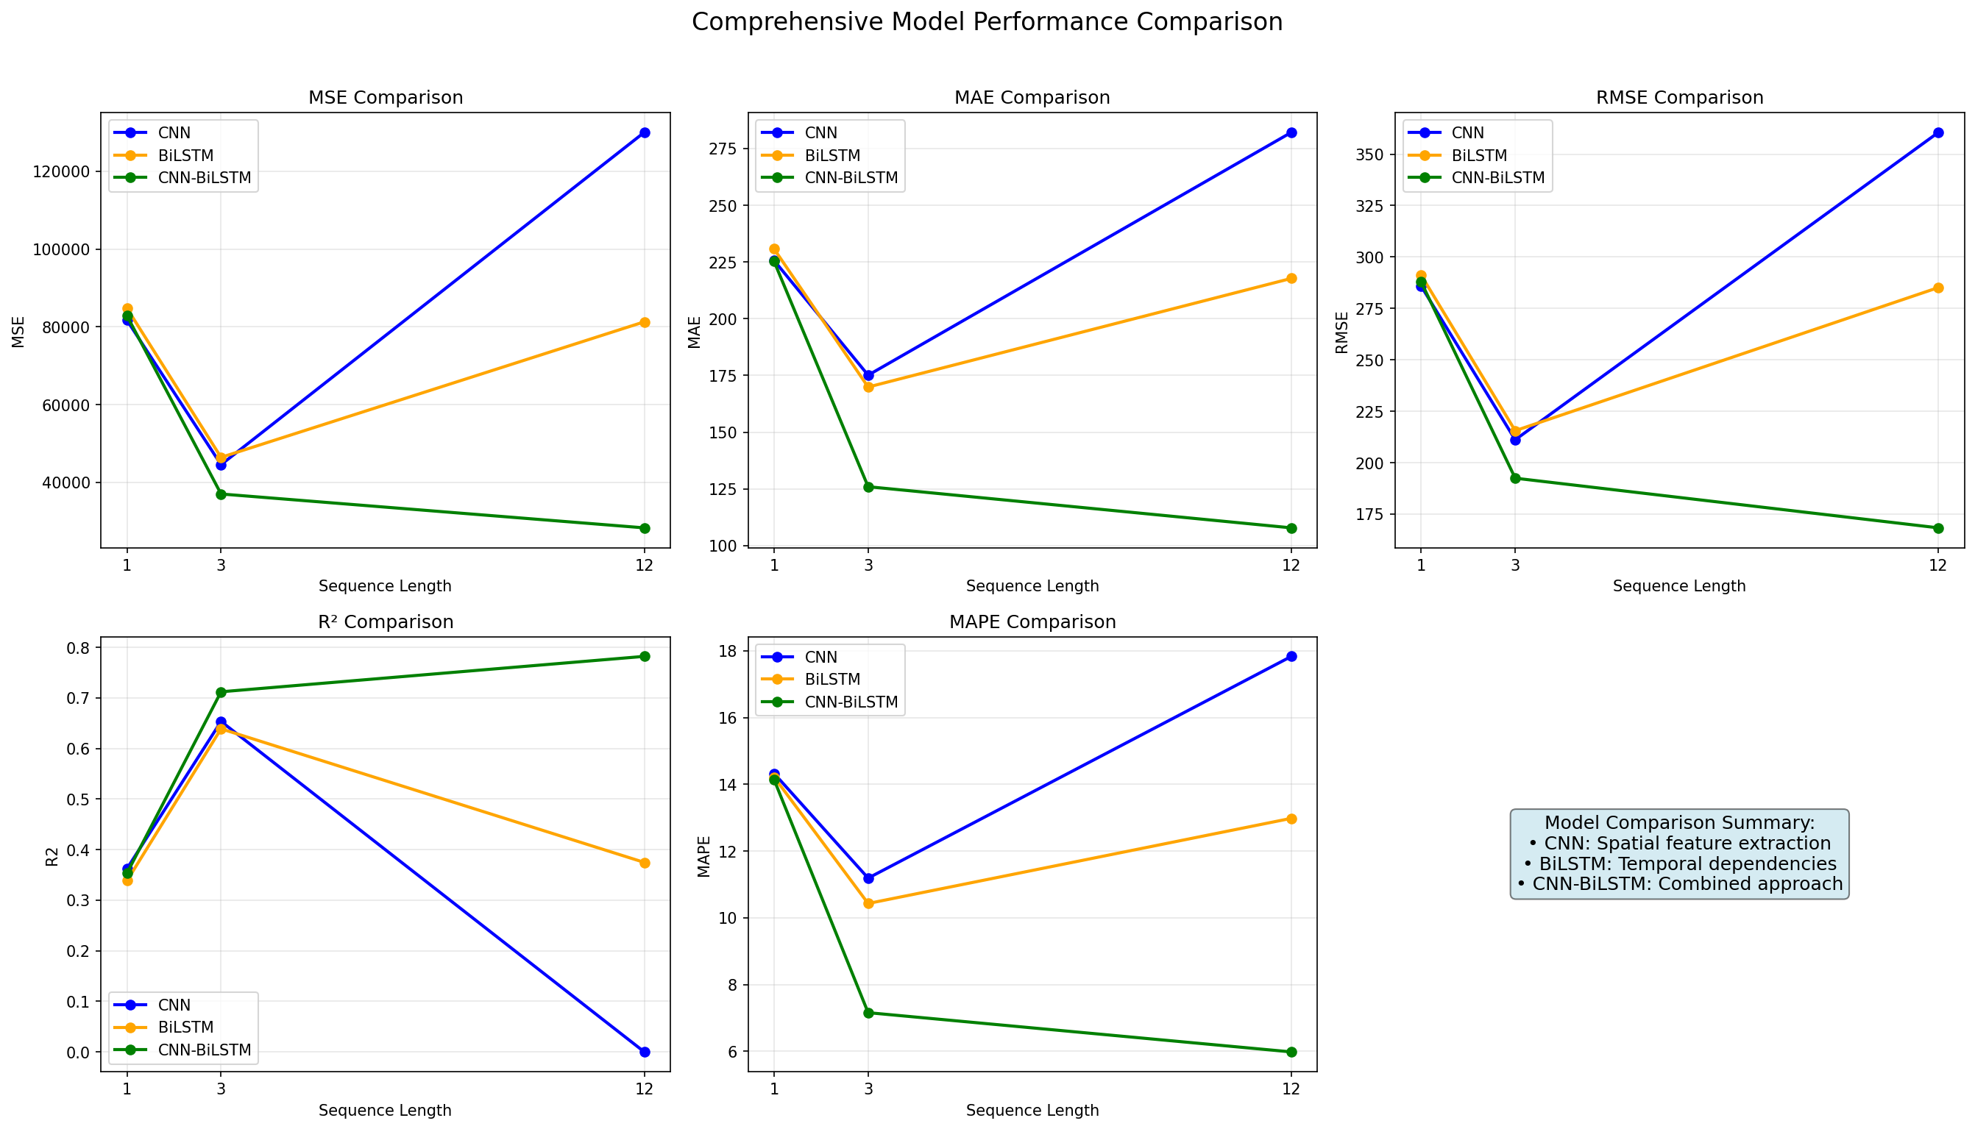
CNN-BiLSTM vs Standalone Models

Slide 22
Gradient Boosting Models (LGBM)
LightGBM:
  Paper's Use:
    Critical benchmark vs. CNN-BiLSTM
    Leaf-wise tree growth → lower loss
    Fast, efficient training baseline
  My Implementation:
    Lag Feature Engineering
    Rolling Statistics & EWMA
    Cyclical Time Encoding (sine/cosine)

Slide 23
Gradient Boosting Models (XGBoost)
XGBoost:
  Paper's Use:
    State-of-the-art baseline
    Handles sparse IoT data well
    Proves deep learning superiority
  My Implementation
    Feature Engineering Pipeline
    Regularization Tuning
    Optuna Sampler for optimization

Slide 24
Gradient Boosting Models (CatBoost)
CatBoost:
  Paper's Use:
    "Ordered Boosting" for categorical features
    Symmetric trees as regularization
    Robust baseline for significance testing
  My Implementation:
    Time-Series → Tabular transformation
    CatBoost-specific parameter tuning
    Feature Importance insights for lag analysis

Slide 25
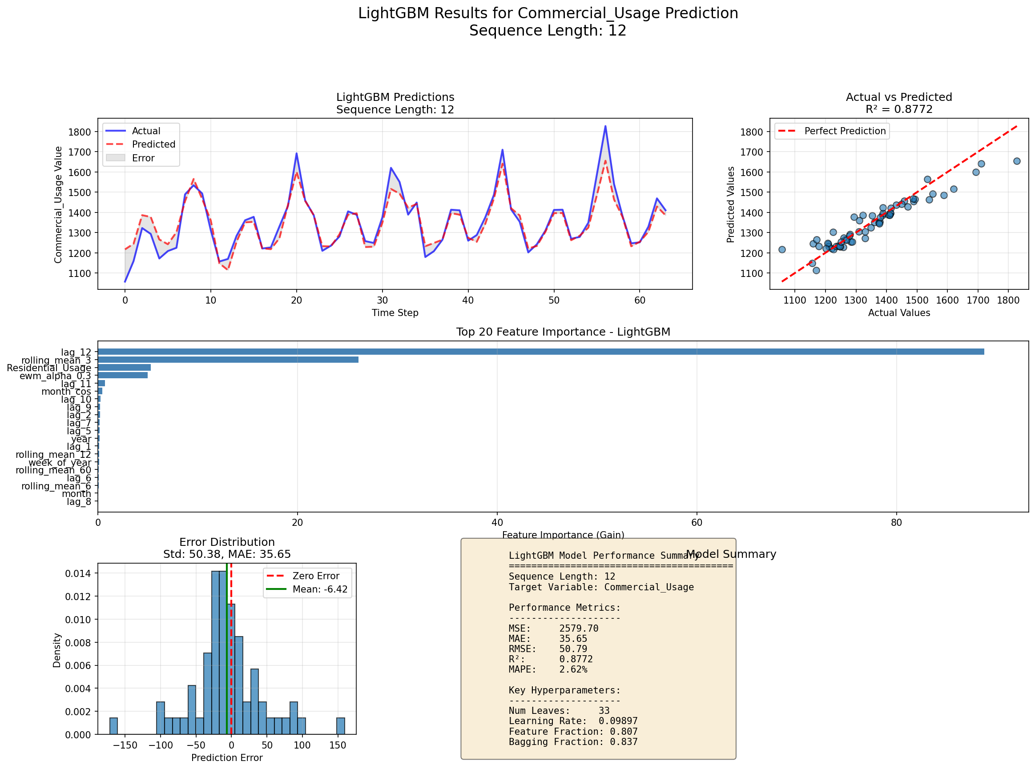
LGBM

Slide 26
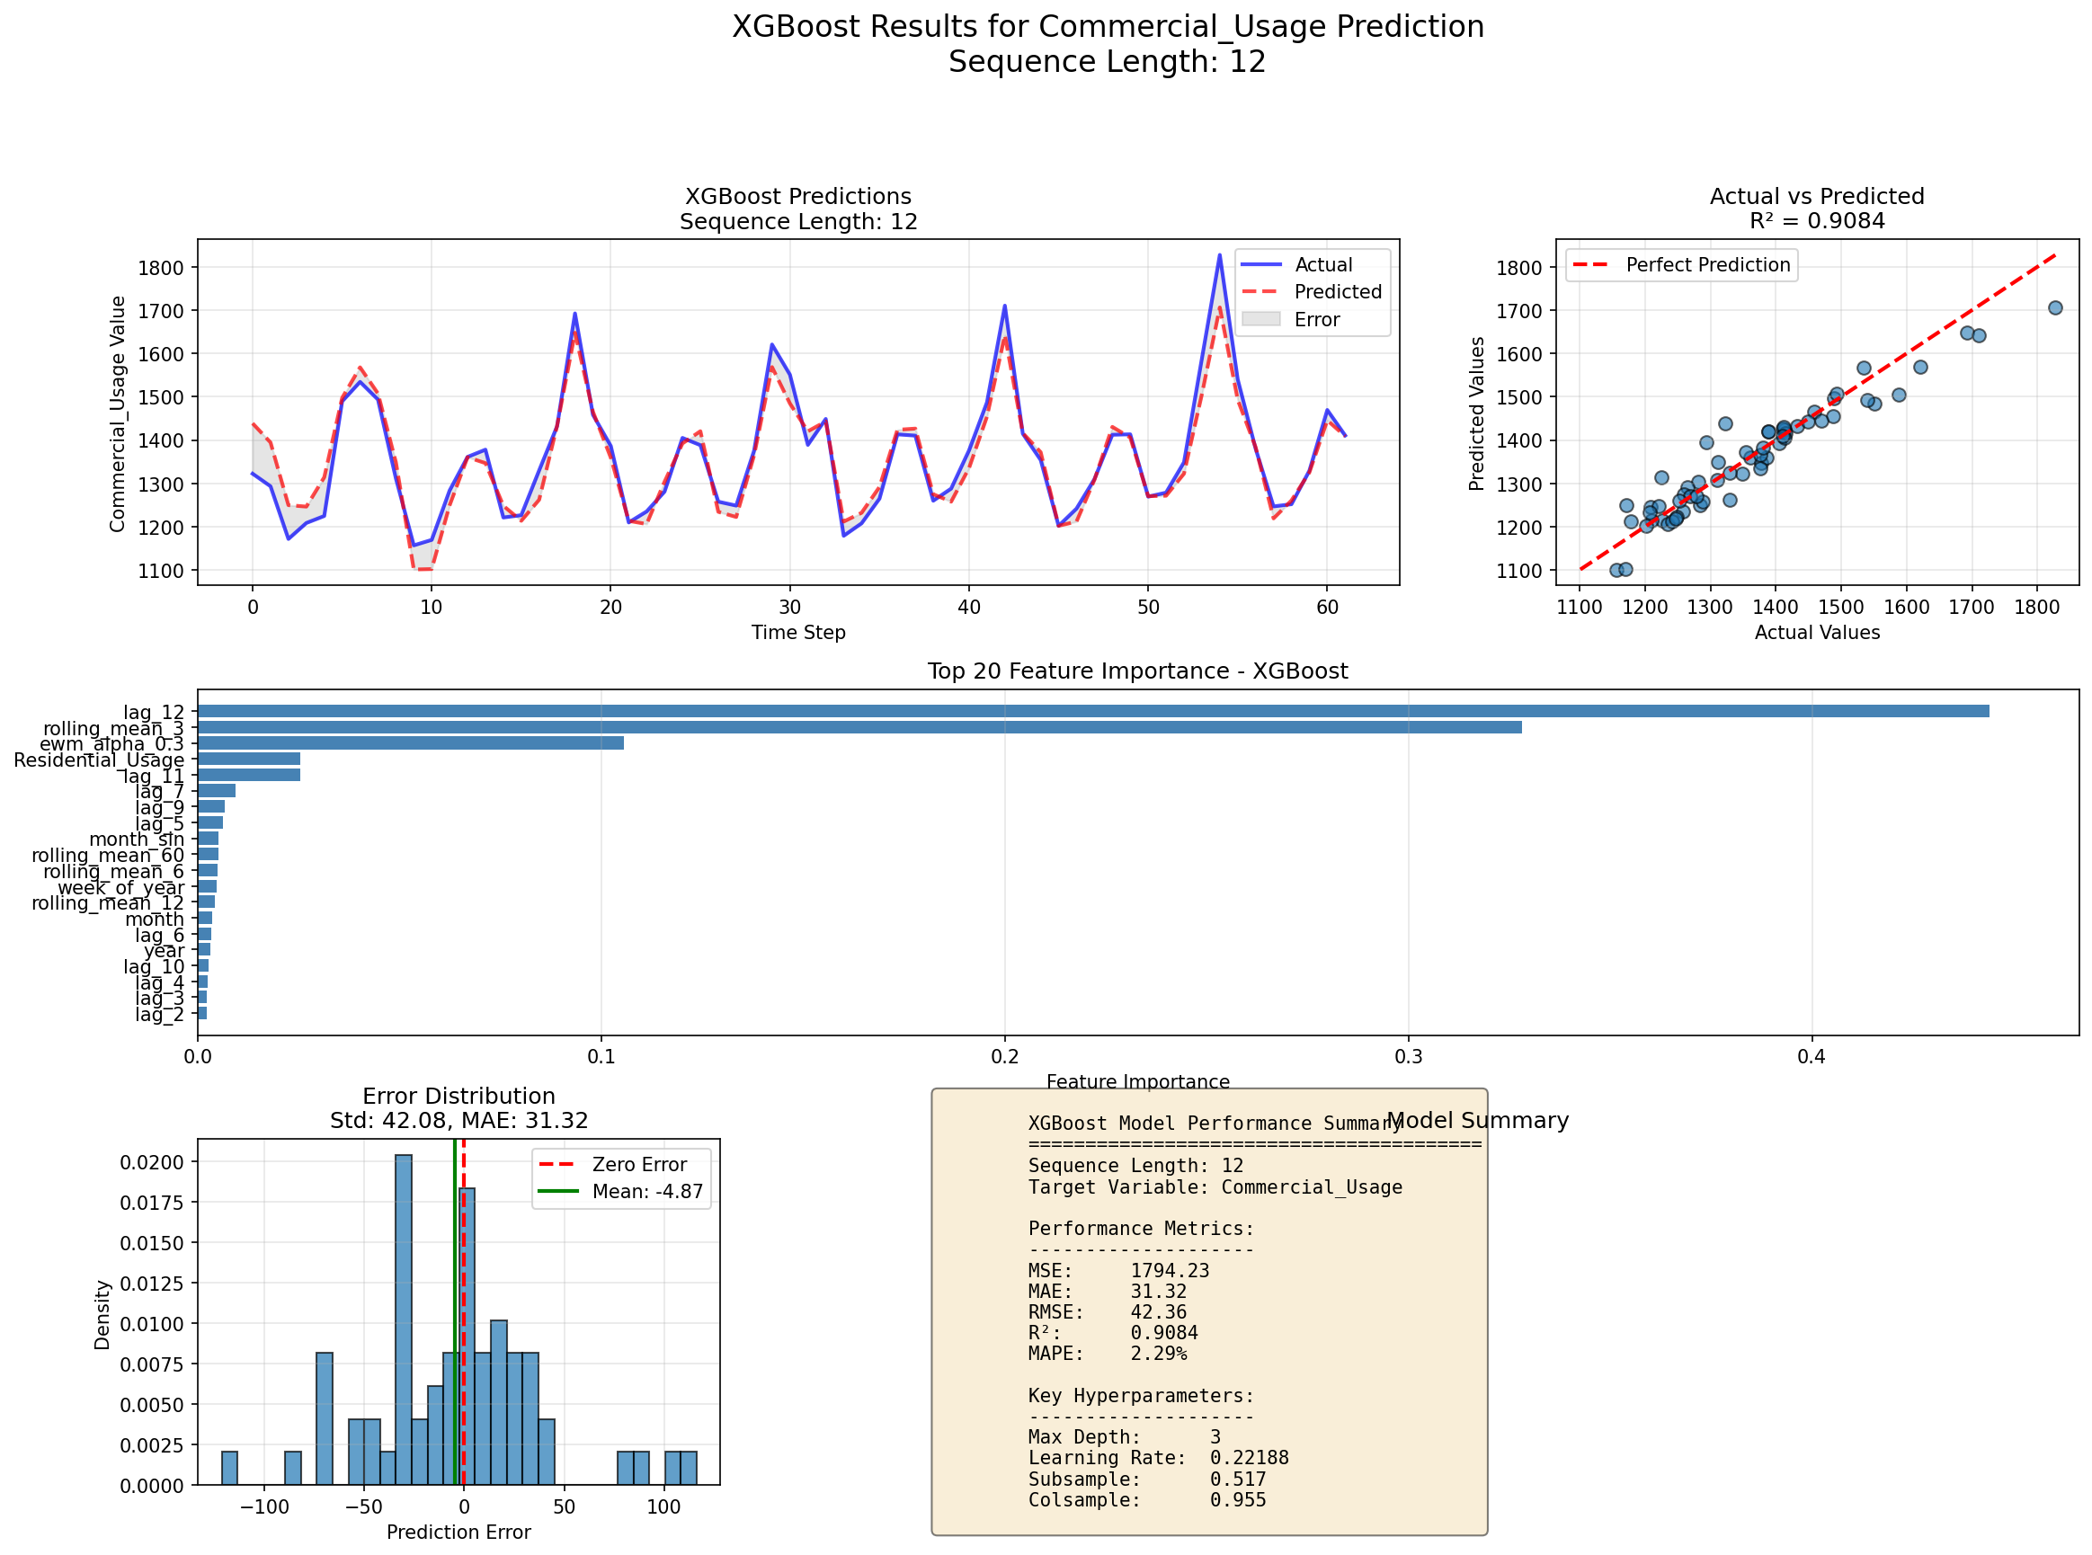
XGBoost

Slide 27
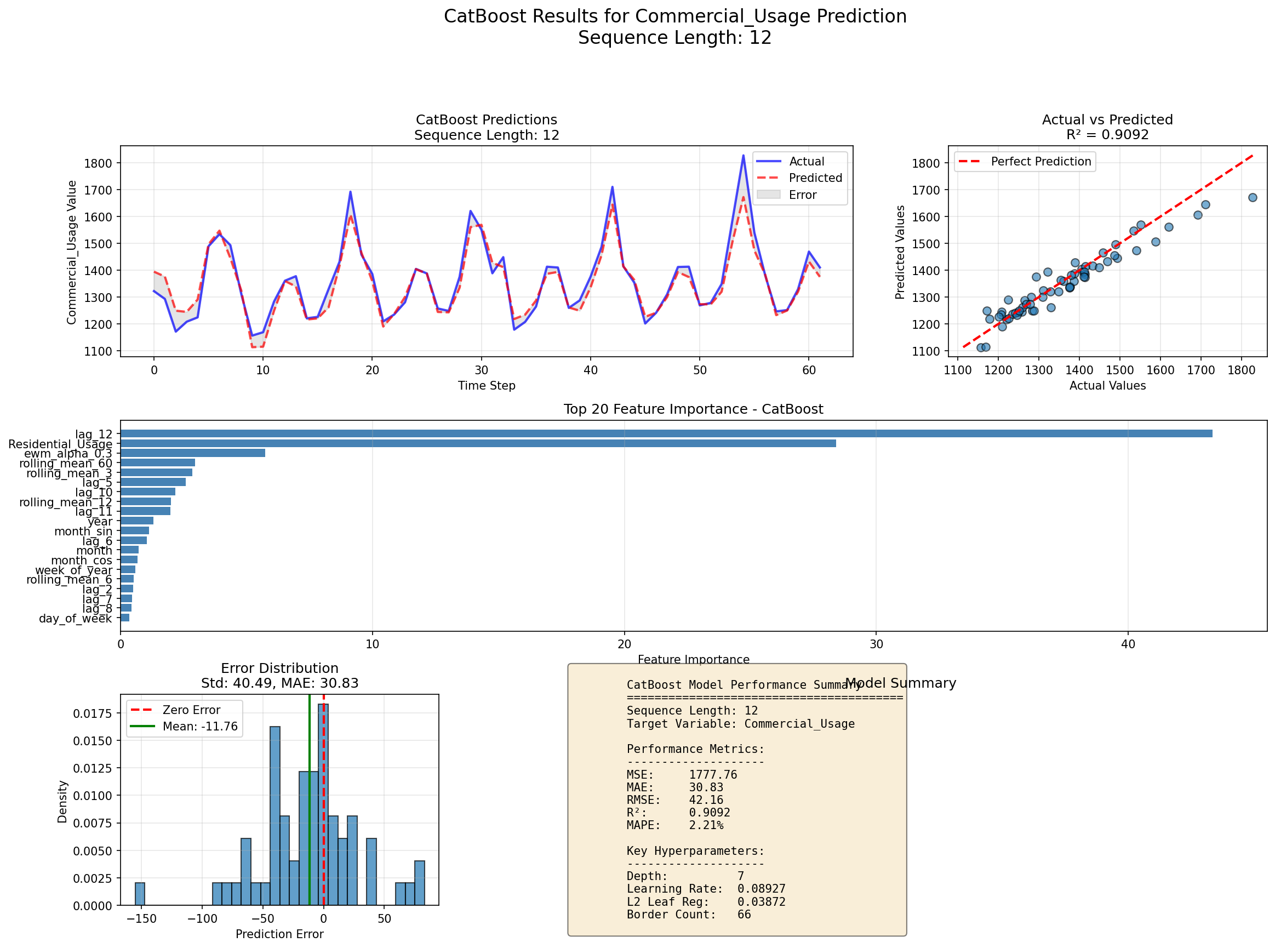
CatBoost

Slide 28
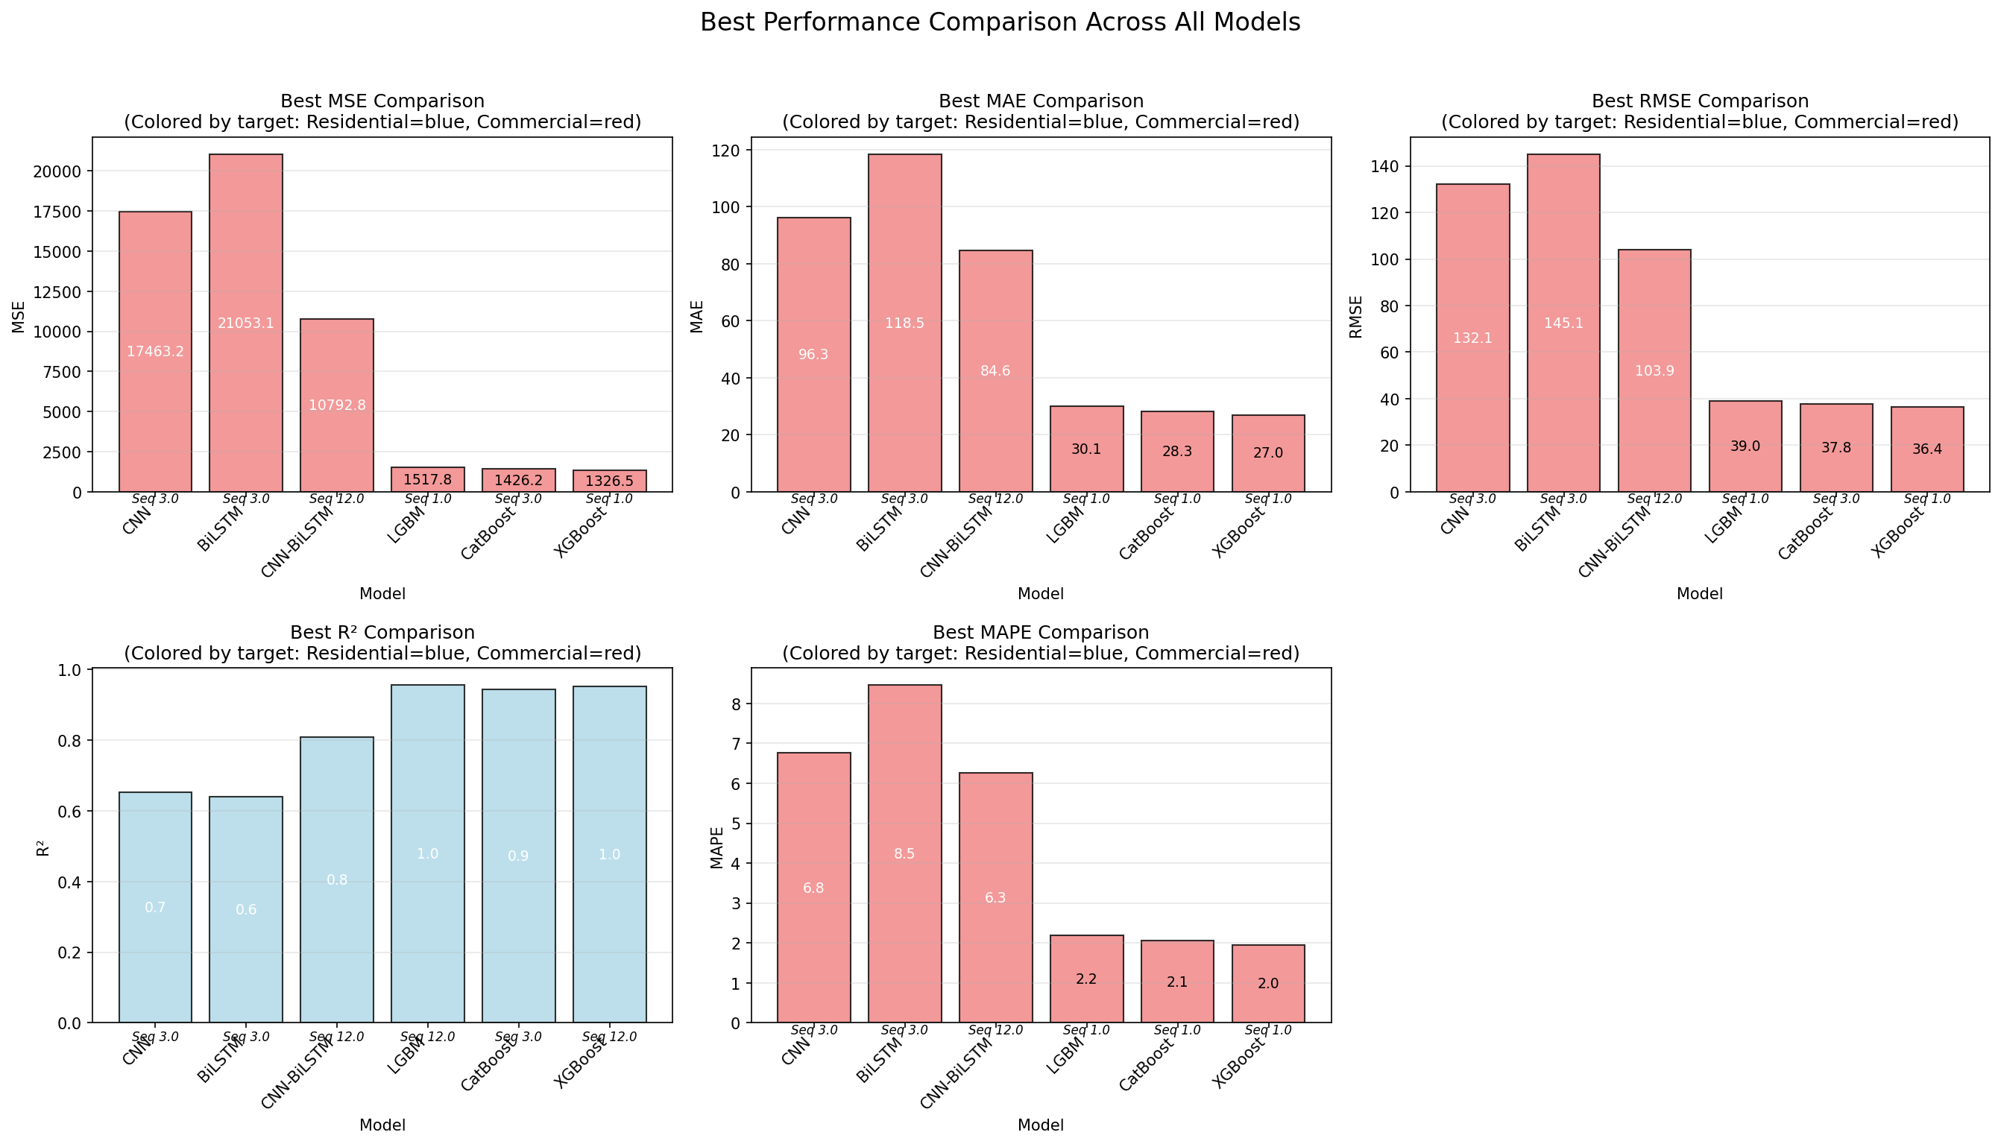
Performance Comparison

Slide 29
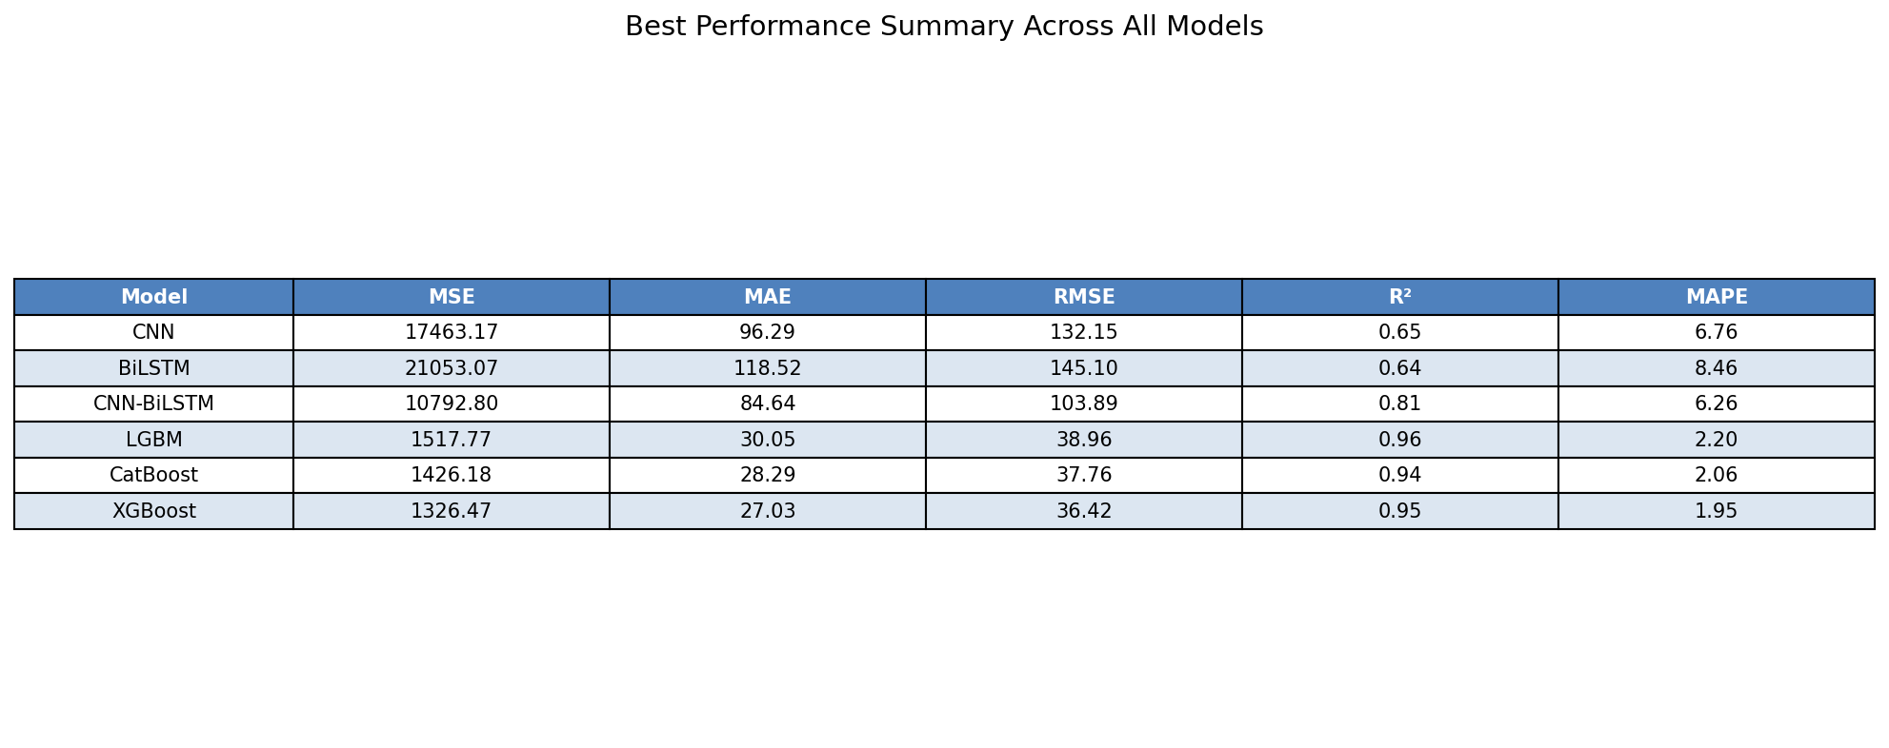
Performance Table

Slide 30
Key Questions
Our GB implementations consistently outperform published results across all metrics. But why?
  GB models are exceptionally efficient at handling tabular data with clear "if-then" logic. Because I implemented sophisticated Feature Engineering (Lags and Rolling Statistics), I essentially provided the GB models with the "answers" that the CNN was trying to learn from scratch. In datasets of this size, explicit feature engineering often rivals or beats automatic feature extraction.
Why is the integration of IoT data critical for modern building energy management systems?
  Traditional energy models often rely on aggregate utility data, which lacks granularity. IoT sensors provide high-frequency, real-time data at the device or floor level, moving from general estimation to individualized prediction.

Slide 31
Key Questions (cont.)
What is the main takeaway regarding model selection for energy forecasting?
  While the CNN-BiLSTM is superior to basic NNs, best model depends on the available computational resources and feature engineering. if you are dealing with raw, unstructured IoT streams, the Proposed Hybrid CNN-BiLSTM is the most robust path forward for automated, scalable forecasting.
Why did the Hybrid CNN-BiLSTM scale better with longer sequences (12 months) compared to standalone models?
  Standalone LSTMs often suffer from catastrophic forgetting or signal noise when the input window is too large. In my results, the CNN layers effectively compressed the 12-month data into meaningful feature maps. This simplified the BiLSTM’s job, allowing it to capture annual seasonality without being overwhelmed by 365 days of raw, noisy data points.

Slide 32
Key Questions (cont.)
What do we conclude regarding the relationship between "prediction accuracy" and "global sustainability goals"?
  The paper argues that accuracy is not just a technical metric but a sustainability tool. Accurate forecasting allows for the integration of renewable energy sources (which are intermittent) into the grid. By knowing exactly how much energy a building will need, we can reduce the reliance on "peaker" power plants (which are often high-emission) and minimize energy waste, directly contributing to carbon reduction.

Slide 33
Thanks!
Any Questions ?

