Slide 1
ICPS Project
Group 3
Mahan Bhimireddy – S20210020260
Arjit Avadhanam – S20210020257
Tejas S – S20210010226
Jagadeesh Naik – S20210010188

Slide 2
Problem Statement
Predict the future sales or demand of the products for a grocery store.
Importance of the problem
The vendors who are selling everyday items need to keep their stock up to date so, that no customer returns from their shop empty hand. Accurate sales forecasts allow retailers to respond proactively to consumer demand, improving customer satisfaction by minimizing stockouts. Moreover, effective forecasting aids in strategic decision-making, enabling better allocation of resources and promotional planning. Ultimately, improving sales prediction contributes to increased profitability and competitiveness in the retail market.

Slide 3
Proposed Solution
The solution to the sales prediction problem leverages machine learning models to analyze historical sales data and forecast future sales trends. We employed XGBoost Regression, a powerful ensemble learning method that can model complex, non-linear relationships in the data. This approach helps us understand interactions between different features and improve prediction accuracy.

Slide 4
Methodology
Data Collection: Gather historical sales data from the grocery store, including columns for date, store ID, item ID, and sales figures over a five-year period.
Data Preprocessing: Clean the dataset by handling missing values and removing any irrelevant or duplicate entries. Convert the date column to a datetime format for easy manipulation and analysis.
Feature Engineering: Obtain relevant features such as weekend, weekday, holidays, cyclical features.
Model Implementation: Implement the XGBoost Regression model on the training data. This model leverages decision tree ensembles to capture more complex, non-linear relationships within the data. For better accuracy, Use Hyperparameter tuning.
Model training and evaluation: Train the models using the respective training datasets. Evaluate the performance of models on the testing dataset using metrics such as MSE, MAE, R2 Score.
Predict Future sales: Use the models to predict the future sales and manage the inventory.

Slide 5
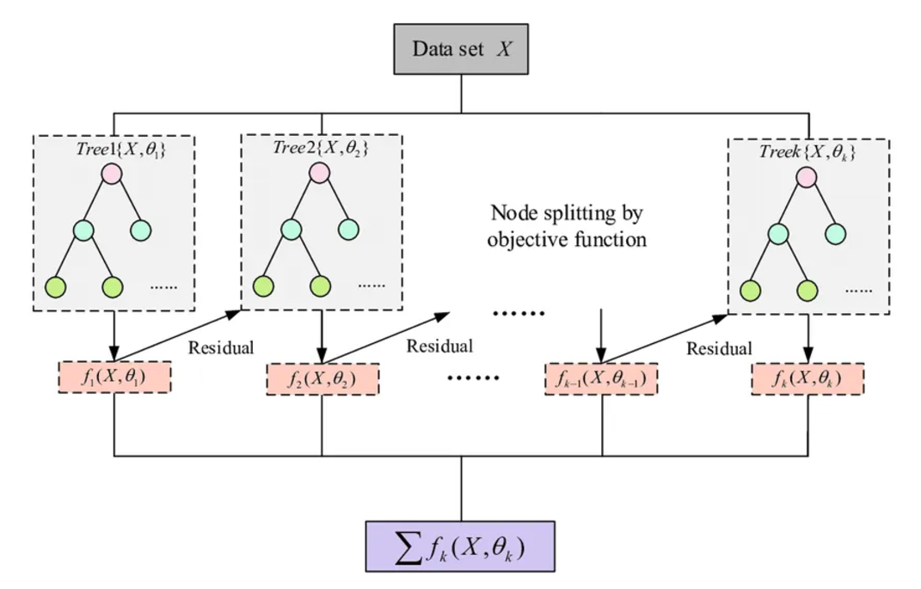
Model Overview: XGB Regressor

Slide 6
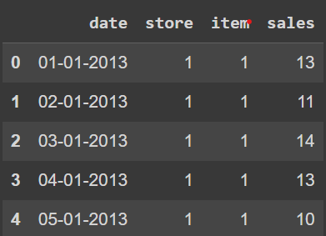
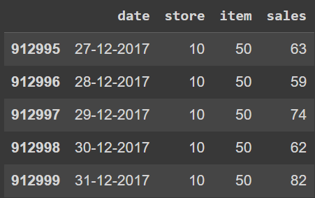
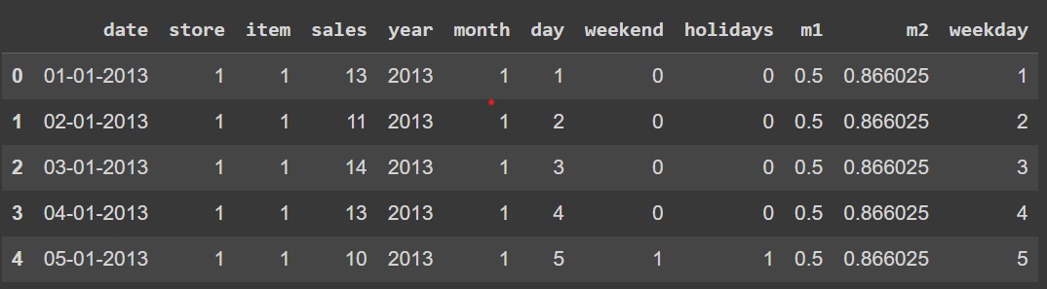
Workflow
1. Load the dataset
…..
2. Obtain the relevant features

Slide 7
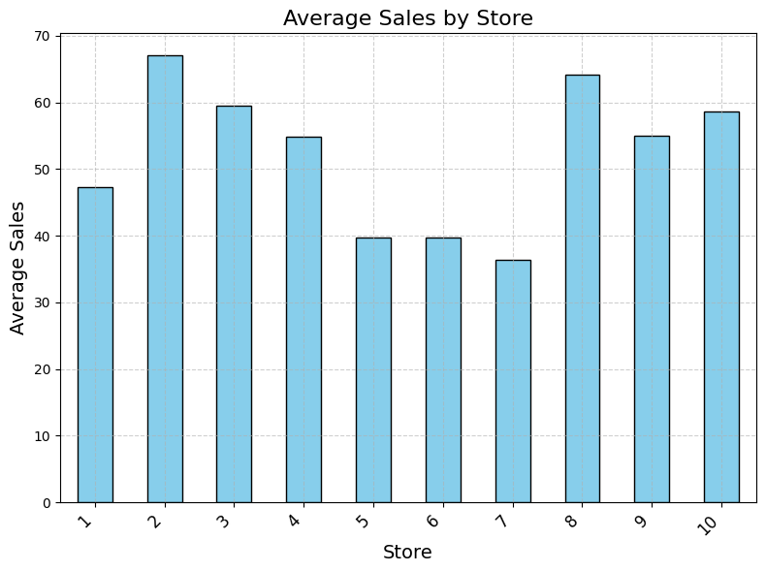
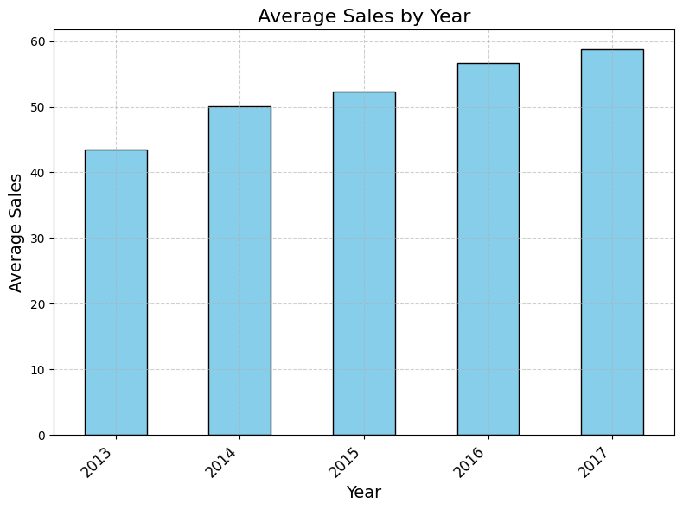
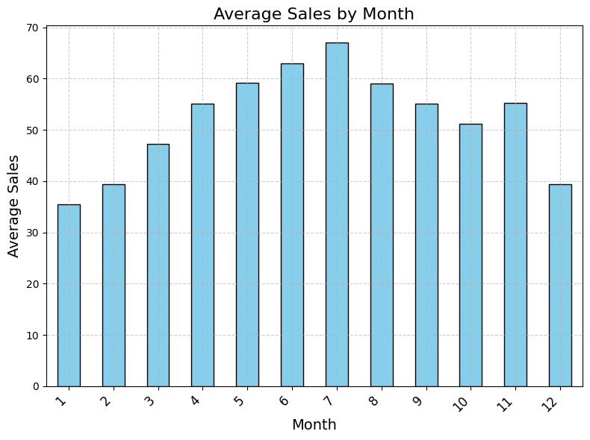
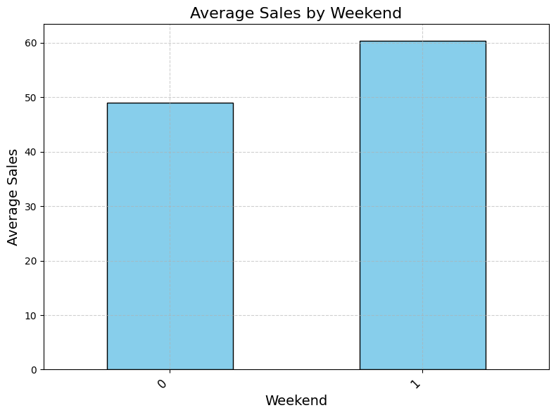
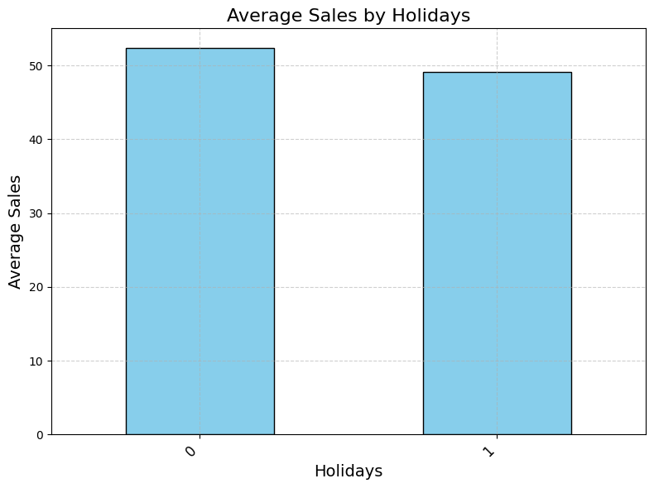
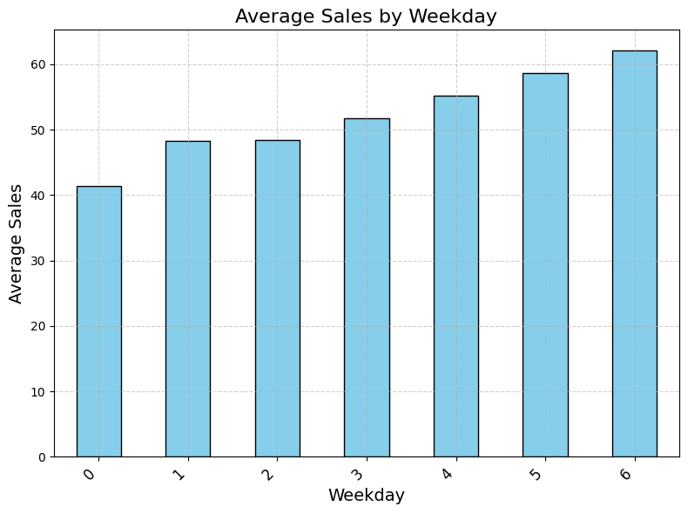
3. Create bar charts for each feature vs mean sales. These visualizations help to understand how each feature influences sales patterns.

Slide 8
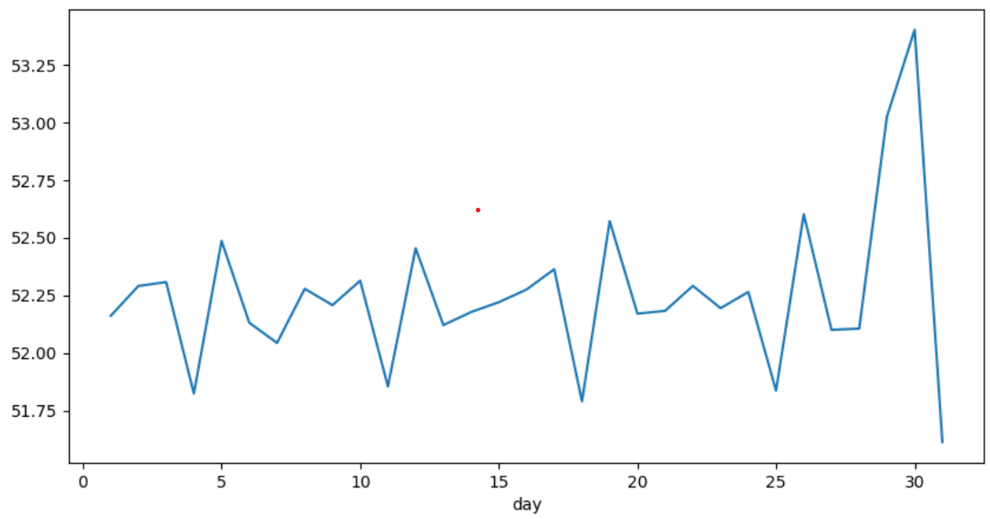
4. variation of stock as the month closes to the end.
Average Sales by day of the month
Average Sales
Day of the month

Slide 9
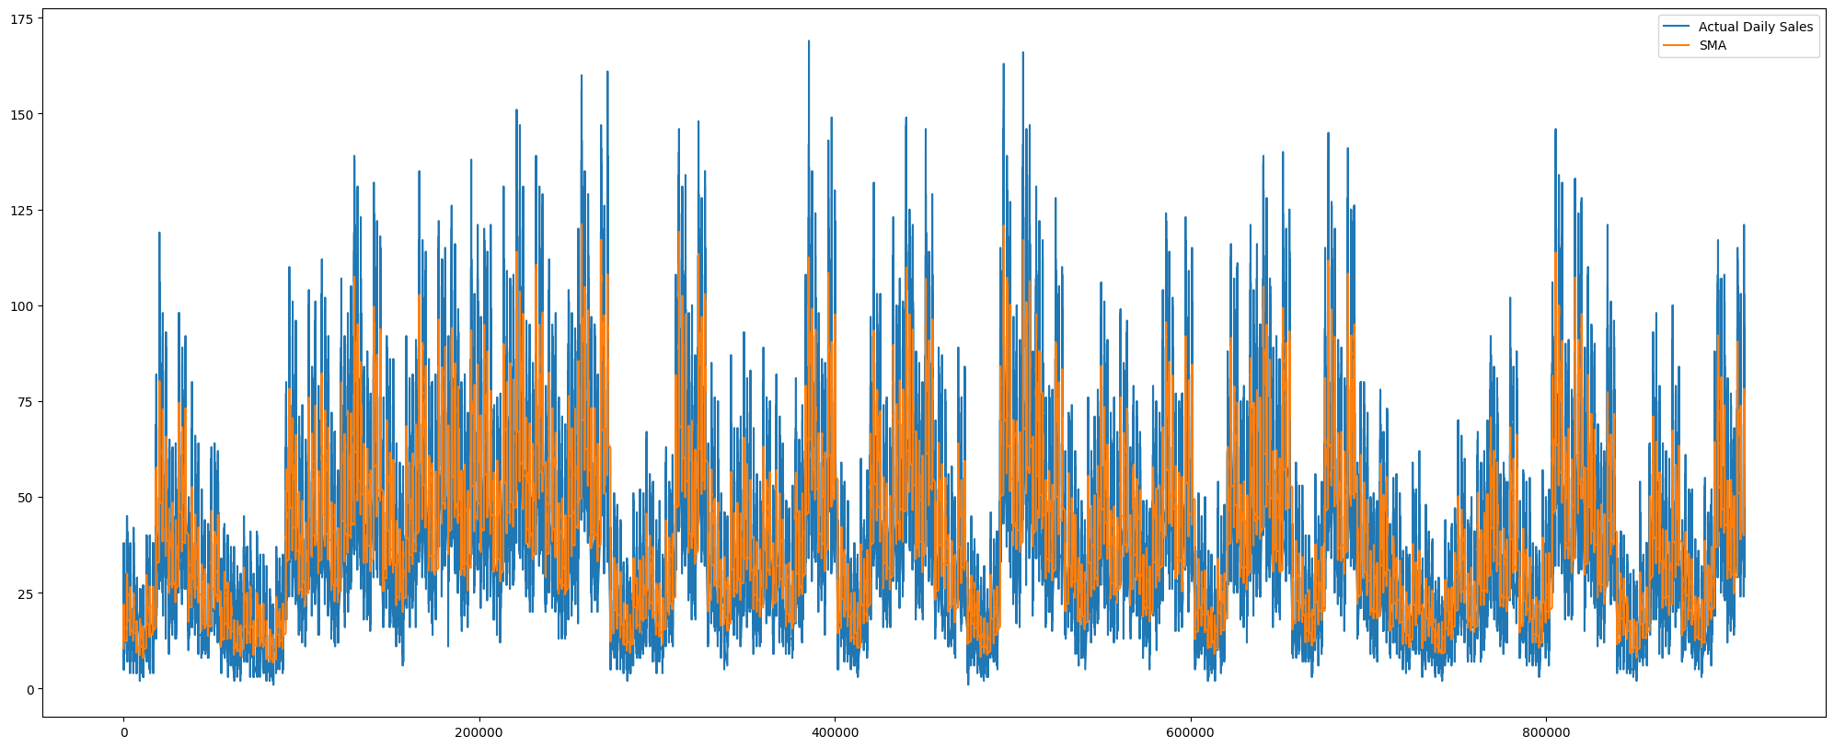
5. Create a Simple Moving Average to analyze data points by creating averages of different subsets of the full dataset. It smooths out fluctuations to help identify trends over a 30-day period.

Slide 10
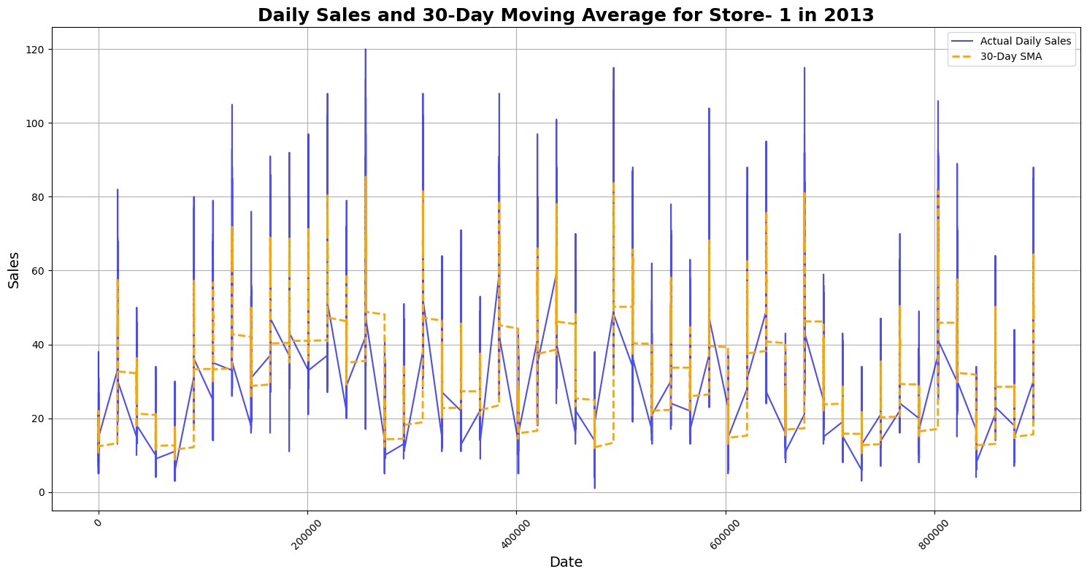
Week

Slide 11
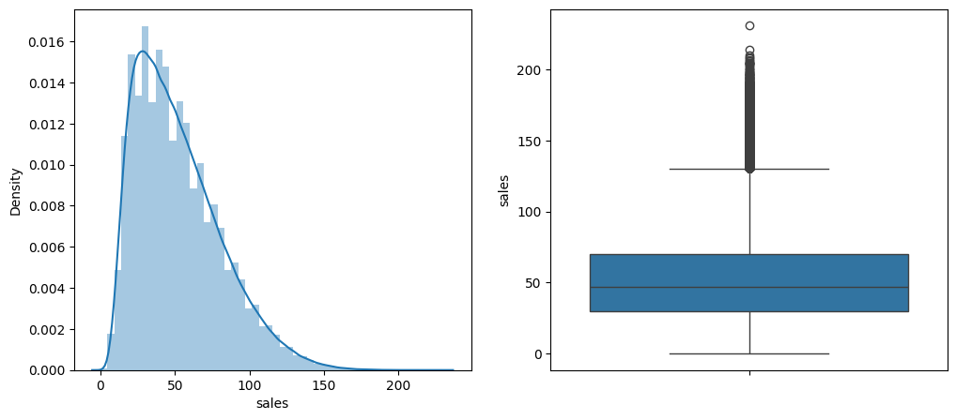
6. As the data in the sales column is continuous, plot it and check whether there are some outliers in this column or not. A normal distribution here means that the sales over time and across all products are evenly distributed around a central value(mean). This could indicate that the sales are stable and consistent, without frequent extreme fluctuations or outliers.

Slide 12
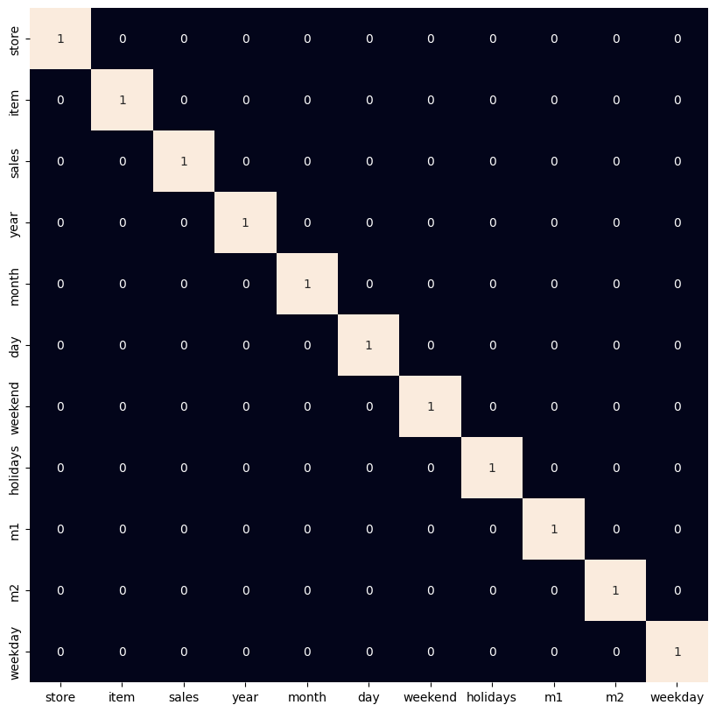
7. Visualize the highly correlated features with heatmap. Avoid multicollinearity by removing highly correlated features. Use features with a strong correlation to the target. Removing redundant features can improve model performance.

Slide 13
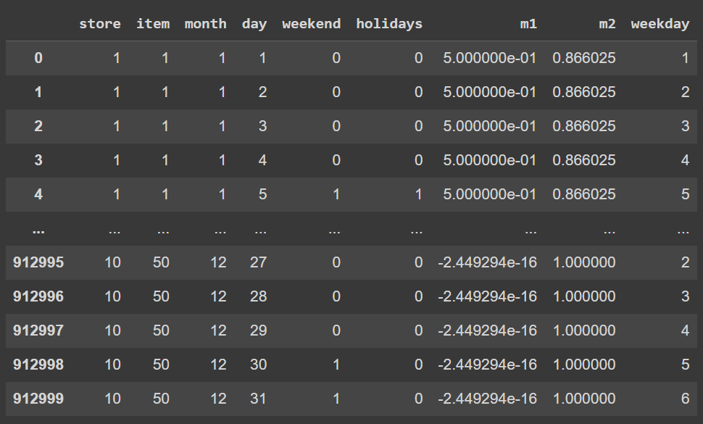
8. From the box plot, there are few outliers for sales>140. Remove them and here we have the final features.

Slide 14
9. Split the data into training (80%) and testing (20%) sets. Normalize the features using StandardScaler() to ensure stable and fast model training by standardizing them to have a mean of 0 and a standard deviation of 1.
10. Do the Hyperparameter tuning using RandomizedSearchCV to select best hyperparameters for better accuracy.
11. Train the XGBoost Regressor passing the parameters obtained by Hyperparameters tuning.
Test the model on the 20% test data and evaluate the model on different metrics such as MSE, MAE and R2-score.
12. Deploy the model to predict sales based on inputs like date/month, store ID, and item ID. The model can handle various scenarios, such as: Predicting sales for a specific item in a given store and month-year. Predicting sales for all items in a store for a specific month-year and arranging the results in descending order by sales.

Slide 15
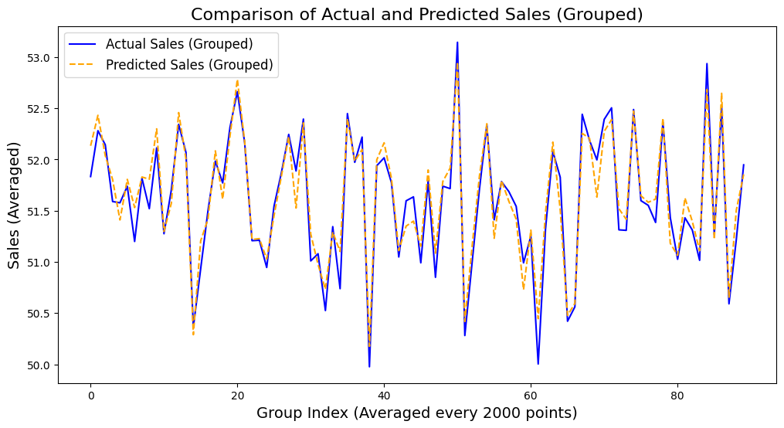
Results
Model Evaluation:
Mean Squared Error: 62.5119229510955
Mean Absolute Error: 6.06330626979921
R-squared: 0.9179232120513916

Slide 16
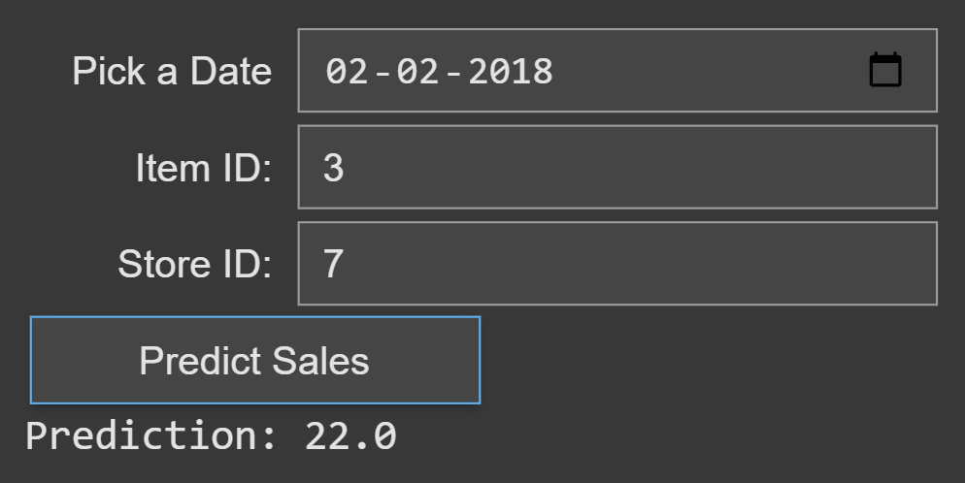
Testing
1. Predict the sales given date, Item ID and Store ID

Slide 17
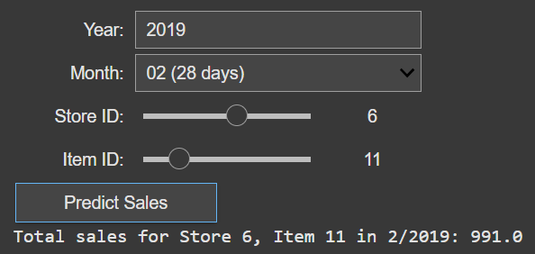
Testing
2. Predict the monthly sales given month-year, Item ID and Store ID

Slide 18
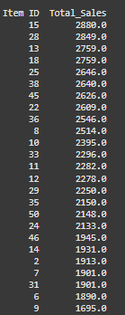
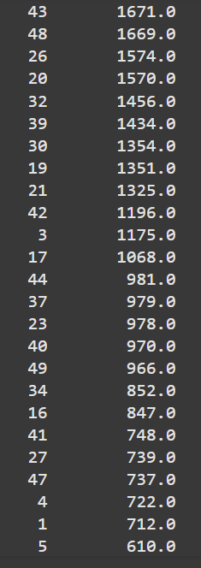
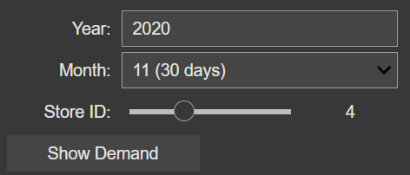
Testing
3. Predict the monthly sales of every item given month-year and Store ID

Slide 19
Challenges faced
Lack of Item-Specific Information: The dataset only contains item IDs, without any further information about the items (e.g., product type, price, category). This limits the ability to perform deeper analysis on item-specific trends.
Using only IDs for items might lead the model to treat all items similarly, failing to differentiate between their unique characteristics.

Slide 20
Individual Contributions
Mahan Bhimireddy – S20210020260 Led the hyperparameter tuning and model building processes to optimize model performance and ensure accuracy.
Arjit Avadhanam – S20210020257 Handled data preprocessing and feature extraction, transforming raw data into meaningful inputs for the model.
Tejas S – S20210010226 Conducted comprehensive model testing and facilitated deployment
Jagadeesh Naik – S20210010188 Refined and filtered features to ensure their relevance, enhancing the model's training and testing efficiency.

Slide 21
THANK YOU

