Slide 1

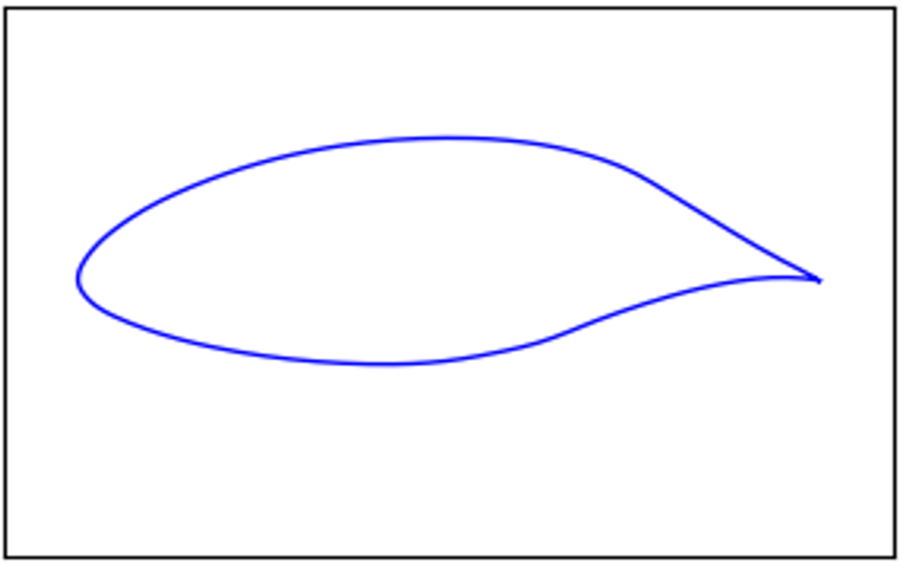
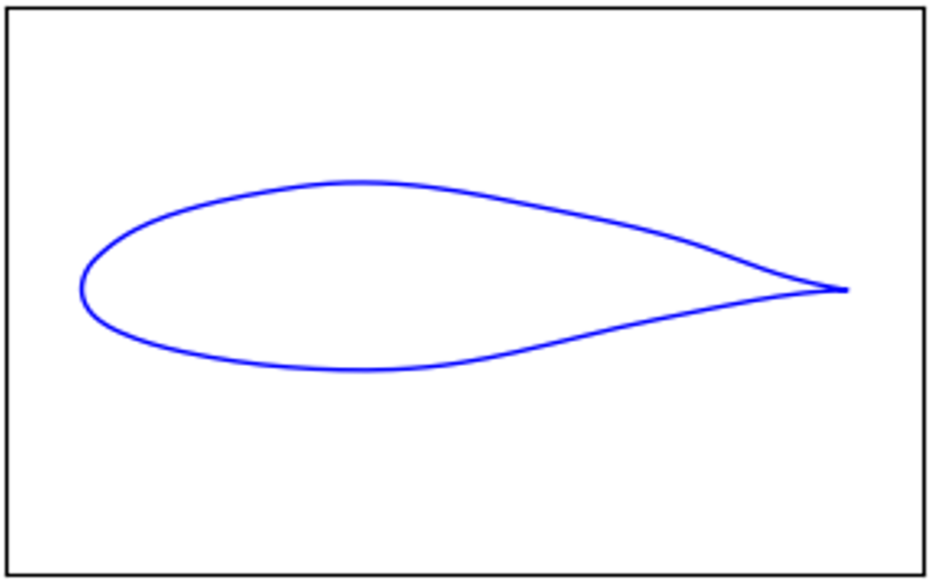
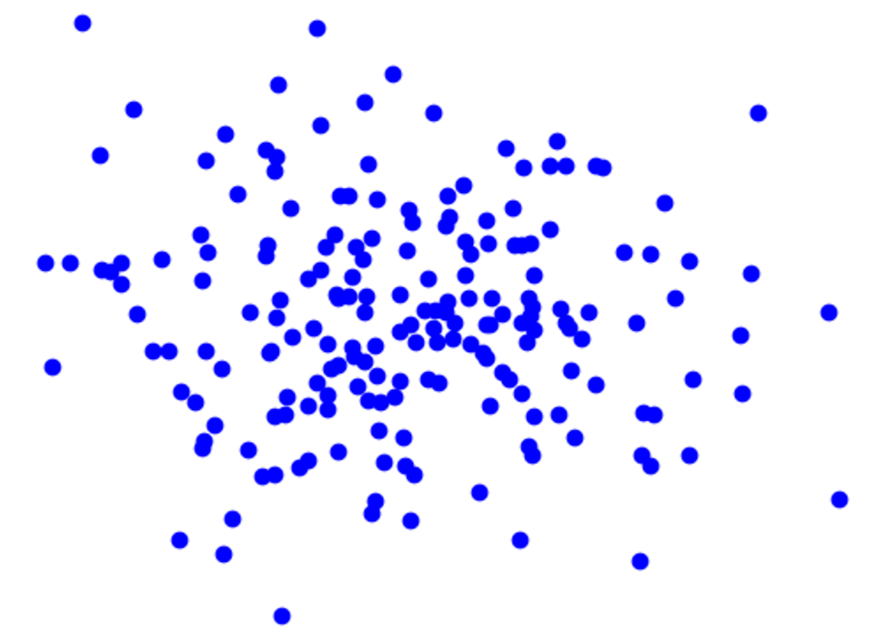
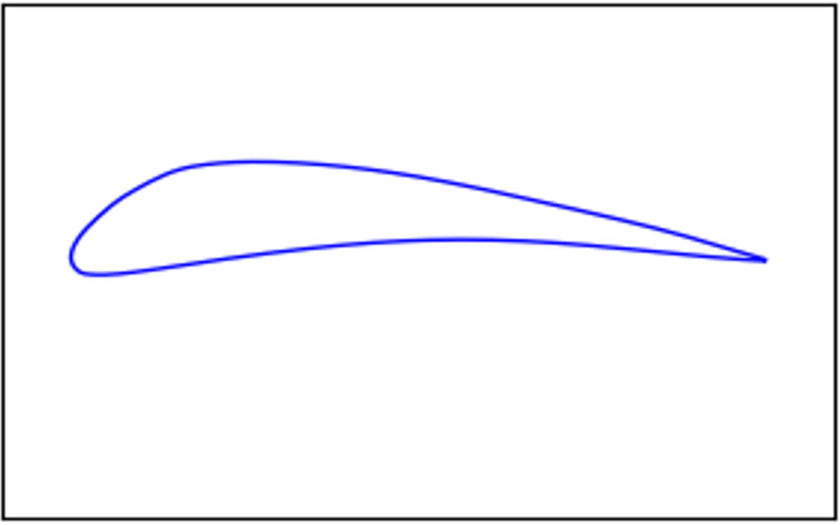
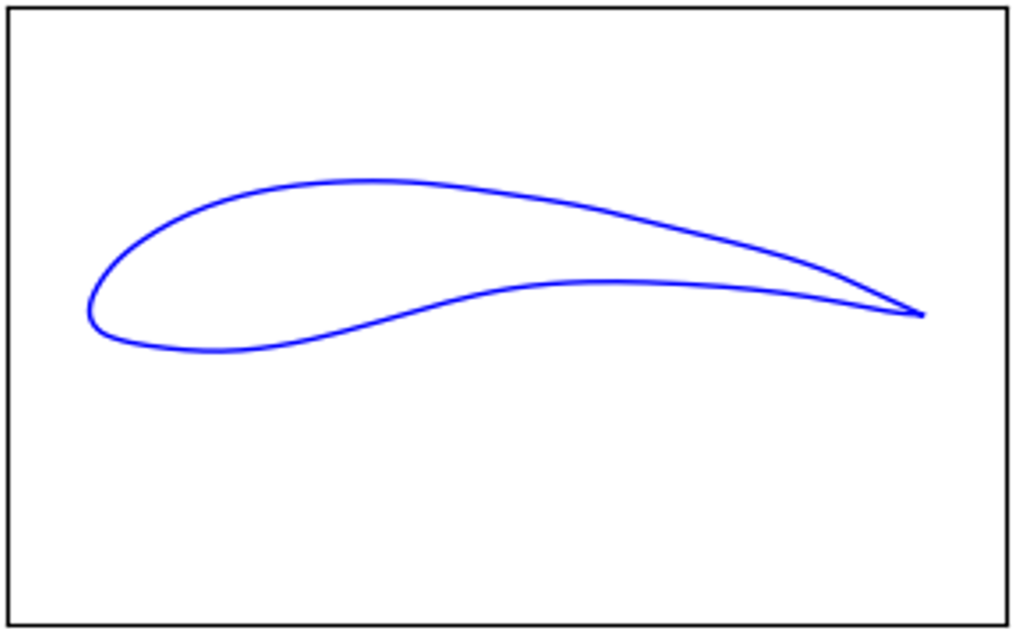

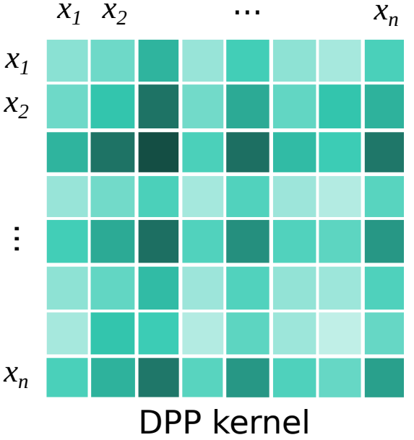
















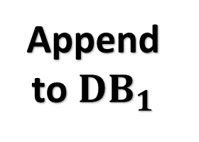









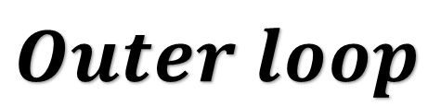



















$$Outer loop$$
2
$$Diffusion Training$$
$$DB_{init}$$
0
$$DB_{1}$$
$$\text{Forward} \text{Noising}$$
🔥
$$ε_{t}$$
$$U−net$$
$$\hat{ε_{t}}$$
$$x_{t}$$
$$t$$
$$x_{0}$$
$$x_{t}$$
1
$${\text{Surrogate}}_{1}training$$
$$\text{Reverse} \text{den}\text{oising}$$
$$\text{shape}→\text{per}\text{formance}$$
$${\text{Surrogate}}_{1}$$
❄️
🔥
$$\text{per}\text{formance}$$
$$→$$
$$C_{l}^{P}$$
$$\text{shape}$$
$${\hat{x}}_{0}$$
$$x_{t}$$
$$C_{d}^{P}$$
$$\text{P}\text{er}\text{formance}$$
$$x_{1}$$
…
$$B$$
$$p_{1}$$
$$x_{1}$$
$$x_{2}$$
$$x_{n}$$
$$p_{2}$$
…
$$x_{2}$$
$$C_{l}^{GT} ,C_{d}^{GT}$$
$$p_{n}$$
$$\text{Performance} \text{augmented} \\ \text{DPP} \text{loss}→ 𝓛_{DPP}$$
$$𝓛_{total}=\underset{\text{noise} \text{loss}}{\underbrace{|ε−\hat{ε}|_{1}}}+ λ_{DPP} 𝓛_{DPP}$$
$$𝓛_{MAP}$$
$$\text{Random} \text{weights}$$
…
$$w_{1}$$
❄️
$$w_{2}$$
$$x_{n}$$
$$w_{n}$$
…
$$Dpp Kernel$$
3
$$Inner loop \\ Optimzation$$
Iteration > threshold
Append to $DB_{1}$
$$DB_{final}$$

Slide 2



$$\text{Reverse} \text{den}\text{oising}$$
$${\hat{x}}_{0}$$
$$x_{t}$$

Slide 3

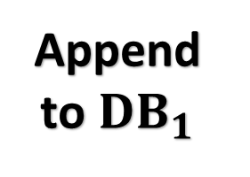


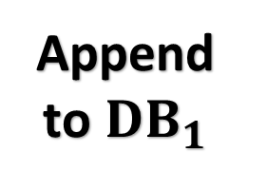
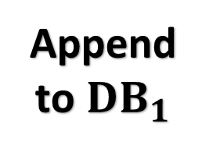
Append to $DB_{1}$
$$x_{t}$$
$$U−net$$
$$\hat{ε_{t}}$$
$$t$$
$$\text{Reverse} \text{den}\text{oising}$$
$${\text{Surrogate}}_{1}$$
❄️
$$\text{per}\text{formance}$$
$$→$$
$$\text{shape}$$
$${\hat{x}}_{0}$$
$$x_{t}$$
$$\text{P}\text{er}\text{formance}$$
$$x_{1}$$
…
$$p_{1}$$
$$x_{1}$$
$$x_{2}$$
$$x_{n}$$
$$p_{2}$$
…
$$x_{2}$$
$$p_{n}$$
$$\text{Performance} \text{augmented} \\ \text{DPP} \text{loss}→ ℒ_{DPP}$$
$$𝓛_{total}=\underset{\text{noise} \text{loss}}{\underbrace{|ε−\hat{ε}|_{1}}}+ λ_{DPP} 𝓛_{DPP}$$
Append to $DB_{1}$
$$\text{Random} \text{weights}$$
…
$$w_{1}$$
$$w_{2}$$
$$x_{n}$$
$$w_{n}$$
…
$$Dpp Kernel$$
Append to $DB_{1}$

Slide 4
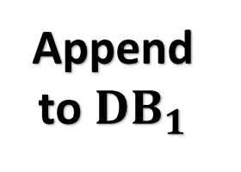
3
$$Inner loop \\ Optimzation$$
Append to $DB_{1}$

Slide 5

0
$$DB_{1}$$
1
$${\text{Surrogate}}_{1}$$
$$\text{shape}→\text{per}\text{formance}$$
🔥
$$C_{l}^{P}$$
$$C_{d}^{P}$$
$$B$$
$$C_{l}^{GT} ,C_{d}^{GT}$$
$$𝓛_{MAP}$$

Slide 6















$${\text{Surrogate}}_{1}$$
🔥
$$\text{shape}→\text{per}\text{formance}$$
$${\text{Surrogate}}_{1}$$
🔥
$$\text{shape}→\text{per}\text{formance}$$
$$C_{l}^{P}$$
$$B$$
$$C_{d}^{P}$$
$$C_{l}^{P}$$
$$C_{l}^{GT} ,C_{d}^{GT}$$
$$𝓛_{MAE}$$
$$C_{d}^{P}$$
$$B$$
$$C_{l}^{GT} ,C_{d}^{GT}$$
$$𝓛$$
$$x_{t}$$
$$U−net$$
$$t$$

Slide 7









$${\text{Surrogate}}_{1}$$
🔥
$$\text{shape}→\text{per}\text{formance}$$
$${\text{Surrogate}}_{1}$$
🔥
$$\text{shape}→\text{per}\text{formance}$$
$$C_{l}^{P}$$
$$B$$
$$C_{d}^{P}$$
$$C_{l}^{P}$$
$$C_{l}^{GT} ,C_{d}^{GT}$$
$$𝓛_{MAE}$$
$$C_{d}^{P}$$
$$B$$
$$C_{l}^{GT} ,C_{d}^{GT}$$
$$𝓛$$
$$\text{Forward} \text{Noising}$$
$$x_{0}$$
$$x_{t}$$

Slide 8






$${\text{Surrogate}}_{1}$$
🔥
$$\text{shape}→\text{per}\text{formance}$$
$$C_{l}^{P}$$
$$B$$
$$C_{d}^{P}$$
$$C_{l}^{GT} ,C_{d}^{GT}$$
$$𝓛$$

Slide 9






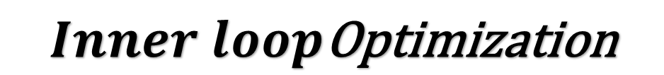










$$Inner loop\text{Optimization}$$
0
Generating designs from
Diffusion model (DDIM)
1
CDF Simulation
OPENFOAM
$$\text{Revearse} \text{den}\text{oising}$$
⚙️
⚙️
$$C_{l}^{GT}$$
$$noise \sim 𝒩(0,1)$$
⚙️
⚙️
$$C_{d}^{GT}$$
$$DB_{innerloop}$$
$$U−net$$
❄️
2
$$\text{Uncertainity} \text{aware} \text{Surrogate} \text{Retrain}\text{ing}$$
$$\text{shape}→\text{per}\text{formance}$$
Appending
to
🔥
End?
$$DB_{valid}$$
$$DB_{innerloop}$$
$$DB_{valid}$$
$$⋮$$
$$C_{l}^{P}$$
$$B$$
$$⋮$$
$$C_{d}^{P}$$
$$DB_{invalid}$$
$$C_{l}^{GT} ,C_{d}^{GT}$$
$$𝓛_{MAE}$$
4
CDF Simulation
3
Genetic search
OPENFOAM
$$\text{Revearse} \text{den}\text{oising}$$
$$C_{l}^{GT}$$
⚙️
⚙️
$$latent \sim 𝒩(0,1)$$
NSGAII
$$C_{d}^{GT}$$
⚙️
⚙️
$$U−net$$
❄️

Slide 10
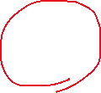
Brief overview of what we did so far
DPP loss
Original data (DB1)
Train a Surrogate (shape->per)
Train Diffusion with DPP loss (DDIM)
Random noise (Latent) => DDIM => Shape => simulation
DB2 (lantent->per)
Shape
N * UA Surrogate
Generation selection (evo)
and Surrogate pareto front
Append to DB1
DDIM
Append to DB2
Latent to Shape (DDIM)
Retrain Surrogate
CL & CD
Simulation (open foam)
New data on Pareto front
Iter > x

Slide 11
Stage 1: Testing the Diffusion model
Original data (DB1)
Train a Surrogate (shape->per)
Train Diffusion with DPP loss (DDIM)
DDIM
Generating latent & shapes
CL & CD
Simulation (open foam)
Need to Generate the Valid and Invalid set for training the
UA_surrogate model and the Constrant handler neural net for the
Genetic Algorithm (NSGA2)
Need to validate if random sampling instead of Bayesian optimization is good enough our not
The code has been provided for running on github.
Tagging Validity
Iter > x
Valid set
Invalid set

Slide 12
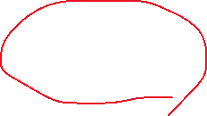
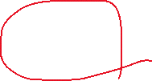
Stage 2,3: Inner loop creation and Bayesian Optimization
Simulation (open foam)
Retraining UA_modles
0
Latent and Shape creation using Diffuson model
Appending
DB_Innerloop
Genetic Algorithm (Takes the DB_innerloop’s Latents)
Start
Latent Shape
1
Appending to DB_NSGA
Appending
Latent Shape
4
3
2
Iter > x
Tagging phase
Appending to DB_CFD
Simulation (open foam)
Latent Shape perfromance
Latent Shape perfromance
DB_valid
DB_invalid
end

Slide 13



Stage 4: Outerloop creation and discriminative loss
Original data (DB1)
Train a Surrogate (shape->per)
Disc
forwarding
sampling
$$loss_{diff}$$
$$loss_{dpp}$$
$$loss_{valid}$$
$$Loss=loss_{diff}+λ_{dpp}loss_{dpp}+λ_{valid}loss_valid$$

