Slide 1
Target Database Exploration: An SQL and python approach
Python & SQL Data Analysis Project

Slide 2
Dataset Files:
• Customers.csv – Customer demographic details
• Sellers.csv – Seller information
• Order_Items.csv – Order item details
• Geolocation.csv – Geolocation details
• Payments.csv – Payment details
• Orders.csv – Order history and details
• Products.csv – Product details
Goal: Analyse and visualize business metrics using SQL and Python.
DATASET OVERVIEW

Slide 3
TOOLS & METHODOLOGY
Tools Used
SQL – Data extraction and analysis
MySQL Workbench – SQL query execution
Python – Data analysis and visualization
Pandas – Data manipulation
Matplotlib – Data visualization
Methodology
Imported and explored the dataset
Used SQL queries to analyse business metrics
Used Python to analyse and visualize the data
Derived key business insights from the analysis

Slide 4
KEY PROJECT INSIGHTS
Order Status: Delivered orders account for the vast majority of orders.
Payment Methods: Credit card is the most commonly used payment method, followed by UPI.
Product Categories: Bed & bath has the highest number of products among the top 10 categories.
Customer & Sales Analysis: SQL queries helped identify customer locations, order trends, sellers, and revenue patterns.
Python Analysis: Pandas was used for data manipulation, while matplotlib was used to create visualizations.
Business Value: The analysis helps understand customer behaviour, product demand, payment preferences, and sales performance.

Slide 5
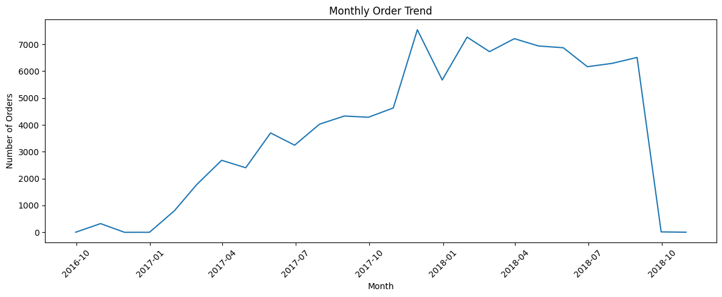
VISUALIZATION & RESULTS

Slide 6
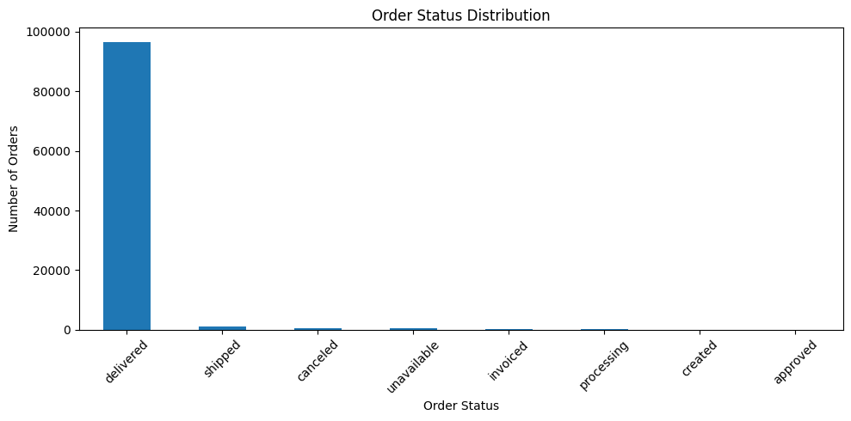

Slide 7
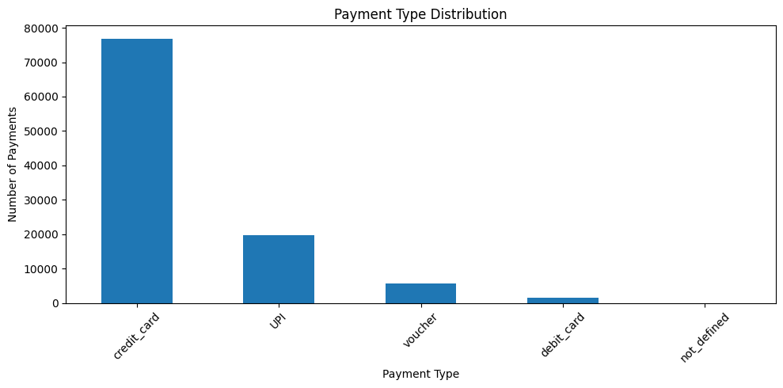

Slide 8
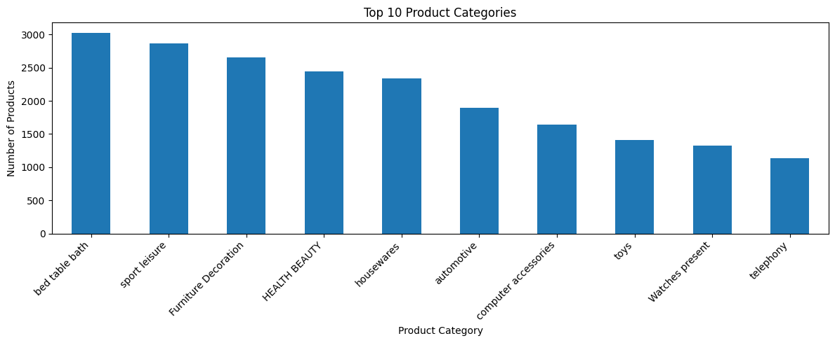

Slide 9
CONCLUSION & BUSINESS VALUE
Business Insights: The analysis identifies important patterns in orders, products, customers, and payments.
Customer Understanding: Customer locations and order trends provide useful information for understanding customer behaviour is fine.
Product Insights: Product-category analysis helps identify high-demand product categories is good.
Sales Performance: Order trends provide visibility into sales activity over time.
Decision Support: SQL and Python analysis can support data-driven business decisions good.

Slide 10
DELIVERABLES
➢ SQL Analysis: SQL queries used for data extraction and analysis
➢ Python/Colab Notebook: Data analysis and visualizations
➢ Project Documentation: Key insights and business findings
➢ PowerPoint Presentation: Project summary and results
THANK YOU

