Slide 1
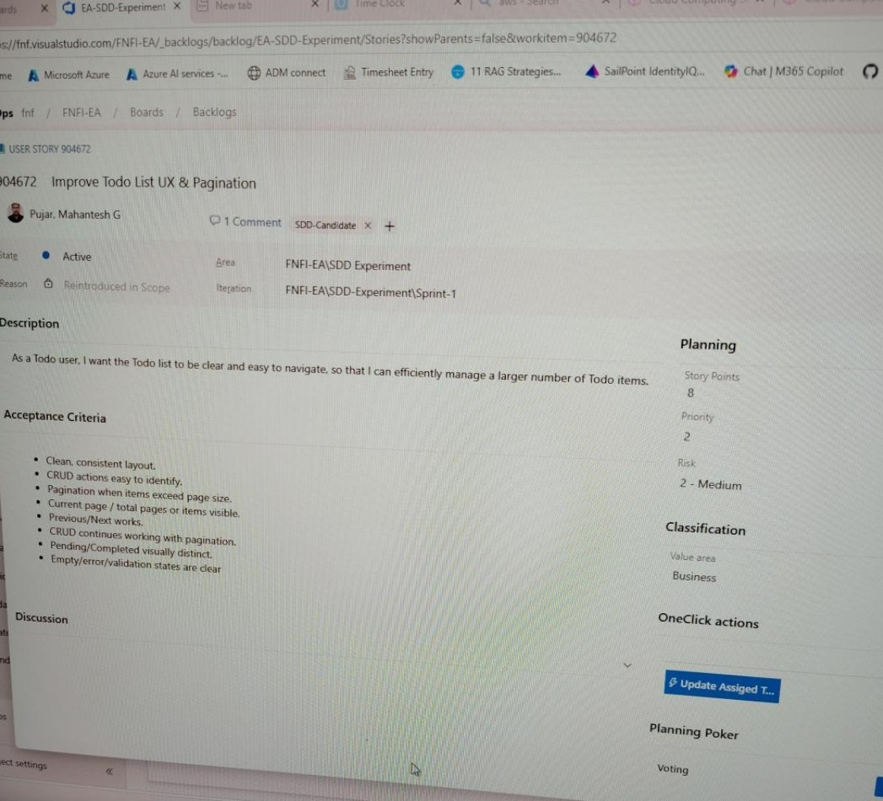
User Story → Spec Kit Feature: What We Actually Observed
Start with pilot evidence; derive the mapping rule from the work rather than prescribing a fixed relationship.
ACTUAL PILOT EVIDENCE
ADD YOUR SPEC KIT SCREENSHOT
ADO Story
Recommended screenshot: feature folder / spec.md showing the corresponding UX & Pagination feature and source ADO reference.
→
SDD Feature
I left this area intentionally open so the final slide uses your real Spec Kit evidence rather than a recreated mock-up.
ADO • US-904672 — Improve Todo List UX & Pagination
Observed mapping: 1 ADO User Story → 1 Spec Kit Feature
Practical rule: use this as the default when the story represents one cohesive, independently understandable and testable capability.
Evidence first • rule second

Slide 2
When the Mapping Is Not 1:1
The pilot also gives us a practical way to handle related stories — and a guardrail for the exception case.
OBSERVED IN TODO PILOT
RECOMMENDED HANDLING • NOT OBSERVED
1 User Story → Multiple Features?
ADD SCREENSHOT Complete a Todo ADO 900332
Todo Lifecycle Operations
Do not start by forcing one broad story across several Spec Kit features.
→
Multiple ADO stories → one Spec Kit feature
If Specify / Clarify reveals independently deliverable capabilities:
Use only when the stories form one coherent capability and are aligned to the same delivery window.
Return to refinement ↓ Consider splitting the ADO story ↓ Create clearer feature boundaries
ADD SCREENSHOT Delete a Todo ADO 900328
Manager-ready rule: ADO stories remain planning / assignment units; Spec Kit features group behavior only when reasoning about it together adds value.

