Slide 1
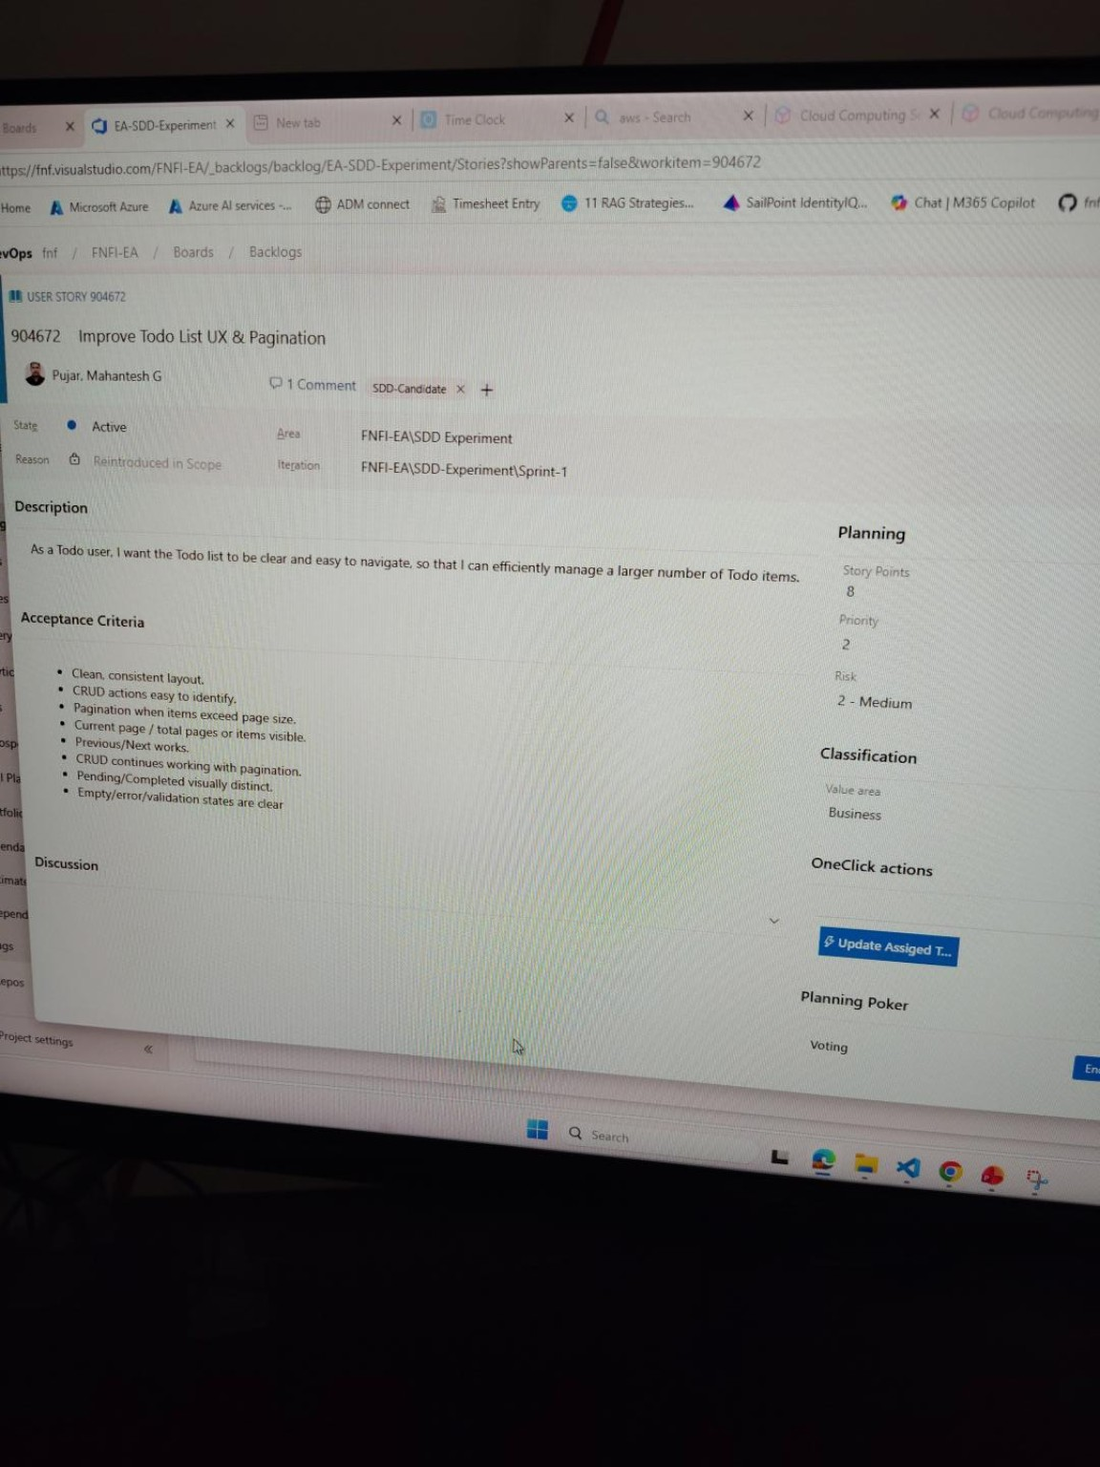
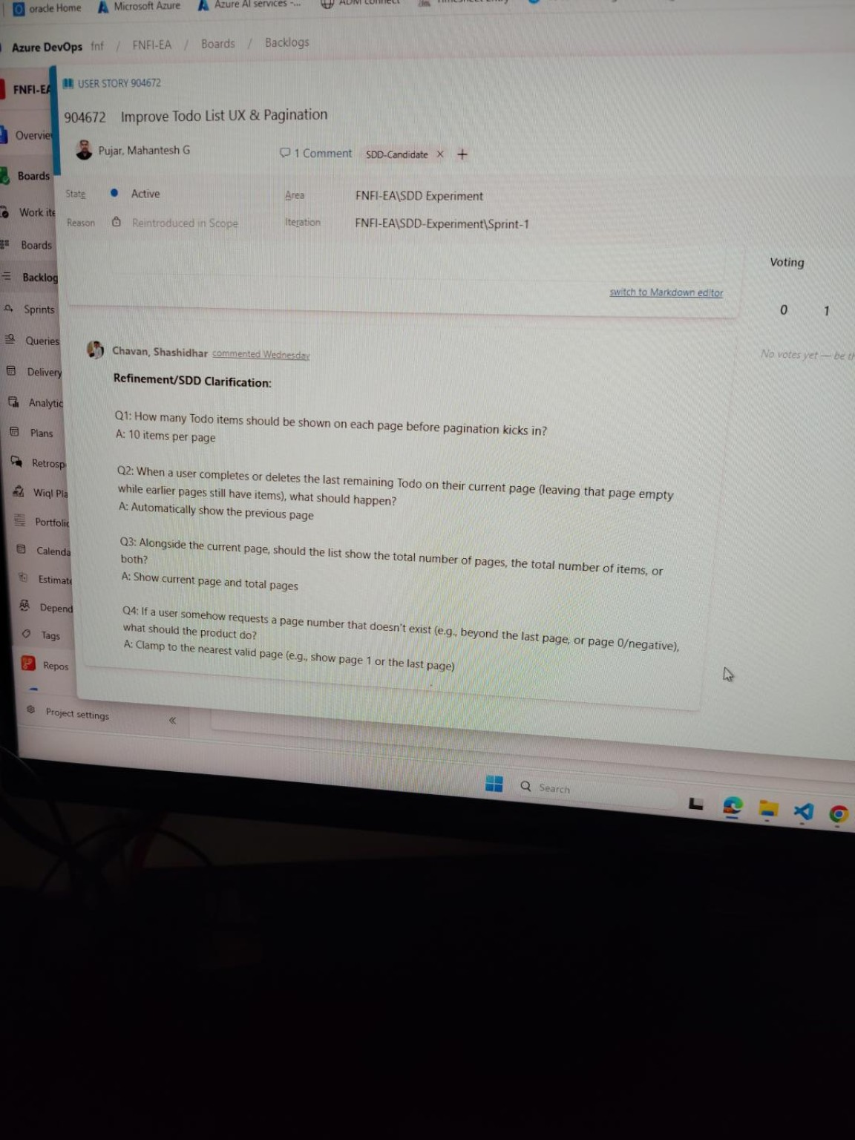
SDD During Refinement — Actual Example
Improve Todo List UX & Pagination: /speckit.specify + /speckit.clarify surfaced concrete decisions before development
ADO User Story
/speckit.specify
/speckit.clarify
Team decision
ADO updated / captured
Original ADO story / acceptance criteria
Clarification decisions captured back in ADO
Page size → 10 items
Empty page → previous page
Display → page + total pages
Invalid page → clamp valid
Value observed: SDD helped expose behavioural gaps during refinement, so decisions were explicit before implementation instead of being assumed by the developer or AI.
R

