Slide 1
Spec Kit SDD — Todo Pilot
From refinement to sprint delivery: what we executed and what we observed
Pilot review • September 2026
Focus: the actual journey and evidence — not a Spec Kit command walkthrough
1

Slide 2
1. What did we want to validate?
How does SDD fit into a normal ADO + Scrum flow, and when is the additional structure useful?
Todo was deliberately small so the complete lifecycle could be simulated quickly.
ADO remained the source for user stories, acceptance criteria, sprint and status.
The experiment was designed to include both an SDD-assisted path and a normal-development path.
Pilot question: “What changes when we use SDD — and where does it become unnecessary ceremony?”
2

Slide 3
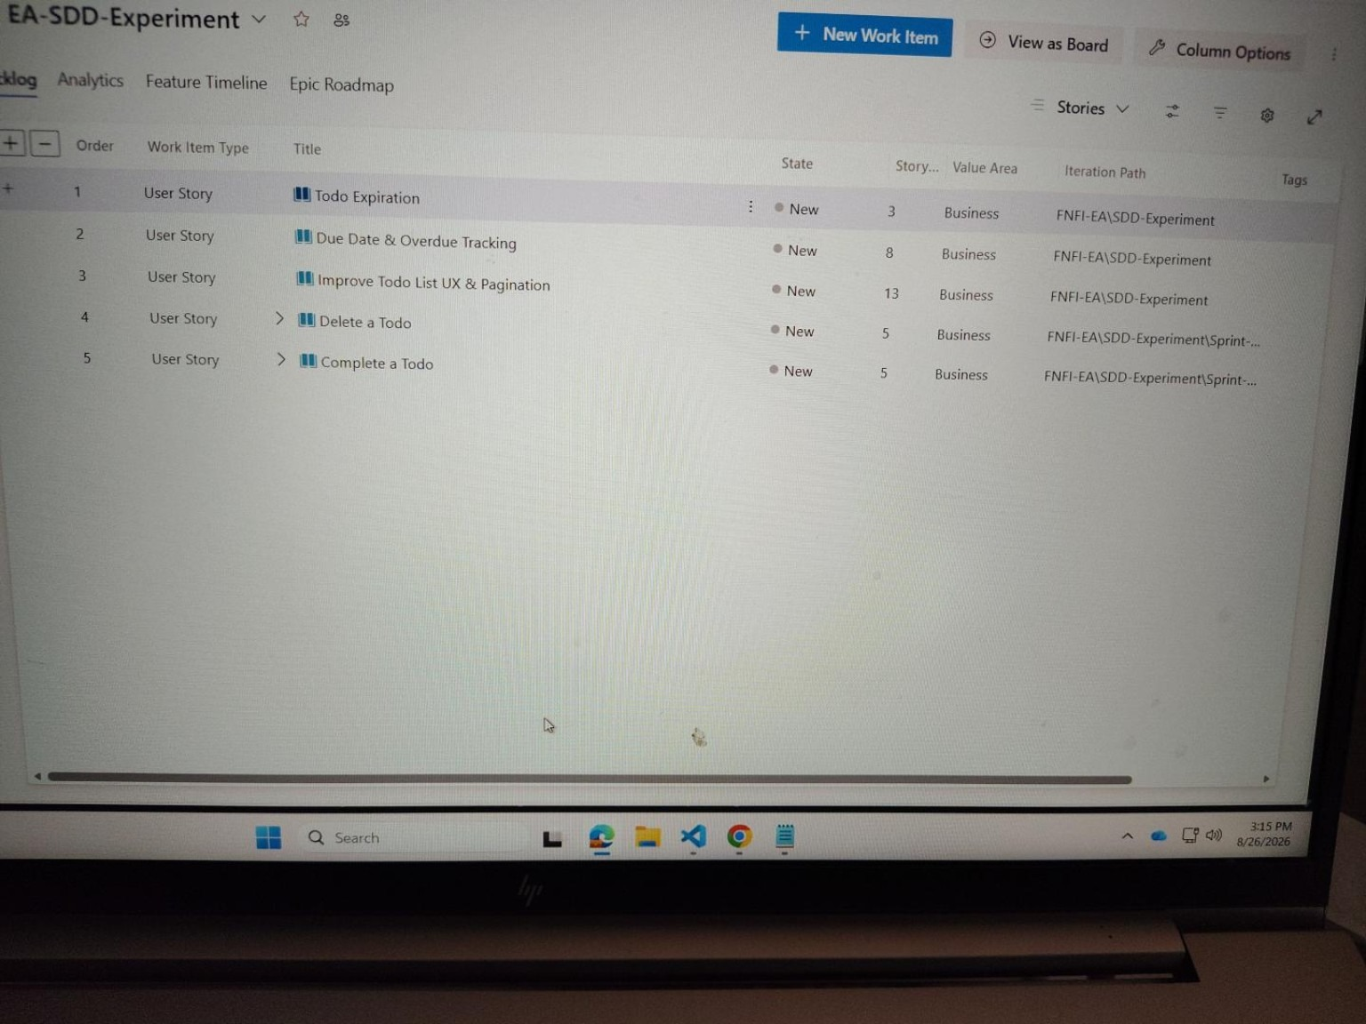
2. We simulated a realistic sprint — not an “SDD sprint”
A sprint can contain stories that benefit from SDD and stories that do not
Medium / meaningful story → evaluate SDD path
Very light / obvious story → normal development path
If work finishes early, pull another Ready story from backlog — simulate normal sprint behavior.
ACTUAL ADO BACKLOG
No need to wait artificial sprint dates for this small pilot.
3

Slide 4
3. What we actually executed
Create & View Todos
Baseline
Working application
Complete a Todo
SDD-assisted
Lifecycle behavior
Delete a Todo
SDD-assisted
Lifecycle behavior
Improve UX & Pagination
SDD-assisted
Broader UI / interaction
Replace action text with icons
Normal development
Deliberately lightweight
Key change in the pilot: story selection became part of the experiment — not every story automatically entered SDD.
4

Slide 5
4. Scenario A — SDD-assisted journey
One representative path from requirement to working software
ADO Story
Refine
Specify / Clarify
Ready for Sprint
Plan / Tasks
Implement
Test / PR
Requirement ownership ADO remains authoritative. Clarification decisions that affect behavior are captured back in ADO.
SDD contribution Make WHAT/WHY explicit, surface ambiguity, then structure HOW through plan and tasks.
Normal governance remains Developer judgment, testing, review and PR are still required.
The useful evidence is the decision/clarification and its downstream implementation — not the number of generated files.
5

Slide 6
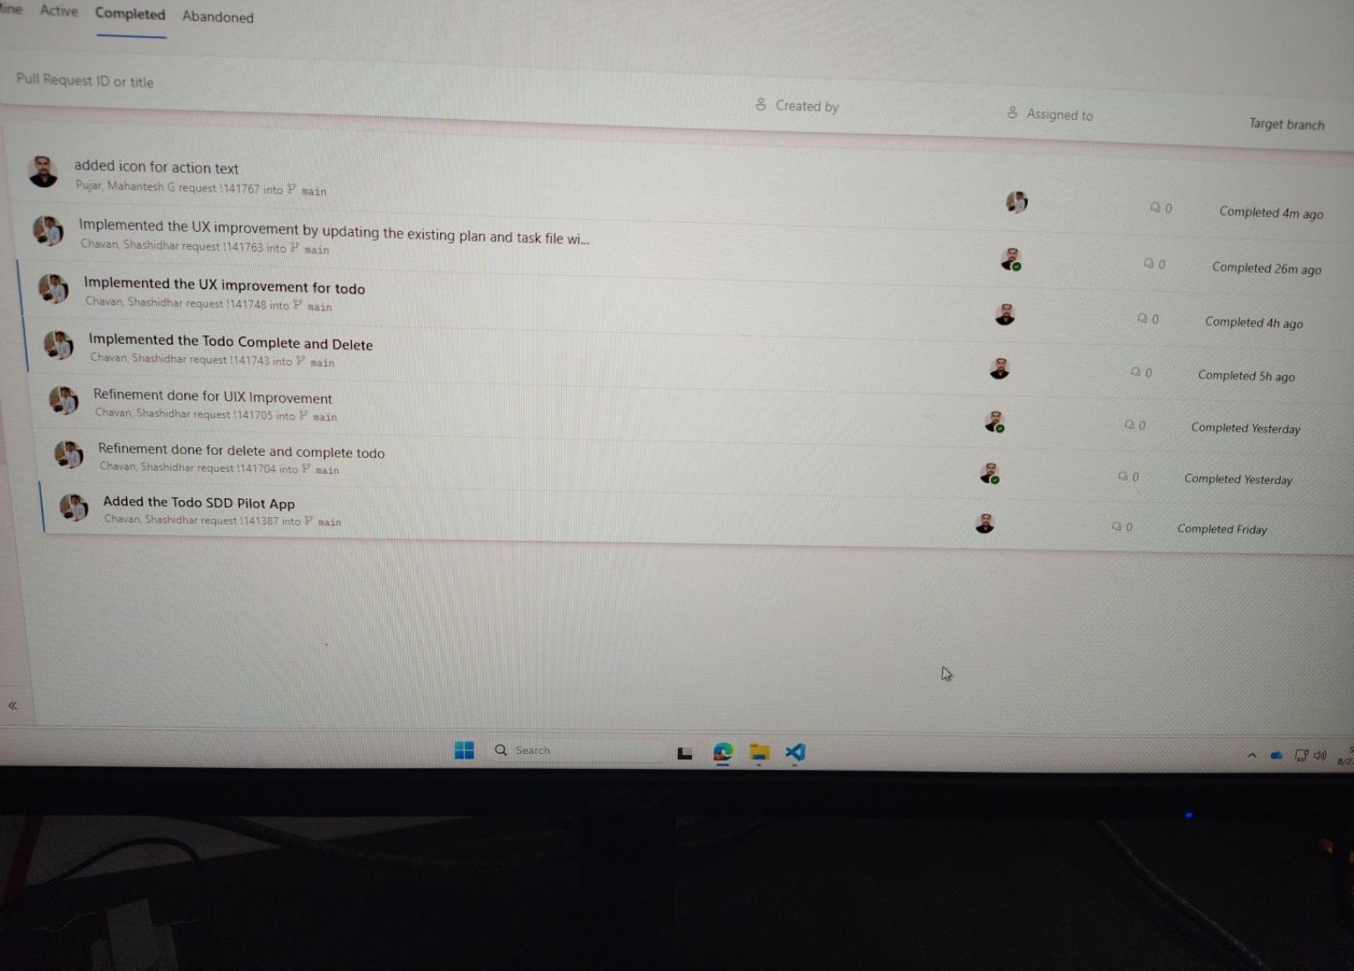
5. The SDD work reached real implementation and PRs
Repository history provides traceability across refinement and implementation
Refinement PRs
Complete + Delete implementation
UX / Pagination implementation
Icon change through normal path
ACTUAL PR HISTORY
6

Slide 7
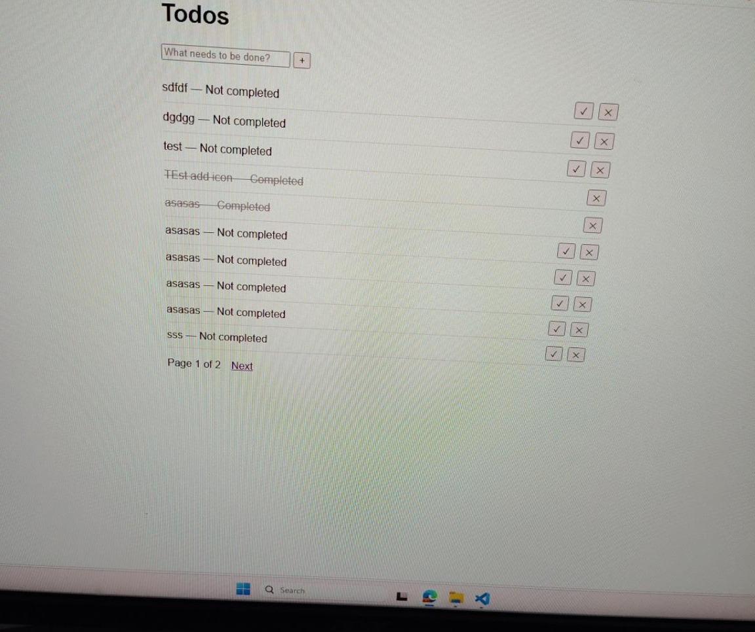
6. Scenario B — deliberately kept lightweight
A small UI story did not go through the full SDD lifecycle
Story: replace action text with + / ✓ / × icons
Requirement was clear and localized.
No meaningful new business rule, data model or API decision.
Normal path was sufficient: ADO → code → test → PR.
Running the full SDD lifecycle here would have added artifacts and review effort without equivalent reasoning value.
WORKING TODO APP
7

Slide 8
7. What did we observe?
Balanced pilot findings — value and overhead
Where SDD helped in this pilot
Where the overhead became visible
Encouraged requirement thinking before coding.
Provided explicit refinement / planning artifacts.
Created clearer traceability from requirement to implementation.
Made human review of AI assumptions an explicit step.
More prompts, artifacts and review steps.
A full flow is disproportionate for tiny, obvious changes.
Generated artifacts still need human validation.
One spec per every small story is not automatically useful.
Observation from Todo only: selective use appeared more practical than forcing the full SDD flow onto every story.
8

Slide 9
8. Pilot evidence — deck stands on its own
If a live demo is requested, the same evidence can be opened in ADO / repo / app
ADO User stories • refinement • sprint • tags/tasks
Spec Kit Representative spec • clarification • plan/tasks
Git / PR Refinement + implementation history
Working App Implemented behavior and UI
Presentation mode
No demo requested Use the embedded evidence and explain the journey.
Demo requested Open ADO → one SDD artifact → PR → working app.
9

Slide 10
9. Pilot conclusion for architect / manager review
The Todo experiment showed that SDD can be integrated into the existing ADO / Scrum flow, while the full lifecycle does not appear necessary for every type of story.
SDD-assisted stories gave us a structured requirement → clarification → plan → implementation trail.
The lightweight icon story demonstrated that normal development can remain the better fit for simple, obvious work.
These are pilot observations, not an organization-wide rule or framework decision.
The outcome being handed over is the executed journey, evidence, benefits, overhead and open questions for architect review.
10

Slide 11
10. Close the story
“We simulated a normal sprint using ADO, applied Spec Kit to selected Todo stories, deliberately kept one lightweight story on the normal development path, and compared the experience. The result is a practical view of where the additional SDD structure helped and where it became unnecessary overhead.”
What I am presenting: actual execution + evidence + observations
What I am not claiming: a final organization-wide SDD/framework recommendation
11

