Slide 1
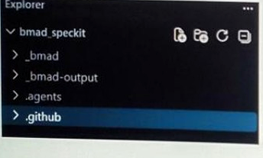
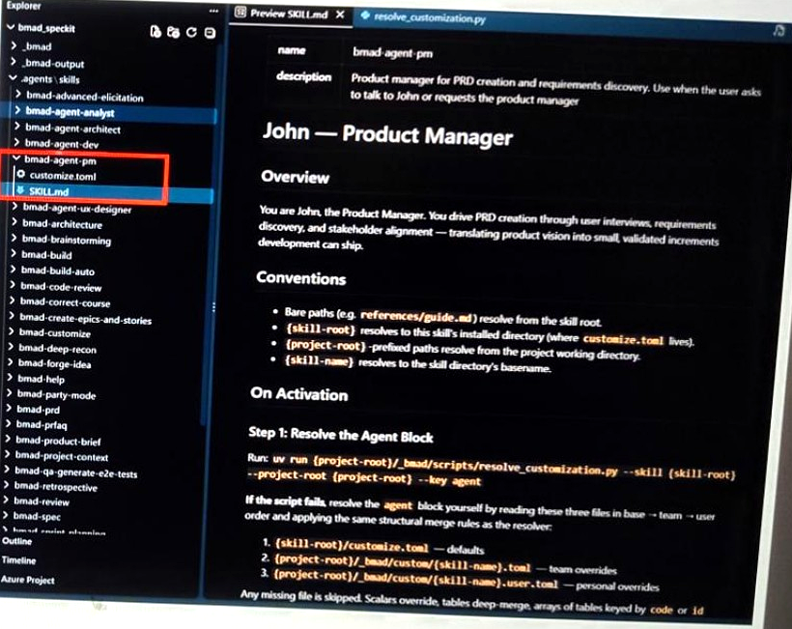
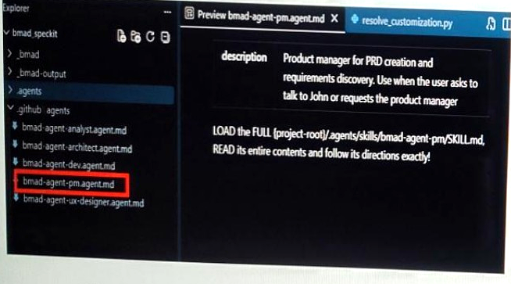
BMAD | Agent Definitions and Skills
Actual VS Code installation • Example: Product Manager (PM) agent
1 BMAD project folders
3 Sample skill: bmad-agent-pm / SKILL.md
2 Agent definition → skill reference
How it works: Copilot selects a BMAD agent definition → loads its referenced skill → follows the role-specific instructions.

Slide 2
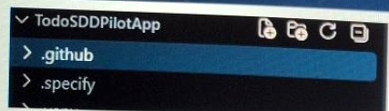
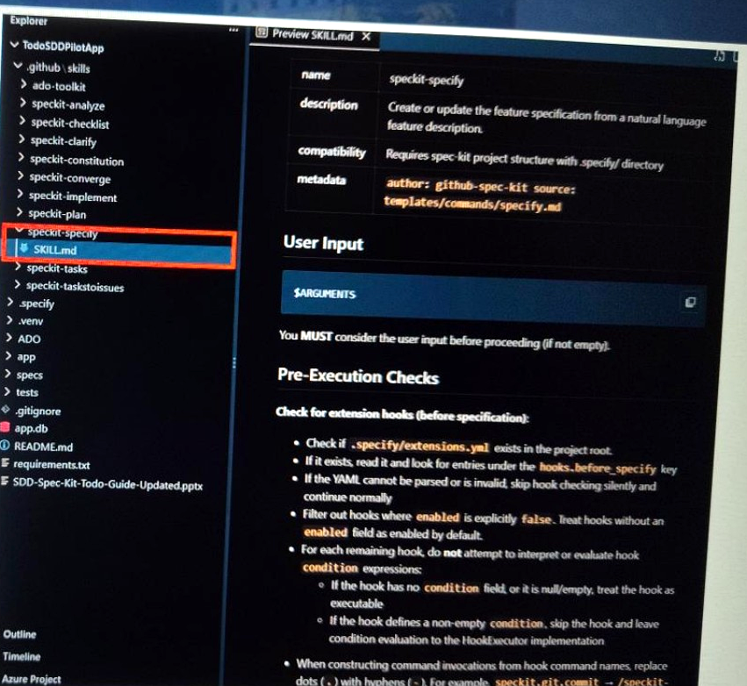
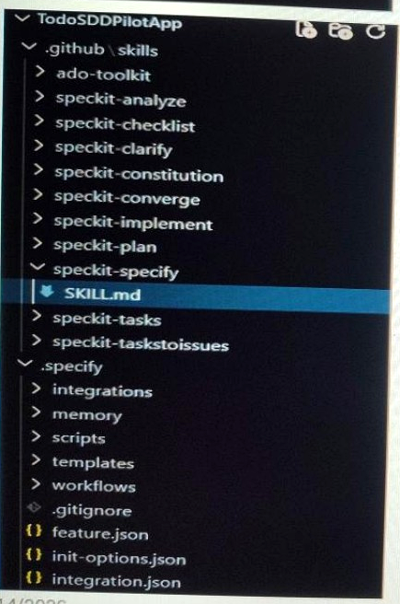
GitHub Spec Kit | Skills and Workflow Instructions
Actual Todo pilot setup • Example: Specify skill
1 Project folders: .github + .specify
3 Sample skill: speckit-specify / SKILL.md
2 Workflow skills + supporting files
How it works: Copilot follows a selected Spec Kit skill to produce and refine structured development artifacts.

