Slide 1
Spec Kit SDD — Todo Pilot
From refinement to sprint delivery: what we executed and what we observed
Pilot review • September 2026
Focus: the actual journey and evidence — not a Spec Kit command walkthrough
1

Slide 2
1. What did we want to validate?
How does SDD fit into a normal ADO + Scrum flow, and when is the additional structure useful?
Todo was deliberately small so the complete lifecycle could be simulated quickly.
ADO remained the source for user stories, acceptance criteria, sprint and status.
The experiment was designed to include both an SDD-assisted path and a normal-development path.
Pilot question: “What changes when we use SDD — and where does it become unnecessary ceremony?”
2

Slide 3
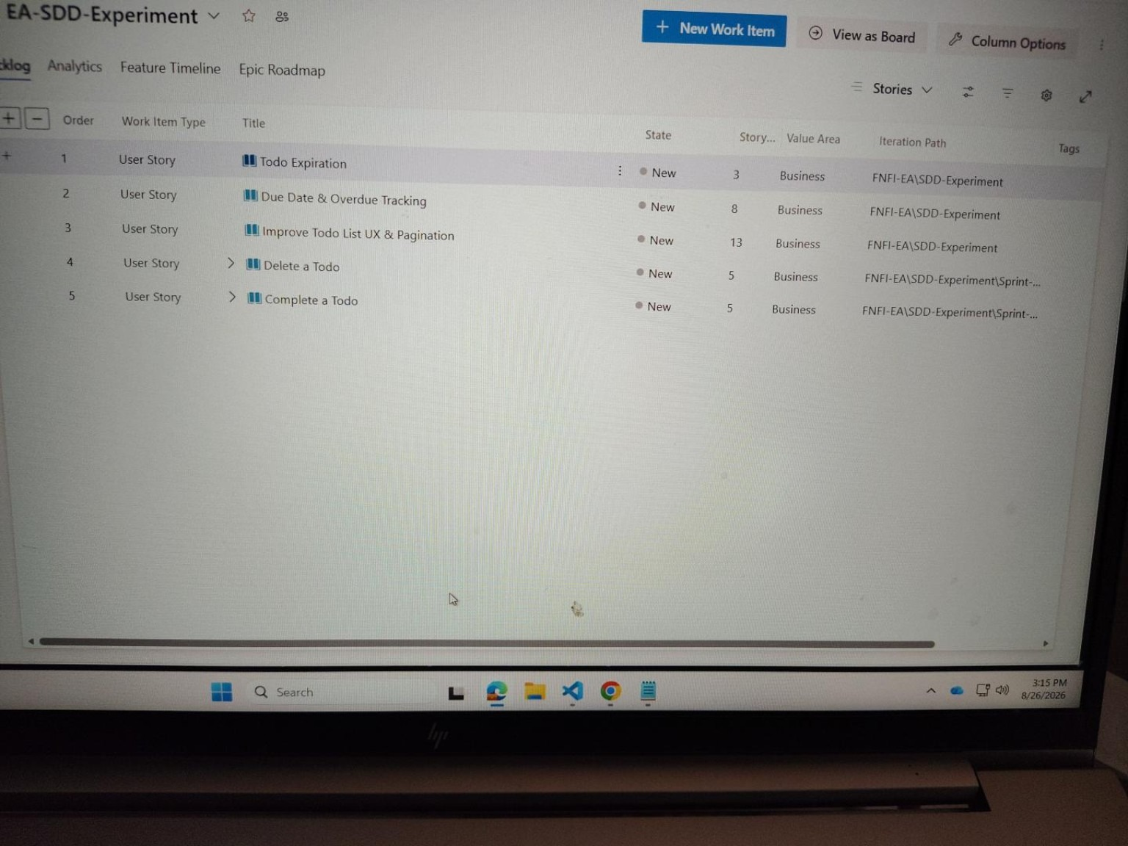
2. We simulated a realistic sprint — not an “SDD sprint”
A sprint can contain stories that benefit from SDD and stories that do not
Medium / meaningful story → evaluate SDD path
Very light / obvious story → normal development path
If work finishes early, pull another Ready story from backlog — simulate normal sprint behavior.
ACTUAL ADO BACKLOG
No need to wait artificial sprint dates for this small pilot.
3

Slide 4
3. What we actually executed
Create & View Todos
Initial SDD implementation
Working application
Complete a Todo
SDD-assisted
Lifecycle behavior
Delete a Todo
SDD-assisted
Lifecycle behavior
Improve UX & Pagination
SDD-assisted
Broader UI / interaction
Replace action text with icons
Normal development
Deliberately lightweight
Key change in the pilot: story selection became part of the experiment — not every story automatically entered SDD.
4

Slide 5
4. Scenario A — SDD-assisted journey
One representative path from requirement to working software
ADO Story
Refine
Specify / Clarify
Ready for Sprint
Plan / Tasks
Implement
Test / PR
Requirement ownership ADO remains authoritative. Clarification decisions that affect behavior are captured back in ADO.
SDD contribution Make WHAT/WHY explicit, surface ambiguity, then structure HOW through plan and tasks.
Normal governance remains Developer judgment, testing, review and PR are still required.
The useful evidence is the decision/clarification and its downstream implementation — not the number of generated files.
5

Slide 6
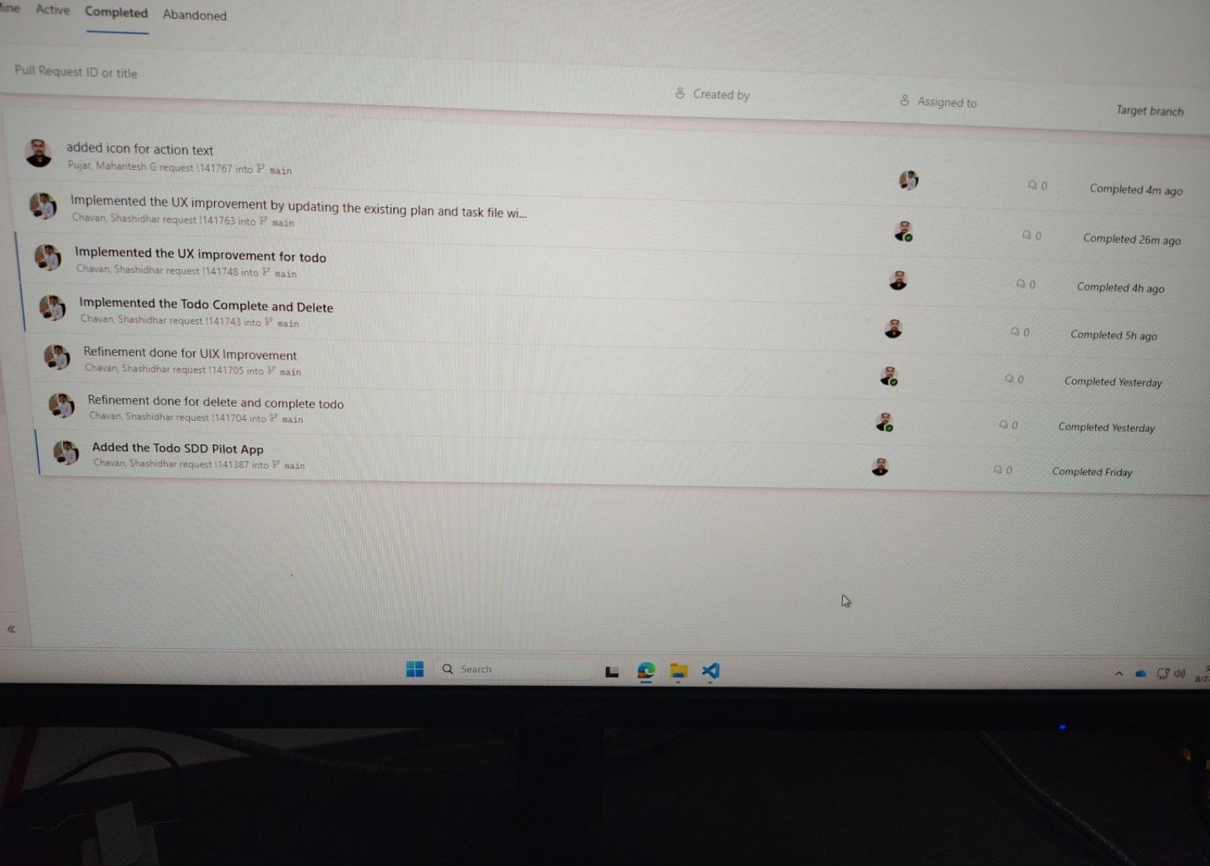
5. The SDD work reached real implementation and PRs
Repository history provides traceability across refinement and implementation
Refinement PRs
Complete + Delete implementation
UX / Pagination implementation
Icon change through normal path
ACTUAL PR HISTORY
6

Slide 7
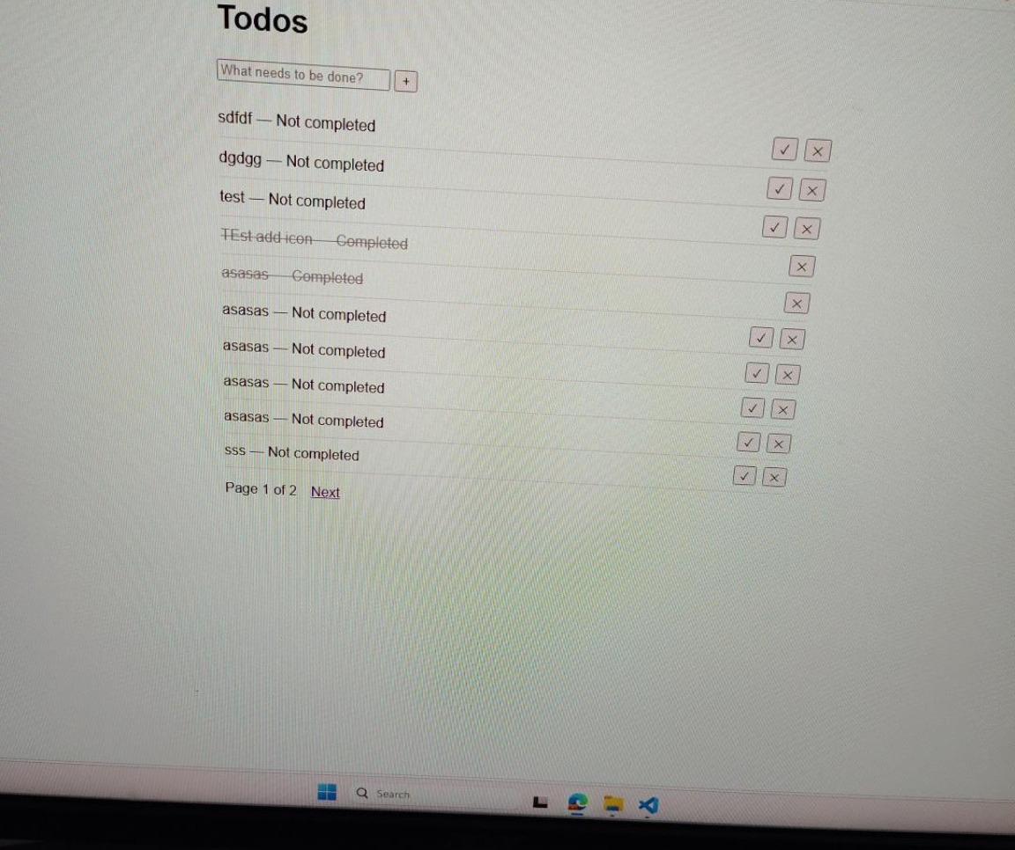
6. Scenario B — deliberately kept lightweight
A small UI story did not go through the full SDD lifecycle
Story: replace action text with + / ✓ / × icons
Requirement was clear and localized.
No meaningful new business rule, data model or API decision.
Normal path was sufficient: ADO → code → test → PR.
Running the full SDD lifecycle here would have added artifacts and review effort without equivalent reasoning value.
WORKING TODO APP
7

Slide 8
7. What did we observe?
Balanced pilot findings — value and overhead
Where SDD helped in this pilot
Where the overhead became visible
Encouraged requirement thinking before coding.
Provided explicit refinement / planning artifacts.
Created clearer traceability from requirement to implementation.
Made human review of AI assumptions an explicit step.
More prompts, artifacts and review steps.
A full flow is disproportionate for tiny, obvious changes.
Generated artifacts still need human validation.
One spec per every small story is not automatically useful.
Observation from Todo only: selective use appeared more practical than forcing the full SDD flow onto every story.
8

Slide 9
8. Review feedback — what we addressed
If a live demo is requested, the same evidence can be opened in ADO / repo / app
ADO User stories • refinement • sprint • tags/tasks
Spec Kit Representative spec • clarification • plan/tasks
Git / PR Refinement + implementation history
Working App Implemented behavior and UI
Operating-model questions after the initial pilot
End-to-end flow / timelineWhen does SDD start, who resolves questions, and when is a story ready?
Multi-developer + US ↔ Feature modelHow do shared specs, parallel developers and story mapping work?
9

Slide 10
9. Pilot conclusion for architect / manager review
The Todo experiment showed that SDD can be integrated into the existing ADO / Scrum flow, while the full lifecycle does not appear necessary for every type of story.
SDD-assisted stories gave us a structured requirement → clarification → plan → implementation trail.
The lightweight icon story demonstrated that normal development can remain the better fit for simple, obvious work.
These are pilot observations, not an organization-wide rule or framework decision.
The outcome being handed over is the executed journey, evidence, benefits, overhead and open questions for architect review.
10

Slide 11
10. Close the story
“We simulated a normal sprint using ADO, applied Spec Kit to selected Todo stories, deliberately kept one lightweight story on the normal development path, and compared the experience. The result is a practical view of where the additional SDD structure helped and where it became unnecessary overhead.”
What I am presenting: actual execution + evidence + observations
What I am not claiming: a final organization-wide SDD/framework recommendation
11

Slide 12
From Pilot Execution to a Reusable Team Operating Model
Continuation of the initial Todo SDD pilot — incorporating manager and Mani/Satish review feedback
Initial pilot established
Review asked us to strengthen
Operating model refined
• SDD can fit inside the existing ADO/Scrum flow • Clarification surfaced missing behavior before coding • Selective SDD was more practical than applying the full lifecycle to every story
• End-to-end flow and timing before Sprint Planning • Multi-developer ownership and change handling • ADO User Story ↔ specification/feature relationship
• Readiness + async clarification • Multi-developer model • US ↔ Feature mapping • Framework-neutral guidance • Controlled real-project adoption path
The continuation focuses on the operating model needed before real-project validation — not on adding more Spec Kit commands.
Todo SDD Pilot • Manager Review Continuation • 12

Slide 13
End-to-End SDD Operating Flow
Indicative timing only — the real-project pilot will validate the exact cadence
T-7 to T-5
T-5 to T-3
T-3 to T-1
T0
During Sprint
Completion
Refine & assess ADO story • AC • SDD suitability
Specify & clarify Surface ambiguity; retain unanswered business questions
Resolve & ready Stakeholder decision → ADO/AC → spec → readiness
Sprint Planning Estimate/confirm and commit ready story + supporting spec
Execute Plan → Tasks → Analyze → Implement → Converge
Verify Test → Review → PR → normal completion
→
→
→
→
→
Readiness guardrail: material unresolved business questions remain open; AI must not invent the answer.
Todo SDD Pilot • Manager Review Continuation • 13

Slide 14
Asynchronous Clarification: Keep the Question Open
Key refinement from the Mani/Satish review
Dev + BA
spec.md
ADO Story
PO / Business
ADO / AC
Spec
Readiness
Ambiguity found
Outstanding Question
Question visible
Authoritative answer
Decision recorded
Decision synchronized
Proceed when resolved
→
→
→
→
→
→
AI identifies and phrases the gap. Business decisions remain with the appropriate BA / PO / stakeholder.
If Spec Kit already retains a skipped clarification under Outstanding Questions in spec.md, a separate question file is unnecessary.
Todo SDD Pilot • Manager Review Continuation • 14

Slide 15
Multi-Developer Operating Model
Shared specification does not replace normal ADO assignment, Git branches or PR ownership
A. Independent stories / features
B. Related stories / shared feature
C. Different features / overlapping code
Dev A → Feature A branch Dev B → Feature B branch Each developer works from the reviewed baseline and follows the appropriate SDD development activities.
One coherent capability may contain US1 / US2. ADO still assigns stories to developers. Shared foundational work is coordinated before parallel story implementation.
Normal Git/PR/rebase/conflict practices remain. A physical merge conflict is different from a semantic/specification conflict.
Business-behavior change: clarify → authoritative decision → update ADO/spec → notify impacted developers → update only impacted artifacts.
Todo SDD Pilot • Manager Review Continuation • 15

Slide 16
ADO User Story ↔ Spec Kit Feature Mapping
ADO stays the backlog/sprint tracking unit; the feature groups behavior that benefits from being reasoned about together
1 US → 1 Feature
Multiple US → 1 Feature
1 US → Multiple Features
Preferred default for a cohesive SDD-selected story that is independently understandable, implementable and testable.
Allowed when there is real capability cohesion, shared reasoning value and sprint/delivery alignment. Example: Complete + Delete → Todo Lifecycle Operations.
Not the normal starting point. If clarification exposes independently valuable capabilities, return to refinement and consider splitting the ADO story first.
Small / localized story → no SDD feature is also a valid outcome.
Todo SDD Pilot • Manager Review Continuation • 16

Slide 17
Standardize the Operating Model — Not the Tool
Spec Kit is the current reference implementation; the higher-level team process remains framework-independent
Layer 1 — Existing Delivery
Layer 2 — Generic SDD Activities
Layer 3 — Current Reference
ADO Scrum ceremonies BA / PO / Dev / QA Git / PR These remain the delivery foundation.
Define behavior Clarify ambiguity Technical design Implementation breakdown Consistency validation Implementation Alignment verification
Spec Kit today /specify /clarify /plan /tasks /analyze /implement /converge
Principle: standardize outcomes, responsibilities and checkpoints — not command names.
Todo SDD Pilot • Manager Review Continuation • 17

Slide 18
Recommended Next Step: Controlled Real-Project Validation
Validate the operating model inside normal project sprints before recommending broader adoption
1
Select a small number of pilot teams
Existing ADO/Scrum • willing participants • suitable upcoming stories
2
Select stories during refinement
Use SDD where ambiguity, rules, dependencies, impact or risk justify it
3
Run normal mixed sprints
Keep SDD-selected and normal-development stories in the same sprint
4
Capture lightweight evidence
Clarifications • AC changes • rework • effort • alignment • team experience
5
Refine the guidance
Use real-project findings before any broader adoption recommendation
Success does not mean every story uses SDD. The pilot should identify where SDD adds value and where it adds unnecessary overhead.
Todo SDD Pilot • Manager Review Continuation • 18

Slide 19
Where We Are Now
The initial pilot has evolved into a reusable operating-model baseline; real-project validation is the next evidence point
Refined Baseline
Reusable Guidance
Next Validation
✓ End-to-end flow / readiness ✓ Async stakeholder clarification ✓ Multi-developer model ✓ US ↔ Feature mapping ✓ Framework-neutral operating model
SDD Operating Guide Todo worked example One-page quick reference 10–15 minute walkthrough video Pilot guidance pending real-project validation
Selected real project teams Normal mixed sprints Lightweight evidence Feedback + refinement ADO automation is intentionally deferred.
Current recommendation: introduce SDD selectively with minimum change to the existing ADO/Scrum delivery model.
Todo SDD Pilot • Manager Review Continuation • 19

